Slide 1





Smart contract development with solidity
Solidity types
Smart Contract Development with Solidity
SoftUni Team
Technical Trainers
Software University
http://softuni.bg
Logos: https://www.ethereum.org/assets

Slide 2

Table of Contents
Rational and integer literals (incl 0x, …)
Enums
Structs
Fixed size arrays
Dynamic size arrays
Mappings
Storage location & gas expenses
Pointers and location copy
Passing types as return values/function arguments
The constraints
Type deduction

Slide 3
Questions
sli.do #SContracts

Slide 4
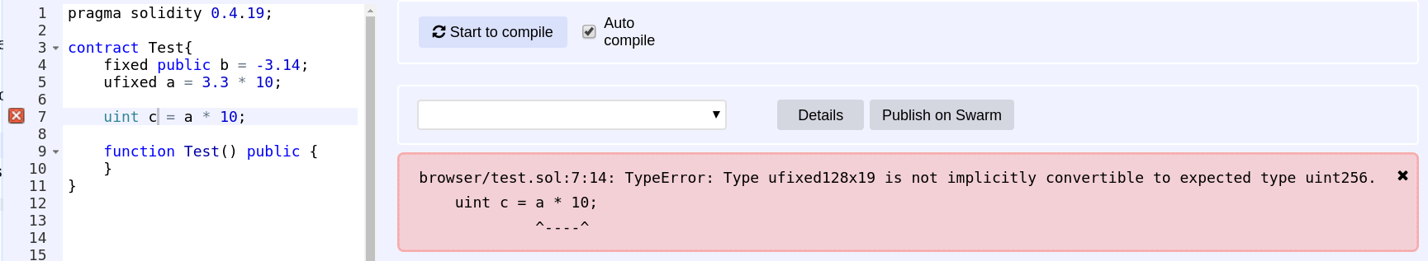
Rational and integer literals (1/2)
Literals are notations for representing a fixed value
Rational literals are allowed, but cannot be assigned to or from
Rational numbers can be stored in types fixed and ufixed, but not assigned to or from
Remix doesn’t even compile them

Slide 5



Rational and integer literals (2/2)
Any computations made with literals retains arbitrary precision
Integer literal division evaluates to a rational number
Expressions with variables don’t retain arbitrary precision!

Slide 6
Enums
A user defined type
A set of possible choices
Can be explicitly cast to all integer types

Slide 7
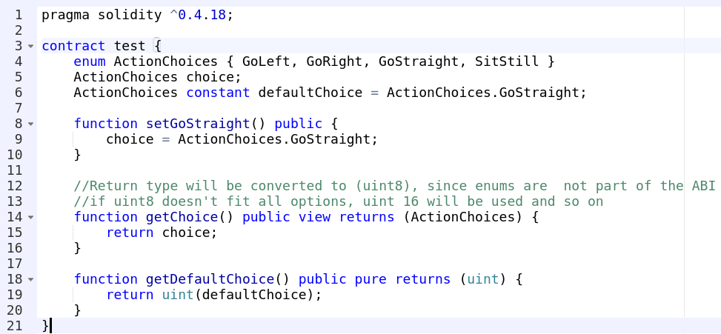
Example enum contract

Slide 8
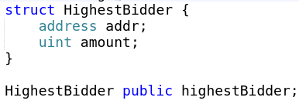
Structs
A structure/combination of existing types
Like a class but without methods

Slide 9
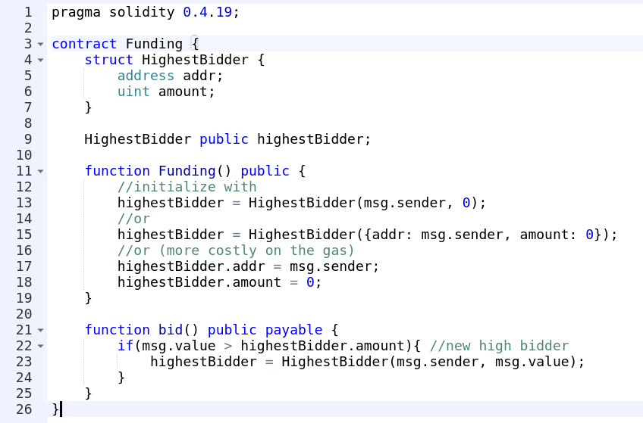
Example struct contract

Slide 10
Exercise
Write a contract, that:
Has 3 kinds of states: locked, unlocked and restricted
The owner can change the state
Locked means that nobody can call public contract functions (even fallback)
Unlocked means that everyone can call contract functions
Restricted means that only the owner can call contract functions
Have a structure that contains a counter, a timestamp and an address
Have a function that increments the counter by one, sets the current timestamp and sets the address to that of the caller

Slide 11
Arrays
Fixed-size
T[k] - array of type T with size k
.length = k (read only)
Dynamic
T[] - dynamic array of type T
Modifying .length resizes the array
.push adds new element and increases length
Index access
Read and write

Slide 12
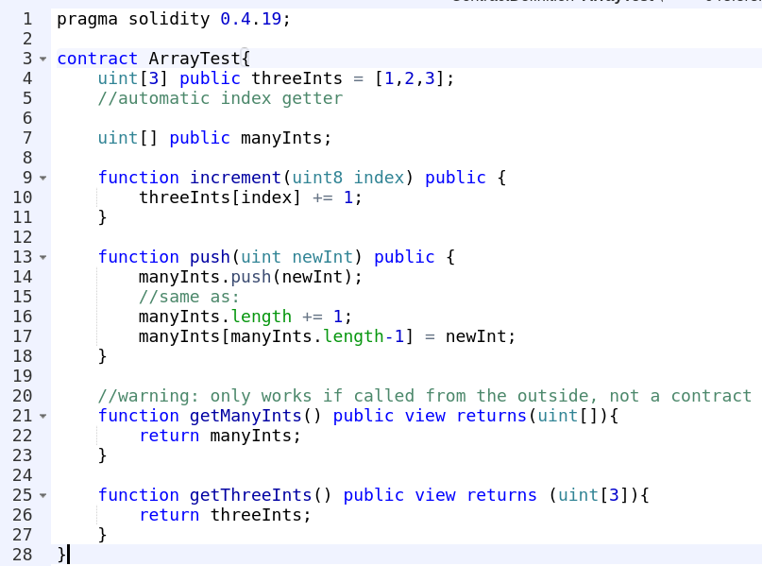
Array example

Slide 13

Multi-dim arrays warning!
Arrays can be multidimensional
Unlike other languages (incl C#), the above array is a dynamic array of 2 booleans (not two dynamic arrays of booleans)!
Index access is the same as other languages

Slide 14
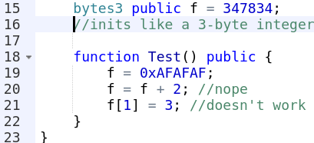
Fixed-size byte arrays
bytes1, bytes2, bytes3, ….bytes32
Initialized with 0 (as are all solidity types)
bytesX[n] accesses the n-th byte (n < X). Read-only!
bytesX[n] is from 0 to 255
bytesX.length = X
Operations:
Comparisons
Bit operators
Index access (reading)

Slide 15
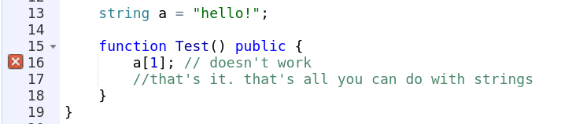
Dynamic sized byte array
bytes
Arbitrary-length raw byte data
The same as uint8[]
string
Arbitrary-length UTF-8 data
No index access. You need to cast it to bytes!
Always use fixed size if you can (less gas)

Slide 16
Exercise
Write a contract, that:
Can accept ETH
Has N number of owners (a list of owners given in constructor)
A proposal can be made to transfer funds to an account (make it a struct)
For the proposal to be accepted, each owner must agree in the order defined in the list
For the second owner to agree, the first one has to agree first.
The same logic for all owners
If all agree within 5 minutes of the proposal, the proposal is accepted and the funds are transferred
Include the necessary constraints

Slide 17
Mappings
Key-value pair mapping(_KeyType => _ValueType)
The key is not stored, its keccak256 is used to look up the value
-> It is impossible to retrieve the keys
-> It is impossible to retrieve the values without the keys
Cannot be passed/returned by functions

Slide 18
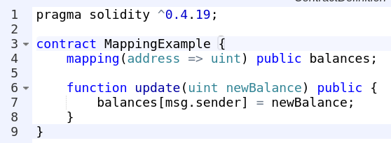
Mapping example

Slide 19

Type deduction
Sometimes the compiler can guess the type of a variable and we don’t have to explicitly specify it
The type of y is uint24

Slide 20
Storage location
Every complex type (array, struct, …) has a storage location
Two main types:
storage : stored in the contract state (state & local variables)
memory : temporary cheaper storage (function parameters)
The location of local and function parameters can be changed by the modifiers storage and memory.

Slide 21
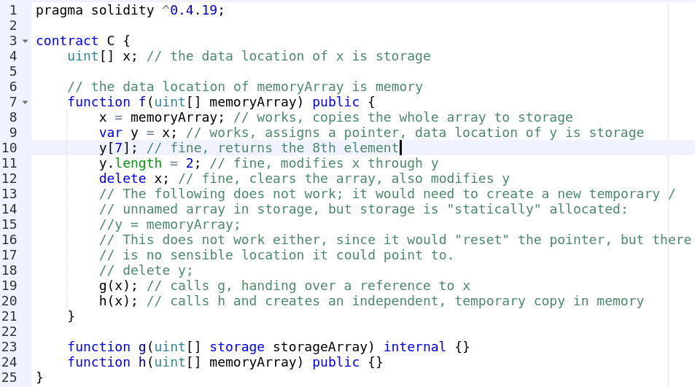
Storage location example

Slide 22
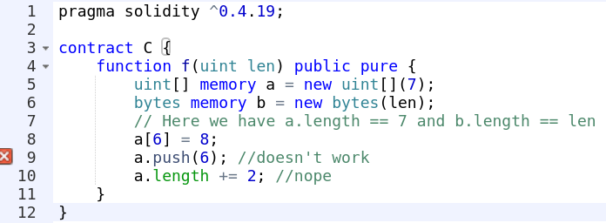
Arrays in memory
Have to be allocated with new, specifying the size
They cannot be resized!

Slide 23
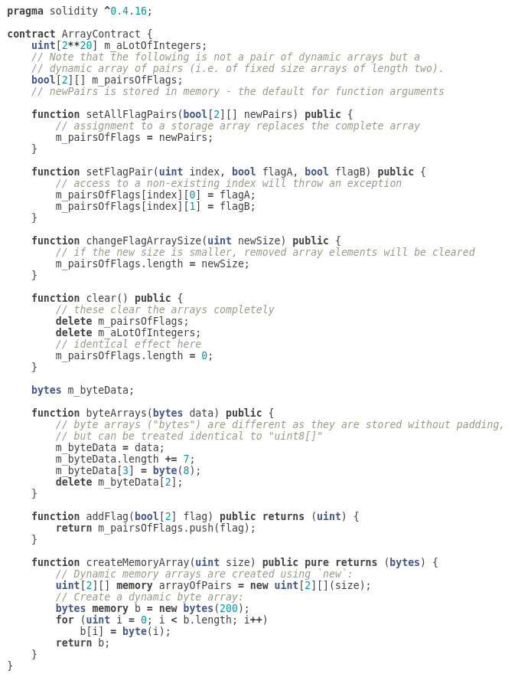
A more complex array example

Slide 24
Exercise
Create a Pokemon game, that:
Knows ~10 different types of Pokemons
Any person can say that he caught a Pokemon, but maximum once per 15 seconds (personalized timer)
The contract can list the Pokemons that a person has caught
The contract can list which people possess a Pokemon of certain type
Watch out for duplicates!

Slide 25
Homework
Create people balances contract. The contract holds the account balance and the balance is represented by an integer (think tokens). The that:
Has states:
Crowdsale in the first 5 minutes, where people can buy the token at a rate of 5 Tokens / 1 ETH. People cannot transfer during this period
Open exchange of tokens after that period.
The contract owner can withdraw the ETH 1 year after the initial sale
For each token holder there should be a boolean flag that shows if that person holds or ever held tokens
There should be an array that contains all current or past token holders
No duplicates :)

Slide 26
Summary
Rational and integer literals (incl 0x, …)
Enums
Structs
Arrays
Mappings
Storage location & pointers
Type deduction

Slide 27
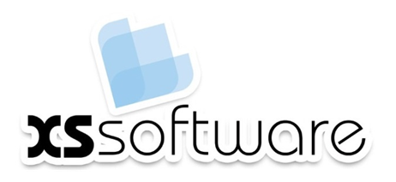






https://softuni.bg/courses/

Slide 28





Trainings @ Software University (SoftUni)
Software University – High-Quality Education, Profession and Job for Software Developers
softuni.bg
Software University Foundation
http://softuni.foundation/
Software University @ Facebook
facebook.com/SoftwareUniversity
Software University Forums
forum.softuni.bg

