Slide 1
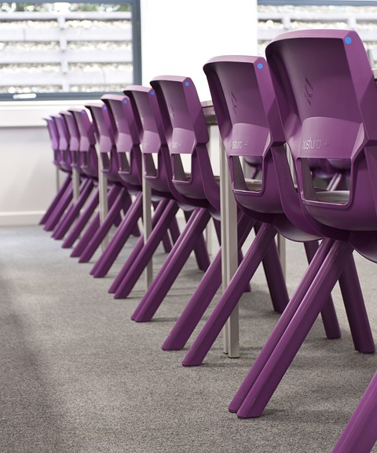
03
Sharing Chinese Culture with the World
Cultural Dissemination Through a Gaming Masterpiece

Slide 2
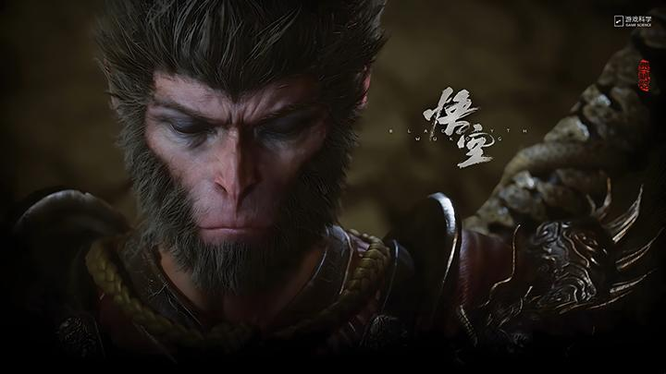

Wukong draws its soul from Journey to the West, one of China’s greatest literary classics. This timeless tale of Sun Wukong, the Monkey King, is filled with adventure, mythology, and wisdom.
Based on a Chinese literary treasure
The “Destined One”
Instead of retelling the original story, the game introduces players as the “Destined One”, a monkey descendant uncovering the truth behind Sun Wukong’s fall. This fresh perspective blends traditional Chinese folklore with creative storytelling, immersing players in a mythical world that feels both ancient and new.

Slide 3
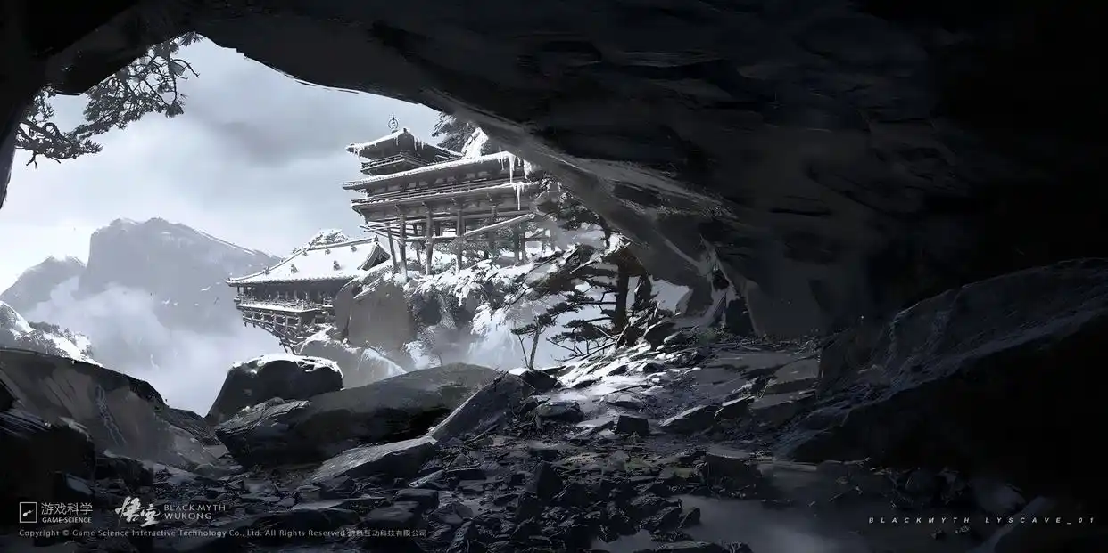
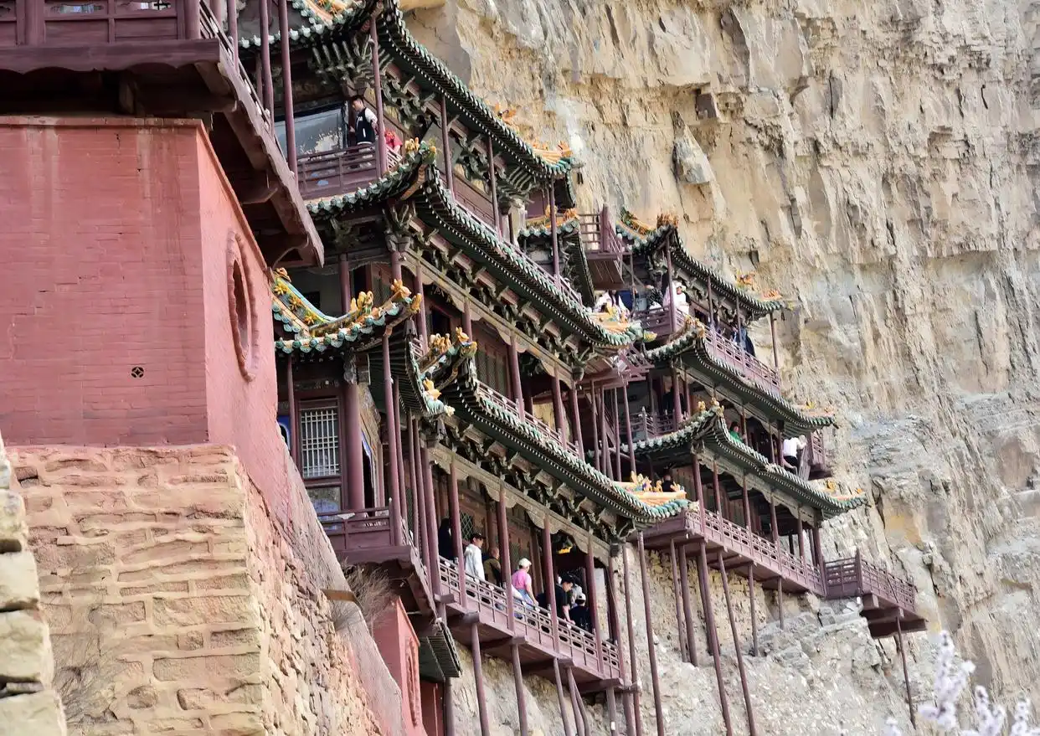
Iconic Sites Reimagined
Authentic Immersion
Cultural Impact
The game recreates landmarks like Yungang Grottoes and Dazu Rock Carvings, showcasing China’s architectural treasures.
Advanced scanning technology brings these real-world locations to life, creating a vivid cultural experience.
By featuring these sites, the game boosts tourism and shares Chinese heritage with players worldwide.

Slide 4
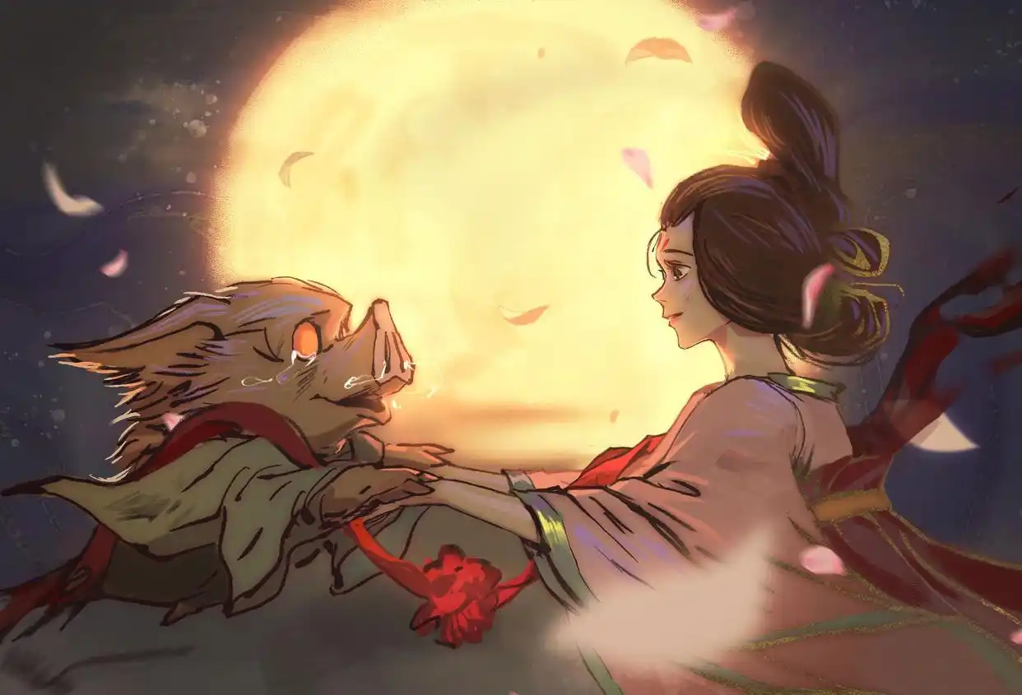
Original Chinese voice acting immerses players in the essence of Chinese folklore and emotion.
Authentic Cultural Voice
Zhu Bajie’s tragic romance blends Chinese philosophy with universal themes of love and sacrifice.
Emotional Stories Connect

