Slide 1
Yet Another Rhythm Presentation
Vinicius Walker Oliveira

Slide 2
Data
Data was taken from a videogame titled YARG(Yet Another Rhythm Game), a Rock Band clone with some aspects inspired by guitar hero.
Since 2022, I have been downloading charts for games like this and playing them , usually either downloading music choices based on what I would like to play.
Exporting data from this game provides a JSON file (which I chose to convert to .csv) detailing each song with seven attributes
Name, Artist, Charter, Album, Genre, Year, song length (ms)
Cleaned data removes faulty year data
The main variable of interest was year, followed by song length (both numerical)
Dimensions- 6180 x 7

Slide 3
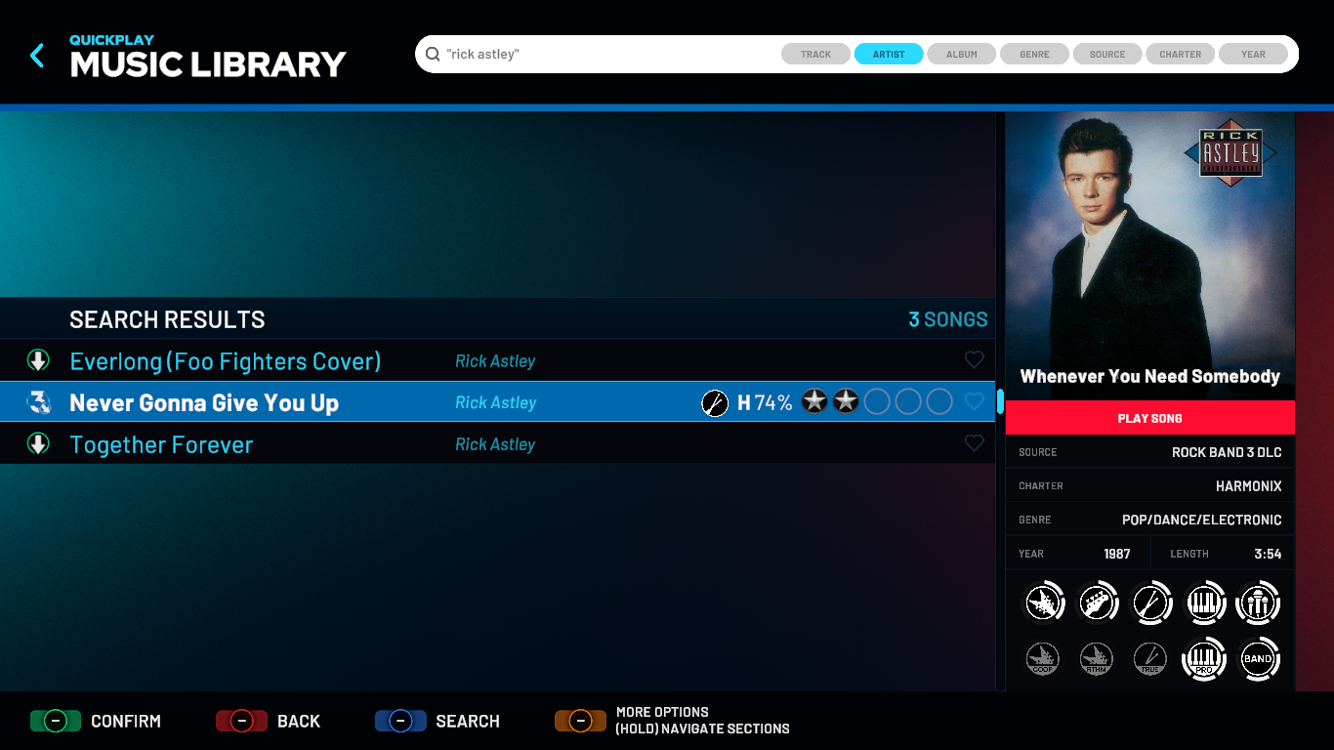
D A T A I N - G A M E
Album
Artist
Name
Charter
Genre
Year
Not Tracked- Source, supported instruments, score, times played
Length
(min)

Slide 4
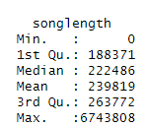



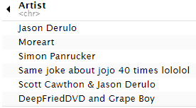
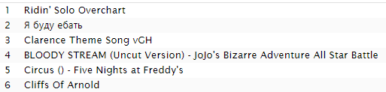
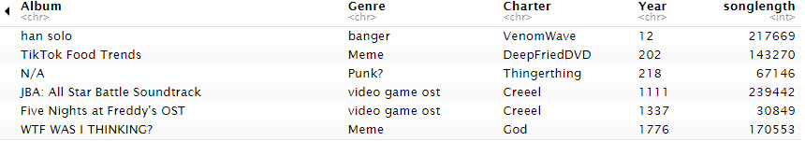

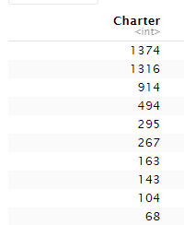
Notable Data
Summary- redundant for Name/Artist/Album/Genre/Charter. Year is listed as a character class due to some values being entered as words instead of just numbers. (outliers in “year” sometimes show exact dates) “songlength” ALWAYS showed numbers
Head- I would consider all of these “meme charts”. Despite that one factor they have in common, they do not all show first in any category.
Top Charters- harmoniccharted the most songs, as I wanted to know which charter I liked to use most. the three highest are “Harmonix” (Rock band 1-3), “Neversoft” (Guitar Hero), and “Harmonix, Rhythm authors” (Rock band 4)

Slide 5
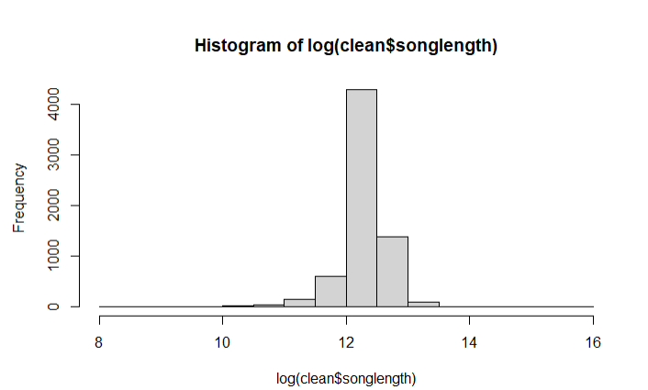
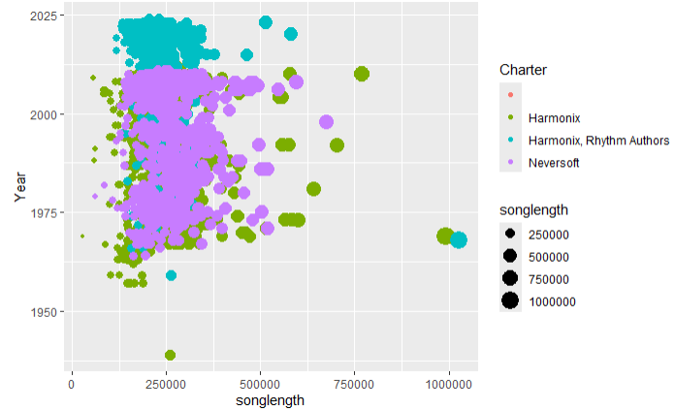
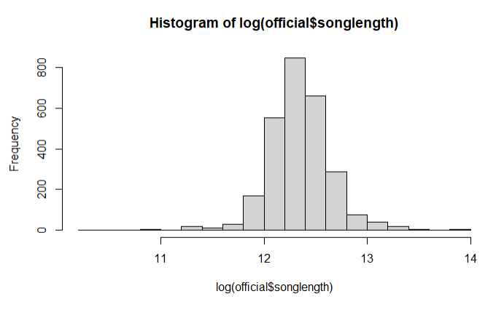
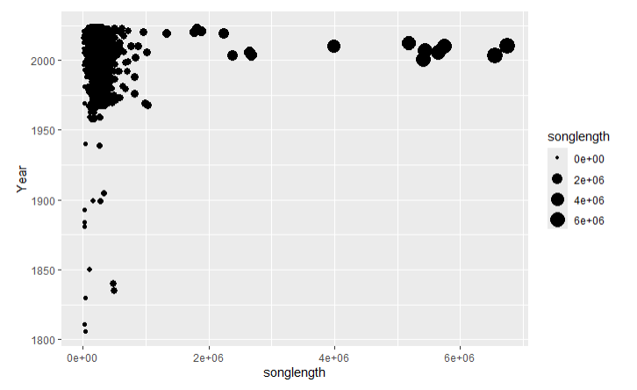
Plotting Data

Slide 6
Results
Data is rather difficult to work with due to the large size, but our last chart showed some valuable information with the logs of songs released.
I seem to enjoy downloading much longer charts from the early 2010s. (some of these are movie-length)
I have far fewer charts from the 60s and 70s compared to the 80s
My genre preferences lean towards rock, with those providing a challenge with longer runtimes and charters that are passionate for the genre.

