Slide 1
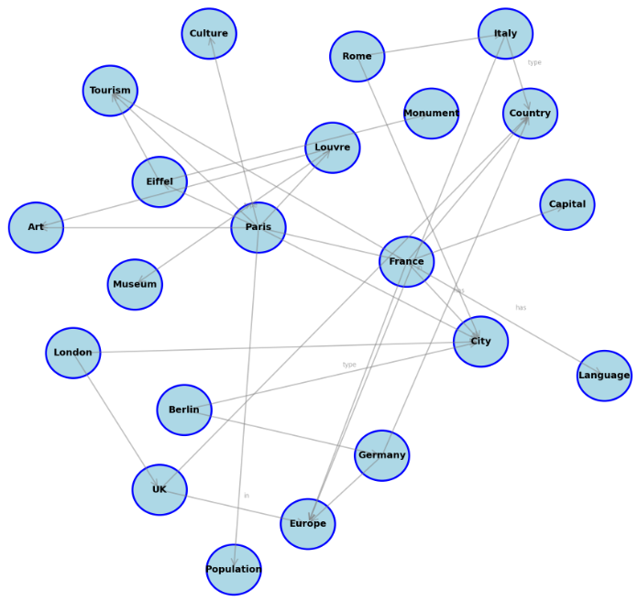
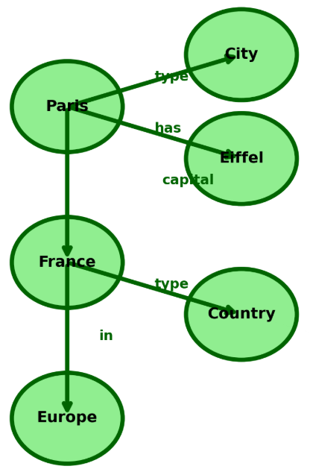
Large Knowledge Graph
Query-based Summarized
Knowledge Graph
User Query:
What is the capital
of France?

