Slide 1
Knowledge Graph-Based Workflow Validation Using PROV Graphs
Valantis Zervos, Chrysostomos Zeginis, Dimitris Plexousakis
Presenter:
Valantis Zervos
vzervos@ics.forth.gr
Notes:
Hello everyone.
My name is Valantis Zervos a Master student in Computer Science Department of the University of Crete and a Graduate Research Fellow in the Institute of Computer Science at FORTH, and today I will present our work on Knowledge Graph-Based Workflow Validation Using PROV Graphs.
This work was done together with Chrysostomos Zeginis and Dimitris Plexousakis.
The main idea of the work is to investigate whether representing workflow executions as provenance knowledge graphs can provide a more flexible way to validate workflow behavior, especially for constraints involving relationships and provenance information.

Slide 2
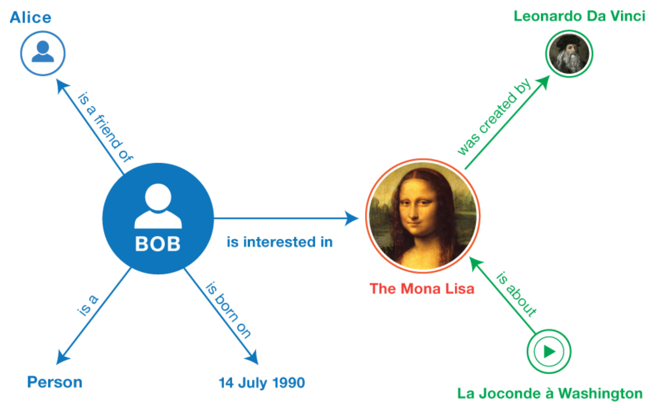
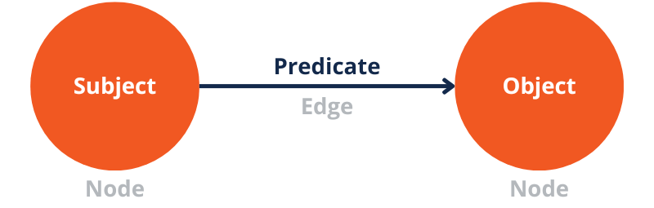
Basic Terminology
Workflow
  ordered tasks with inputs and outputs
Knowledge Graph
  entities connected by relationships
RDF
  triples (subject, predicate, object)
  Example: (TaskA, uses, DatasetB)
  Enables structured, machine-readable relationships
Notes:
Before going into the problem, let me briefly clarify three concepts I will use throughout the presentation.
First, a workflow is essentially a sequence of tasks, with inputs and outputs.
A knowledge graph represents entities and the relationships between them.
And RDF is the representation we use to express these relationships as machine-readable triples — for example, a task uses a particular dataset.

Slide 3
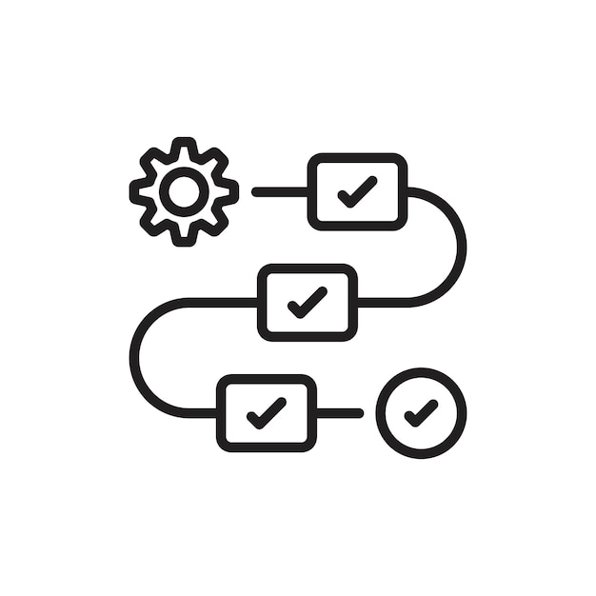
From Traces to Provenance
Execution traces record what happens during workflow runs
  Support replay, profiling, and debugging tasks
  Often engine-specific and semantically limited
Provenance is the metadata describing what, when, where, how, and who of execution
  Adds structured and interoperable context
  Enables cross-system analysis
Notes:
So, when a workflow is executed, we typically get an execution trace describing what happened during that run.
These traces are useful for things like replay, profiling, and debugging, but they are often specific to the workflow engine and provide limited semantic context.
Provenance gives us a richer representation.
Instead of only recording what happened, it captures additional context about what happened, when, where, how, and who was involved.
And this is important for our approach, because we want to move from simply looking at a sequence of events to explicitly representing the relationships between the different elements of an execution.
Provenance captures the history of a workflow execution, including the activities that were performed, the data that were used or produced, and the agents involved. The W3C PROV
model provides a standard vocabulary for representing this information through three core concepts: entities, activities, and agents.
In the XES format, a log is organized as a collection of traces, where each trace corresponds to one process instance or case. A trace contains events, and each event, together with attributes such as timestamps, resources, roles, and other domain-specific values, records the execution of one activity [1], [2].
For instance, in the BPI Challenge 2020 Domestic Declarations dataset, one trace represents a domestic travel declaration case [8]. Such a trace may include events such as Declaration Submitted by Employee, Declaration Final Approved by Supervisor, Request Payment, and Payment Handled.

Slide 4


Classical Validation
Operates directly on event logs and case-based traces to check activity order, timestamps, resources, roles, and attributes.
Uses procedural logic and event correlation to reconstruct relationships and identify workflow violations.
It successfully…
  Ensures structural correctness and execution feasibility
  Detects missing dependencies and invalid control flows
But…
  Struggles with complex relational checks, multi-step dependency paths, and attribute- or provenance-aware constraints that require procedural reconstruction.
Notes:
So, how is validation normally performed?
Classical workflow validation operates directly on event logs and case-based traces.
It can check things such as the order of activities, timestamps, resources, roles, and other event attributes.
Using procedural logic and event correlation, it reconstructs the relationships between events and identifies violations of the expected workflow behavior.
This works well for structural correctness and standard control-flow constraints.
However, there is a limitation.
When the validation requires more complex relational checks, multi-step dependency paths, or constraints involving attributes and provenance, we often need procedural reconstruction of those relationships.
And this is where we see an opportunity for a knowledge graph-based approach.

Slide 5
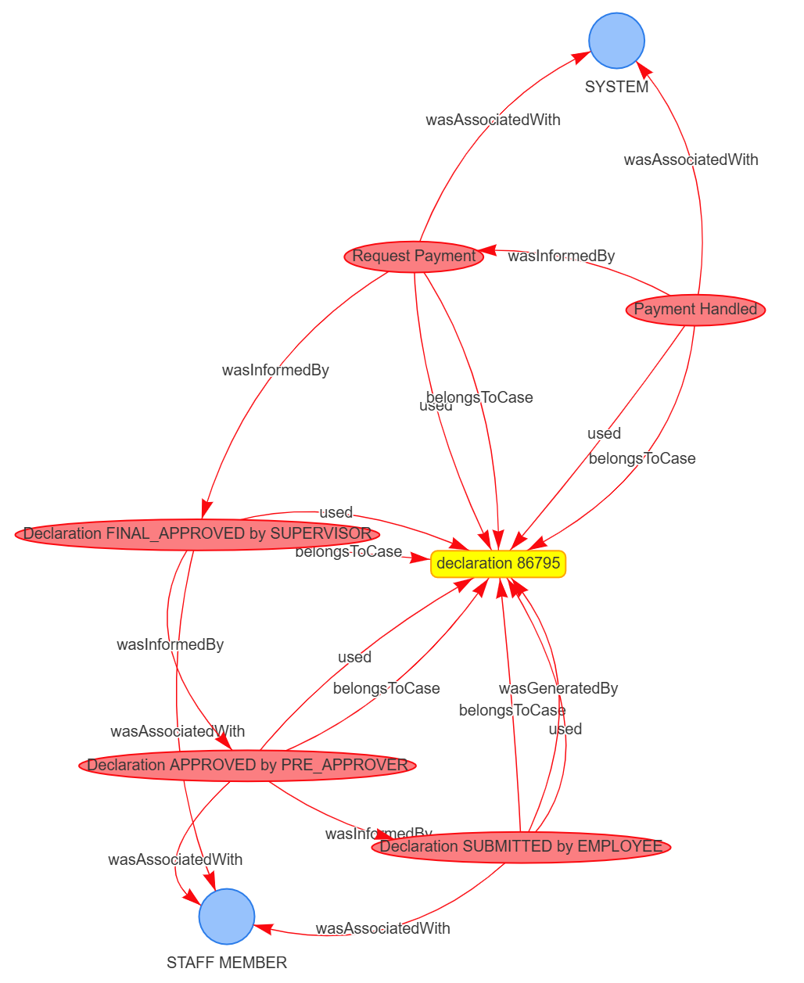
What if?
Represent workflow executions as interconnected PROV-aligned knowledge graphs.
  Explicitly link activities, cases, agents, roles, and attributes.
Express validation rules as graph patterns over execution relationships.
Trace multi-step dependencies to detect complex workflow violations.
Notes:
So, this leads to our main question:
What if we represented the workflow execution itself as a knowledge graph?
Instead of treating the execution as primarily a sequence of events, we represent the activities, cases, agents, roles, and attributes as interconnected entities.
Then, instead of implementing every validation condition through procedural logic, we can express the validation rules as graph patterns.
This also allows us to follow relationships across multiple steps of the workflow.
For example, consider a general payment workflow:
employee submission → pre-approval → final approval → payment request → payment.
The key question is whether the final payment is actually supported by all the required previous steps.
Simply checking for an approval before the payment is not enough, because the required payment request could still be missing.
This is where the knowledge graph helps. It allows us to verify that the payment is connected to a valid request, approval, and original submission within the same case.
This is what we mean by a multi-hop action: following a chain of relationships across multiple steps, rather than checking only a direct connection.
So, the main idea is that multi-hop dependencies are easier to express and validate when event logs are represented as a connected knowledge graph.

Slide 6
XES Elements to KG Entities
Concept (XES) | Meaning | PROV / KG Representation
Trace / Case | A single process execution (e.g., a declaration case) | prov:Entity (workflow case)
Event | An activity executed within a trace | prov:Activity (process step)
Resource / Role | The actor or organizational role associated with an event | prov:Agent
Timestamp | Additional case-level or event-level metadata | prov:startedAtTime / endedAtTime
Event order | The chronological sequence in which activities occur during a process execution. | prov:wasInformedBy between activities
Case membership | The relationship connecting an individual event or activity to its specific workflow trace or case instance. | wf:belongsToCase
Notes:
Now, the question is: how do we actually move from an XES event log to a knowledge graph?
We map the main XES concepts to PROV-aligned entities.
A trace, or case, becomes an entity representing the workflow execution.
Each event becomes a PROV activity.
And the resource or role associated with an event is represented as an agent.
We also preserve the temporal and relational information.
For example, event ordering is represented through prov:wasInformedBy, while the relationship between an event and its case is explicitly represented through wf:belongsToCase.
The mapping is intentionally lightweight and validation-oriented. Existing studies primarily investigate how workflow or event data can be represented, enriched, or verified structurally. Our contribution is to use a PROV-aligned knowledge graph as a reusable validation substrate .

Slide 7
Research questions
RQ1:
  How effectively can XES logs be transformed into validation-ready PROV knowledge graphs?
RQ2:
  Can KGs detect diverse workflow violations through graph-based validation rules?
RQ3:
  What are the performance costs of KG construction and SPARQL-based validation?
RQ4:
  How does KG-based validation compare with classical log-based validation?
Notes:
Based on this idea, we formulated four research questions.
First, we want to know how effectively XES logs can be transformed into validation-ready PROV knowledge graphs.
Second, whether these knowledge graphs can actually detect different types of workflow violations through graph-based validation rules.
Third, we investigate the performance cost: specifically, the cost of constructing the knowledge graph and performing SPARQL-based validation.
And finally, we compare the KG-based approach with classical log-based validation.
So overall, we are looking at construction, correctness, performance, and comparison with existing validation approaches.

Slide 8
Dataset & Methodology
BPI Challenge 2020 – Domestic Declarations
  10,500 traces, 56,437 events over two years
  XES file: ~1.54 MB, generated KG: ~850,000 RDF triples
Fault Injection
  R1–R4: Mutations on XES log before KG construction (event removal, activity exchange)
  R5, R5B, R6: Mutations on KG after conversion (role/resource modification, provenance rewiring)
  100 faults per rule (isolated), 700 total in combined setting
  Results are means over 10 repeats, fixed random seed (42)
Setup
  Intel Core Ultra 7 155H, 32 GB RAM, Windows 11
Notes:
For the evaluation, we used the BPI Challenge 2020 Domestic Declarations event log.
It contains around 10,500 traces and more than 56,000 events, covering a period of two years.
From the approximately 1.54 megabyte XES file, our generated knowledge graph contains around 850,000 RDF triples.
To evaluate the validation rules, we used fault injection.
For rules R1 to R4, we introduced mutations in the XES log before constructing the knowledge graph, such as removing or exchanging events.
For R5, R5B, and R6, we introduced mutations directly in the knowledge graph, such as modifying roles or rewiring provenance relationships.
We injected 100 faults per rule in the isolated setting, and 700 faults in total for the combined setting.
The results reported here are means over ten repetitions, using a fixed random seed.

Slide 9
Validation Rules
Rule | KG Interpretation | DECLARE Template
R1 | At least one submission S per trace | Existence(S)
R2 | Each approval A eventually followed by request R | Response(A, R)
R3 | Each payment P has an earlier request R | Precedence(R, P)
R4 | R eventually followed by P, and P has earlier R | Succession(R, P)
R5/R5B | R5: Payment must be handled by SYSTEM only R5B: No EMPLOYEE role should handle a payment | -
R6 | Payment must be linked via prov:wasInformedBy path to a submission → approval → request path (intermediate actions allowed) | -
S = Submitted, A = Final Approved, R = Request Payment, P = Payment Handled.
R5, R5B, and R6 are not expressible in standard pm4py DECLARE templates.
Notes:
We then defined six types of validation rules.
The first four correspond to standard control-flow constraints.
R1 requires at least one submission in every trace.
R2 requires every approval to eventually be followed by a payment request.
R3 requires every payment to have an earlier request.
And R4 combines these ideas, requiring a request to eventually be followed by a payment, with the request occurring first.
Then we have three additional constraints that are particularly relevant to the knowledge graph approach.
R5 requires a payment to be handled only by the SYSTEM role.
R5B checks that an EMPLOYEE role does not handle a payment.
And R6 is a provenance-based rule: the payment must be connected through a prov:wasInformedBy path to a submission, approval, and request, while allowing intermediate actions.
The important distinction is that R1 to R4 have equivalent DECLARE templates, while R5, R5B, and R6 are not expressible using the standard pm4py DECLARE templates.

Slide 10
The Pipeline
XES Event Log
XES event log: Input process executions containing traces, events, timestamps, activities, agents, and XES attributes.
Mapping XES to KG: Python incrementally converts each trace into RDF, generating stable URIs and preserving missing attributes.
Provenance KG: RDF encodes event ordering with prov:wasInformedBy and case membership with wf:belongsToCase.
Validation rules: Six SPARQL 1.1 rules execute on Fuseki, detecting violations and returning the involved entities.
Validation report: Detected violations are exported as a structured JSON report for analysis and identification of incomplete executions.
Mapping (XES → KG)
Provenance KG
Validation Rules
Violation Report
Notes:
This is the overall pipeline of our approach.
We start with the XES event log, which contains the process executions, events, timestamps, activities, agents, and other XES attributes.
The first step is to map this information into RDF.
The mapping is performed incrementally, trace by trace, generating stable URIs and preserving missing attributes.
The result is the provenance knowledge graph.
Within the graph, event ordering is represented using prov:wasInformedBy, while case membership is represented using wf:belongsToCase.
We then execute our six validation rules as SPARQL 1.1 queries using Fuseki.
The queries identify the violations and return the entities involved.
Finally, the detected violations are exported as a structured JSON report, which can then be used for further analysis.
The implementation 2 uses rdflib for XES-to-KG conversion and Turtle serialization, Apache Jena Fuseki as a SPARQL 1.1 triple store for validation, the Python standard-library XML parser for XES files, and pyvis for optional visualization.
Log conversion is performed incrementally by processing one trace at a time and appending the generated RDF fragment to a Turtle document. This streaming strategy limits memory
consumption and enables efficient processing of large event logs. Stable URIs are generated for cases, activities, and agents, while XES attributes are represented as RDF literals. Event ordering is encoded through prov:wasInformedBy, and case membership through wf:belongsToCase. Missing attributes are preserved as absent values rather than being
imputed, allowing incomplete process executions to be identified during validation.
Validation is performed after uploading the generated Turtle graph into Fuseki via the Graph Store Protocol. Each rule is defined as a SPARQL SELECT that returns one result per detected violation together with the corresponding entities. All rules R1–R6 are executed exclusively as SPARQL queries on Fuseki. Rule R6 in particular uses prov:wasInformedBy property paths to check the submission–approval–request–payment chain. Validation results are exported as a JSON report.

Slide 11
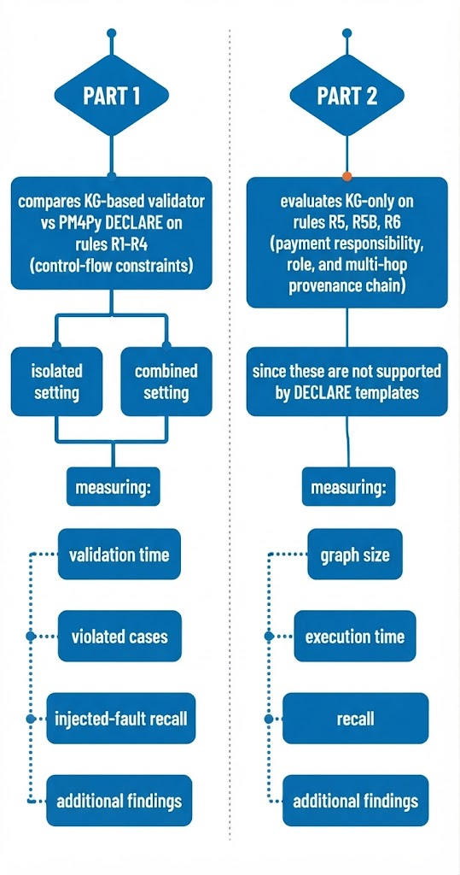
The Experiment
Part 1 measures agreement between KG validation and DECLARE on equivalent control-flow constraints, while Part 2 tests constraints beyond standard DECLARE, exploiting KG attributes and multi-hop provenance relationships.
Isolated setting: Each rule is evaluated independently, enabling rule-specific performance and recall analysis.
Combined setting: All rules operate on one artifact, exposing interaction effects and additional execution cost.
  A single mutation may trigger multiple rules
Measuring
  Validation Time
  Violated Cases
  Injected-fault recall
Measuring
  Graph Size
  Execution Time
  Recall
Notes:
To evaluate the approach, we look at both performance and correctness.
For performance, we measure the time required for validation, as well as the one-time cost of constructing and loading the knowledge graph.
For correctness, we look at the violated cases and, more importantly, the recall of the faults that we injected into the data.
We evaluate this in two settings.
First, an isolated setting, where each rule is evaluated independently.
And second, a combined setting, where all rules operate on the same artifact. This allows us to see not only the individual performance of the rules, but also possible interactions between them.
Finally, the experiment has two purposes: for rules R1 to R4, we compare the KG approach with equivalent DECLARE constraints. For R5, R5B, and R6, we evaluate constraints that go beyond what standard DECLARE templates can express.
So, what do we actually observe?

Slide 12
Results – Isolated setting
Rule | KG (s) | DECLARE (s) | KG/DECLARE additional
R1 | 0.07 | 2.29 | 135
R2 | 0.2 | 2.25 | 32
R3 | 0.15 | 2.26 | 7
R4 | 0.33 | 2.25 | 10
R5 | 0.04 | - | 0*
R5b | 0.02 | - | 0*
R6 | 0.96 | - | 9*
10,500 cases evaluated
100 faults injected per rule
  100% injected-fault recall for all rules
KG validation: 0.02–0.96 s/rule
DECLARE validation: 2.25–2.28 s/rule
KG One-time cost:
  Conversion (62–175 s)
  loading (~9.3 s)
KG ~7–57× faster depending on the rule
*For KG only
Notes:
Let's first look at the isolated setting.
Here, we evaluated all 10,500 cases, with 100 injected faults for each rule.
The first important result is that we achieved 100% injected-fault recall for every rule.
In terms of validation time, the KG queries range from about 0.02 to 0.96 seconds per rule.
For the equivalent DECLARE rules, validation takes roughly 2.25 to 2.28 seconds per rule.
So, once the knowledge graph has been constructed, KG-based validation is between approximately 7 and 57 times faster, depending on the rule.
However, there is an important trade-off.
The KG has a significant one-time construction cost: conversion takes between roughly 62 and 175 seconds, followed by around 9 seconds for loading.
So the main result here is that KG validation has a higher setup cost, but substantially lower validation time afterward.
And for R5, R5B, and R6, the comparison with DECLARE is not available because these constraints are not expressible using the standard templates.

Slide 13
Results – Combined setting (stress-test)
Rule | KG (s) | DECLARE (s) | KG additional | DECLARE additional
R1 | 0.07 | 2.29 | 135 | 135
R2 | 0.2 | 2.25 | 54 | 32
R3 | 0.15 | 2.26 | 179 | 107
R4 | 0.33 | 2.25 | 282 | 210
R5 | 0.05 | - | 0 | -
R5b | 0.06 | - | 0 | -
R6 | 0.95 | - | 305 | -
10,500 cases evaluated
700 faults injected in total
  1829 violation rows
KG 845594 triples
  Conversion 68.73s
  Loading 9.32s
KG validation: 1.8 s average
Recall: 1.00 for every rule
Additional KG findings due to cross-rule interference
  Additional findings are not necessarily false positives as they may be pre-existing violations.
Notes:
We then move to the combined setting.
Here, all rules are evaluated on the same artifact, with 700 faults injected in total.
The resulting knowledge graph contains approximately 846,000 triples.
The conversion took about 69 seconds, loading about 9 seconds, and the average validation time for the combined setting was approximately 1.8 seconds.
Again, the injected-fault recall was 1.00 for every rule.
However, we can see additional findings compared with the isolated setting.
This happens because the rules can interact with one another.
For example, one injected fault can cause a violation of more than one rule.
Importantly, these additional findings should not automatically be interpreted as false positives. They may correspond to violations that already existed in the data or violations triggered by the interaction of the rules.

Slide 14
Discussion
Overhead &
Reusability (R1-R4)
Control-flow equivalence
(R1-R4)
The high setup cost of KG make up with SPARQL queries that run up to 57 times faster than DECLARE for control-flow rules (R1-R4).
The KG approach matches standard DECLARE templates for basic constraints, identifying identical violated cases with a 1.00 recall.
Multihop support (R5-R6)
Practical Implications
Rules R5, R5B, and R6 enable attribute-aware, role-aware, and multi-hop validation that standard DECLARE templates cannot express.
DECLARE suits standard control-flow checks, while KGs enable complex queries that scale to large logs and support unified compliance and analytical analysis.
Notes:
So, what do these results tell us?
First, there is a clear overhead associated with constructing the knowledge graph.
However, once the graph exists, the SPARQL validation queries can be considerably faster than the equivalent DECLARE validation for the control-flow rules.
Second, for R1 to R4, we observed control-flow equivalence between the KG validation and the corresponding DECLARE constraints.
They identified the same violated cases, with a recall of 1.00.
The other important point concerns R5, R5B, and R6.
These rules use attributes, roles, and multi-hop provenance relationships.
This is where the graph representation provides capabilities that standard DECLARE templates do not directly express.
So the distinction is not that the KG approach replaces every form of classical validation.
Rather, DECLARE provides a way to express standard control-flow constraints, while the knowledge graph gives us a representation that can also support more complex relational and provenance-aware queries.

Slide 15
Sum up & Future Directions
Traditional log-based validation struggles with relational checks, multi-step dependency paths, and constraints requiring procedural reconstruction.
We transformed event logs into knowledge graphs, making relationships explicit and enabling validation through SPARQL queries.
On the BPI Challenge 2020 dataset, the KG approach achieved perfect recall (1.00) and faster validation, while supporting constraints beyond standard DECLARE templates.
Future work: evaluate more datasets, automate rule derivation, and explore time-bounded validation.
Notes:
So, to summarize.
We started from the observation that traditional log-based validation can become difficult when we need relational checks, multi-step dependency paths, or constraints that depend on provenance and attributes.
We addressed this by transforming workflow event logs into knowledge graphs, using a PROV-aligned representation that makes these relationships explicit.
On the BPI Challenge 2020 Domestic Declarations dataset, the approach achieved a recall of 1.00 for all the injected faults.
For the control-flow rules that could also be expressed using DECLARE, the KG approach produced equivalent validation results and faster query execution after the graph had been constructed.
At the same time, the knowledge graph allowed us to express additional role-aware and multi-hop provenance constraints that were not expressible using the standard DECLARE templates we used.
There are several directions for future work.
We want to evaluate the approach on additional datasets, investigate automated derivation of validation rules, and extend the approach to time-bounded validation.

Slide 16


Thank you for your attention!
Let’s validate the answers to your questions! ☺
/vzervos
vzervos@ics.forth.gr

Slide 17
A Dataset Entry
<?xml version="1.0" encoding="UTF-8" ?>
<!-- Sample extracted from DomesticDeclarations.xes.gz for demo/testing -->
<log xes.version="1.0" xes.features="nested-attributes" openxes.version="1.0RC7">
<extension name="Organizational" prefix="org" uri="http://www.xes-standard.org/org.xesext"/>
<extension name="Time" prefix="time" uri="http://www.xes-standard.org/time.xesext"/>
<extension name="Concept" prefix="concept" uri="http://www.xes-standard.org/concept.xesext"/>
<string key="concept:name" value="Domestic Declarations"/>
<trace>
<string key="id" value="declaration 86791"/>
<string key="concept:name" value="declaration 86791"/>
<string key="BudgetNumber" value="budget 86566"/>
<string key="DeclarationNumber" value="declaration number 86792"/>
<float key="Amount" value="26.85120450862128"/>
<event>
<string key="id" value="st_step 86794_0"/>
<string key="org:resource" value="STAFF MEMBER"/>
<string key="concept:name" value="Declaration SUBMITTED by EMPLOYEE"/>
EMPLOYEE"/>
<date key="time:timestamp" value="2017-01-09T09:49:50.000+01:00"/>
<string key="org:role" value="EMPLOYEE"/>
</event>
<event>
<string key="id" value="st_step 86793_0"/>
<string key="org:resource" value="STAFF MEMBER"/>
<string key="concept:name" value="Declaration FINAL_APPROVED by SUPERVISOR"/>
<date key="time:timestamp" value="2017-01-09T11:27:48.000+01:00"/>
<string key="org:role" value="SUPERVISOR"/>
</event>
<event>
<string key="id" value="dd_declaration 86791_19"/>
<string key="org:resource" value="SYSTEM"/>
<string key="concept:name" value="Request Payment"/>
<date key="time:timestamp" value="2017-01-10T09:34:44.000+01:00"/>
<string key="org:role" value="UNDEFINED"/>
</event>
<event>
<string key="id" value="dd_declaration 86791_20"/>
<string key="org:resource" value="SYSTEM"/>
<string key="concept:name" value="Payment Handled"/>
<date key="time:timestamp" value="2017-01-12T17:31:22.000+01:00"/>
<string key="org:role" value="UNDEFINED"/>
</event>
</trace>
</log>
Notes:
For the evaluation, we used the BPI Challenge 2020 Domestic Declarations event log.
It contains around 10,500 traces and more than 56,000 events, covering a period of two years.
From the approximately 1.54 megabyte XES file, our generated knowledge graph contains around 850,000 RDF triples.
To evaluate the validation rules, we used fault injection.
For rules R1 to R4, we introduced mutations in the XES log before constructing the knowledge graph, such as removing or exchanging events.
For R5, R5B, and R6, we introduced mutations directly in the knowledge graph, such as modifying roles or rewiring provenance relationships.
We injected 100 faults per rule in the isolated setting, and 700 faults in total for the combined setting.
The results reported here are means over ten repetitions, using a fixed random seed.

