Slide 1
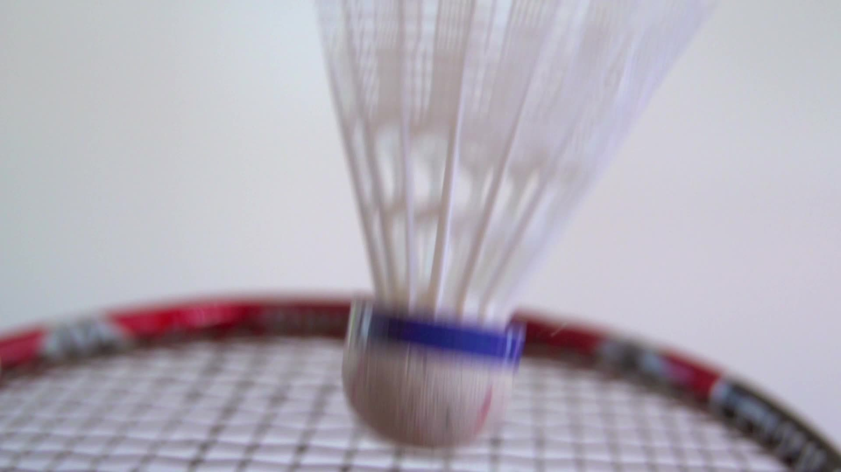

BADMINTON STROKE DETECTION
BY VAIBHAV WANJARI

Slide 2
Introduction
Sports, as a universal language and cultural cornerstone, play a crucial role in promoting physical health, mental resilience, and community spirit. Among these, badminton stands out as one of the most popular sports worldwide, known for its fast-paced rallies, skillful techniques, and the athletic agility it demands from players. Monitoring athlete performance and tracking specific movements, such as strokes in badminton, have become key areas of interest for coaches, analysts, and enthusiasts alike.
In badminton, player monitoring and stroke identification are particularly vital for understanding gameplay and enhancing training regimens. This project addresses these areas by focusing on the classification of badminton strokes, specifically categorizing them into forehand and backhand. Using a dataset of 1,000 images captured from various match videos, this project applies machine learning techniques to distinguish between these two types of strokes, enabling a deeper understanding of player strategies and stroke mechanics. The significance of this research extends beyond stroke categorization; it represents a valuable step in leveraging AI to support player development and performance optimization.

Slide 3
PROBLEM STATEMENT
Despite the growing interest in monitoring and analyzing player actions in sports, accurate classification of badminton strokes-specifically forehand and backhand-remains a challenge. In the realm of sports analytics, accurately identifying and classifying badminton strokes remains a challenge due to the complexity of player movements and variations in stroke execution.This study aims to address the need for effective stroke identification by leveraging image data from badminton matches.
This project addresses the need for a reliable classification system to distinguish between forehand and backhand strokes in badminton using image-based machine learning techniques.The problem focuses on the development of a robust methodology for distinguishing between forehand and backhand strokes using various feature extraction techniques and machine learning algorithms. The objective is to enhance the accuracy of stroke classification, thereby improving training, performance analysis, and player monitoring in badminton. This system aims to enhance player performance analysis and provide insights into stroke mechanics, benefiting coaches, players, and the broader sports analytics community, empowering coaches and players with insights that were previously difficult to capture and analyze accurately.

Slide 4
Literature survey
1. Terence Bloom and Andrew P Bradley, “Player tracking and stroke recognition in tennis video”, In APRS Workshop on Digital Image Computing (WDIC’03), volume 1, pages 93–97, University of Queensland, St Lucia, Brisbane Australia, 2003.
Terence Bloom et al. broke algorithm into three sections: player finding, player tracking, and stroke recognition due to some model limitation. The difference in the image is identified following thresholding and morphological filtering. Also tennis strokes can be recognized using key postures wherein a dataset of different tennis players can be collected using a low cost IP camera. And with background subtraction and morphological filtering strokes recognition can be done from raw frames.
2. Damien Connaghan, Ciaran O Conaire, Philip Kelly, and Noel E ´ O’Connor, “Recognition of tennis strokes using key postures”, In 2010- 21st IET conference on Irish Signals and Systems C.
The player action recognition from broadcast tennis video is a new approach wherein tracking and stabilization, motion descriptor computing and supervised learning on the model is performed. In order to present a method for semantic and tactical analysis of the broadcast tennis footage, the model is also combined with a multi-modal framework.

Slide 5
3. P. Liu and J. -H. Wang, "MonoTrack: Shuttle trajectory reconstruction from monocular badminton video," 2022 IEEE/CVF Conference on Computer Vision and Pattern Recognition Workshops (CVPRW), 2022, pp. 3512-3521.
TrackNet is used in to improve processing speed, prediction accuracy, Overall testing reveals that TrackNetV2 achieves accuracy, precision, and recall rates during training and testing on a brand-new match. Newer frameworks recover the high resolution representation of the input image after first encoding it as a low-resolution representation utilising ResNet, VGGNet, etc. The High-Resolution Network (HRNet) is a network that retains high-resolution representations throughout the entire process, as stated by the authors.
4. Heng Wang, Alexander Kläser, Cordelia Schmid & Cheng-Lin Liu, “Dense Trajectories and Motion Boundary Descriptors for Action Recognition”, May 2013 International Journal of Computer Vision 103(1) DOI:10.1007/s11263-012-0594-8
used a accurate and efficient extraction of dense trajectories in video representation that is a cutting-edge optical flow technique A descriptor is introduced called motion boundary histograms (MBH) which rely on differential optical flow. k-NN and SVM classifiers are used to identify those behaviours after gathering data from a big number of users and labelling their data across various instances.

Slide 6
5. Sing Loong Teng, R. Paramesran, “Detection of service activity in a badminton game”, TENCON 2011 - 2011 IEEE Region 10 Conference
The authors applied a slice-based optical flow weightage (SOFW) algorithm to calculate the player's upper and lower body's motion within the bounding box area to detect service activity. Authors proposed a two stage method firstly, keypoint estimation in frames or short clips, then light tracking to produce keypoint predictions linked over the full video. They used Mask R-CNN, accuracy of their approach was found to be 55.2% on the validation and 51.8% on the test set using the Multi-Object Tracking Accuracy (MOTA) metric

Slide 7
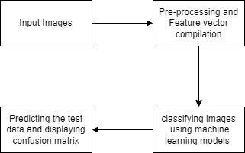
METHODOLOGY
This project presents classification of badminton strokes, it classifies forehand and backhand strokes. Fig.1 depicts a systematic flowchart of the system. It starts with compilation of the dataset of the required images. Followed by pre-processing of the images, which includes changing the color spaces and resizing of the images. The dataset is further split into training and testing dataset. Different feature extraction techniques like SIFT and different algorithms are tested. Out of which the SIFT based feature extraction is preferred. The images are classified using different machine learning models.
Fig.1. Block diagram of the system architecture

Slide 8
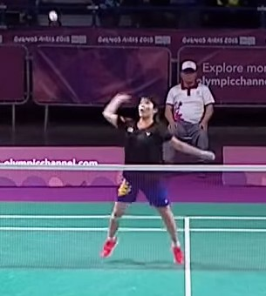
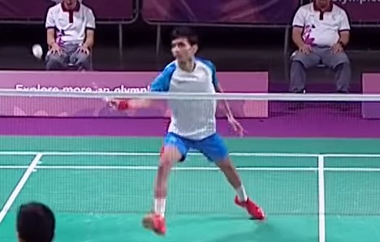
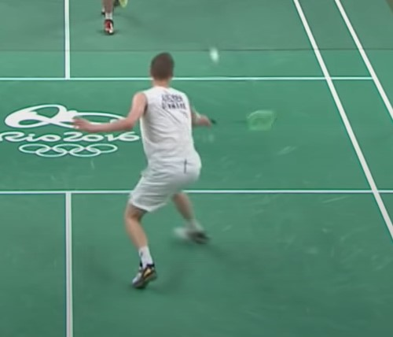
1. Dataset Collection and Pre-processing
The dataset used is a self-collected dataset which contains 1000 images out of which 500 are forehand stroke and 500 are backhand stroke images. The images were taken from various badminton tournament matches such as Olympics, World championship, French Open, Denmark Open etc. The collected dataset underwent pre-processing techniques such as changing color spaces to HSV and resizing the images to 250x250 pixels. The images collected were of right handed players only.
Images containing forehand stroke play

Slide 9
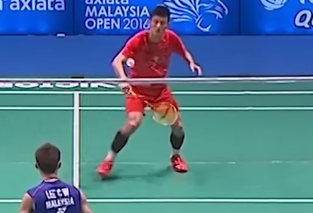
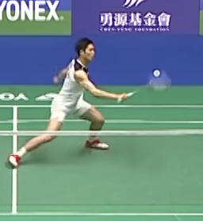
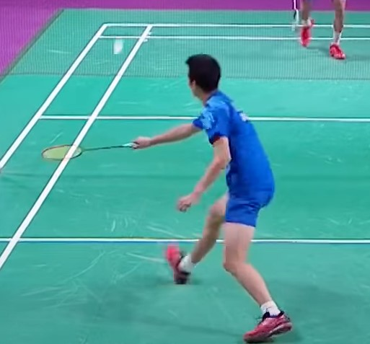
Images containing backhand stroke play
2. Feature Vector Compilation
Feature extraction is the following step. Different feature descriptors were tested. But the SIFT feature descriptor proved to be best performing in this case. A feature descriptor algorithm called SIFT is used to locate, represent, and align neighborhood features in images. SIFT minimizes the possibility of errors by identifying and describing numerous local key points in the image. This descriptor was chosen primarily because it is robustly applicable to problems like clutter and occlusions and is invariant to affine and scaling changes. The SIFT descriptor was applied to extract features from 1000 images.

Slide 10
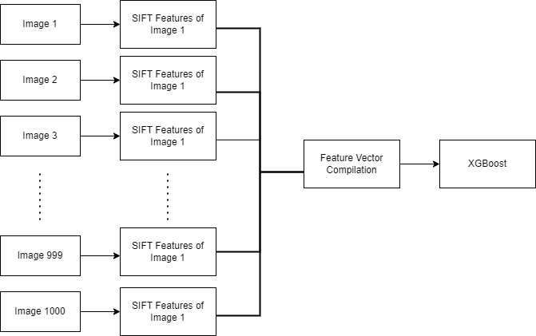
The feature extraction process is represented in Figure

Slide 11
3. Classification
In order to forecast badminton strokes, the paper investigated the use of the following six machine learning classifiers :
K-Means Classifier
K-Nearest Neighbors Classifier
Support Vector Machine Classifier
Random Forest Classifier
Decision Tree Classifier
XG-Boost Classifier
Utilizing performance indicators such as accuracy, precision, recall and F1 score of these Classifiers performance outcomes were compared. The main goal of using various classifiers was to simply comprehend how the training dataset behaved when used with various models.

Slide 12
FLOW CHART OF PROJECT
Start
Input Image
Extraction of SIFT Features
Principal Component Analysis
Classifier
Forehand
Backhand
End
End

Slide 13
RESULT
SIFT ALGORITHM
CLASSIFIERS | SVM | KNN | RANDOM FOREST | K-MEANS | XG-BOOST | DECISION TREE
ACCURACY SCORE | 0.715 | 0.835 | 0.710 | 0.642 | 0.761 | 0.719
DAISY ALGORITHM
CLASSIFIERS | SVM | KNN | RANDOM FOREST | K-MEANS | XG-BOOST | DECISION TREE
ACCURACY SCORE | 0.544 | 0.664 | 0.664 | 0.556 | 0.678 | 0.624

Slide 14
THANK YOU

