Slide 1







Stack Overflow Developer Survey 2019 Analysis and Findings
Vanja Wüster
December 5th 2023

Slide 2



OUTLINE
Executive Summary
Introduction
Methodology
Results
Visualization – Charts
Dashboard
Discussion
Findings & Implications
Conclusion
Appendix

Slide 3

EXECUTIVE SUMMARY
This presentation elucidates the findings derived from the Stack Overflow Developer Survey 2019.
The data has been meticulously collected, prepared, and analyzed to highlight key outcomes.
The ensuing discussion will expound upon the methodology employed in this research endeavor, along with the consequential discoveries.
Furthermore, an insightful examination will be conducted, comparing prevailing trends with anticipated future developments in both technology and demographics.

Slide 4

INTRODUCTION
The Stack Overflow Developer Survey stands as the most extensive and all-encompassing examination of global coders.
Its findings reveal both present and forthcoming trends within the coding community.
The survey provides insights into the demographics and formal education backgrounds of developers.
Additionally, it offers a comprehensive view of the current and anticipated statuses of programming languages, databases, and platforms.
The Objective of the Data Analysis in this context is:
To pinpoint the most in-demand programming languages, databases, platform, and web framework skills.
To discern skill prerequisites for the future.
To uncover human resources (HR) needs within the industry.

Slide 5

METHODOLOGY
Data Sources:
Stack Overflow Developer Survey 2019
GitHub Job Postings
Preparation:
Data Wrangling
Data Exploration and Cleaning
Data Visualization:
Python (diverse Libraries)
IBM Cognos Analytics

Slide 6
RESULTS
Programming Languages
Top 10 current programming languages vs. Top 10 desired programming languages
Database
Top 10 current popular databases vs. Top 10 future Databases
Demographics
Gender, Age and Location

Slide 7
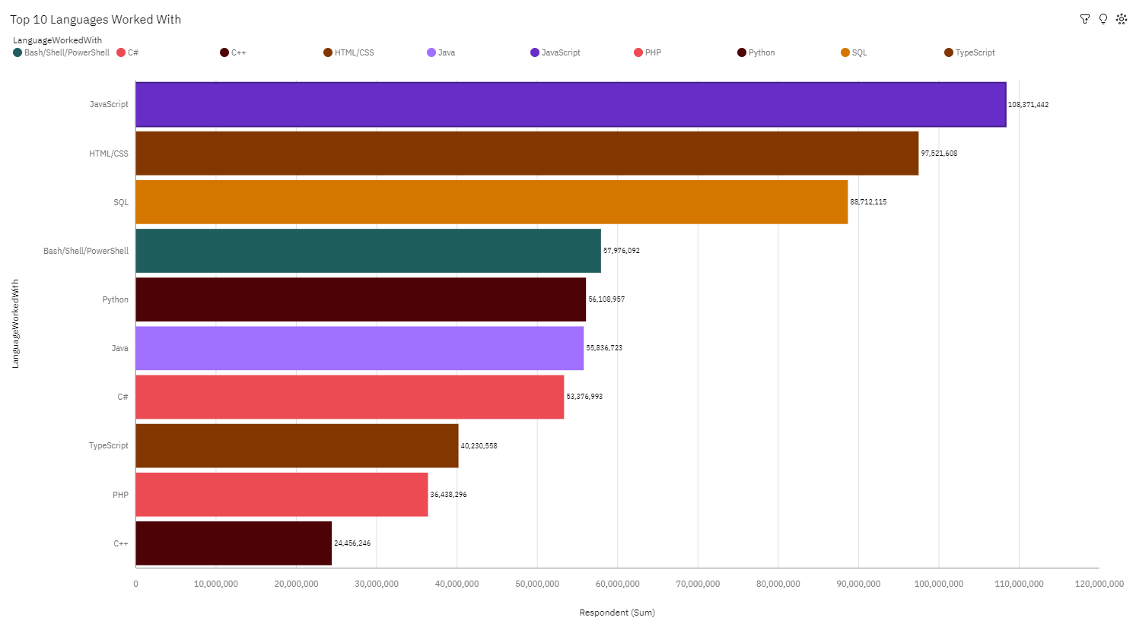
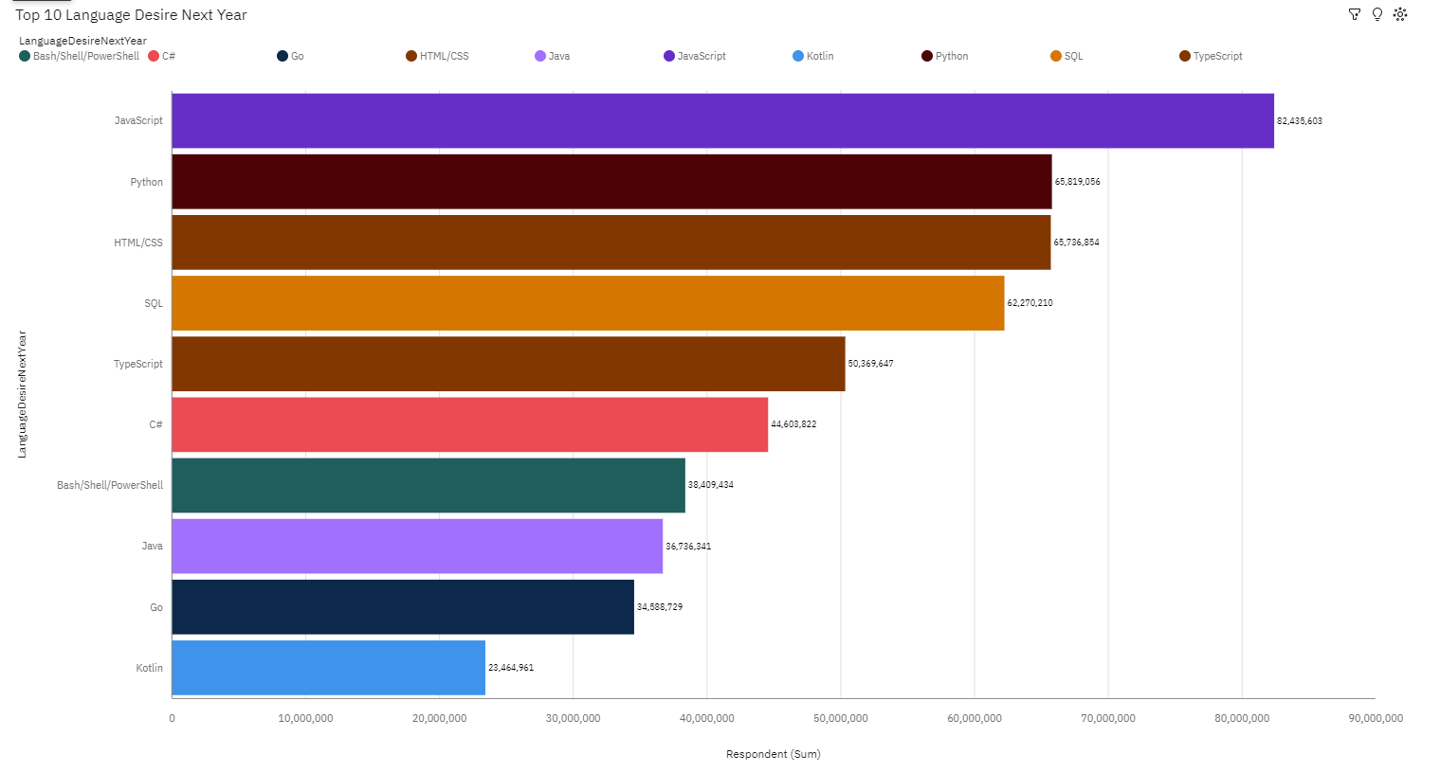
PROGRAMMING LANGUAGE TRENDS
Current Year
Next Year

Slide 8
PROGRAMMING LANGUAGE TRENDS - FINDINGS & IMPLICATIONS
Findings
JavaScript holds the position as the most prominent trending language.
Python and TypeScript are progressively gaining popularity.
HTML/CSS and SQL continue to be extensively utilized.
Implications
Several languages used and popular
Need for developers who are flexible and know more than one language
JavaScript’s popularity is to continue

Slide 9
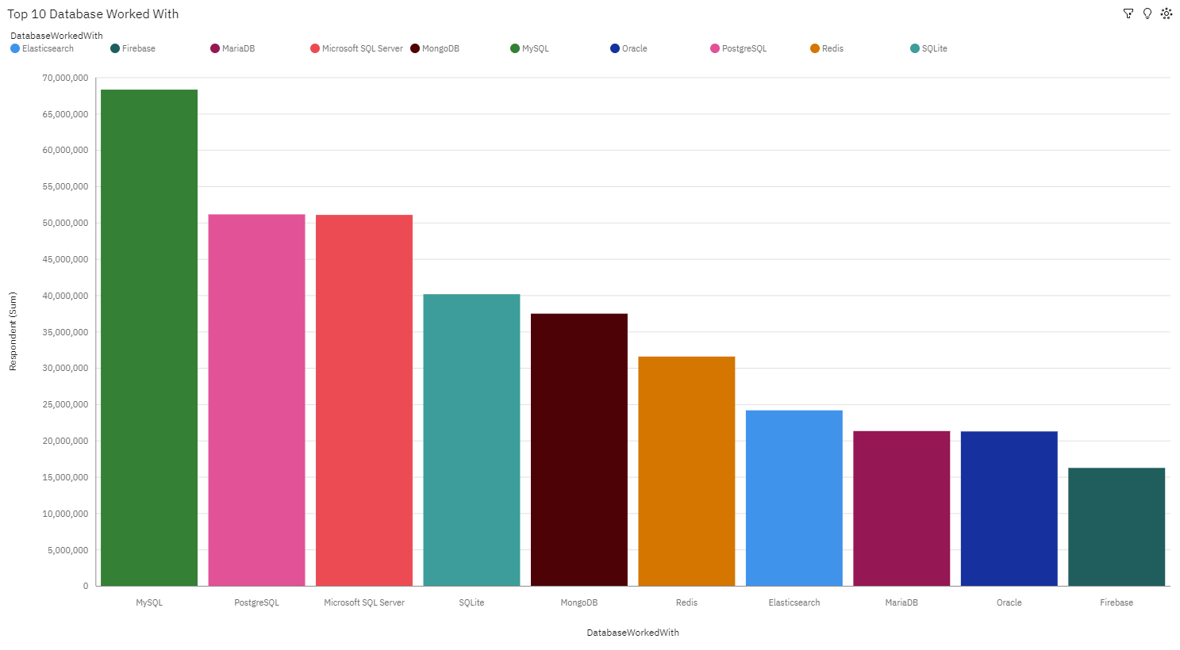
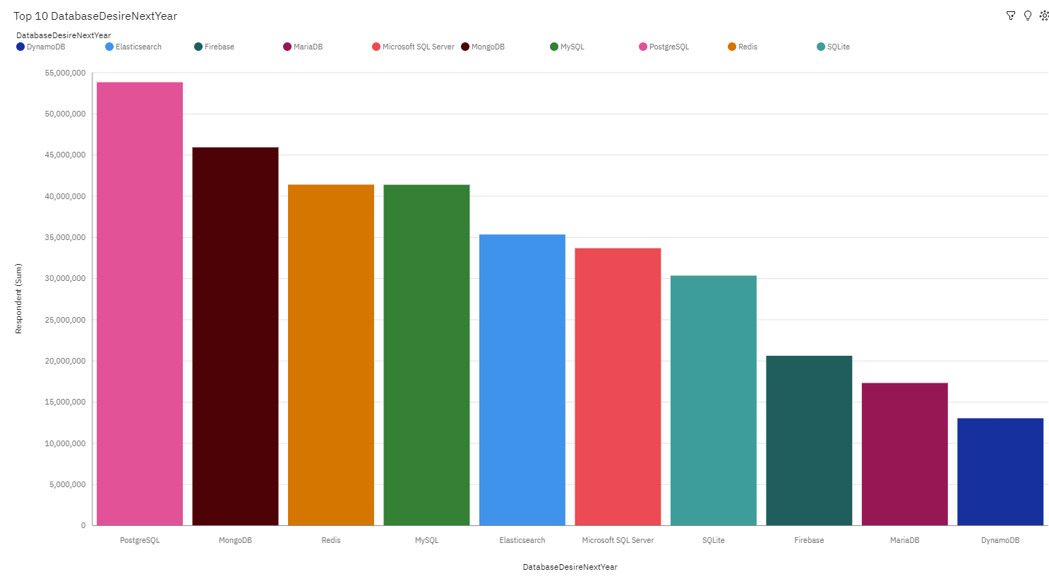
DATABASE TRENDS
Current Year
Next Year

Slide 10
DATABASE TRENDS - FINDINGS & IMPLICATIONS
Findings
MySQL is the most popular database
There are still a lot of companies using Microsoft SQL Server
MongoDB and Redis are the most favorable NoSQL database Implications
Implications
Open-source databases like MySQL are still preferable
Software development and Big Data technology still requires SQL

Slide 11

DASHBOARD
IBM Capstone Project Dashboard

Slide 12
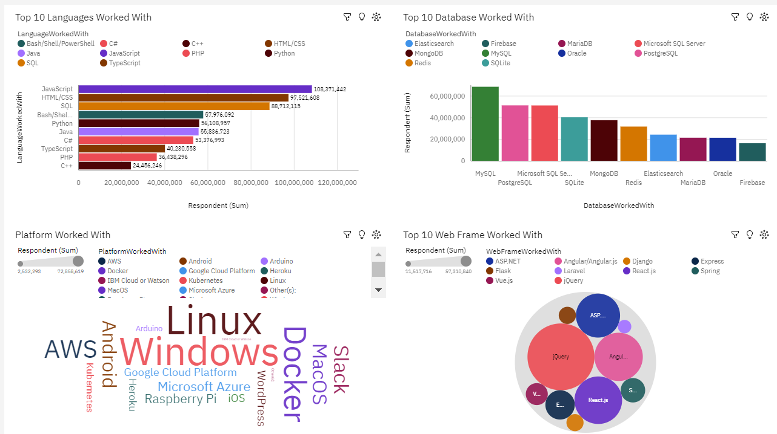
DASHBOARD CURRENT TRENDS

Slide 13
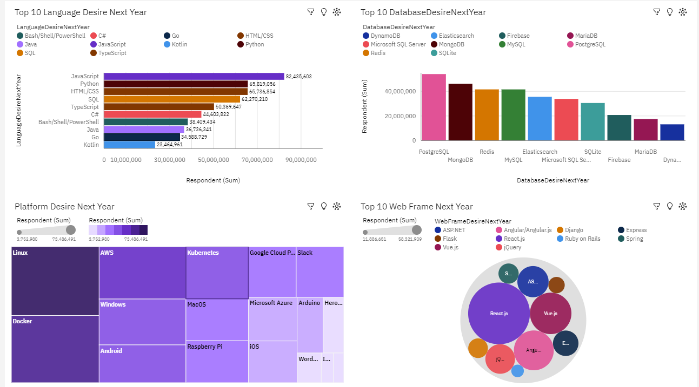
DASHBOARD FUTURE TRENDS

Slide 14
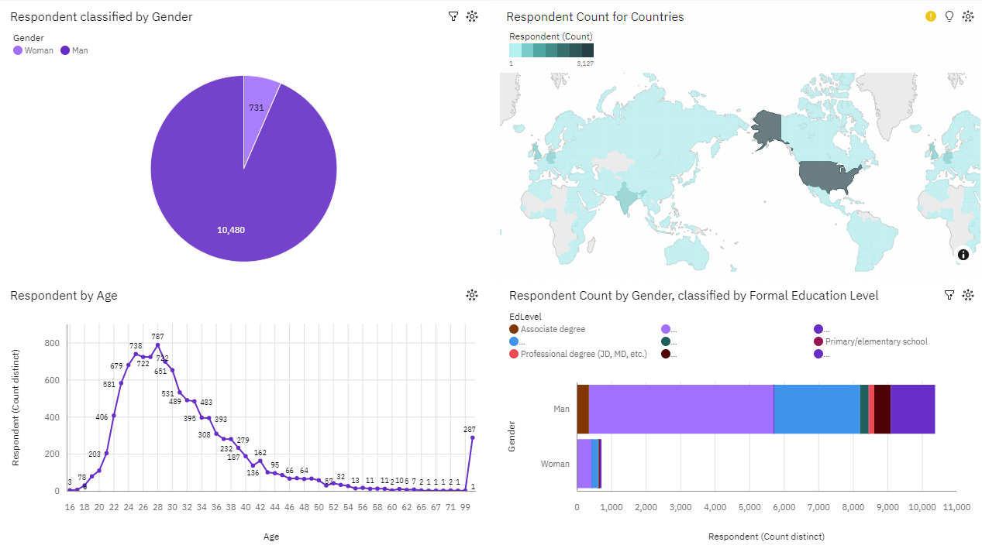
DASHBOARD DEMOGRAPHICS

Slide 15
DISCUSSION

Slide 16
OVERALL FINDINGS & IMPLICATIONS
Findings
Developing Countries (USA, UK, Netherlands leads in technology
There exists significant gender and age discrimination: 90% of developers identify as male
Docker and AWS stand out as the most popular platforms.
Implications
Programmers should consistently stay abreast of the latest technology trends.
Need to improve gender inequality

Slide 17

CONCLUSION
Ongoing changes in technology trends underscore the United States as a technology leader, though issues of gender and age discrimination persist. The imperative is for programmers to stay current with emerging technologies, advocating for equal global access and fostering workplaces free from biases related to gender and age in employment decisions.

Slide 18

APPENDIX
GitHub Repository with Codes, Findings and Visuals

Slide 19
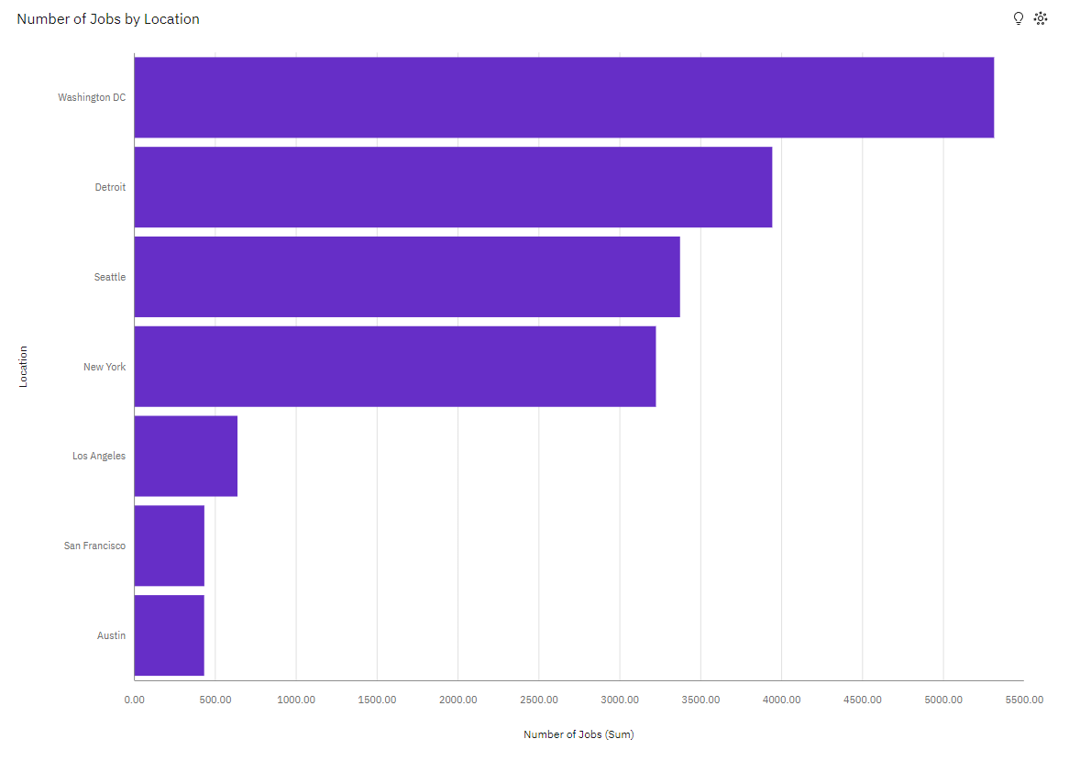
JOB POSTINGS

Slide 20
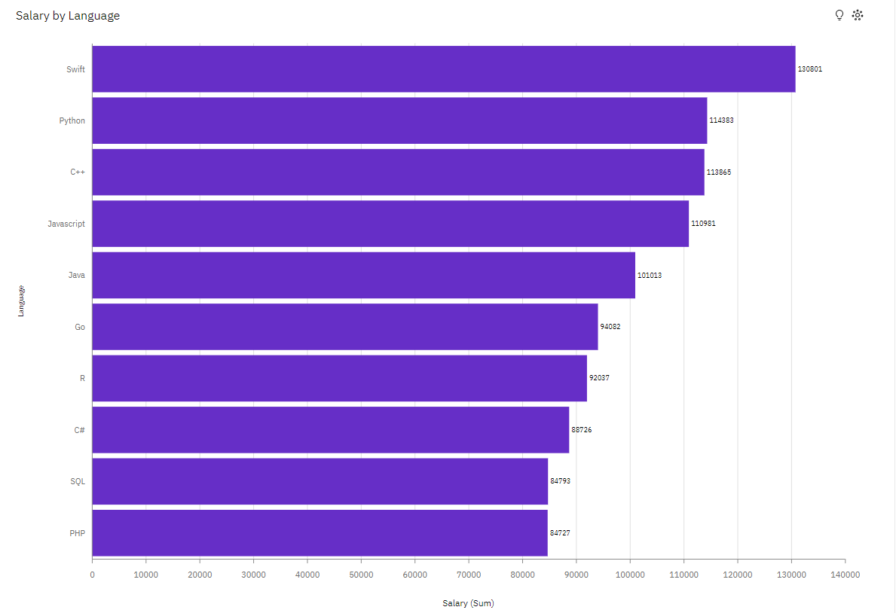
POPULAR LANGUAGES

