Slide 1
Design of unified volume model for NeuronAnnotator
Christopher Bruns
July 2011

Slide 2
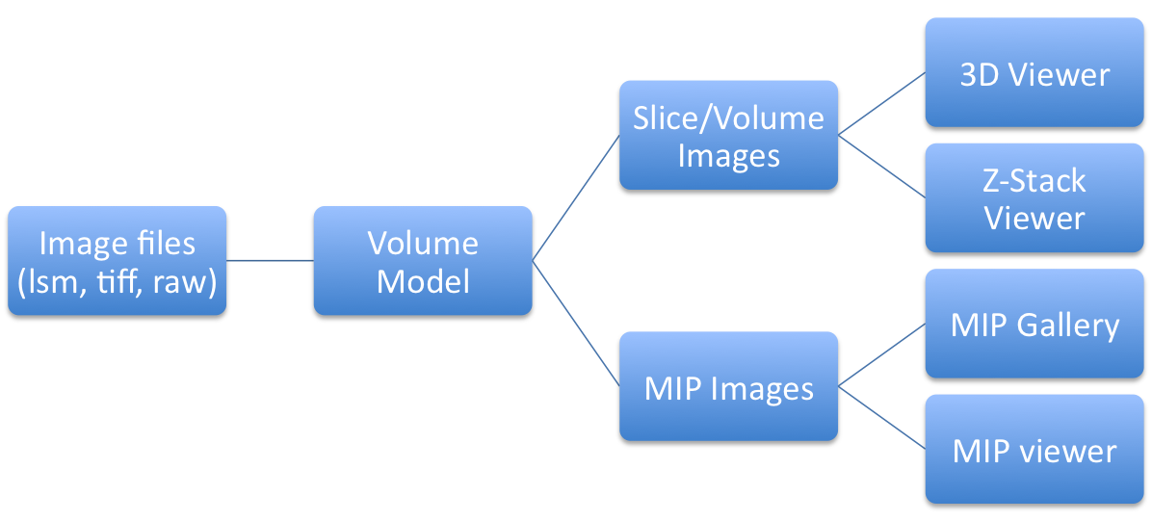
Simplified data flow diagram
(Information flows to the right)
Each node is a WRITER of its own data, and a READER of upstream data.

Slide 3
Operations that can trigger data changes.
Fresh image data loaded
Data channel display color modified (not currently implemented)
Neuron/fragment visibility toggled
HDR/gamma settings changed, in two stages
  faster approximate adjustment to displayed images, handled per-viewer (~10ms?)
  slower “perfect” adjustment from 16-bit data (~200ms?)

Slide 4
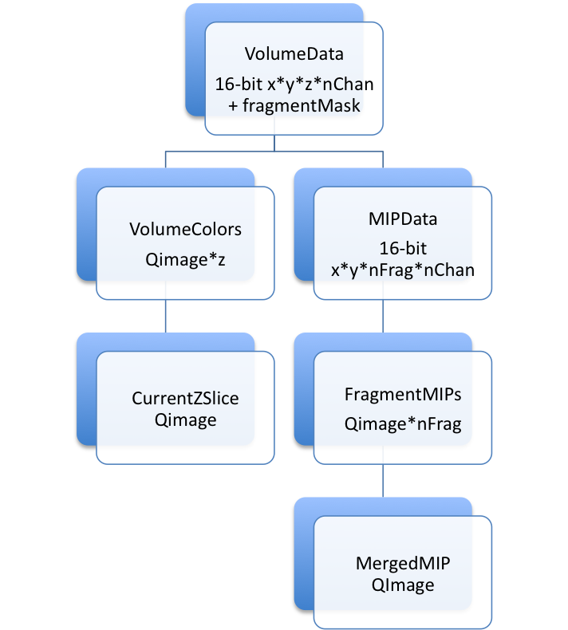
Readers/Writers inventory
Information flows
downward
3D
Viewer
MIP
Gallery
Z-Slice
Viewer
MIP
Viewer

Slide 5
Synchronizing data access
Reading model data
  Listen to the dataChanged() signal to initiate data reads.
  If reading model data takes more than 25 ms, release and reacquire read lock (non-blocking) every 25 ms or so. This is a good time to emit a progress() signal too. A debug mode will be provided so you can see a warning if your lock check interval is outside of the range 5-100 ms.
  If read lock acquisition fails, immediately abort the read operation. You will be notified when updated data are available, via the dataChanged() signal (this is a “push” data model). Emit progressAborted() from the data source you are writing to.
Writing model data
  Run each writer in its own dedicated Qthread. (Further subordinate Qthreads may be used for performance)
  Acquire write lock (blocking) before writing
  Emit dataChanged() signal after entire writing operation is complete.
  Remember that most WRITERS are also READERS of upstream data, so follow the reading rules too.
Everyone
  Run in a Qthread other than the GUI/main thread, unless you *must* modifiy QWidgets or QPixmaps, or make OpenGL calls. If you are in the GUI thread, be fast and light, and be extra vigilant about checking your read lock every 25 ms; and call QCoreApplication::processEvents() before reacquiring your lock. (Eventually OpenGL calls will be moved to a single dedicated Qthread)

Slide 6
NALockableImage API
Each NALockableImage has its own:
  Qthread
  QReadWriteLock
signals:
  dataChanged()
  progressAchieved(int)
  progressAborted()
slots:
  updateData()

Slide 7
What triggers a data update?
  VolumeData
    freshImageDataLoaded
  VolumeColors
    channelColorChanged, gammaChanged, hdrChanged, neuronVisibilityChanged
    (TODO – how to facilitate opengl partial texture update?)
  CurrentZSlice
    currentZSliceChanged, volumeColorsChanged
    (VolumeColors should be optimized to update current z first)
  MIPData
    volumeDataChanged
  FragmentMIPs
    channelColorChanged, gammaChanged, hdrChanged, mipDataChanged
  MergedMIP
    neuronVisibilityChanged, fragmentMIPsChanged
    (includes MIPMergeTree data structure)

Slide 8
Incremental implementation
Begin with file loading operation, wrapping My4DImage in VolumeData.
Next implement VolumeColors and population of 3D viewer
Next implement MIPData (perhaps this should be first, since there is a known bug here.)
And everything else.

Slide 9
Storage | Space | Tiled size | Bandwidth | Contents | …specifically
Network | 100 TB | 250 MB | 25 MB/sec | Files Database | Reference.tif ConsolidatedSignal.tif ConsolidatedLabel.tif
Local disk | 1 TB | 250 MB | 100 MB/sec | Cached files | ?
RAM (multi-threaded) | 32 GB | 1 GB (550 + 2*nFrag MB) | 300 MB/sec | Unified data model 12 bit x data channels | NaVolumeData MipFragmentData MipMergedData NeuronSelectionModel DataColorModel
RAM (multi-threaded) |  |  |  | color RGBA | MipMergedColors VolumeColors ZSliceColors MipFragmentColors
RAM (GUI thread) | 32 GB |  | 2.5 GB/sec | QWidgets QPixmaps OpenGL host calls | MipViewer 3DViewer ZStackViewer GalleryButtons
GPU | 1-2 GB |  |  | OpenGL device calls Texture memory | hundreds of volume textures

Slide 10
Model time/space resource usage with tiled data
files
250 MB
17 s
NaVolumeData
550 MB
4 s
MipFragmentData
2F MB
16-bit data
<1 ms
F = number of fragments
NeuronSelectionModel
<1 MB
<1 ms
60F ms
DataColorModel
<1 MB
13logF ms
MipMergedData
5F MB
colorize 16-bit data x n-channels to 8-bit x R/G/B
11F ms
20 ms
20 ms
MipFragmentColors
1F MB
RGB
color
data
ZSliceColors
1 MB
(VolumeColors) ?
0.5F ms
fast color
update
<1 ms
GalleryMipImages
0.1F MB
<1 ms
1.7-5 s
<1 ms
0.5F ms
GUI
thread
Z-slice Viewer
3D Viewer
Mip Viewer
Mip Gallery

