Slide 1
ML Pipeline – Tools and Platforms

Slide 2
Agenda
ML – Basic Concepts and Terminologies (optional)
ML Pipeline – Tools and Platforms
Training a model
Making predictions using the model
Locally Deploying the model
Deploying the model to cloud
Dockers
CaaS
MLaaS

Slide 3
Training a Model
Hands-on

Slide 4
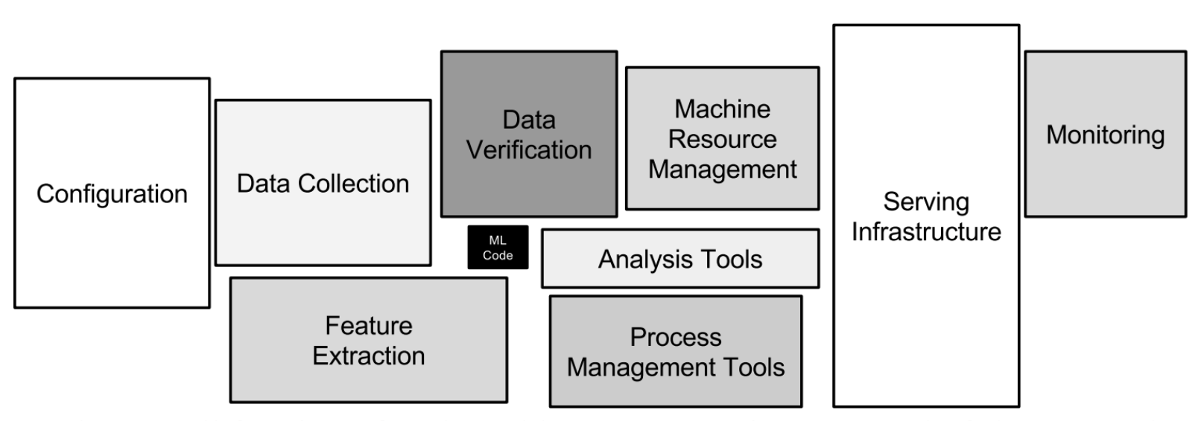
Components of a ML Project.

Slide 5
Using the trained model to make predictions.
Hands-on

Slide 6
Local Deployment
Hands-on

Slide 7
Heroku
Hands-on

Slide 8
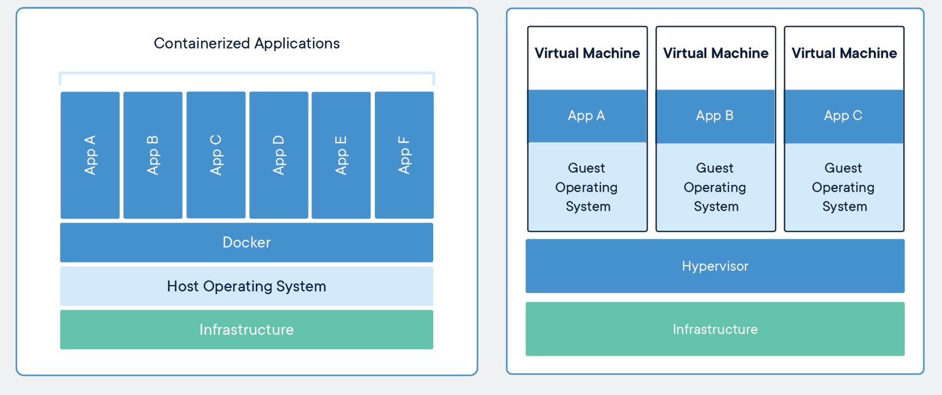
Containers vs Virtual Machines

Slide 9
Dockers and Kubernetes
Docker
Uses OS-level virtualization
Containers are isolated from one another and bundle their own software, libraries and configuration files
They can communicate with each other through well-defined channels
Kubernetes
Kubernetes (K8s) is an open-source system for automating deployment, scaling, and management of containerized applications.

Slide 10
Docker
Hands-on

Slide 11
CaaS
Containers-as-a-Service (CaaS) is an emerging services offering for container-based virtualization in which providers offer a complete framework to customers for deploying and managing containers, applications and clusters.
Platforms include Google Kubernetes, Docker Swarm, Rackspace Carina, Apache Mesos and OpenStack’s nova-docker.
PaaS: PCF, OpenShift

Slide 12
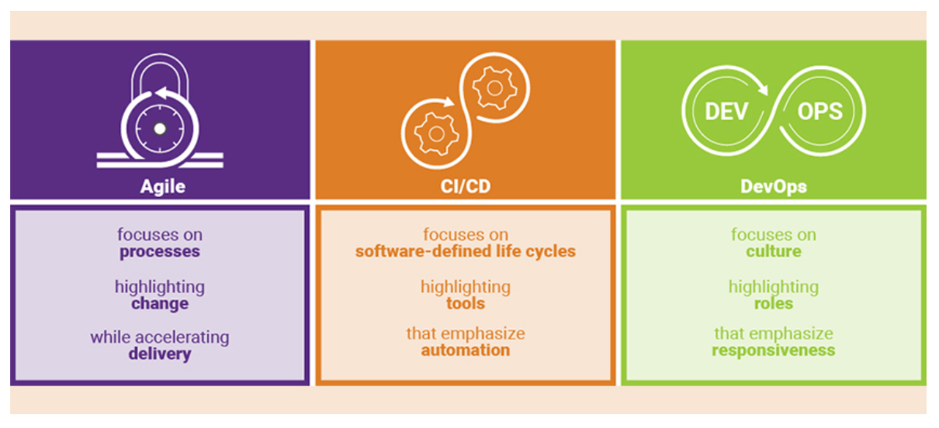
Agile, CI/CD and DevOps
Continuous integration (CI) and continuous delivery (CD) embody a culture, set of operating principles, and collection of practices that enable application development teams to deliver code changes more frequently and reliably.

Slide 13
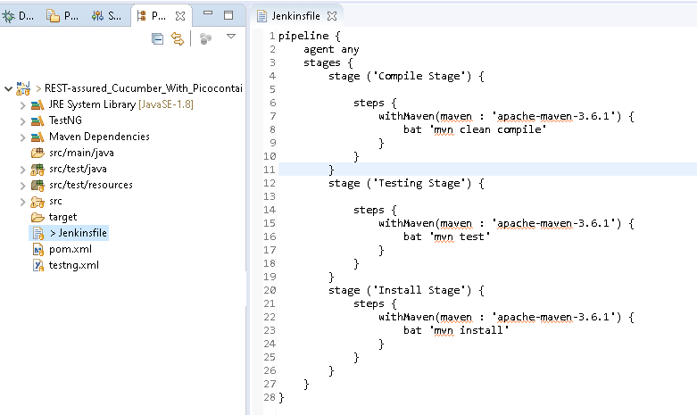
Jenkins
an open source tool to build continuous integration and continuous delivery (CI/CD) pipelines.

Slide 14
MLaaS
Demo/Hands-on

