Slide 1

BIOINFORMATIKA
Izgradnja binarnog stabla valića kao RRR strukture
Denis Čaušević, Hajrudin Ćoralić
siječanj 2016.

Slide 2
Sadržaj
Stablo valića
RRR

Slide 3
Stablo valića
A
C
G
T
A
T
C
A
G
C
T
A
0
1
0
0
1
0
1
0
A
C
G
T
A
C
A
C
A
T
G
T
0
1
0
1
0
1
0
1

Slide 4
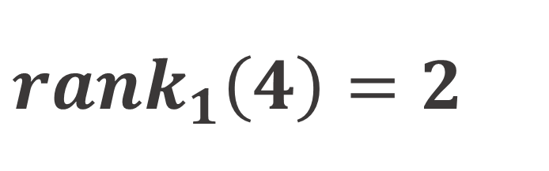
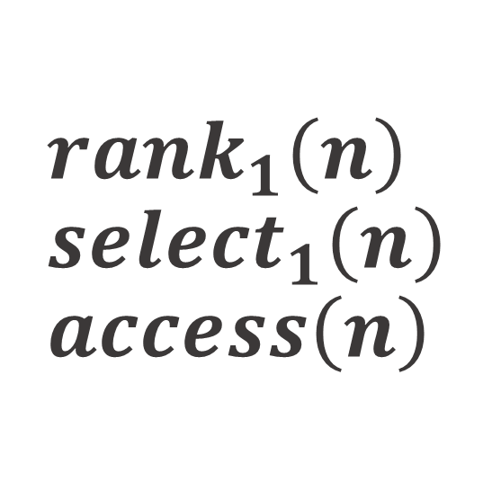
$$rank_{1}\left(n\right) \\ select_{1}\left(n\right) \\ access\left(n\right)$$
0
1
0
0
1
0
1
0
0
1
2
3
4
5
6
7
$$rank_{1}\left(4\right)=2$$

Slide 5
RRR
SUPERBLOKOVI
0
1
BLOKOVI
0
1
0
0
1
0
1
0
0
1
2
3
4
5
6
7

Slide 6
RRR
0
0
0
0
0
0
1
0
1
1
0
1
1
0
1
1
1
1
1
2
2
0
1
1
razred
pomak

Slide 7
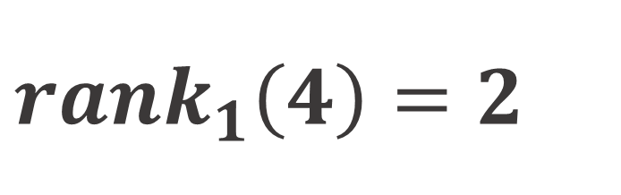
RRR
0
0
0
0
0
1
0
1
$$rank_{1}\left(4\right)=2$$
1
0
1
1
1
1
1
2
0, 0
1, 6
0
1
0
0
0
0
0
1
1
0
1
1

Slide 13
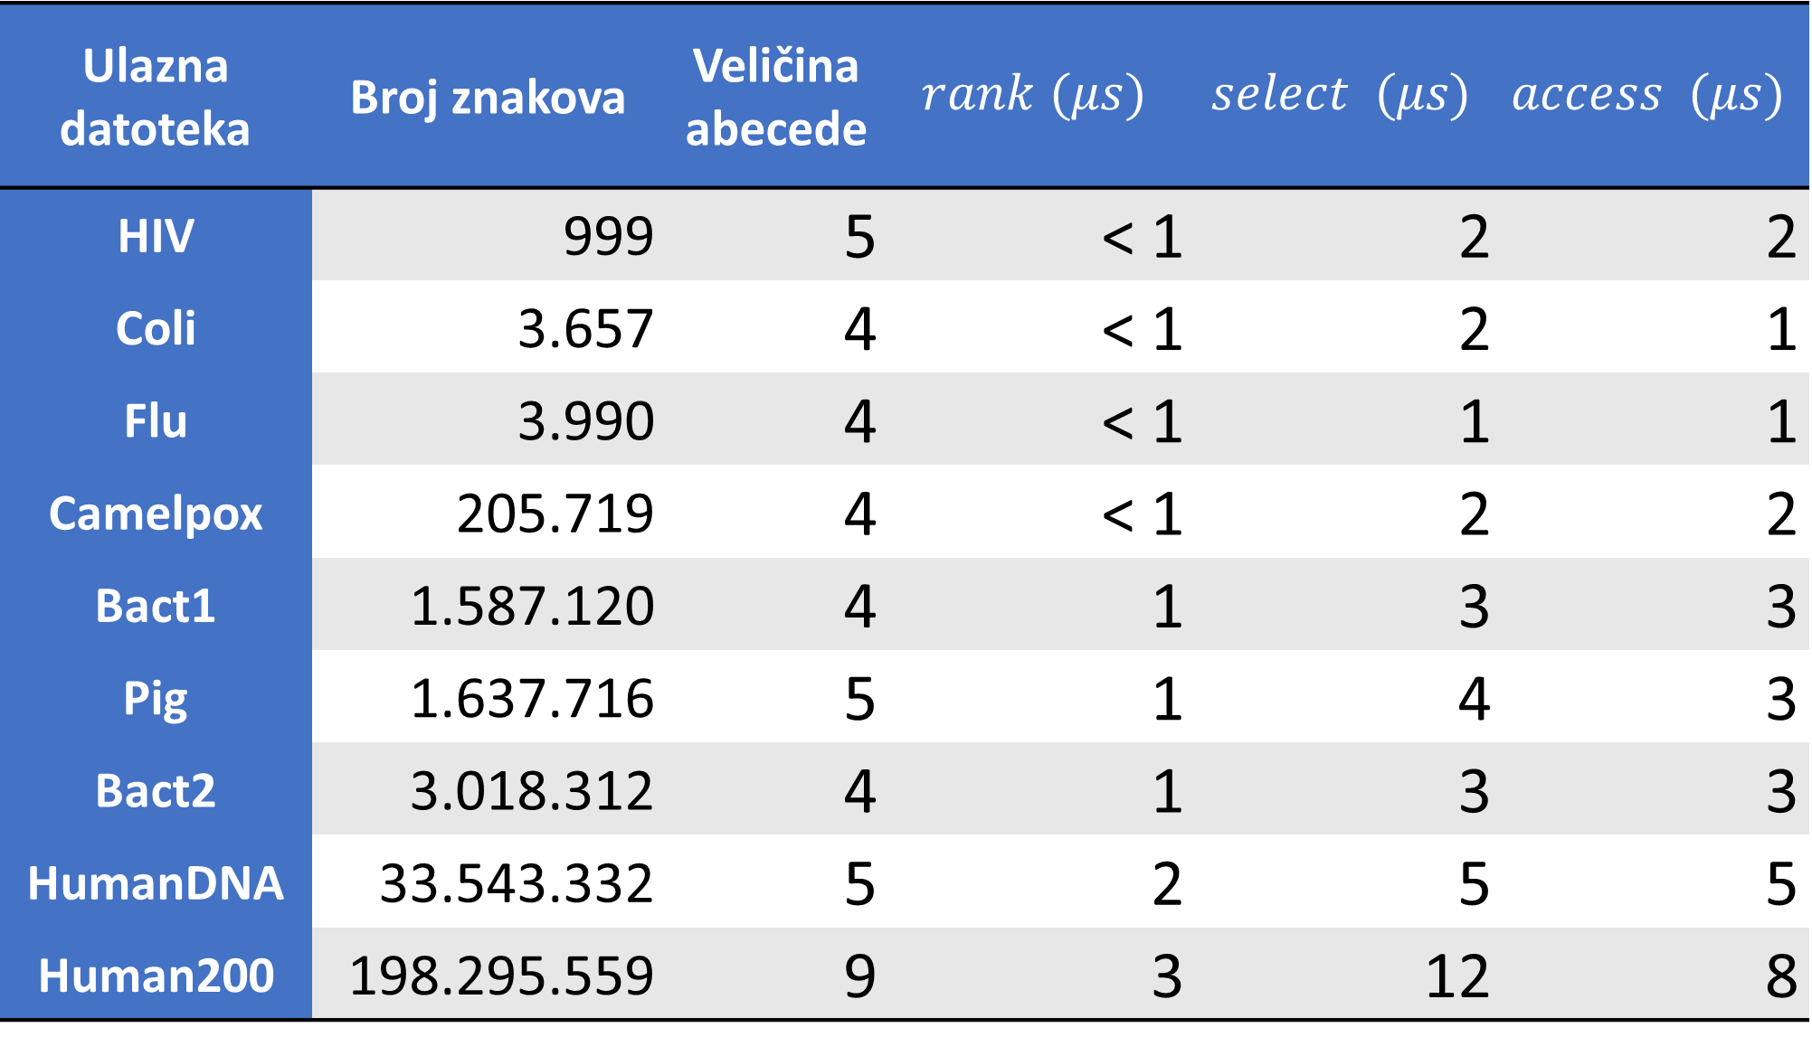
Ulazna datoteka | Broj znakova | Veličina abecede | $$rank (μs)$$ | $$select (μs)$$ | $$access (μs)$$
HIV | 999 | 5 | < 1 | 2 | 2
Coli | 3.657 | 4 | < 1 | 2 | 1
Flu | 3.990 | 4 | < 1 | 1 | 1
Camelpox | 205.719 | 4 | < 1 | 2 | 2
Bact1 | 1.587.120 | 4 | 1 | 3 | 3
Pig | 1.637.716 | 5 | 1 | 4 | 3
Bact2 | 3.018.312 | 4 | 1 | 3 | 3
HumanDNA | 33.543.332 | 5 | 2 | 5 | 5
Human200 | 198.295.559 | 9 | 3 | 12 | 8

Slide 14
ZAKLJUČAK
Izgradnja binarnog stabla valića kao RRR strukture
Denis Čaušević, Hajrudin Ćoralić
siječanj 2016.

