Slide 1
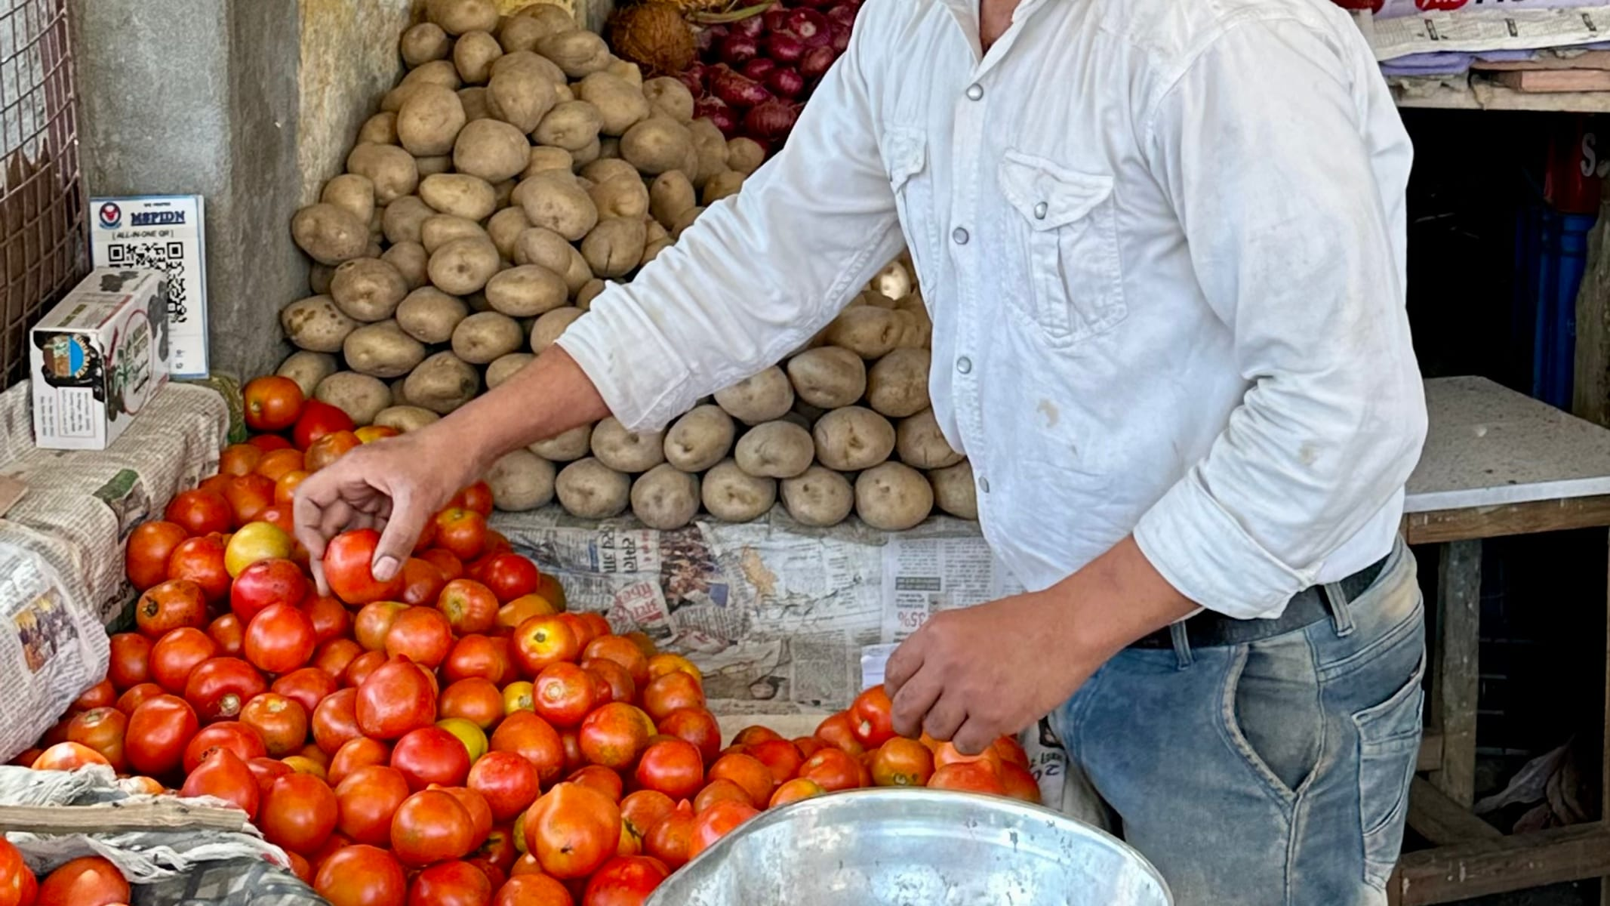
CLASS 11 · ECONOMICS
Demand and Supply
Why the price of onions can jump in a single month
Photo: Whispyhistory · CC BY-SA 4.0
Notes:
Ask students what they paid for onions or tomatoes recently, and whether the price changes through the year.

Slide 2
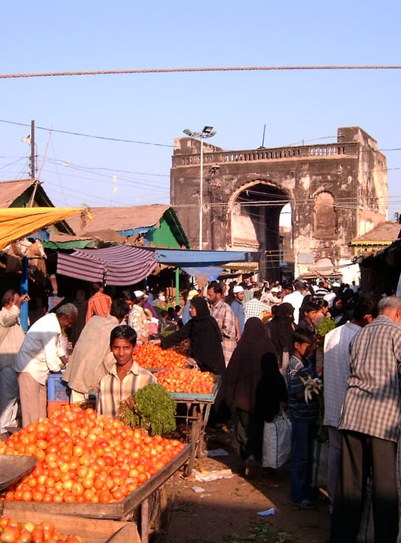



Two forces, one price
Demand: what buyers want
When the price rises, people buy less (other things staying the same).
Supply: what sellers offer
When the price rises, sellers offer more.
Equilibrium: where they meet
The price at which the amount wanted equals the amount offered.
Photo: Iijjccoo at Dutch Wikipedia · Public domain
Notes:
Write the three words on the board: demand, supply, equilibrium.

Slide 3
Where demand meets supply
Quantity (kg)
Demand
100
EQUILIBRIUM
₹30 / kg
80
60 kg bought and sold
60
40
Below ₹30, buyers want more than sellers offer: a shortage pushes the price up.
Above ₹30, sellers are left holding stock: a surplus pushes it down.
20
Supply
₹10
₹20
₹30
₹40
₹50
Price per kg
Illustrative numbers for a local tomato market.
Notes:
Ask: at ₹20, how many kilos are wanted and how many are offered? What happens next?

Slide 4


What moves the curves
Demand shifts when…
Supply shifts when…
Incomes change
Tastes and fashions change
Prices of substitutes change (tea vs coffee)
People expect prices to rise
Costs of inputs change
The weather hits a harvest
Technology improves
Taxes or subsidies change
A change in price moves along a curve. A change in anything else shifts the whole curve.
Notes:
Give each pair a news headline and ask: does it shift demand or supply, and which way?

Slide 5
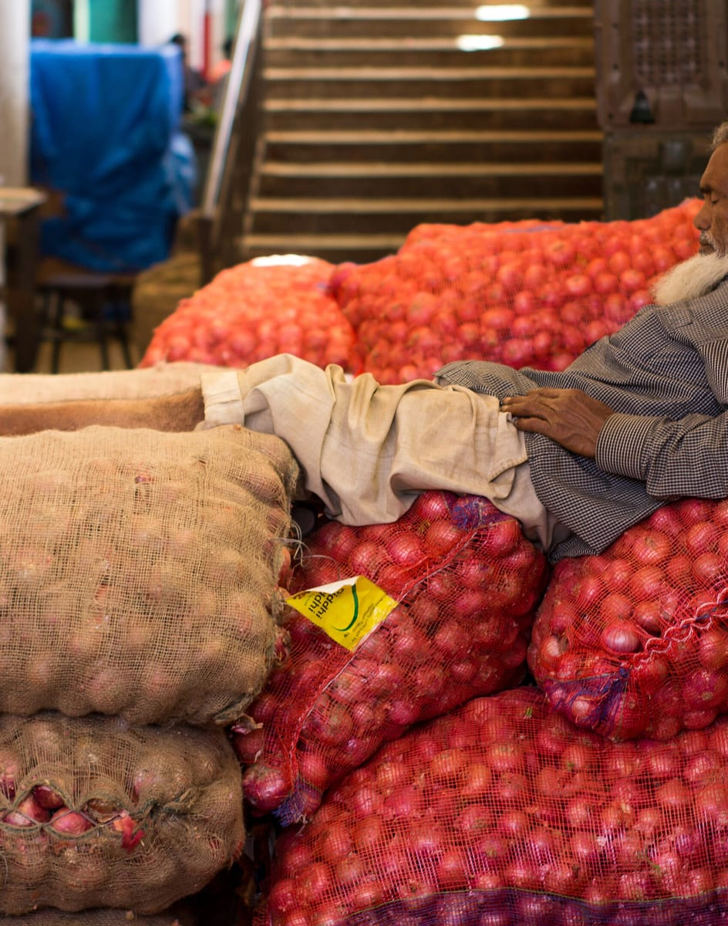
IN REAL LIFE
When the monsoon fails
Less rain,
smaller onion harvest.
Supply shifts left:
fewer onions at every price.
The price rises
until buyers cut back enough to match what's available.
Demand barely changed. The whole price jump came from supply.
Photo: Advay m · CC BY-SA 4.0
Notes:
Sketch the left shift on the board over the chart from slide 3.

Slide 6
Quick check
A bumper harvest increases the supply of tomatoes. If demand doesn't change, what happens to the equilibrium price?
It rises
It falls
A
B
It stays the same
It can't be known
C
D
Notes:
Answer: B. It falls. Supply shifts right: more tomatoes at every price, so sellers lower the price to sell them. Equilibrium price falls and quantity rises.

Slide 7
Remember
1
2
3
4
Demand falls as price rises
Supply rises as price rises
Equilibrium: wanted = offered
Shocks shift curves, then price adjusts
Before next class Track the price of one vegetable at your local market for a week and explain any change.
Notes:
Exit ticket: draw a supply shift and label the new price.

