Slide 1
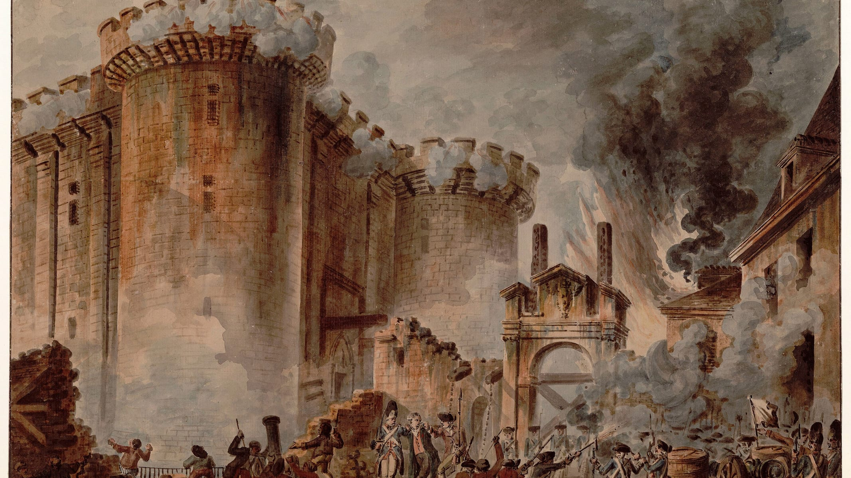
CLASS 9 · HISTORY
The French Revolution
1789–1799: how a kingdom became a republic
Photo: Jean-Pierre Houël · Public domain
Notes:
Ask: what would make ordinary people storm a fortress? Note their answers to revisit at the end.

Slide 2



One kingdom, three estates
First Estate
Second Estate
Third Estate
The clergy
The nobility
Everyone else
Owned a large share of land
Collected a tithe from peasants
Paid almost no taxes
Held the top posts
Collected feudal dues
Also exempt from most taxes
Peasants, workers, merchants, lawyers
The vast majority of people
Paid nearly all the taxes
The few who paid least had most of the power. That imbalance is where the story starts.
Notes:
Divide the class into three groups by estate and hand out 'tax bills' to the Third Estate only.

Slide 3



Why it boiled over in 1789
Empty treasury
Hunger
New ideas
Costly wars, including help for the American Revolution
The king needed new taxes
Poor harvests
The price of bread rose sharply
Families spent most of their income on food
Philosophers such as Rousseau and Montesquieu
Questioned the divine right of kings
Argued for rights and the separation of powers
Notes:
Ask which of the three causes students think mattered most, and why. There is no single right answer.

Slide 4
The revolution in eight moments
May 1789
14 Jul 1789
1791
Jan 1793
Estates-General meets at Versailles
Storming of the Bastille
First written constitution
Louis XVI executed
20 Jun 1789
Aug 1789
Sep 1792
1799
Tennis Court Oath
Declaration of the Rights of Man
France becomes a republic
Napoleon seizes power
Notes:
Students copy the timeline and mark one moment they would have wanted to witness, with a reason.

Slide 5
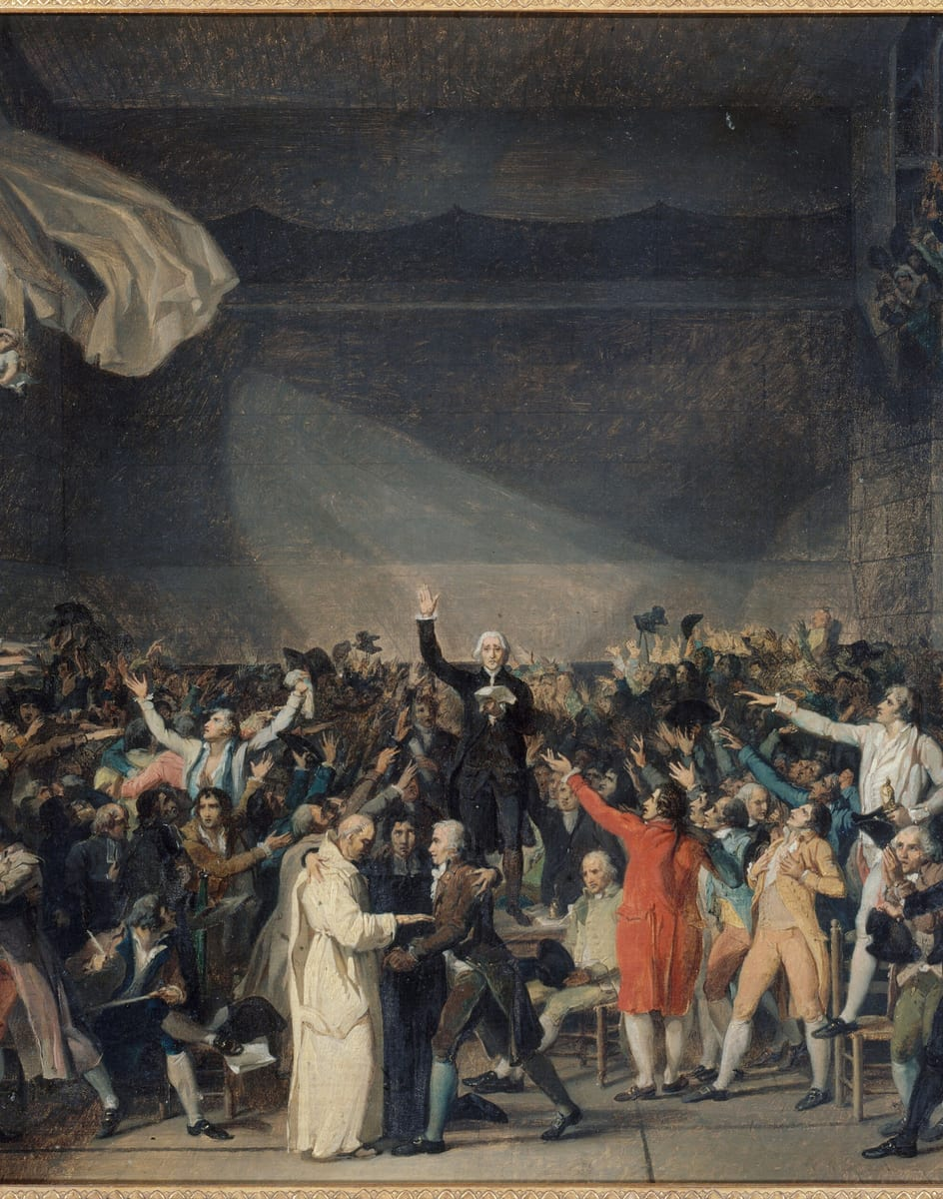
20 JUNE 1789
The Tennis Court Oath
Locked out
of their meeting hall, deputies of the Third Estate gathered at an indoor tennis court.
They swore
not to separate until France had a constitution.
It was the first open challenge
to the king's absolute power.
Look at the arms raised in David's picture. What is he trying to make you feel?
Photo: Jacques-Louis David · CC0
Notes:
Use the image for a two-minute 'see, think, wonder'.

Slide 6
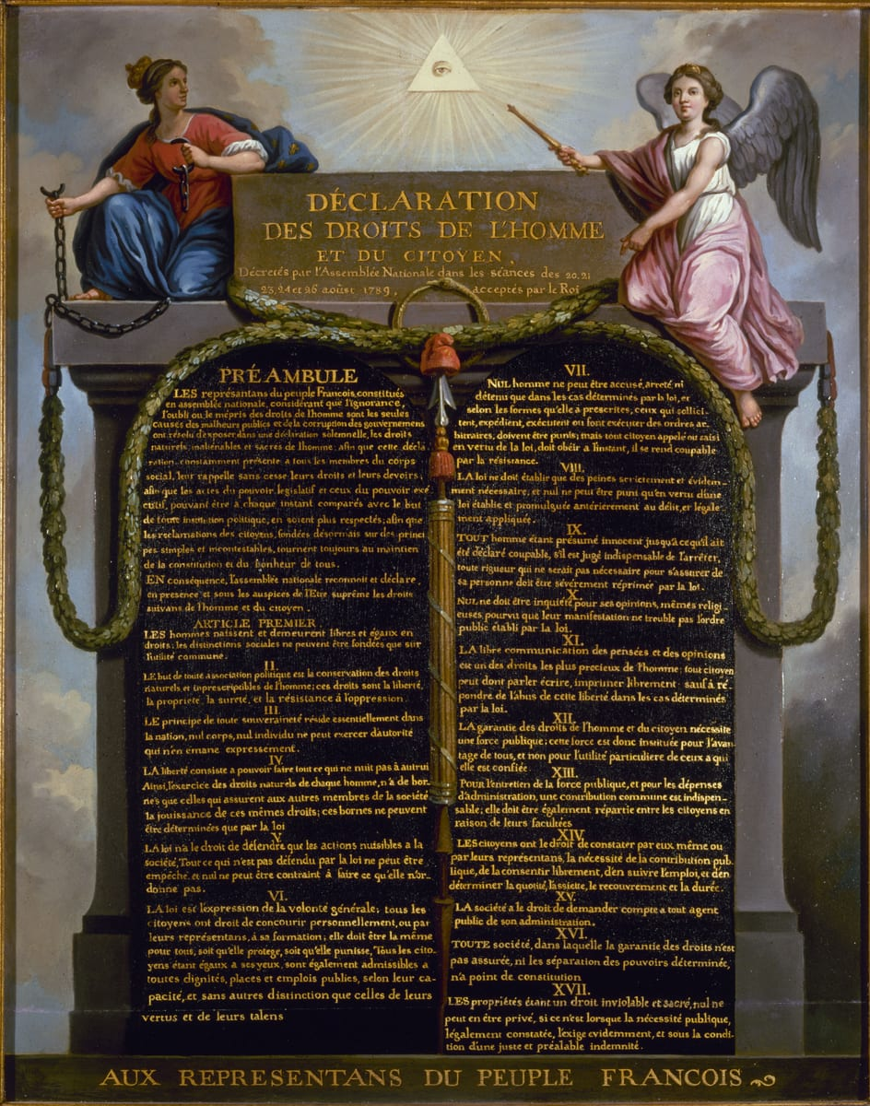
AUGUST 1789
Liberty, equality, fraternity
Article 1:
“Men are born and remain free and equal in rights.”
Natural rights:
liberty, property, security and resistance to oppression.
Power belongs
to the nation, not to the king.
India's Preamble also promises liberty, equality and fraternity.
Photo: Unknown · Public domain
Notes:
Read Article 1 aloud. Ask who it left out at the time (women, the enslaved in French colonies).

Slide 7
DISCUSS
Was the Reign of Terror the revolution defending itself, or betraying itself?
In 1793–94 thousands were executed as 'enemies of the revolution'. Take a side, and use one event from the timeline as evidence.
Notes:
Give 3 minutes in pairs, then take one view from each side. Push for evidence, not opinion.

Slide 8
What the revolution left behind
1
2
3
4
The end of absolute monarchy in France
The idea that power comes from citizens
Written rights for individuals
Ideals that shaped constitutions, including India's
Before next class Write five lines: which idea from 1789 matters most in your life today?
Notes:
Return to the opening question: what makes ordinary people revolt?

