Slide 1
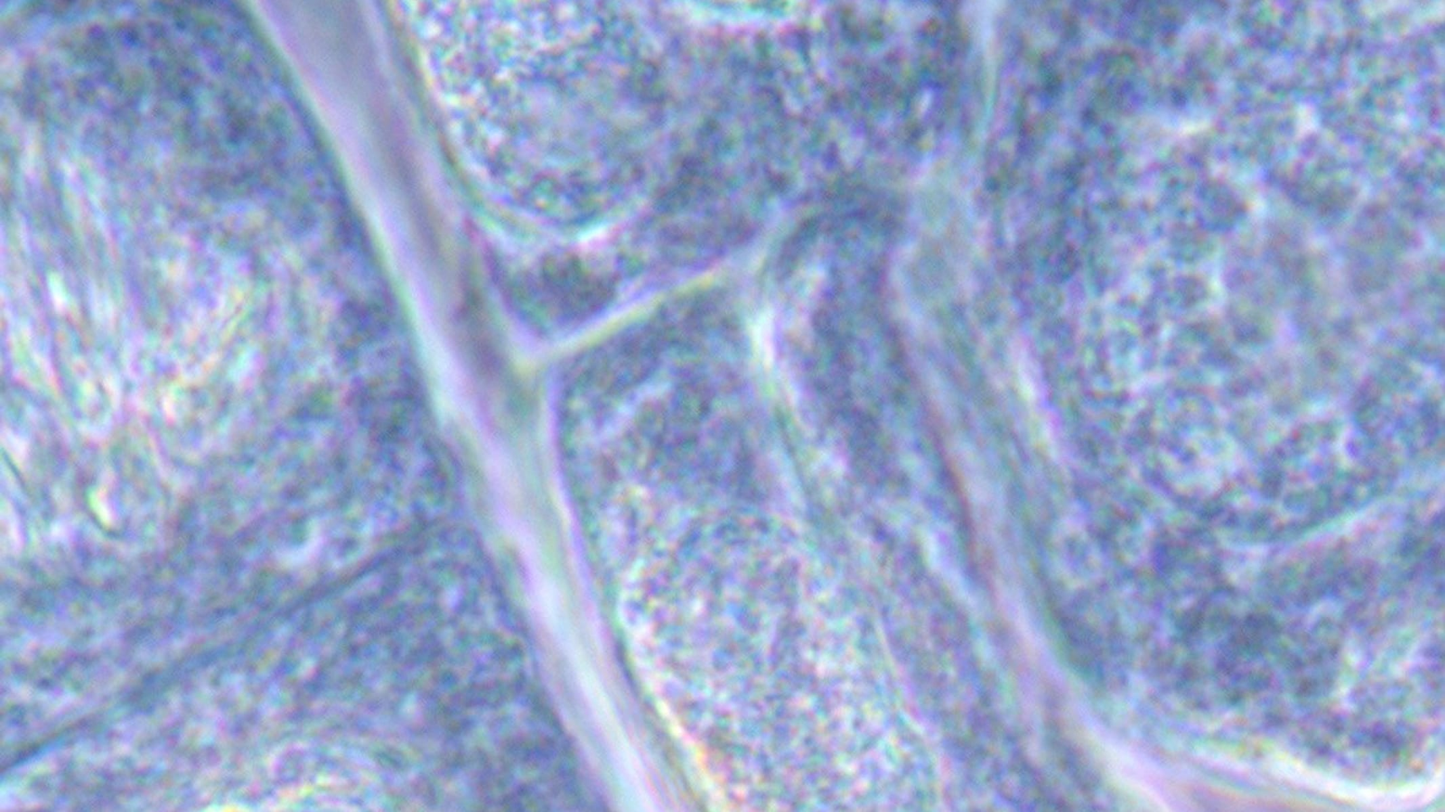
CLASS 11 · BIOLOGY
Mitosis vs Meiosis
Two ways a cell divides, and why your body needs both
Photo: Catfaster · CC BY-SA 4.0
Notes:
Show the micrograph: these are real onion root cells caught mid-division. Ask what stage a few of them are in.

Slide 2


Same start, different jobs
Mitosis
Meiosis
for growth and repair
for making gametes
One division
Two daughter cells
Genetically identical to the parent
Chromosome number stays the same (2n)
Two divisions in a row
Four daughter cells
Each genetically different
Chromosome number halves (2n → n)
Notes:
Ask for one example of each from the human body: skin repair (mitosis), sperm and egg (meiosis).

Slide 3
What happens to the chromosomes
Mitosis
Meiosis
1 division · 2 identical cells
2 divisions · 4 different cells
2n → 2n
2n → n
Simplified: one pair of homologous chromosomes shown, coloured by parent.
Notes:
Trace one red chromosome through each process. Where does it end up?

Slide 4
Side by side
 | Mitosis | Meiosis
Divisions | One | Two (meiosis I and II)
Daughter cells | Two | Four
Chromosome number | Unchanged (diploid) | Halved (haploid)
Genetic makeup | Identical to the parent | Different, due to crossing over
Where | Body (somatic) cells | Reproductive organs
Purpose | Growth, repair, asexual reproduction | Gametes for sexual reproduction
Notes:
Cover one column and quiz the class on the other.

Slide 5
WHY SIBLINGS LOOK DIFFERENT
In meiosis I, paired chromosomes swap pieces.
This crossing over, plus the random way pairs line up, means each gamete carries a new mix of genes. That is why no two siblings (except identical twins) are alike.
Notes:
Use two strips of coloured paper to show crossing over physically.

Slide 6


A common mix-up
Not quite
Actually
“Meiosis is just mitosis done twice.”
Meiosis I separates homologous pairs: that is what halves the number.
Meiosis II separates sister chromatids, like mitosis.
DNA is not copied again between the two divisions.
Notes:
Ask students to explain to a partner why the DNA isn't copied again. Listen for 'it would double the number back'.

Slide 7
Quick check
A human cell with 46 chromosomes undergoes meiosis. How many chromosomes does each gamete have?
46
23
A
B
92
12
C
D
Notes:
Answer: B. 23. Meiosis halves the chromosome number: 2n = 46 becomes n = 23. Fertilisation then restores 46.

Slide 8
Remember
1
2
3
4
Mitosis: 1 division, 2 identical cells
Meiosis: 2 divisions, 4 different cells
Meiosis halves the chromosome number
Crossing over creates variation
Before next class Draw both processes for a cell with 2n = 4, labelling each stage.
Notes:
Exit ticket: one difference, one similarity.

