Slide 1
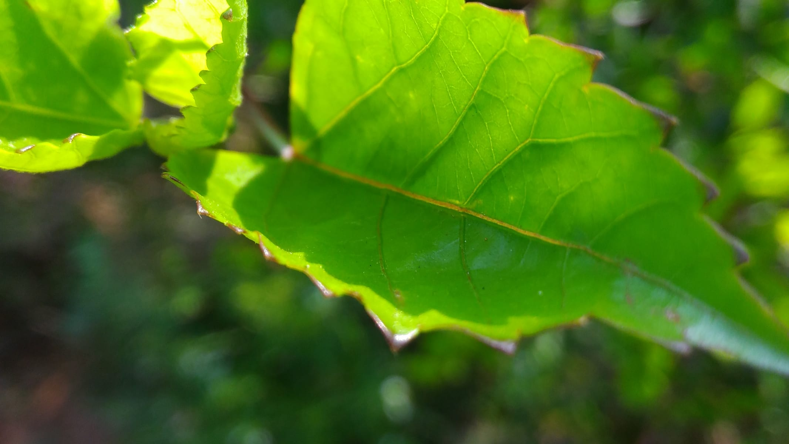
CLASS 7 · SCIENCE
Photosynthesis
How a leaf makes food out of light, water and air
Photo: Aurr123 · CC BY-SA 4.0
Notes:
Open by holding up a leaf. Ask: where does this plant get its food? Collect three answers before moving on.

Slide 2
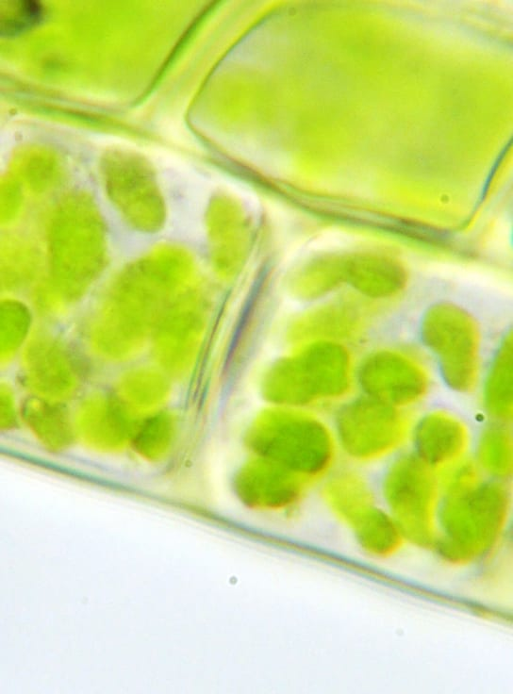



By the end of this lesson, you can…
Name what goes in and what comes out
Water and carbon dioxide in; glucose and oxygen out.
Point to where it happens
Inside chloroplasts, mostly in the cells of the leaf.
Explain why every food chain needs it
The energy in almost all our food first entered through a leaf.
Photo: Kelvinsong · CC BY 3.0
Notes:
Read the three goals aloud. Come back to them at the recap.

Slide 3




What goes in, what comes out
+
+
Water
Carbon dioxide
Glucose
Oxygen
taken up by the roots
from the air, via stomata
sunlight +
chlorophyll
food the plant uses and stores
released into the air
As a chemical equation: 6CO₂ + 6H₂O → C₆H₁₂O₆ + 6O₂
Chlorophyll is the green pigment that traps light. It is why leaves look green.
Notes:
Build the equation on the board tile by tile. Ask where each input comes from before revealing the label.

Slide 4
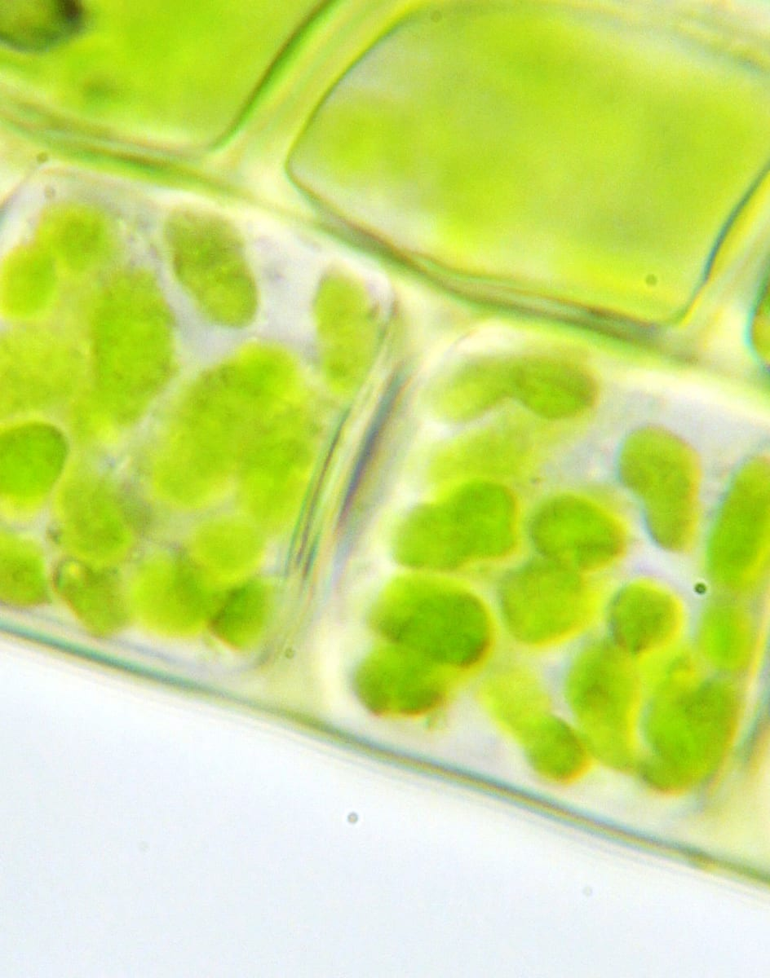
INSIDE THE LEAF
Tiny green factories
Chloroplasts
the small green bodies in leaf cells where food is made.
Chlorophyll
the pigment inside them that captures sunlight.
Stomata
tiny pores on the leaf that let carbon dioxide in and oxygen out.
Each green dot in this photo is one chloroplast, seen through a microscope.
Photo: Kelvinsong · CC BY 3.0
Notes:
If you have a microscope and a moss leaf, show the real thing. Otherwise, zoom into this photo.

Slide 5



How a leaf does it, step by step
01
02
03
04
05
Roots absorb water
Stomata take in CO₂
Chlorophyll traps light
Glucose is made
Oxygen is released
It travels up the stem to the leaves.
Carbon dioxide enters from the air.
Light energy is captured in the chloroplasts.
Water and CO₂ are joined using that energy.
It leaves through the stomata.
Plants also use some of the glucose straight away, and store the rest as starch.
Notes:
Ask pairs to act out the five steps in order, one student per step.

Slide 6
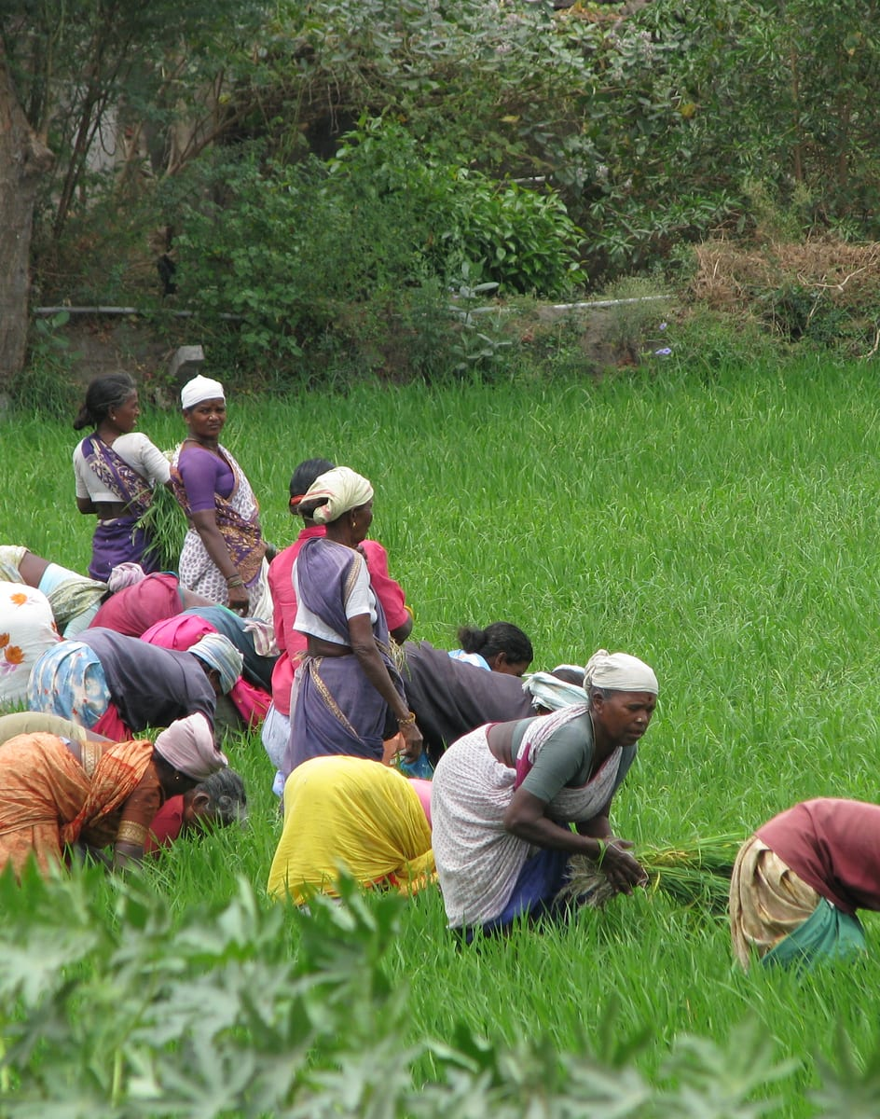
IN REAL LIFE
Your rice is stored sunlight
Leaves make glucose
all season long, from sunlight, water and air.
The plant stores it
as starch in the grain.
We eat the grain
and use that stored energy to move, grow and think.
Every food chain on land starts with photosynthesis.
Photo: McKay Savage · CC BY 2.0
Notes:
Ask: name a food that did not start with a plant. Discuss why even milk and eggs trace back to plants.

Slide 7
Quick check
Which gas do leaves take in to make their food?
Oxygen
Carbon dioxide
A
B
Nitrogen
Hydrogen
C
D
Notes:
Answer: B. Carbon dioxide. Leaves take in carbon dioxide through stomata and combine it with water to make glucose. Oxygen is what they give out.

Slide 8
Remember
1
2
3
4
Water + carbon dioxide go in
Sunlight and chlorophyll power it
Glucose and oxygen come out
It feeds almost every food chain
Before next class Put a potted plant in a dark cupboard for two days. What happens to its leaves, and why?
Notes:
Close by returning to the three goals from slide 2.

