Slide 1
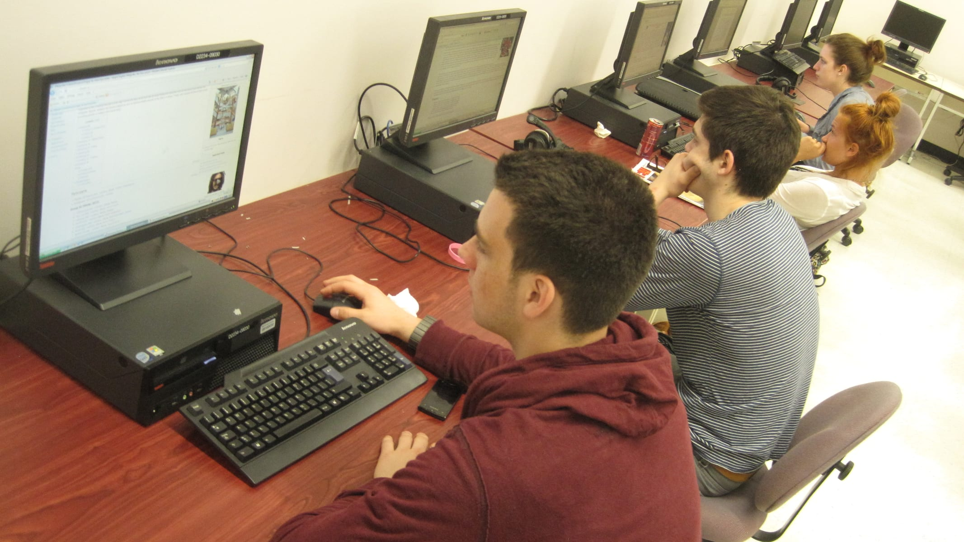
BCA · PROGRAMMING IN PYTHON
for loops in Python
Write it once, let Python repeat it
Photo: MCPearson · CC BY-SA 3.0
Notes:
Ask: what's the most boring thing you've had to repeat on a computer? That's what loops are for.

Slide 2
The same job, two ways
# Without a loop
print("Welcome, Asha")
print("Welcome, Ravi")
print("Welcome, Meera")
# With a loop
for name in ["Asha", "Ravi", "Meera"]:
print("Welcome,", name)
Same output
Both print three greetings.
Less to change
Add a name to the list, not a new line.
Scales
Works the same for 3 names or 3,000.
Notes:
Run both versions live. Then add a fourth name to each and compare the effort.

Slide 3
Anatomy of a for loop
for item in collection:
# runs once per item
do_something(item)
for … in
Python's keywords. Read it as 'for each item in…'.
item
A name you choose. It holds the current value.
collection
A list, a string, a range: anything you can step through.
: and indent
Everything indented under the colon is the loop body.
Notes:
Have students say the loop out loud in English before writing it.

Slide 4
Counting with range()
You write | Python gives you | Why
range(5) | 0, 1, 2, 3, 4 | Starts at 0, stops before 5
range(2, 8) | 2, 3, 4, 5, 6, 7 | Starts at 2, stops before 8
range(0, 10, 3) | 0, 3, 6, 9 | Steps of 3
range(5, 0, -1) | 5, 4, 3, 2, 1 | Counts down
The stop value is never included. That one rule prevents most off-by-one bugs.
Notes:
Ask students to predict each row before revealing it.

Slide 5
Worked example: class average
marks = [72, 85, 64, 90, 58]
total = 0
for m in marks:
total = total + m
average = total / len(marks)
print("Average:", average)
total = 0
Start the running sum before the loop.
total + m
Each pass adds one mark.
len(marks)
Divide after the loop, not inside it.
OUTPUT
Average: 73.8
Notes:
Trace the loop on the board in a table: m, total. 72→72, 85→157, 64→221, 90→311, 58→369; 369 / 5 = 73.8.

Slide 6
The bug everyone writes once
Looks right
Fixed
for i in range(1, 10):
print(i)
for i in range(1, 11):
print(i)
Prints 1 … 9
Prints 1 … 10
Meant to print 1 to 10, but the stop value is never included.
Make the stop value one past the last number you want.
Notes:
Ask students to find the bug before showing the fix.

Slide 7
Quick check
What does this print? for i in range(1, 6, 2): print(i)
1 3 5
1 2 3 4 5
A
B
2 4 6
1 3 5 7
C
D
Notes:
Answer: A. 1 3 5. Start at 1, step by 2, stop before 6: 1, 3, 5.

Slide 8
Remember
1
2
3
4
for item in collection: repeats the body
range(start, stop, step) stops before stop
Set totals before the loop
Indentation is the loop body
Before next class Write a loop that prints the 7 times table from 7 × 1 to 7 × 10.
Notes:
Exit ticket: predict the output of range(10, 0, -3).

