Slide 1
Natural language processing in social media
Student’s Name: Vaani Bisht
Section: DS -1
Course - Btech
Branch: CSE(AI & DS)
University Roll no.: 2024130
Name of the mentor:
Dr. Neha Tripathi
Associate Professor

Slide 2
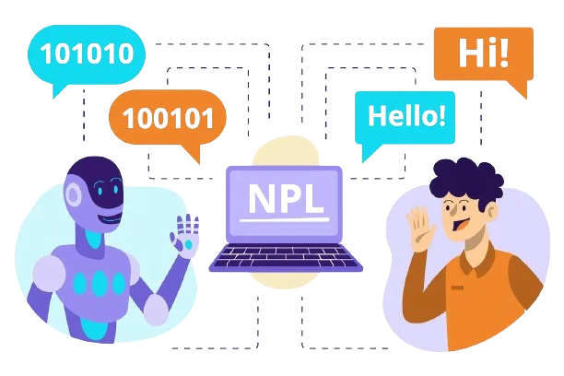
Introduction
Ability of a computer program to understand human language as it is spoken and written.
Gives computers the ability to interpret, manipulate, and comprehend human language.
In essence, NLP bridges the gap between human communication and machine understanding, making it possible for computers to interact with language in a meaningful and intelligent way.
Example: Language translation, Chatbots and Virtual Assistants, Predictive text.

Slide 3
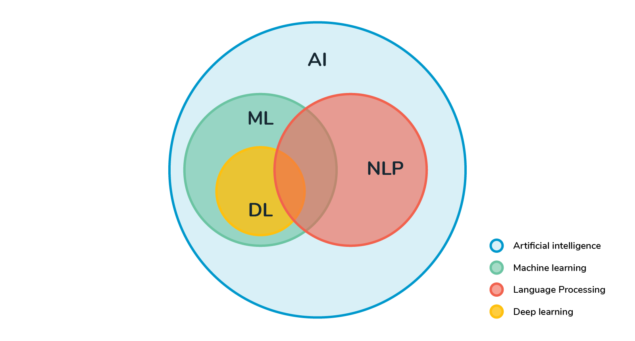
Problem statement
The primary goal of this project is to analyze tweets and determine their emotional tone or sentiment.
Using Python, the text data is classified into three categories: Positive, Neutral, and Negative, reflecting the overall attitude conveyed in each tweet

Slide 4
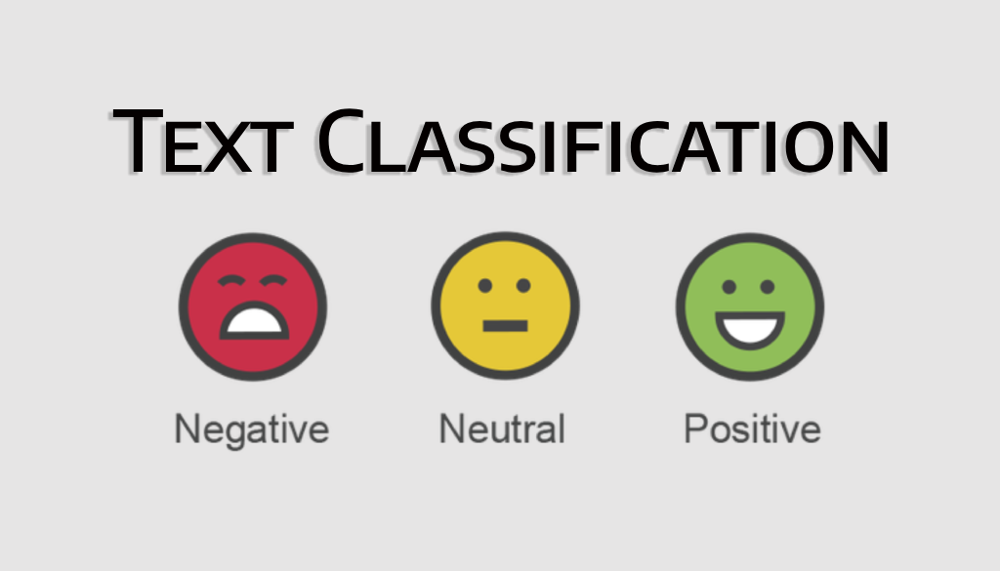

Slide 5
methodology
TOKENIZATION –
Tokenization is the process of splitting text into individual units (tokens) such as words, phrases, or sentences. These tokens serve as the foundation for text analysis and NLP tasks.
DATA CLEANING-
Data cleaning prepares raw text data by removing noise and irrelevant elements. Clean data is essential for accurate analysis.
REMOVAL OF STOP WORDS–
Stop words are commonly used words (e.g., "and," "is," "the") that typically carry little meaning in NLP tasks.
CLASSIFICATION AND SCORING-
This step involves building a machine learning model to classify text and evaluate its performance.

Slide 6
methodology
The language that is used is Python and its libraries. This project is done using the analysis of the data of 31k-41k tweets.
Various modules of the python is imported like pandas, numpy, matplotlib.pyplot, seaborn etc. The re module is to check for the similar patterns occurring in the data. The warnings which can be generated are ignored using warning.filterwarnings(‘ignore’).
After collecting the tweets preprocessing is done to remove twitter handles and “@” symbols which will not contribute anything towards analysis of the sentiments of the tweets.
Words whose length is not more than 3 are also ignored and removed because the do not reflect to any sentiments.
It is converted into Bag of words which represents the occurrence of a particular word. It does not takes into account the order in which each word occur.
The words are generated using these word clouds which represents each root word in a particular size to show the occurrence of that particular root word in the tweets made by the people.

Slide 7
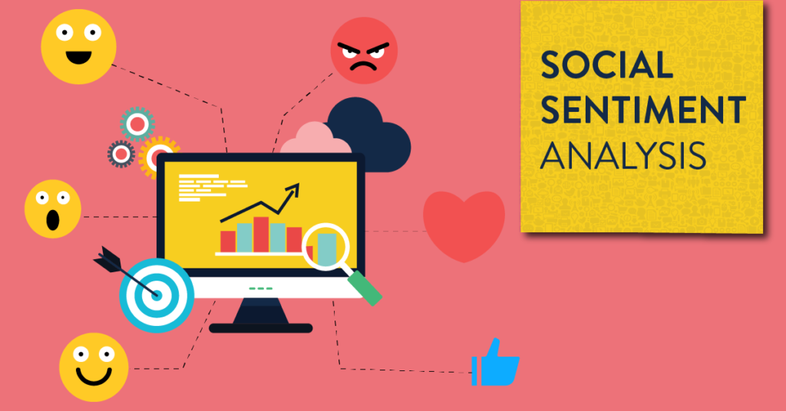
methodology
Hashtags are represented as the list of keys of the tweet and the count is the corresponding value of that key and stored in the tokenized_tweet variable
The graph shows the relation between the particular hashtag and its frequency of first the positive words and then of the negative hashtags.
The dataset is split into X and Y label for training. Finally the accuracy of the model is predicted by importing accuracy_score from sklearn.metrics which help to predict the performance of a particular model or tool
Logistic Regression is used to predict the result using the previous information from data as the basis and generates a specific output.

Slide 8
Result and Discussion
The results of the Natural Language Processing (NLP) project on social media data revealed several significant insights.
During preprocessing, techniques like tokenization, stop word removal, and text cleaning effectively reduced noise and enhanced data quality, enabling meaningful analysis.
The sentiments of the tweets is successfully analyzed with 0.94 accuracy and finally the graphs are plotted between the root words extracted from the tweets and their count or the frequency.
Various modules of the python is imported like pandas, numpy, matplotlib.pyplot, seaborn etc.
Logistic Regression is used to predict the result using the previous information from data. Using word cloud those words are generated which are given 0 as positive label and 1 as negative label.

Slide 9
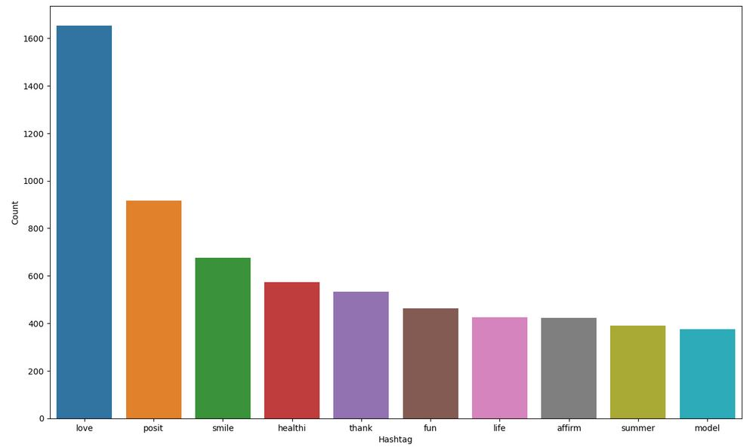
Result and Discussion
The graph shows the relation between the particular hashtag and its frequency of first the positive words. The sentiments of the tweets is judged by knowing the frequency of each positive and then comparing the count from every graph.

Slide 10
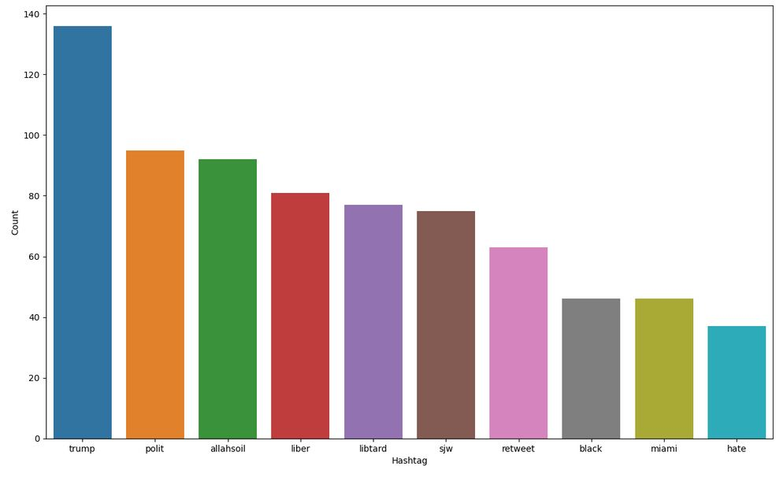
Result and Discussion
The graph shows the relation between the particular hashtag and its frequency of first the negative words. The sentiments of the tweets is judged by knowing the frequency of each negative and then comparing the count from every graph.

Slide 11

Conclusion & future work
Effectiveness of NLP in Social Media Analysis.
Importance of Preprocessing.
Visualization of Results.
The methods and insights can be applied to real-world scenarios like brand monitoring, political sentiment analysis, and public opinion tracking.
Develop algorithms to detect and interpret sarcasm, irony, and idiomatic language.
Expand the scope of the project to include analysis of social media posts in multiple languages.
Optimize models for faster inference to handle live data.
Use sentiment analysis on social media data to understand public concerns during health crises like pandemics.

Slide 12
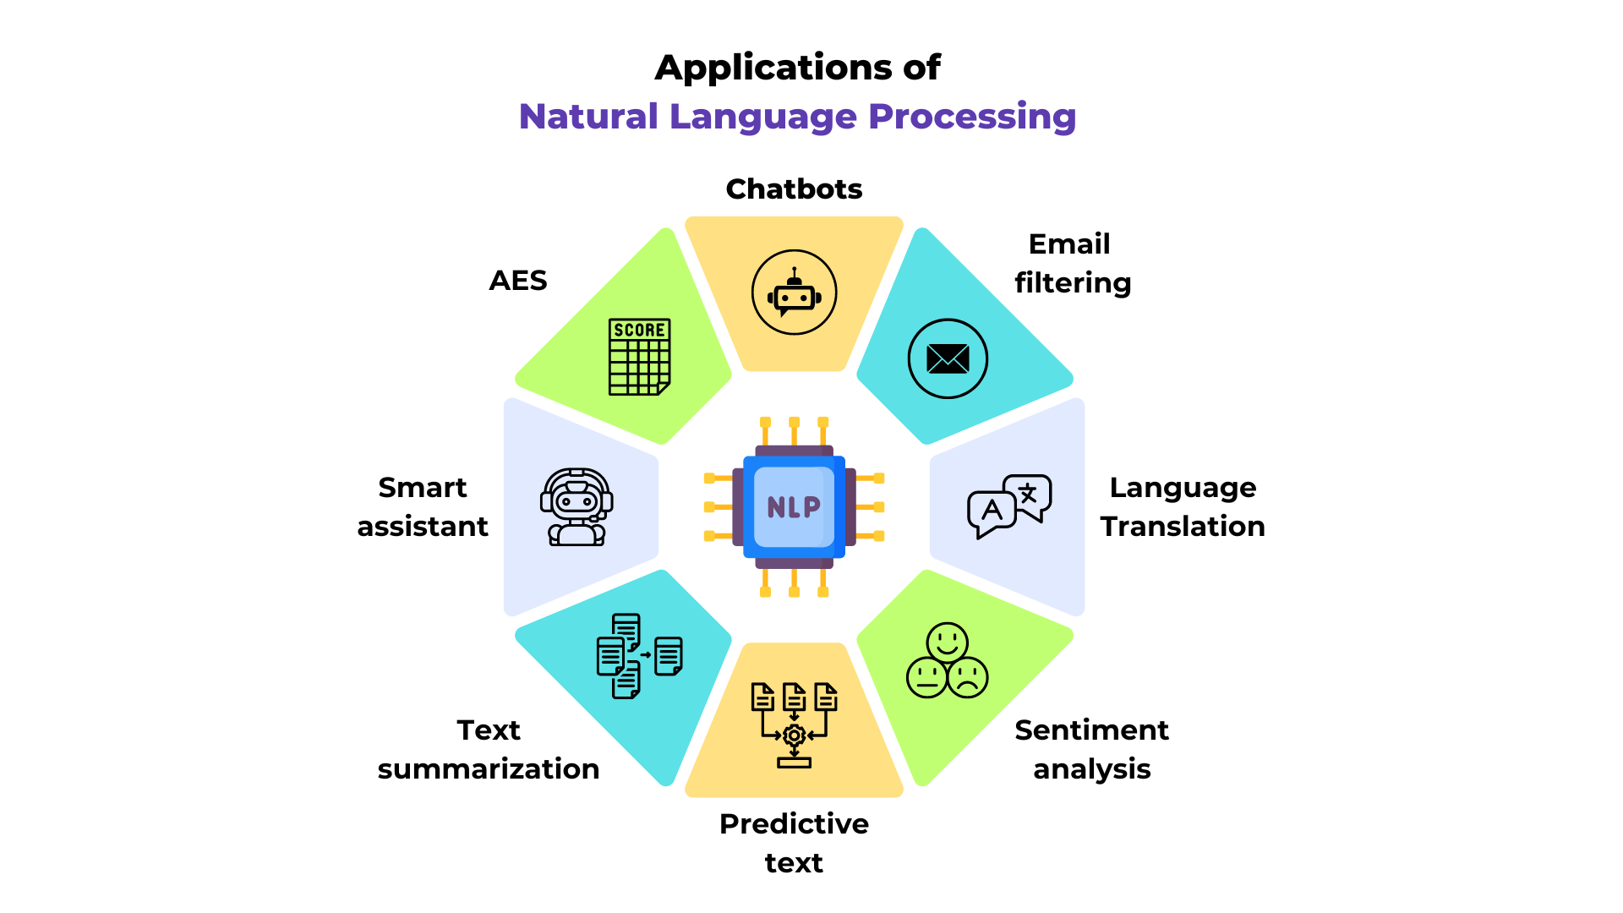
APPLICATIONS

Slide 13


