Slide 1



Climate Risk and Disaster Management using AI/ML

Slide 2

Understand climate risks and their socio-economic impacts.
Build a model to assess vulnerability and risk levels.
Demonstrate real-time analysis through Jupyter Notebook.
Learning Objectives
GOAL
Apply machine learning for disaster prediction and management.
To create a predictive system that helps in assessing and mitigating the impact of natural disasters such as floods, hurricanes, wildfires, and earthquakes.
Source :
www.freepik.com/

Slide 3
Python (Pandas, NumPy, Matplotlib, Scikit-learn)
Jupyter Notebook (.ipynb)
GitHub for version control
Data visualization tools (heatmaps, bar graphs)
Tools and Technology used

Slide 4
Data Collection → Historical disaster datasets
Data Preprocessing → Cleaning, feature encoding, normalization
Model Building → Feature selection, ML model training (Regression/Classification)
Evaluation → Accuracy, precision, recall metrics
Visualization → Risk distribution & disaster trends
Methodology

Slide 5
Problem Statement:
Climate change has significantly increased the frequency and severity of natural disasters, including floods, hurricanes, wildfires, and earthquakes. Despite advancements in technology, there is still a lack of accurate and scalable predictive systems, which leads to delayed responses, poor preparedness, and higher economic and human losses. To address this gap, there is a pressing need for an AI-driven solution that can analyze climate and disaster-related data, predict risks effectively, and support policymakers and disaster management authorities in making proactive, data-driven decisions.

Slide 6
Developed an ML model to predict climate risk index.
Incorporated disaster-specific features (Magnitude, Fatalities, Economic Loss, Location).
Built interactive visualizations to aid decision-making.
https://github.com/Vaarshhh/Week-1
Solution:

Slide 7
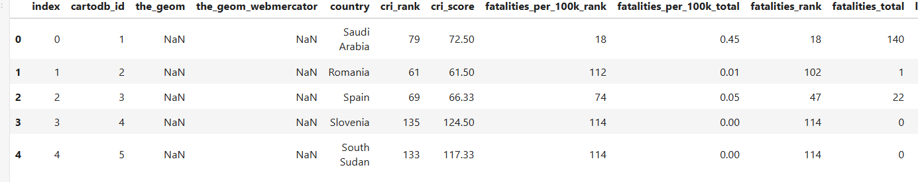
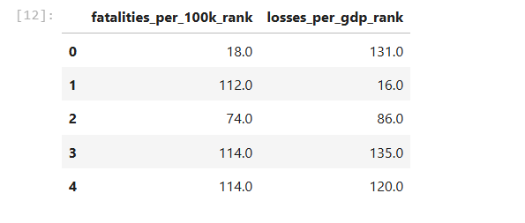
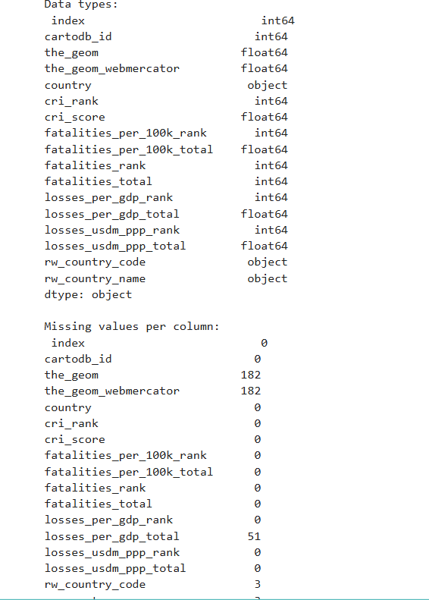
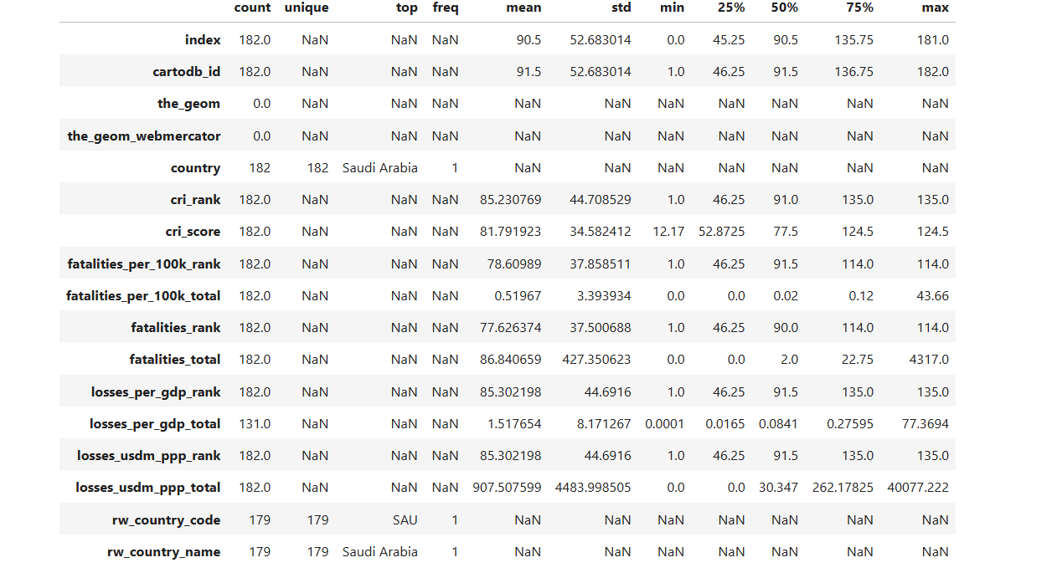
Screenshot of Output:

Slide 8
Conclusion:
The system improves early warning and preparedness.
Helps policymakers and disaster management authorities in resource allocation.
Future scope: Integration with IoT sensors and real-time weather APIs.

