Slide 1

WELCOME
Imagineer
Imagine It. Print It. Hold It.

Slide 2
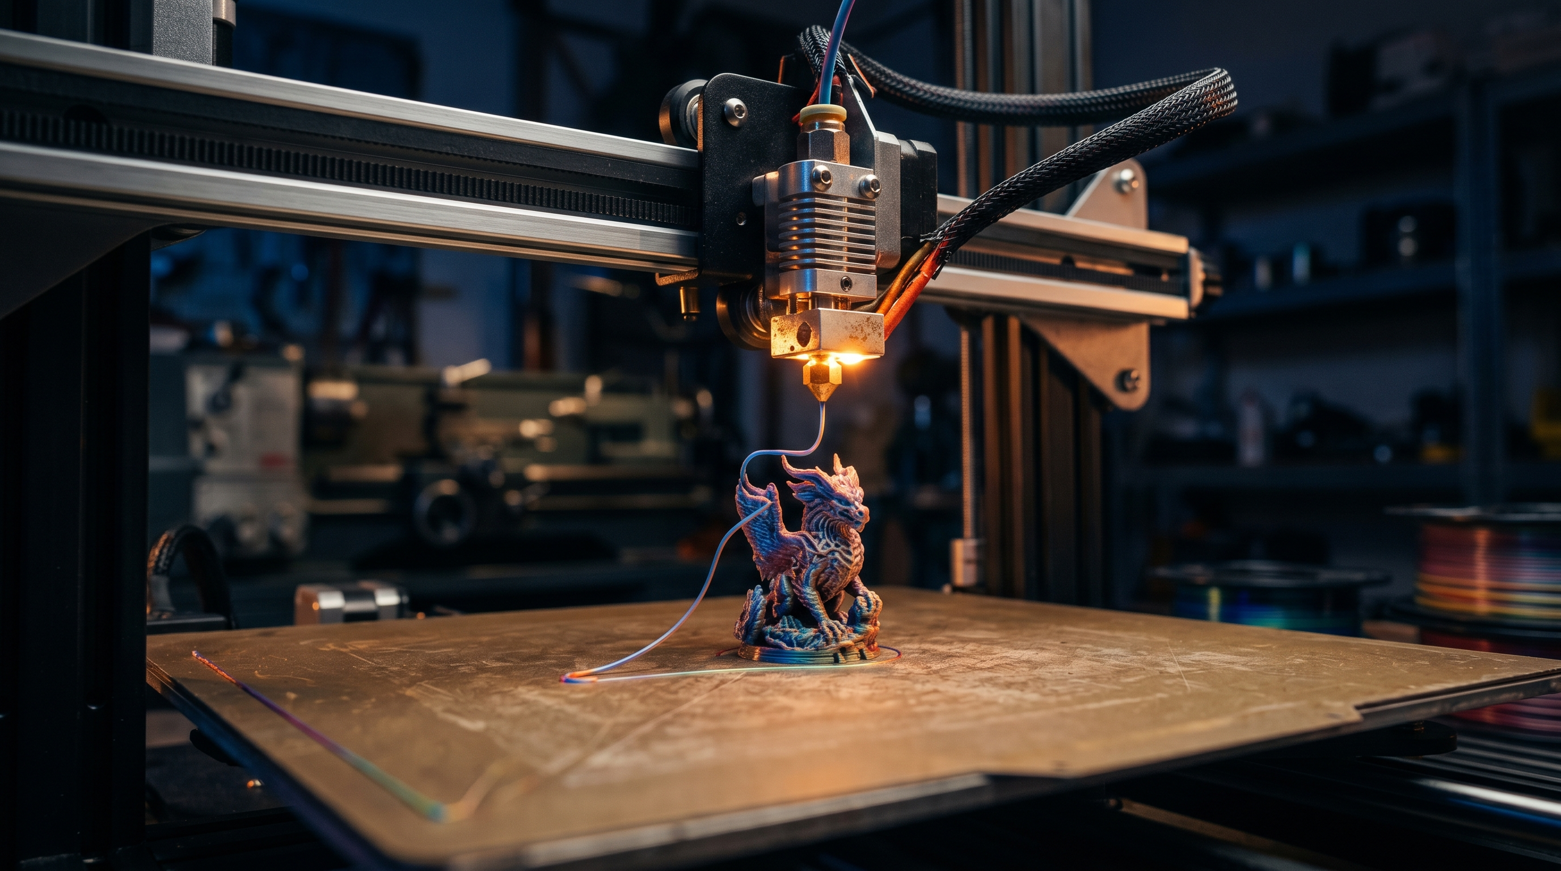
BUSINESS PLAN • MANAGEMENT BRIEFING
Imagineer
Imagine It. Print It. Hold It.
On-demand AI-powered custom 3D printing for everyone.
Prepared for Management • April 2026

Slide 3
THE OPPORTUNITY
Generative AI has finally made physical creation as effortless as imagining it.
We are the first consumer-grade service to operationalize this end-to-end — from text or photo input to a finished printed object delivered to the customer's door.

Slide 4
THE PROBLEM
Imagination has a hardware tax
Today, turning an idea into a physical object requires three things most people don't have:
1
CAD skills Modeling tools have a steep learning curve and weeks-to-months mastery time.
2
Specialized software Slicing, support generation, and print preparation require technical expertise.
3
Hardware investment A capable printer costs $500–$2,000 — plus filament, calibration, and maintenance.
4
Patience for failure Even experienced makers experience 15–25% print failure rates.
Imagineer • Business Plan
2

Slide 5
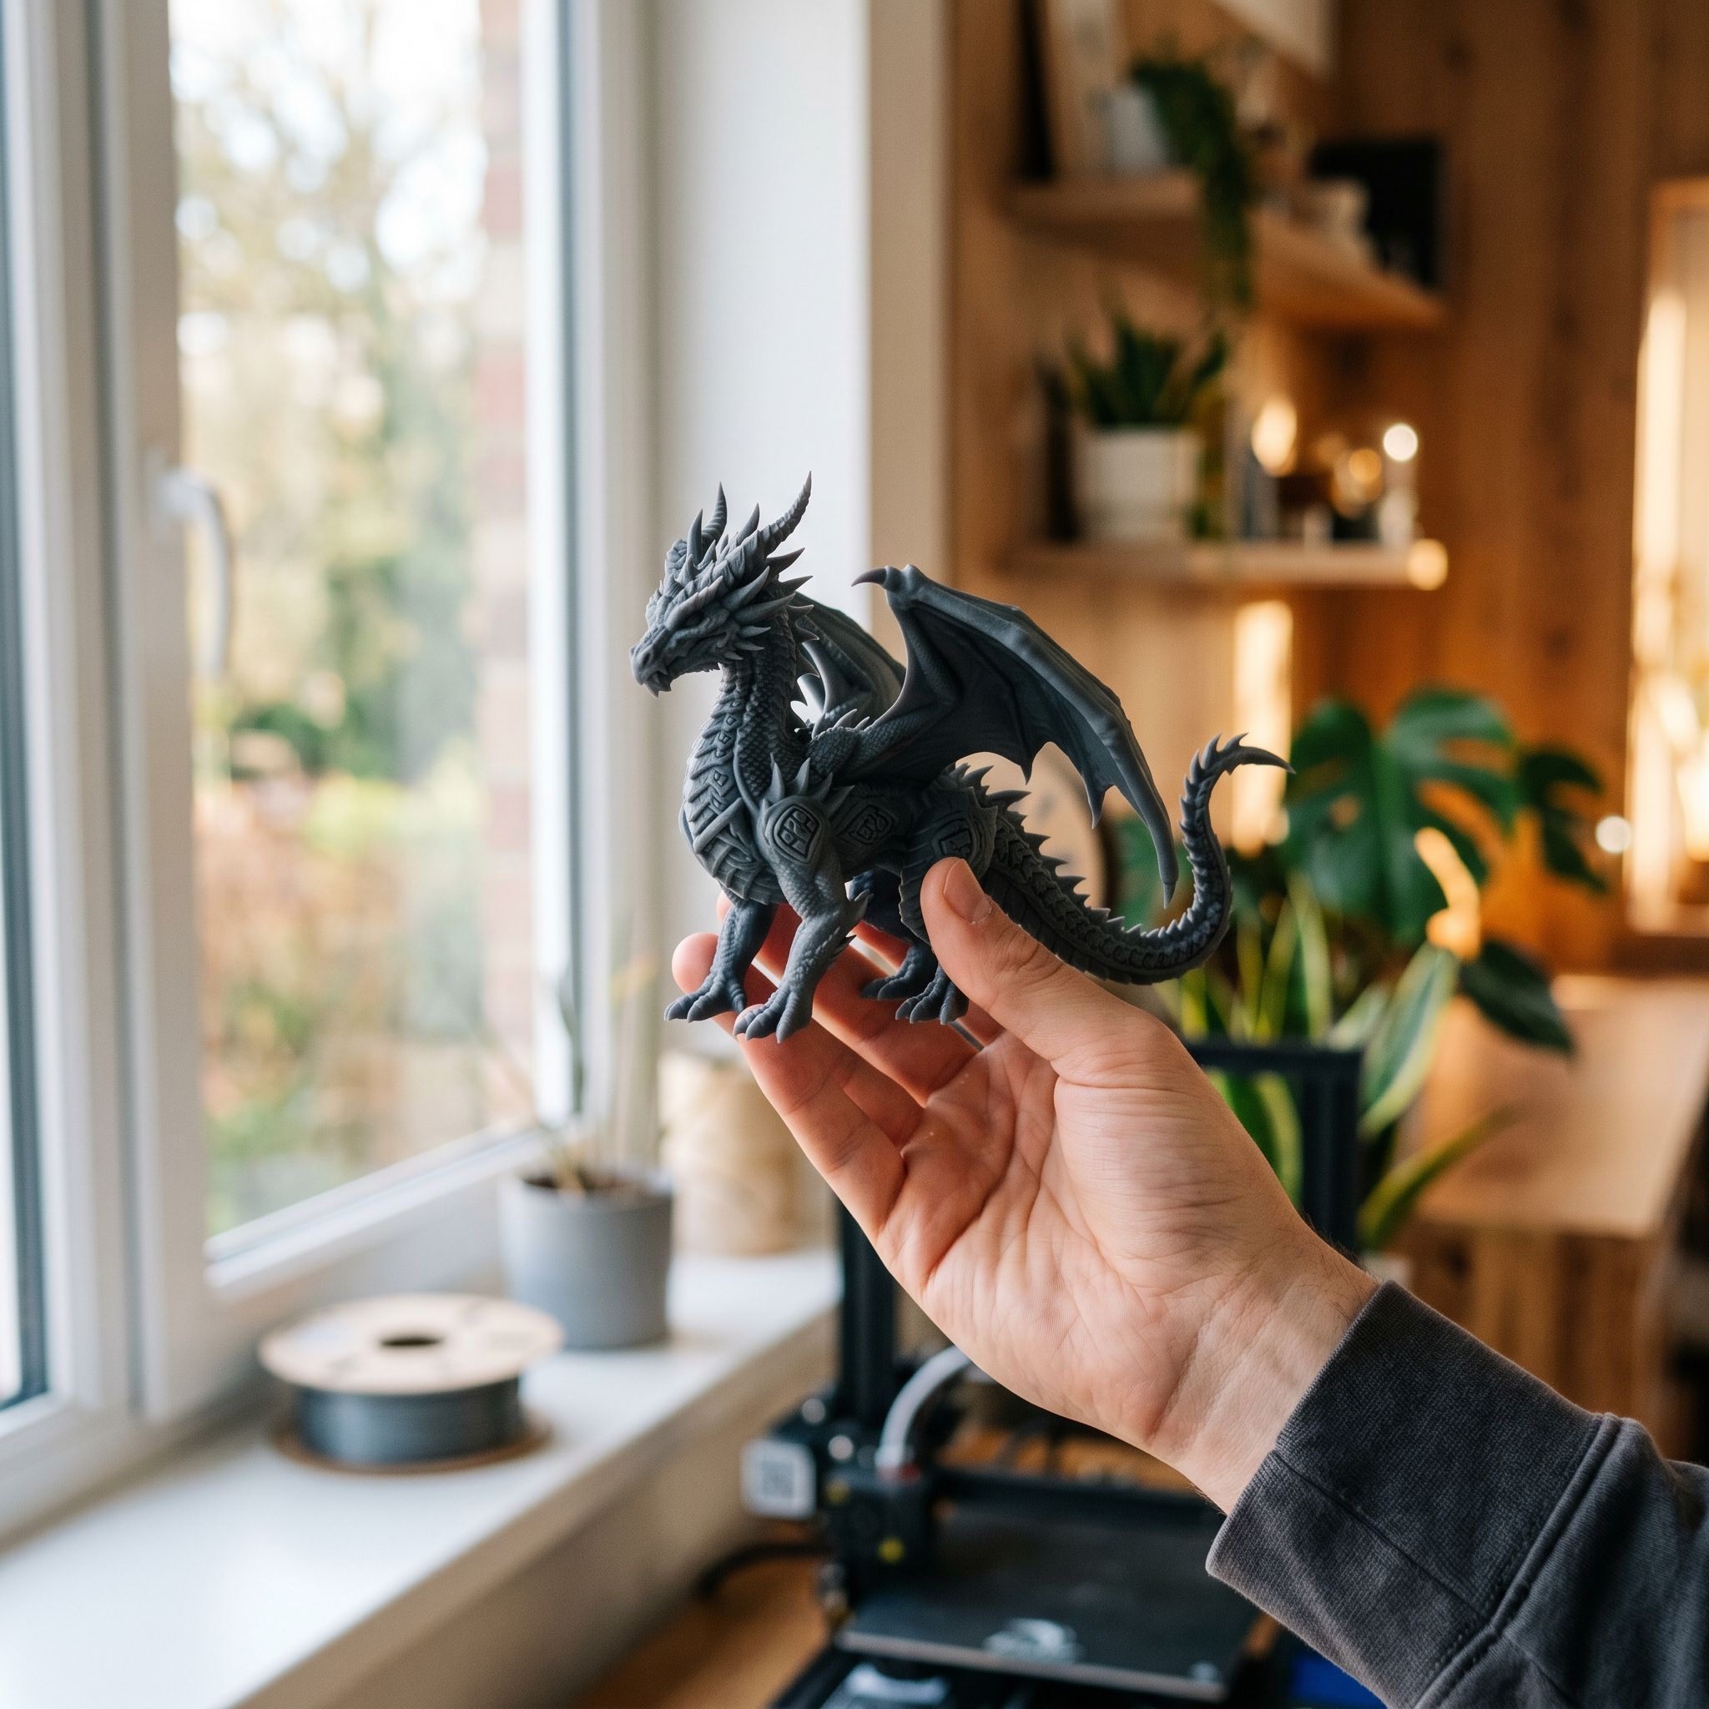
THE SOLUTION
Describe.
Preview.
Receive.
Customers describe what they want or upload a reference image. Our AI generates a 3D model. They preview, refine, and approve it directly in the browser. We print, finish, and ship the piece.
Imagineer • Business Plan

Slide 6
HOW IT WORKS
From text to physical object in six steps
1
2
3
4
5
6
Describe
Generate
Preview
Configure
Approve
Receive
Type or upload
an image
AI creates
a 3D model
Inspect in
the browser
Pick material,
color, size
One-click
order
Print, finish,
and ship
Average end-to-end turnaround: 5–7 days at launch → 2–3 days by Year 3
Imagineer • Business Plan
4

Slide 7
MARKET OPPORTUNITY
A market that's been waiting for a usable on-ramp
$18B
20%+
$420M
Global 3D printing market by 2030
Annual growth rate (CAGR)
Imagineer's serviceable market
Adjacent markets: $30B+ custom gifts • $2B+ tabletop gaming • $5B+ rapid prototyping

Slide 8
WHO WE SERVE
Four core segments, one shared frustration
The Hobbyist
The Gift Buyer
$45 avg order
$60 avg order
Tinkerers and makers who want decorative and functional one-offs without owning a printer.
Occasion-driven shoppers seeking truly personalized presents — birthdays, weddings, holidays.
The Tabletop Gamer
The Designer
$85 avg order
$120 avg order
D&D, Warhammer, and board-game enthusiasts ordering custom miniatures and terrain pieces.
Indie designers and freelancers prototyping product ideas without the overhead of a CAD pipeline.
Imagineer • Business Plan
5

Slide 9
COMPETITIVE POSITION
Why we win
Status Quo
Imagineer
✕ Requires CAD modeling skills
✓ Just describe in plain language
✕ Buy a printer + supplies upfront
✓ $0 capex — pay only per object
✕ Service bureaus take 2–3 weeks
✓ Delivered in 2–7 days end-to-end
✕ Print failures cost the customer
✓ Print failures are our problem
✕ Piecing together vendors and steps
✓ One trusted source, fully integrated
Our moat compounds: a data flywheel of approved prints, vertical operations, and brand trust as the consumer category leader.
Imagineer • Business Plan
6

Slide 10
UNIT ECONOMICS
Margins that scale
$58
48%
30%
$25
Average order revenue
Gross margin
Contribution margin
Customer acquisition cost
Across all material tiers
After materials, labor, equip
After acquisition cost
Blended across channels
Imagineer • Business Plan
7

Slide 11
FINANCIAL PROJECTIONS
Revenue trajectory & path to profit
EBITDA-positive in Year 3 at $8.4M revenue • Y5: $35.5M revenue, $6.6M EBITDA • Driven by repeat purchase rate growth and CAC efficiency
Imagineer • Business Plan
8

Slide 12
ROADMAP
24-month execution plan
Q1–Q2
Q3–Q4
Q5–Q6
Q7–Q8
Foundation
Soft Launch
Scale & Optimize
Series A Ready
Close seed, deploy
first 12 printers,
closed beta
Public ordering,
resin & multi-color,
4,000+ orders
Subscription,
partnerships,
failure rate <5%
Satellite facility,
$300K+ MRR,
clean unit economics
Imagineer • Business Plan
9

Slide 13
THE ASK
$2.5M seed round
To fund 24 months of focused execution toward a Series A from a position of strength.
USE OF FUNDS
Production capacity
$900K • 36%
Engineering & AI team
$700K • 28%
Marketing & acquisition
$450K • 18%
Inventory & supplies
$200K • 8%
Operations & G&A
$150K • 6%
Reserve / contingency
$100K • 4%

Slide 14
WHY NOW
Three trends converging at the same moment
01
Generative AI is print-ready
Text-to-3D quality crossed the production threshold in 2024–2025 — for the first time, AI output is consistently usable without expert clean-up.
02
Personalization is the premium
Consumers consistently pay 30–60% more for customized goods. Mass-produced is increasingly seen as the cheap option.
03
On-demand is the expectation
Sub-week delivery is now the baseline across consumer categories. The market is primed for fast custom physical goods.
Imagineer • Business Plan
10

Slide 15
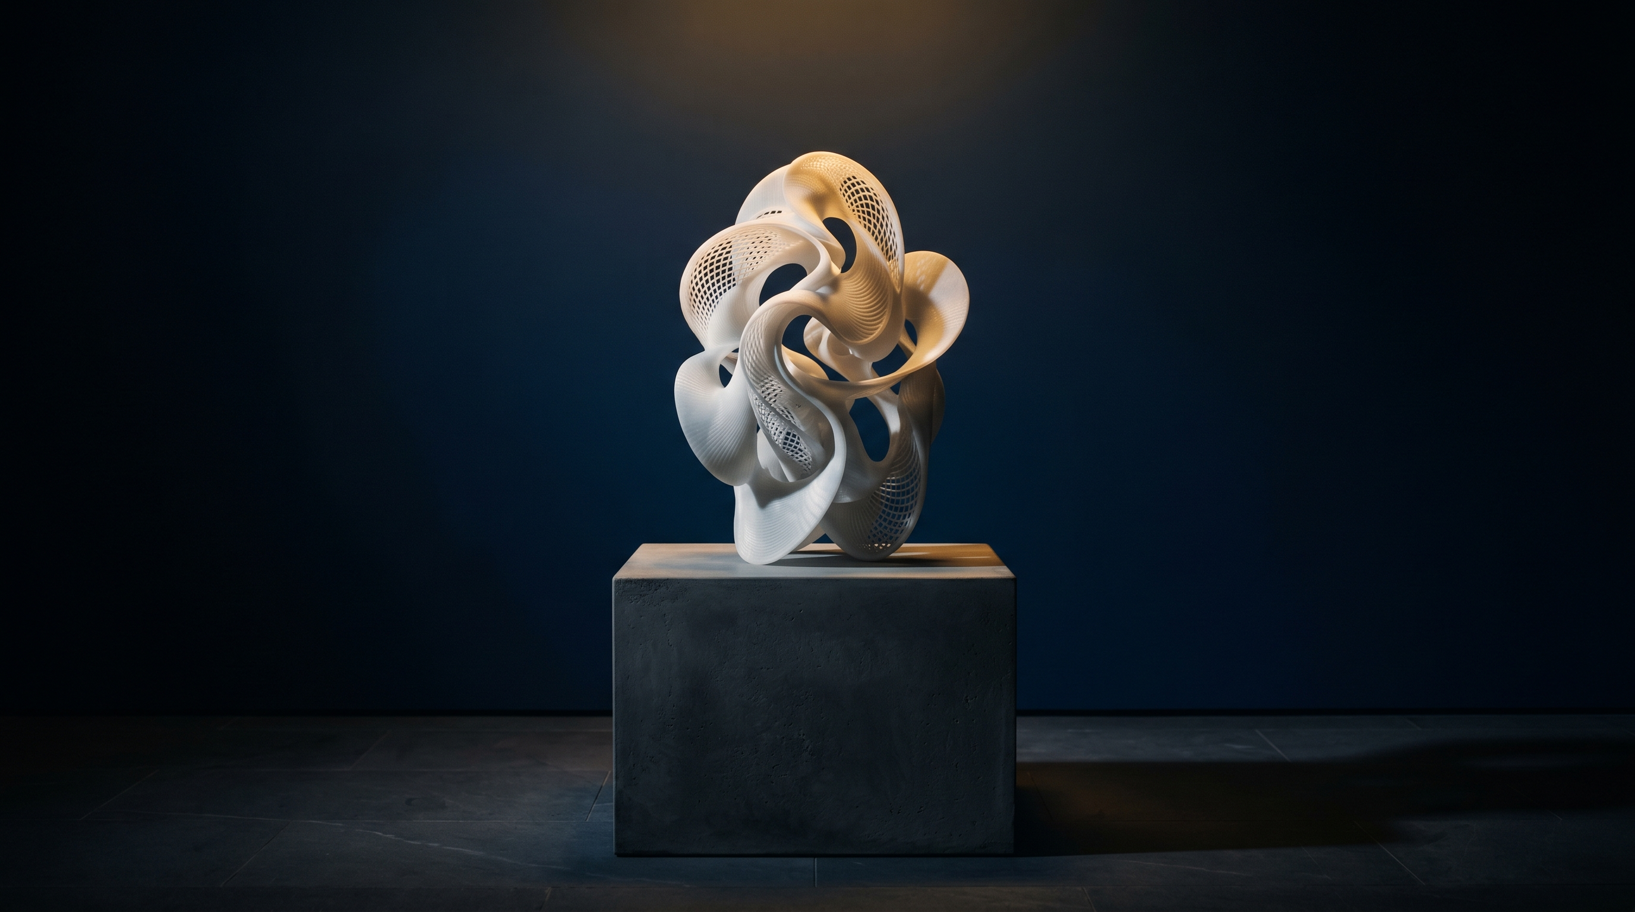
THE INVITATION
Help us make physical creation
as effortless as imagination.
Imagineer • Imagine It. Print It. Hold It.
founders@imagineer.io • Confidential

