Slide 1
AI Based Diabetes Prediction System
Innovation
Anto Charles V au210921104002
2109-Loyola Institute of Technology

Slide 2
Abstract
An AI-based diabetes prediction system is designed to assess an individual's risk of developing diabetes using machine learning techniques and relevant health data. The system involves data collection, preprocessing, model selection, training, and deployment to provide early diagnosis and preventive care. Collaboration with healthcare experts and continuous monitoring ensure its accuracy and usability in clinical settings.

Slide 3
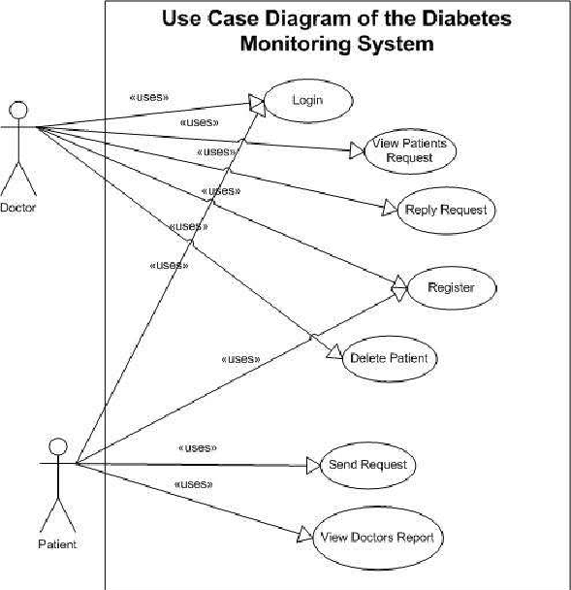
Case Diagram

Slide 4
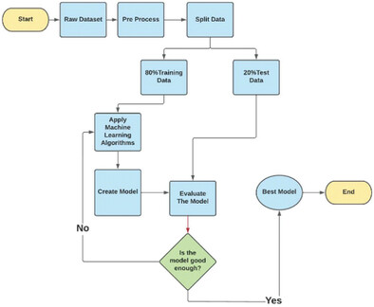
Flow chart

Slide 5
Requirement Analysis
Requirement analysis is the process of identifying, documenting, and understanding the needs and constraints of a project or system to define what it must accomplish. It involves gathering, prioritizing, and documenting functional and non-functional requirements to guide the project's development or solution's design. This phase is crucial for successful project planning and implementation.

Slide 6
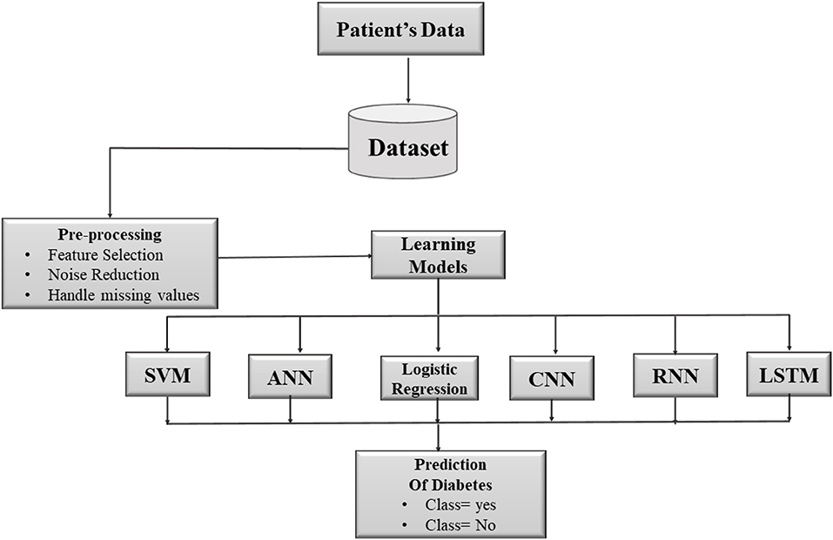
Tools

Slide 7
Goal
Early Detection
Public Health Impact
AI Based Diabetes prediction system
Reduced Health Costs
Prevention

Slide 8
Basic code of Tensor flow
import tensor flow as tf
node1 = tf.constant(3, dtype=tf.int32)
node2 = tf.constant(5, dtype=tf.int32)
node3 = tf.add(node1, node2)
sess = tf.compat.v1.Session()
print("sum of node1 and node2 is :",sess.run(node3))
sess.close()

Slide 9
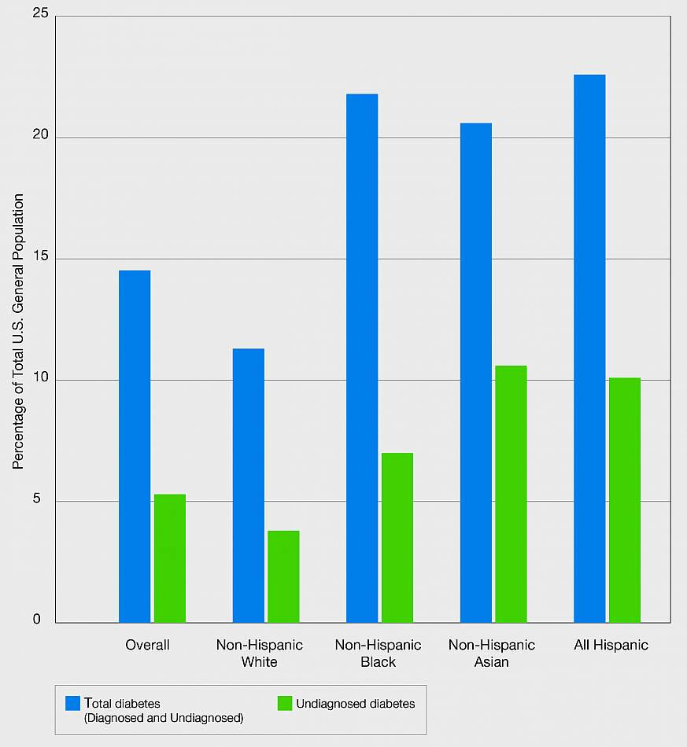
Predictive Analysis

Slide 10
References
Machine Learning Based Diabetes Classification and Prediction for Healthcare Applications (hindawi.com)
(PDF) DIABETES PREDICTION USING MACHINE LEARNING ALGORITHMS (researchgate.net)
Diabetes prediction using machine learning and explainable AI techniques - PMC (nih.gov)

Slide 11
Conclusion
In conclusion, an AI-based diabetes prediction system aims to proactively identify individuals at risk of diabetes, provide personalized recommendations, and contribute to early intervention and prevention efforts, ultimately improving healthcare outcomes and reducing associated costs.

Slide 12
Thank You

