Slide 1
C9555:
A survival guide to simulations
Week 10
William Morton– Nov 30th, 2023

Slide 2
Learning Objectives
Recap from last week
The minimum components of MD
When to use coarse graining
Determine translatable properties from experiment to MD

Slide 3
Review
Where can we improve on AlphaFold using MD?
  Hint: What are the three types of proteins we looked at?

Slide 4
System Components
How do we start a MD simulation?
  Component 1?
  Component 2?
  Component 3?

Slide 5
Review
Where can we improve on AlphaFold using MD?
  Hint: What are the three types of proteins we looked at?
How can we speed up simulations with larger folded regions
  Consequences?

Slide 6
The issue with protein folding
  Let's pretend we have the perfect force-field
  Alpha Fold has given us a good guess
  We start our simulation... What happens?

Slide 7
Two Methods (in MD)
Parallel Tempering (Replica Exchange)
  Generally applicable
  Highly dependent on parameters
Hierarchial Chain Growth
  Lower computational resource
  Ideal for disordered proteins

Slide 8
Two Methods (in MD)
Parallel Tempering (Replica Exchange)
  What energy are we measuring?
Hierarchial Chain Growth
  What biological considerations do we have?

Slide 9
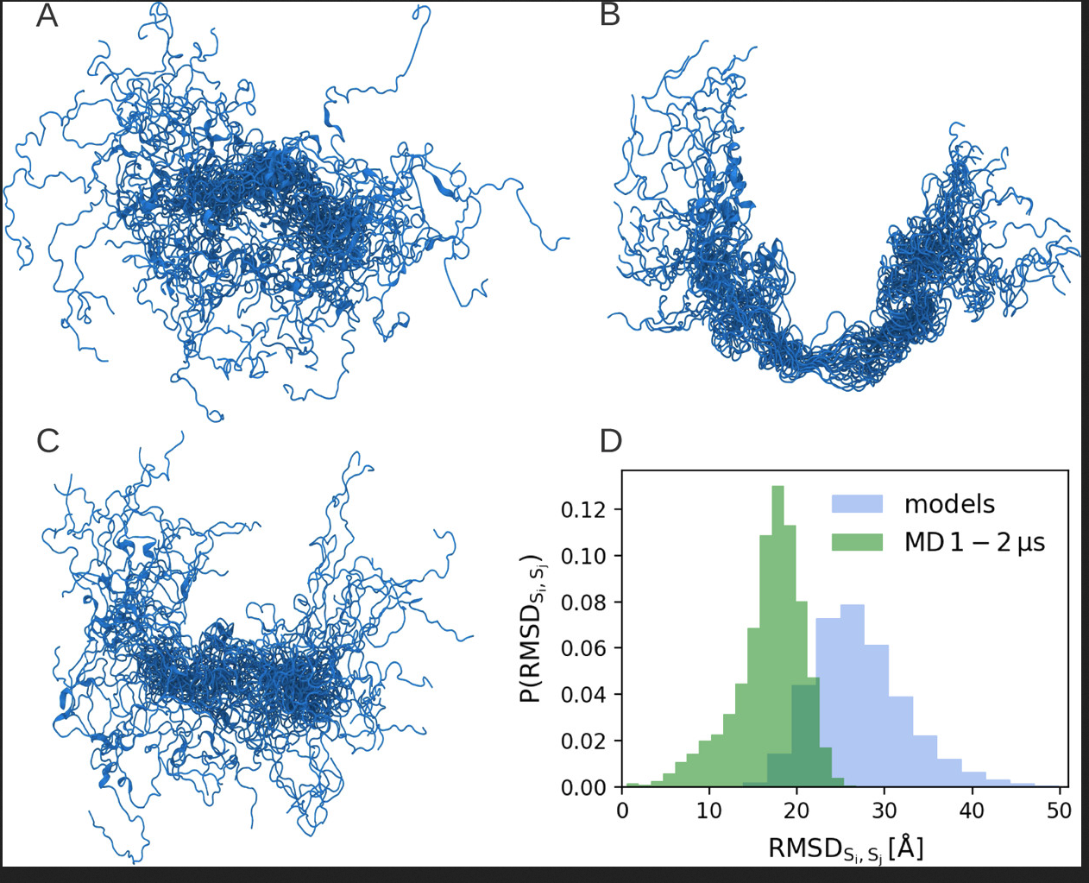
HCG
MD 10ns
MD 100ns

Slide 10
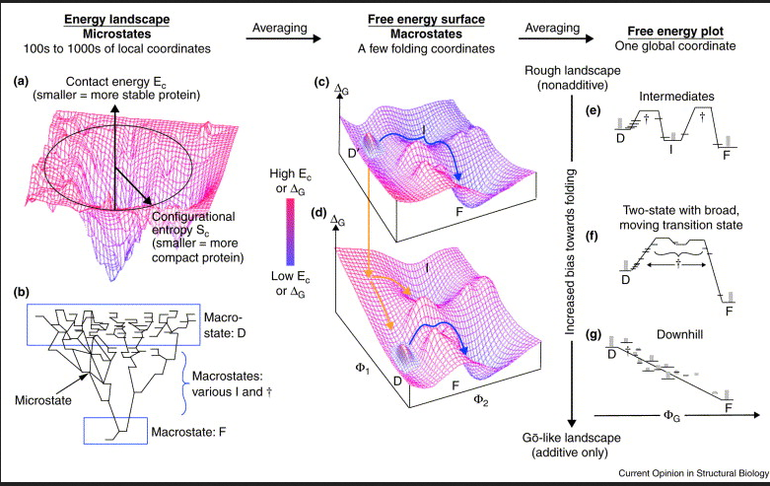

Slide 12
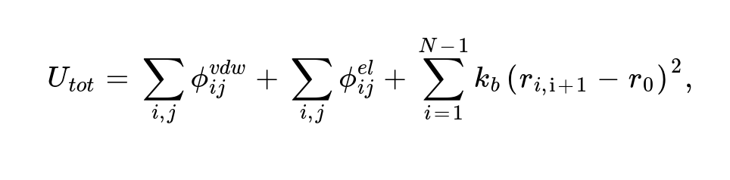
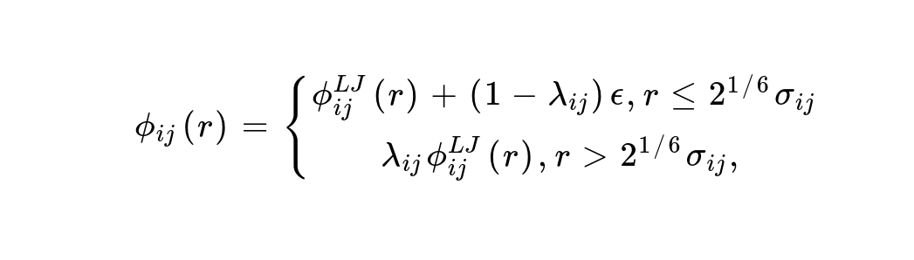
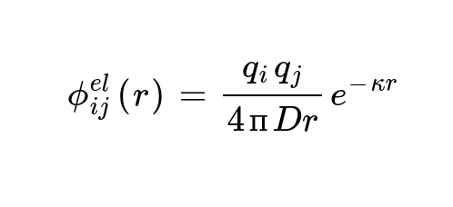
Example: Carbon Alpha Models

Slide 13
In today's practical...
Part 1
  You are given two parameterizations for the Carbon-Alpha models
  Find the biggest difference in amino acid interactions
    Running the notebook as written may not be the fastest way...
  https://colab.research.google.com/drive/1nWnm-Kpq6qmenbbGM3o6eMTAIidUxpdf?usp=sharing
Part 2
  Answer the questions in the Leonard-Jones notebook
  https://colab.research.google.com/drive/1rkW6sEzNF1HIWEuhih9uvpIiyqPm0f0I?usp=sharing

