Slide 1
Making Drugs in silico,
Part 2
CEITEC
at Masaryk University
Notes:
Hello and welcome
My name is xxx and I am xxx of CEITEC.
It is my great pleasure to welcome you today and to introduce CEITEC – Central European Institute of Technology.
The story of CEITEC is much like science itself – exciting and in some ways unpredictable. So let me share with you some key moments of CEITEC’s history, its key achievements of the present and the outlook for its future.
1

Slide 2
Get ready for practical session
A bit of things to be done:
  mv ~/survival_guide_simulations_c9555/week05/ ~/C9555/
  rm –rf {SURVIVAL_GUIDE_DIRECTORY}
    BE SURE THAT PREVIOUS COMMAND (MV) WAS SUCCESSFUL BEFORE DELETING
https://gitlab.com/denysbiriukov/survival_guide_simulations_c9555

Slide 3
Get ready for practical session
git clone https://gitlab.com/denysbiriukov/survival_guide_simulations_c9555.git
cd survival_guide_simulations_c9555/
cd week06/
bash ../infinity/infinity-temp.sh
cp /storage/brno14-ceitec/shared/softmatter/mr_dizzy/teaching/ .

Slide 4
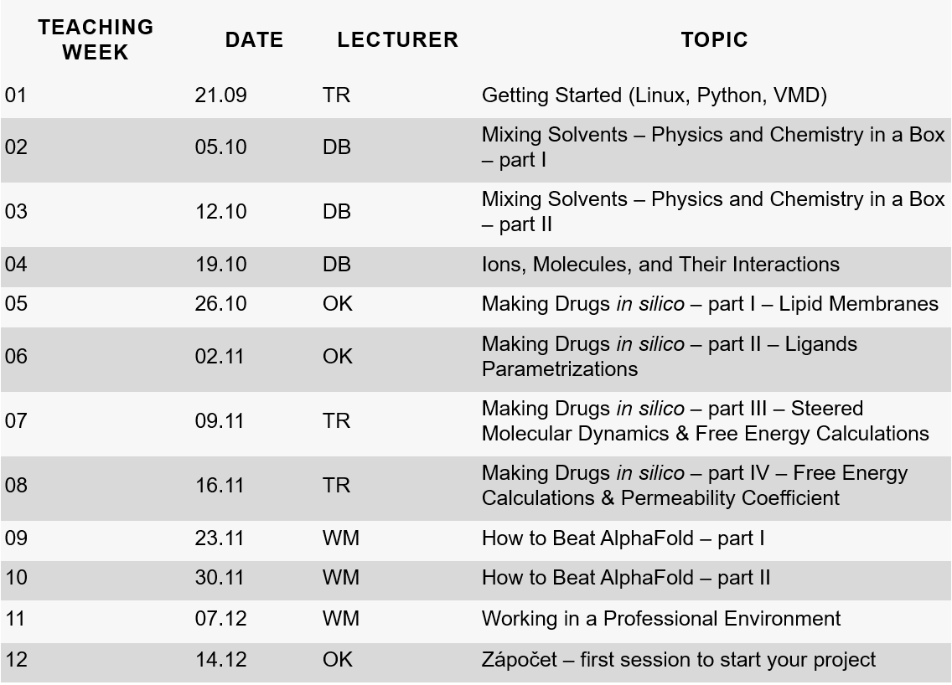

What is today?
Week 06:
Making Drugs in silico Part II
CEITEC at Masaryk University
4
Notes:
fix the table for typos and new changes
4

Slide 5
Today program
Lecture (1st hour)
Partial charges: what are they and how to get them
Modeling “new” molecules
Force field: the good, the bad, and the ugly
Practical session (2nd and 3rd hours)
Build ligand/drug and get a working force field for it
Derivation of partial charges using CGenFF, SwissParam, or Antechamber
Free energy of solvation using Accelerated Weight Histogram (AWH) method
CEITEC at Masaryk University
5
Notes:
add sexy picture
5

Slide 6
More a discussion than monologue
If you have a quick question to catch up, raise your hand and ask – we will try to fix it and bring you back
If quick answer does not help, let’s chat during a break or after
CEITEC at Masaryk University
6
Notes:
maybe, polish a bit
6

Slide 7
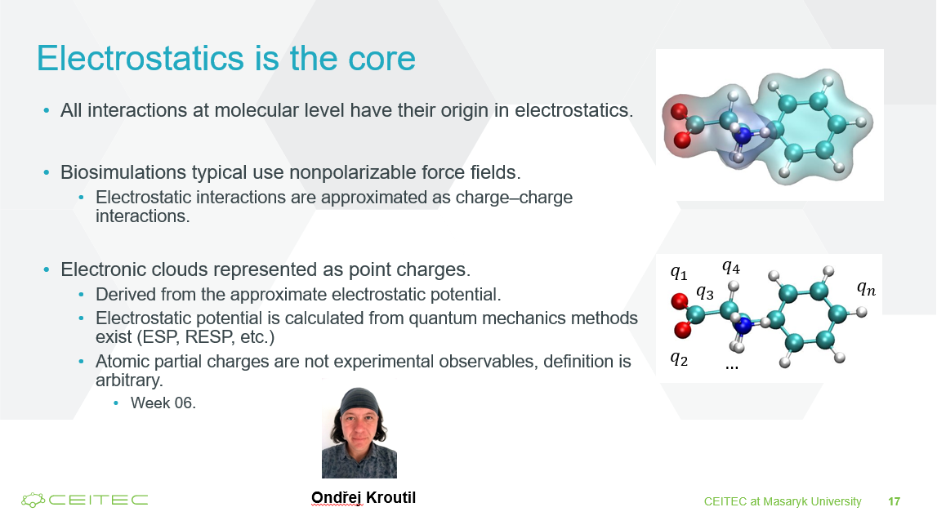
Partial charges: what are they and how to get them
Week 04

Slide 8
Partial charges: what are they and how to get them
Partial charges are a representation of the distribution of electric charge within a molecule or a portion of a molecule.
  Used to describe the electrostatic interactions between atoms in the simulation
  Typically assigned to individual atoms in a molecule.
  In a neutral molecule, the sum of all the partial charges should add up to zero.

Slide 9
Partial charges: what are they and how to get them
Different force fields derive partial charges different way:
Charge Fitting Methods (examples):
  AMBER RESP Charges
  CHARMM ChelpG Charges
  MM2, MM3 Gasteiger-Marsili Charges
  ReaxFF Reactive Force Field - Charges derived from bond-order analysis
  UFF Gasteiger-Marsili Charges (Universal Force Field)

Slide 10
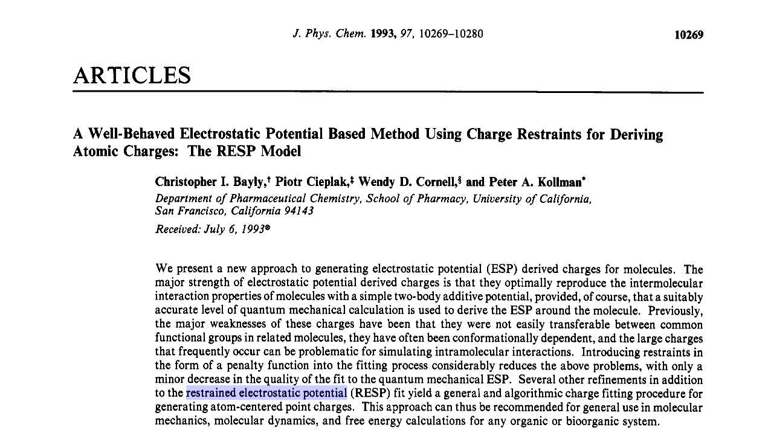
Partial charges: what are they and how to get them
RESP = Restrained ElectroStatic Potential
Main concept how to derive partial charges in AMBER FF (!!!)
More info in:
  J. Phys. Chem, 1993, 97, 10269-10280.

Slide 11
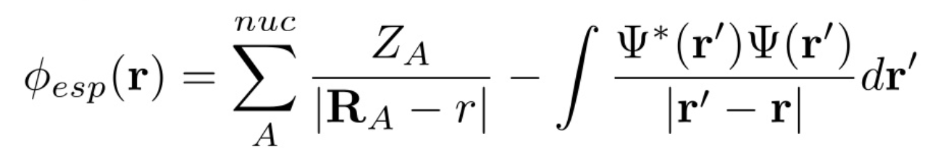
Partial charges: what are they and how to get them
Partial charges are NOT physical observable quantities.
Potential (ESP) is fitted just outside of the vdW radius from wavefunction (QM calc.) according to:
Least squares algorithm derives atom centered charges that best reproduces MEP.
Potential calculated on large number of points on 4 shells of surfaces defined by {1.4, 1.6, 1.8, 2.0} x VDW radii.

Slide 12
Partial charges: what are they and how to get them
Starting structure from PDB
Perform
Geometry Optimization (HF-631G*)
Gaussian
Compute
Electrostatic Potential Charges
(pop=mk)
Gaussian
Fit ESP charges
(RESP)
Antechamber
Convert (ACPYPE)
MD simulation (Gromacs)
MD simulation (AMBER)

Slide 13
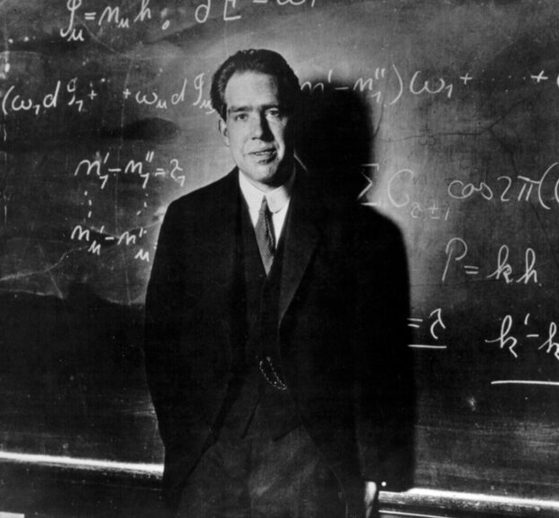
Partial charges: what are they and how to get them
Standalone molecule
– EASY PEASY!!!
Optimize geometry in Gaussian
Make single point calculation in Gaussian to get ESP
Run Antechamber to derive FF params (one command line)
Export to amber style parameter and input coordinate files
Convert using Acpype
TASK1 -> Prepare FF parameters for hydrogen phosphate (HPO42-)

Slide 14
Partial charges: what are they and how to get them
GAUSSIAN input:
%mem=7000MB -- memory specification
%nproc=4 -- number of processors (max 16 reccom.)
%chk=resp_b3lyp-opt -- checkpoint file name spec.
#P B3LYP/6-31G* opt scf=tight freq=NoRaman -- method/basis set, optimization, tighter
convergence crit., time-saving option
hpo42- -- custom name
-2 1 -- charge, spin
P 1.183 1.676 0.035 -- element symbol, xyz (Å)
O 1.834 0.348 0.618
O -0.399 1.584 0.122
O 1.612 1.834 -1.489
O 1.708 2.964 0.817
H 1.676 0.244 1.577

Slide 15
Partial charges: what are they and how to get them
GAUSSIAN keywords:
#P HF/6-31G* Geom=check SCF=Tight Pop=MK IOp(6/33=2, 6/50=1,6/41=10,6/42=17)
Geom=check – takes coordinates from checkpoint file
SCF=Tight – SCF procedure convergence criterion
Pop=MK - Produce charges fit to the electrostatic potential at points selected according to the Merz-Singh-Kollman scheme
IOp 6/33=2 makes Gaussian write out the potential points and the potentials - Do not change.
IOp 6/50=1 generates data file for Antechamber
IOp 6/41=10 specifies that 10 concentric layers of points are used for each atom.
IOp 6/42=17 specifies the density points in each layer - 17 gives 2500 points per atom. For larger molecules it may be necessary to reduce this slightly. The maximum number of ESP points that RESP can utilize is 99,999. The value of 17 can be reduced to any integer value.

Slide 16
Partial charges: what are they and how to get them
%mem=7000MB
%nproc=4
%chk=resp_b3lyp-opt
#P B3LYP/6-31G* opt scf=tight freq=NoRaman
hpo42-
-2 1
P 1.183 1.676 0.035
O 1.834 0.348 0.618
O -0.399 1.584 0.122
O 1.612 1.834 -1.489
O 1.708 2.964 0.817
H 1.676 0.244 1.577
--Link1—
%mem=7000MB
%nproc=4
%chk=resp_b3lyp-opt
#P HF/6-31G* SCF=Tight Pop=(MK) Geom=check IOp(6/33=2) IOp(6/50=1) IOp(6/41=10) IOp(6/42=17)
hpo42-
-2 1
hpo4.gesp

Slide 17
Partial charges: what are they and how to get them
Antechamber:
Old style
antechamber -i resp_b3lyp-opt_hf-sp.log -fi gout -o h3po4.mol2 -fo mol2 -at gaff -c resp
New style
antechamber -i hpo4.gesp -fi gesp -o hpo4.prepc -fo prepc -at amber -c resp

Slide 18
Partial charges: what are they and how to get them
Non-standard residue (connected)
– HIGHWAY TO HELL!!!
Add capping groups
Optimize geometry in Gaussian
Make single point calculation in Gaussian to get ESP
Run Antechamber to derive FF params
  Prepare .respadd file
  Do 2 stage fitting of the charges using resp utility
Export to amber style parameter and input coordinate files
Convert using Acpype

Slide 19
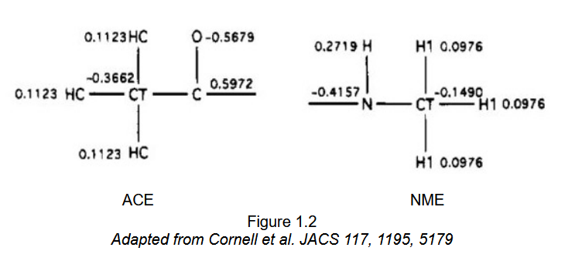
Partial charges: what are they and how to get them
Capping groups
TASK2 -> Prepare FF parameters for cysteinamide

Slide 20
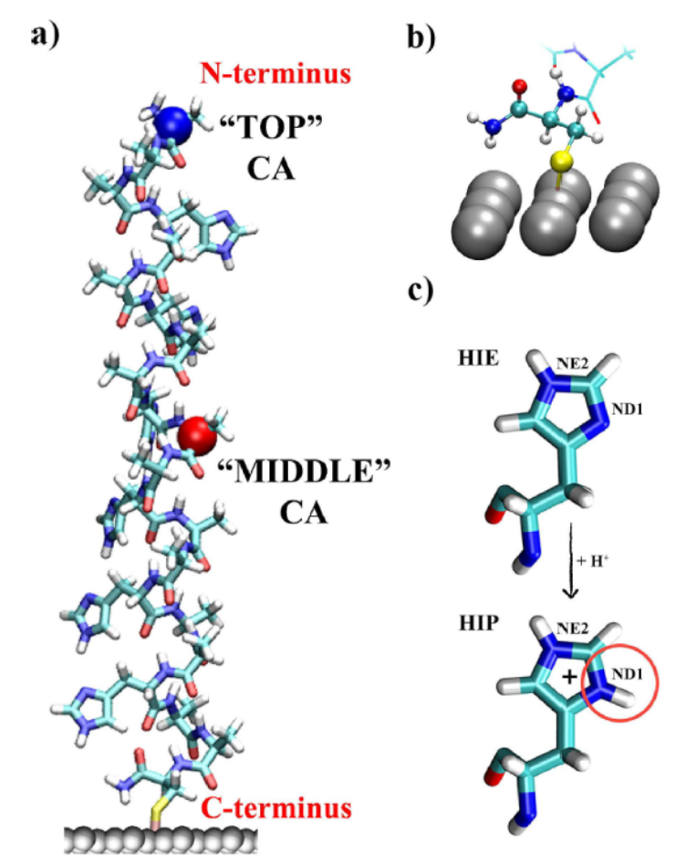
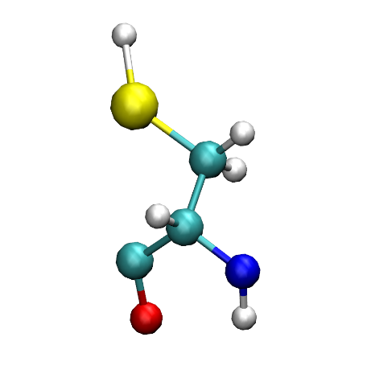
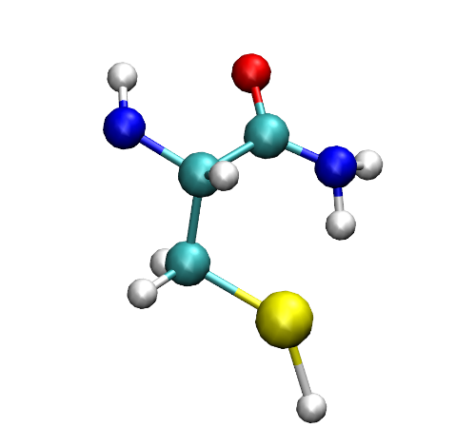
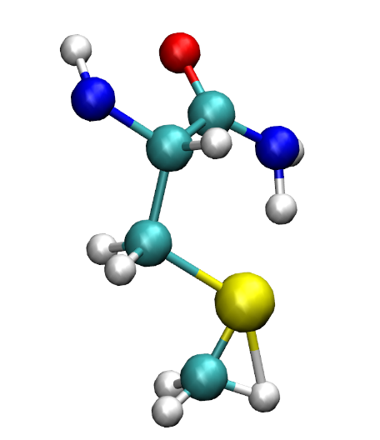
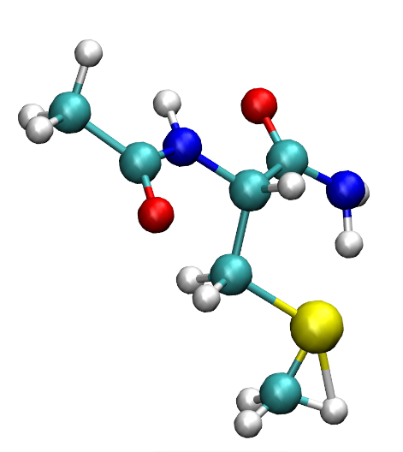
Partial charges: what are they and how to get them
Cysteinamide on mercury surface:

Slide 21
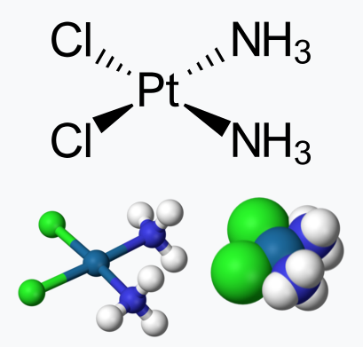
Partial charges: what are they and how to get them
Cisplatin
TASK3 -> Calculate RESP charges for cisplatin (and its hydrated forms) and for cis0 prepare .itp file from scratch using paper of Ruano2022 (SI)

Slide 22
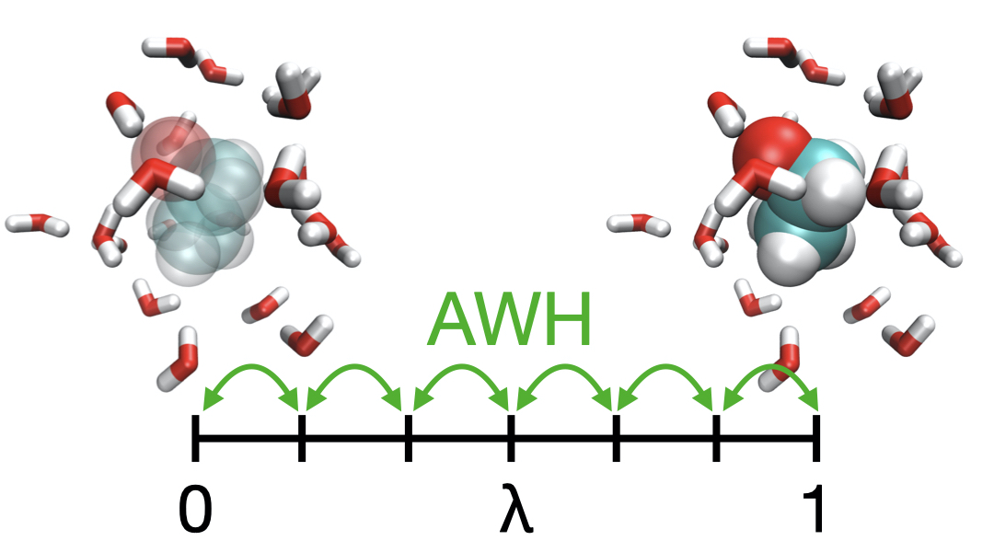
Free energy of solvation using Accelerated Weight Histogram (AWH) method
Accelerated Weight Histogram method
  Calculates the PMF along a reaction coordinate by adding an adaptively determined biasing potential.
  Flattens free energy barriers along the reaction coordinate by applying a history-dependent potential to the system that “fills up” free energy minima.

