Slide 1
C9555:
A survival guide
to simulations
Week 9
William Morton– Nov 23rd, 2023
Notes:
<number>

Slide 2
Learning Objectives
How does Alpha Fold predict a protein structure
Move proteins from Alpha Fold to MD
When to use coarse graining
Determine translatable properties from experiment to MD
CEITEC at Masaryk University
2

Slide 3
Review
What dictates the timestep of a simulation?
How might we tell the temperature of a simulation?
How do we know if our system is in equilibrium?
Which force field have we used for all atom simulations?
How does the starting point of the simulation effect results?
CEITEC at Masaryk University
3

Slide 4
Alpha Fold
The big deal is that we undergo a transformation from text to 3D positions
MAVVKGNKDVFVCMPTGAGKSLCYQLPALLAKGITIVVSPLIALIQ...
CEITEC at Masaryk University
4

Slide 5
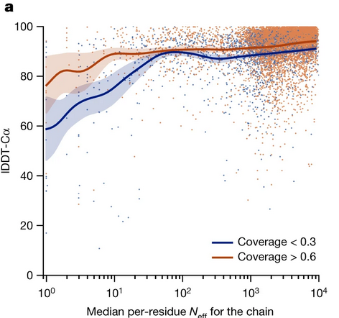
Alpha Fold
Multiple Sequence Alignment (MSA)
  Form is required for function
  Evolution can be highly conserved
  Sequencing is comparatively inexpensive, fast, and robust
Templates are ignored unless MSA is small
CEITEC at Masaryk University
5

Slide 6
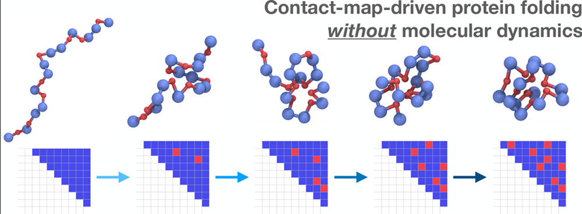
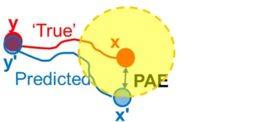
Alpha Fold Prediction Accuracy
Predicted LLDT
  Determines the accuracy of local structures
  Recquires a reference model
Predicted Aligned Error
  Determines the accuracy of the relative position between pairs of residues
  Good for exploring residues in the same domain
CEITEC at Masaryk University
6

Slide 7
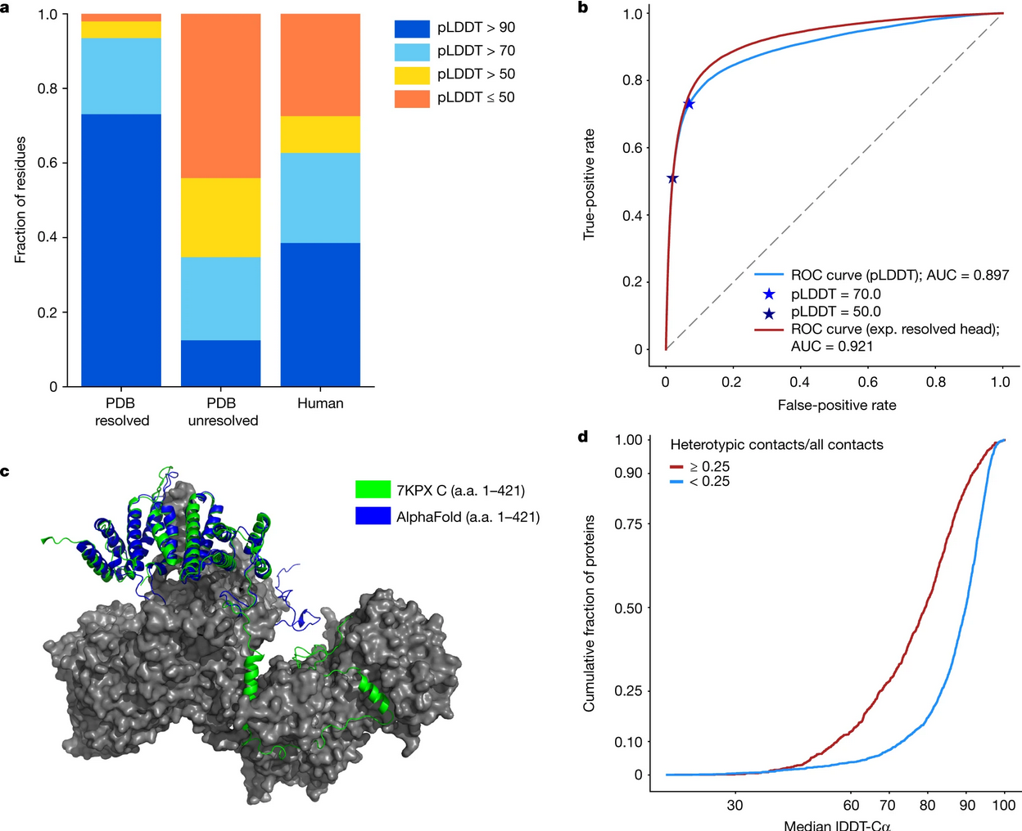
CEITEC at Masaryk University
6

Slide 8
Disorder is common
Fully solved structures have few disordered regions
Intrinsic bias in reports/studies
AF predicts these extremely well
Or
Regions that are ordered in complexes
CEITEC at Masaryk University
8

Slide 9
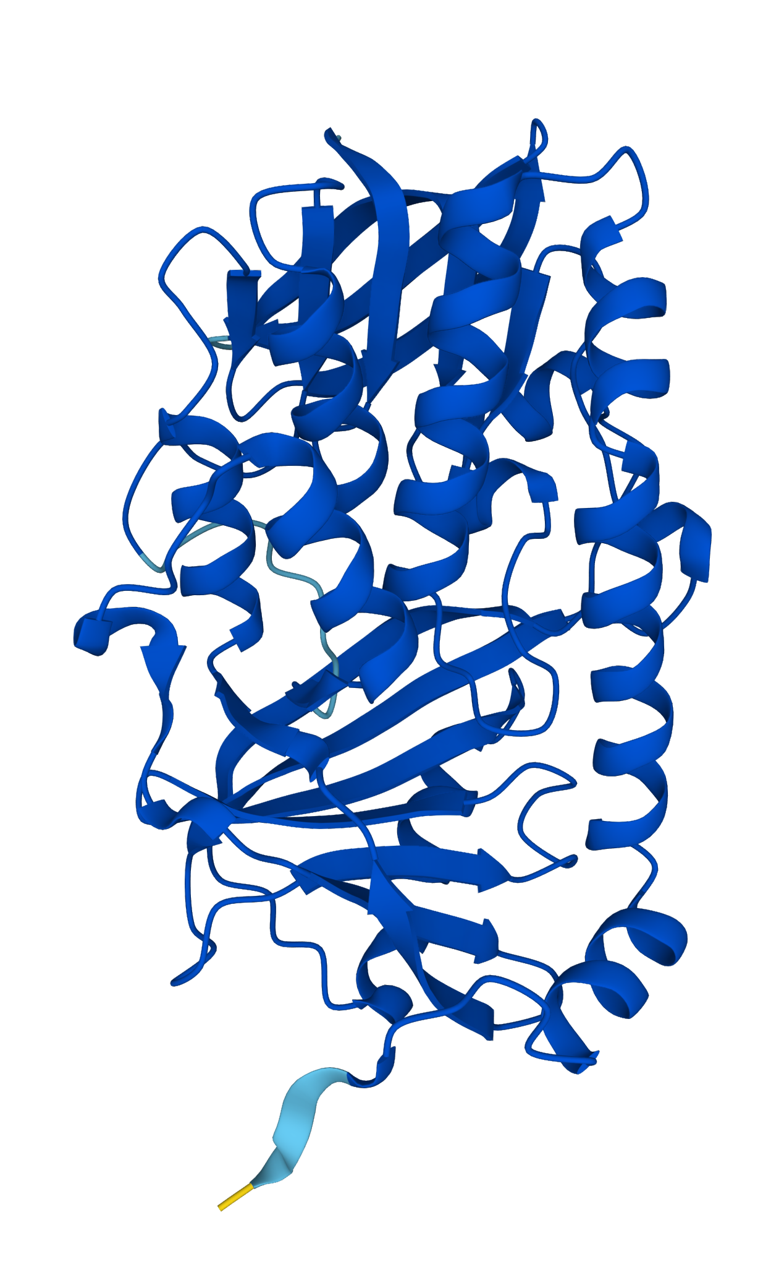
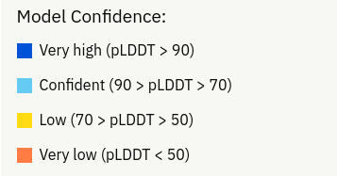
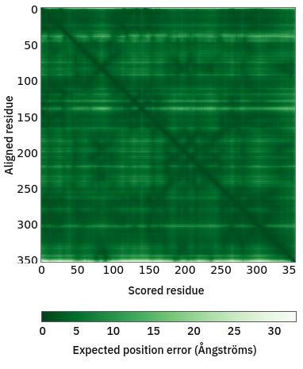
Protein CbrA
How would we transfer this to MD?
What would we see in an all atom simulation?
CEITEC at Masaryk University
9

Slide 10
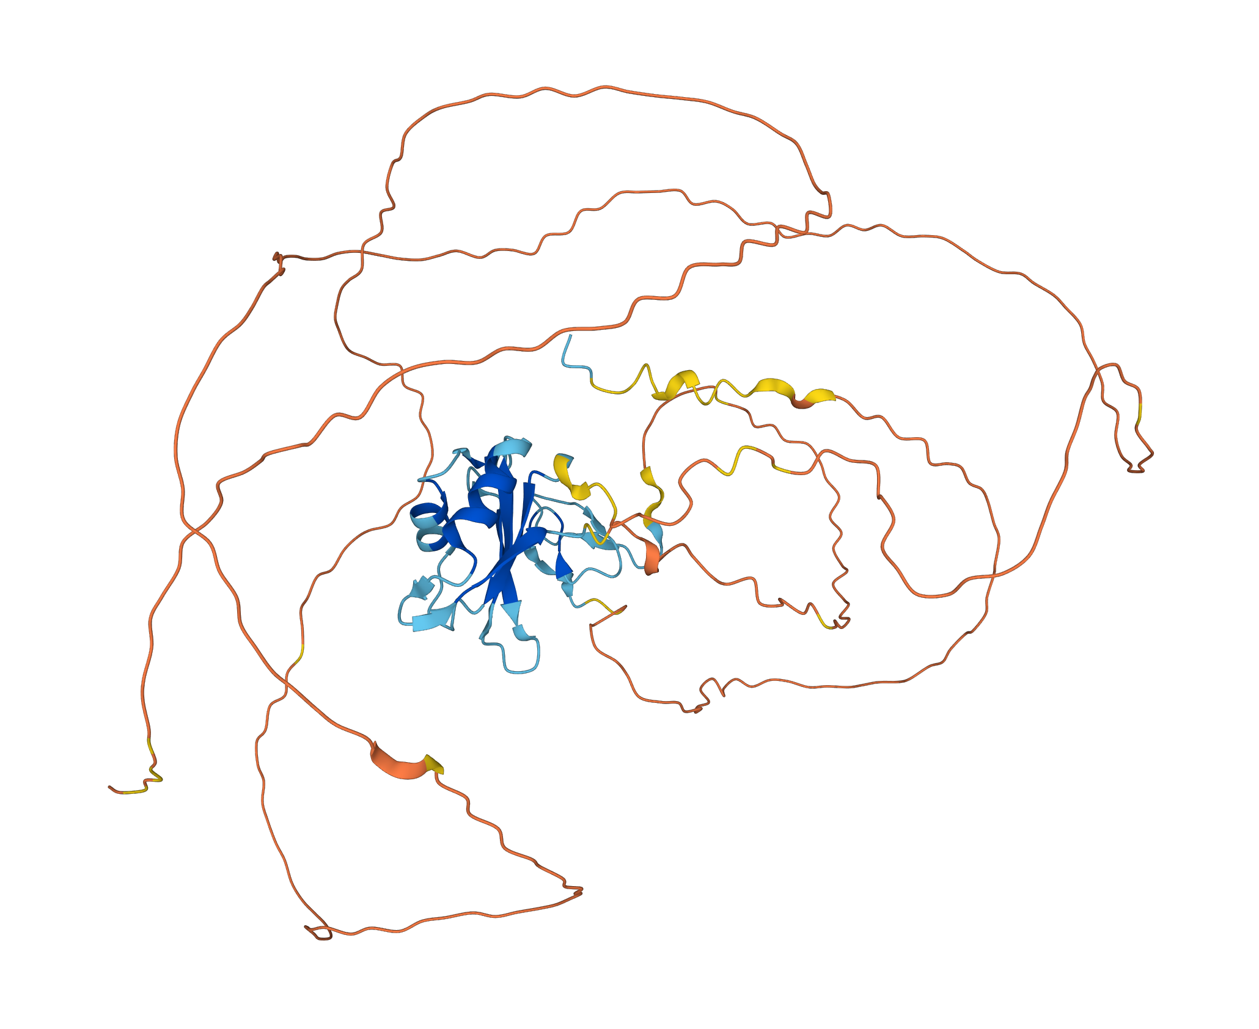
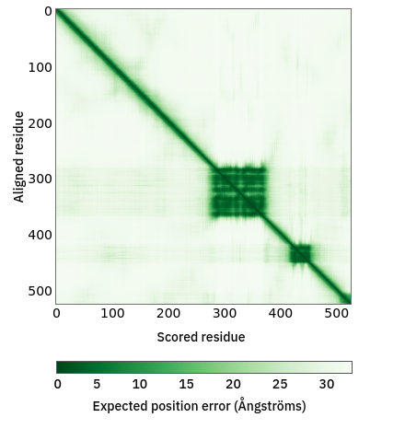
Protein FUS
How would we transfer this to MD?
What would we see in an all atom simulation?
CEITEC at Masaryk University
10

Slide 11
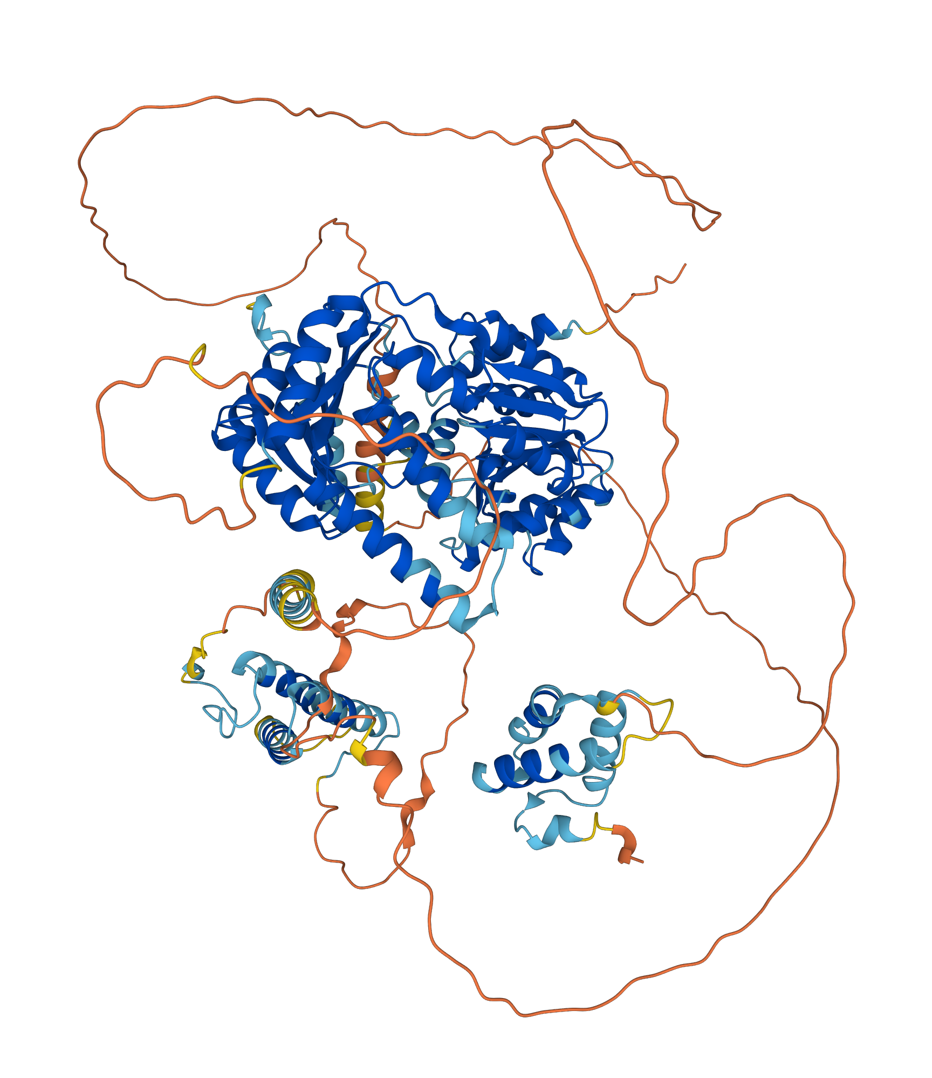
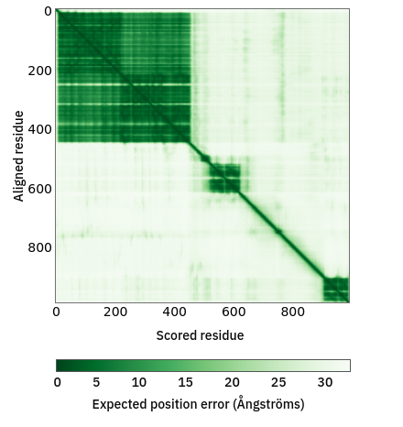
Protein RECQL5
How would we transfer this to MD?
What would we see in an all atom simulation?
CEITEC at Masaryk University
11

Slide 12
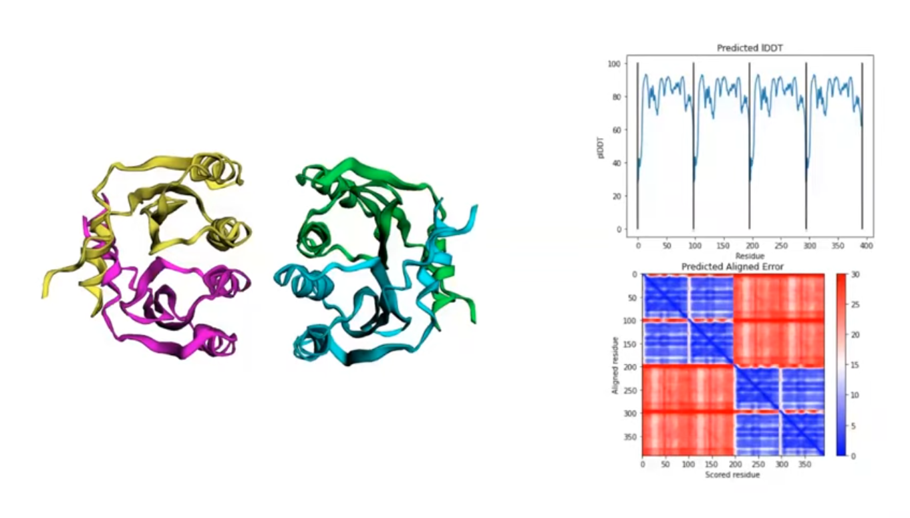
Alpha Fold Tips/Tricks
Structure predictions can be recycled
  Alpha-Fold has 3 recycle steps
  More may increase accuracy
Sequences can be connected
  Protein-protein interactions
You can add in your own MSA
Uses amber to relax chemical bonds
CEITEC at Masaryk University
11

Slide 13
Review (not covered)
What's the biggest computational expense when simulating a protein?
Name one weakness in Alpha Fold.
Why does Alpha Fold use amber?
What is PLDDT based on?
What is PAE based on?
CEITEC at Masaryk University
<number>

Slide 14
What is the relevance for MD?
CEITEC at Masaryk University
<number>

Slide 15
Coarse Grained Simulations
How long does it take to see the effects you'd like to study?
How much sampling will you need in/around that state?
Will you need to understand the effect of water or ions?
What is the resolution you need for a scientific finding?
CEITEC at Masaryk University
<number>

Slide 16
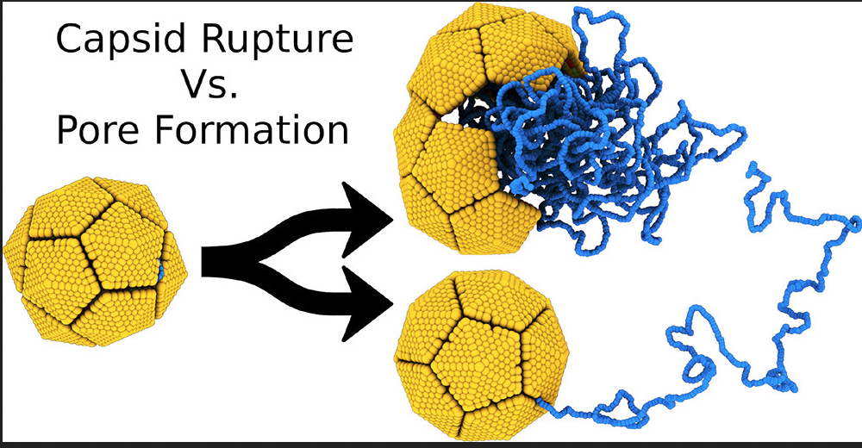
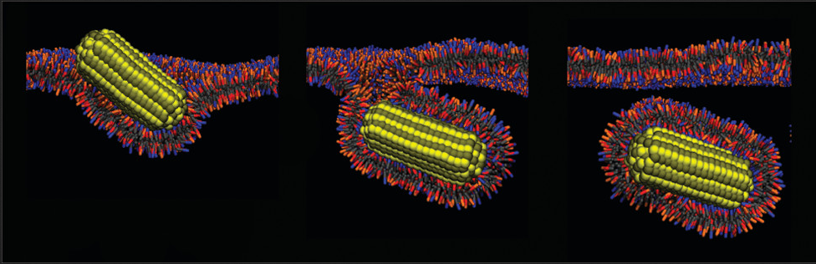
Coarse Grained Simulations
CEITEC at Masaryk University
<number>

Slide 17
Coarse Grained Simulations
Water
  Treated explicitly – to transfer heat and introduce brownian motion, add random forces
Atoms
  Group their movement together, smoothing the surface (atoms become 'beads')
Force Field
  Ensure that the interaction between beads is representative of the desired interaction
CEITEC at Masaryk University
<number>

Slide 18
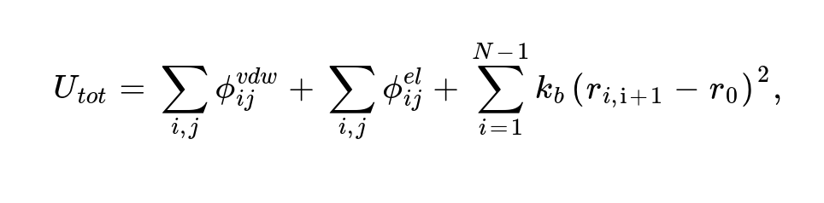
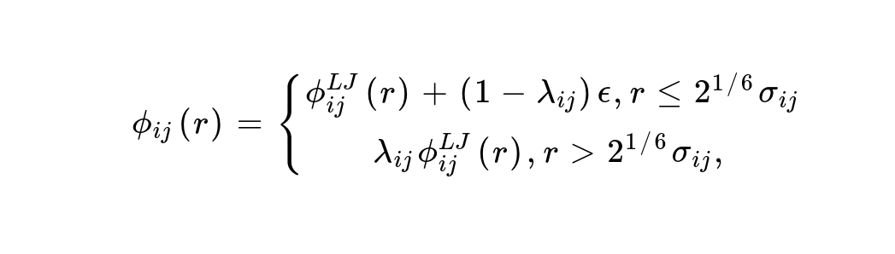
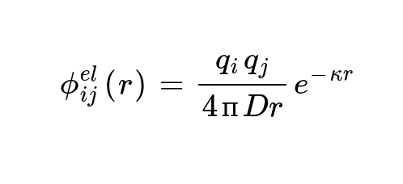
Example: Carbon Alpha Models
CEITEC at Masaryk University
<number>

Slide 19
Example: Carbon Alpha Models
CEITEC at Masaryk University
<number>

Slide 20
Example: Carbon Alpha Models
CEITEC at Masaryk University
<number>

Slide 21
Review
What do we loose in the coarse grained approach?
When is the carbon-alpha model appropriate?
How can we compare results?
What's the disadvantage of implicit solvents?
What are three things we can use to determine if coarse-graining is appropriate?
CEITEC at Masaryk University
<number>

Slide 22
In today's practical...
Part 1
  Go through the provided code, and write out the pseudocode for the system
  Determine what the difference is between r5_1.dcd and r5_2.dcd
    What is their radius of gyration?
    Which is more accurate?
Part 2
  Find a PDB structure of a protein (experimentally derived)
  Use Alpha Fold to determine domains
  Simulate your protein!
CEITEC at Masaryk University
<number>

Slide 23
Protein RECQL5
CEITEC at Masaryk University
<number>

