Slide 1
C9555:
A survival guide to simulations
Week 11
William Morton– Dec 7th, 2023

Slide 2
Learning Objectives
Recap from last week
Force fields again?!
Splitting Performance
Benchmarking

Slide 3
Do we actually want long timescales?

Slide 4
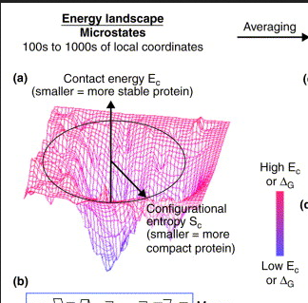
Do we actually want long timescales?

Slide 5
Do we actually want long timescales?
Umbrella Sampling
Hierarchial Chain Growth
Parallel Tempering
Coarse Graining
Alchemical Mutations (not covered)

Slide 6
Brief Introduction to Martini
If you want to get in a fight with someone, model with Martini

Slide 7
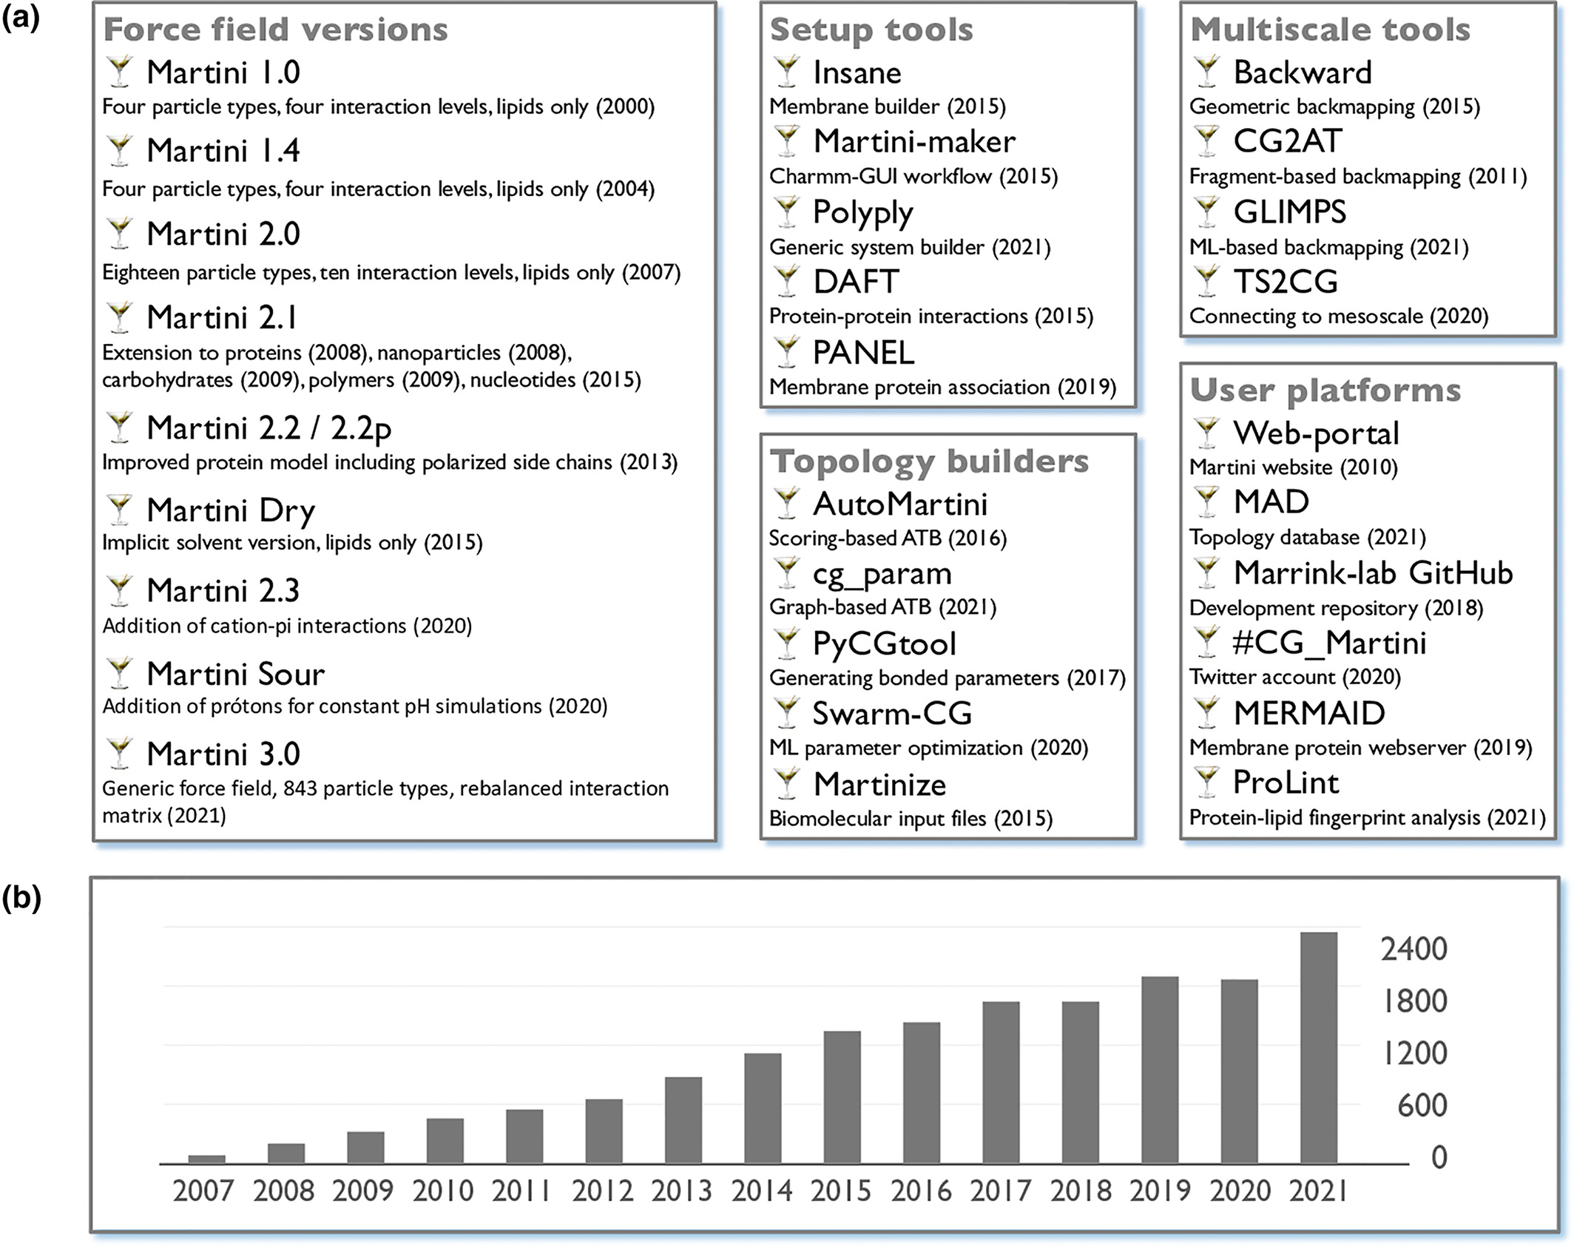
Brief Introduction to Martini
Two decades of Martini: Better beads, broader scope
Siewert J. Marrink, Luca Monticelli, Manuel N. Melo, Riccardo Alessandri, D. Peter Tieleman, Paulo C. T. Souza

Slide 8
Brief Introduction to Martini
If you want to get in a fight with someone, model with Martini
“small chemical fragments can be represented by specific CG bead types (the building blocks), irrespective of the molecule to which the fragment belongs”
  Is this true from a molecular orbital point of view?
Martini 3 reparameterized beads, and added new species to the list – expanding the library
  When we make something more general, we make it less specific
  Martini and Marini 2 were made more specifically for lipids

Slide 9
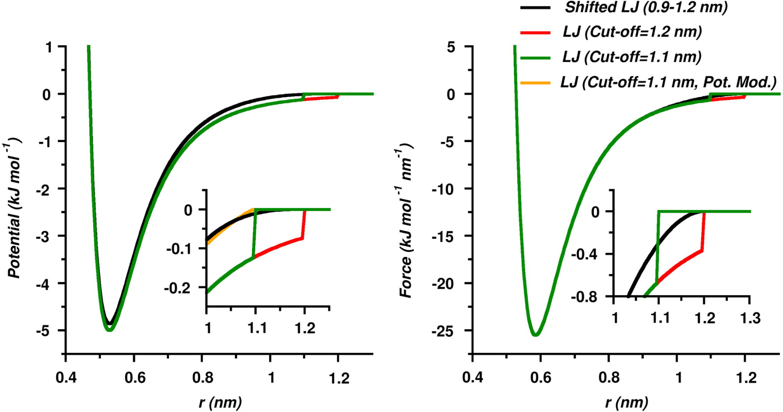
Paramaterization
Parameterization of bonds was done from all-atom simulations (bottom up)
Parameterization of non-bonded interaction was from experiment (top down)
  This uses our favourite potential…
What are those??
Martini straight: Boosting performance using a shorter cutoff and GPUs,
Djurre H. de Jong, Svetlana Baoukina, Helgi I. Ingólfsson, Siewert J. Marrink,

Slide 10
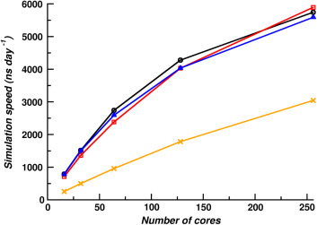
Paramaterization
Parameterization of bonds was done from all-atom simulations (bottom up)
Parameterization of non-bonded interaction was from experiment (top down)
  This uses our favourite potential…
Large DPPC Bilayer (183,296 beads)
New
Old
Martini straight: Boosting performance using a shorter cutoff and GPUs,
Djurre H. de Jong, Svetlana Baoukina, Helgi I. Ingólfsson, Siewert J. Marrink,

Slide 11
Your MD engine
What is calculated at each timestep?
Where does that calculation take place? (CPU/GPU)
How is information transfered from one to the other?
OpenMP vs MPI
  Working together vs splitting up hard tasks

Slide 12
Your MD engine
OpenMP 4
MPI 1
Using 4 cores
OpenMP 1
MPI 4
Using 4 cores
OpenMP 1
MPI 4
Using 4 cores

Slide 13
Your MD engine
What is calculated at each timestep?
Where does that calculation take place? (CPU/GPU)
How is information transfered from one to the other?
OpenMP vs MPI
  Working together vs splitting up hard tasks
Use representative benchmark systems

Slide 14
In today's practical...
There is only one goal for the day:
Determine the largest membrane you can use to calculate lipid head area
using a 30 minute (runtime)
but I‘ve been told I don‘t give enough instruction so here‘s a step-by-step

Slide 15
In today's practical...
First, look at the model for the lipid in VMD. What is the mapping that‘s used?
  1:1, 1:2, 1:3, 1:4…
Second, build an equilibrated membrane, with 6 water beads per lipid (you may have to increase this for larger membranes
Third, determine how long you need to model the membrane… look in literature.
Fourth, optimize your computational resources for the problem! (doesn‘t have to be perfect, just enough to simulate)
Finally, once you have your ideal parameters, tell me the flaw in using the efficiency found here. Then you can go!

