Slide 1
C9555:
A survival guide to simulations
Week 9
William Morton– Nov 23rd, 2023

Slide 2
Learning Objectives
When to use coarse graining
Algorithms used to describe the accuracy of predictions
How does Alpha Fold predict a protein structure
Move proteins from Alpha Fold to MD
Determine translatable properties from experiment to MD

Slide 3
Coarse Grained Simulations
How long does it také to see the effects you'd like to study?
How much sampling will you need in/around that state?
Will you need to understand the effect of water or ions?
What is the resolution you need for a scientific finding?

Slide 4
Coarse Grained Simulations
Video of spike protein
Video of capsid rupture

Slide 5
Coarse Grained Simulations
Water
  Treated explicitly – to transfer heat and introduce brownian motion, add random forces
Atoms
  Group their movement together, smoothing the surface (atoms become 'beads')
Force Field
  Ensure that the interaction between beads is representative of the desired interaction
Will cover this more in the practical

Slide 6
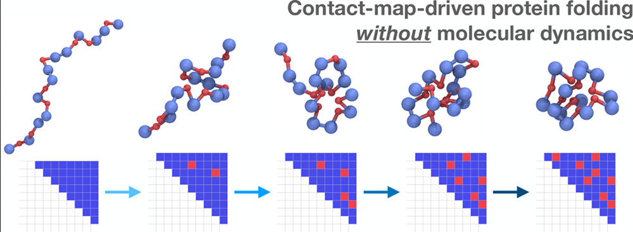
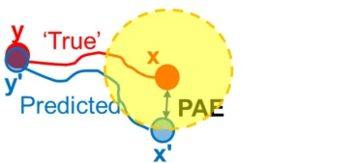
Alpha Fold Prediction Accuracy
Predicted LLDT
  Determines the accuracy of local structures
  Recquires a reference model
Predicted Aligned Error
  Determines the accuracy of the relative position between pairs of residues
  Good for exploring residues in the same domain

Slide 7
Alpha Fold V1
The big deal is that we undergo a transformation from text to 3D positions
MAVVKGNKDVFVCMPTGAGKSLCYQLPALLAKGITIVVSPLIALIQ...
Look for 'templates' (similar proteins) and create similar structures

Slide 8
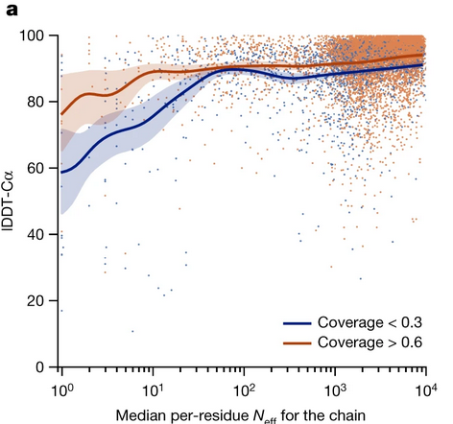
Alpha Fold V2
Multiple Sequence Alignment (MSA)
  Form is required for function
  Evolution can be highly conserved
  Sequencing is comparatively inexpensive, fast, and robust
Templates are ignored unless MSA is small

Slide 9
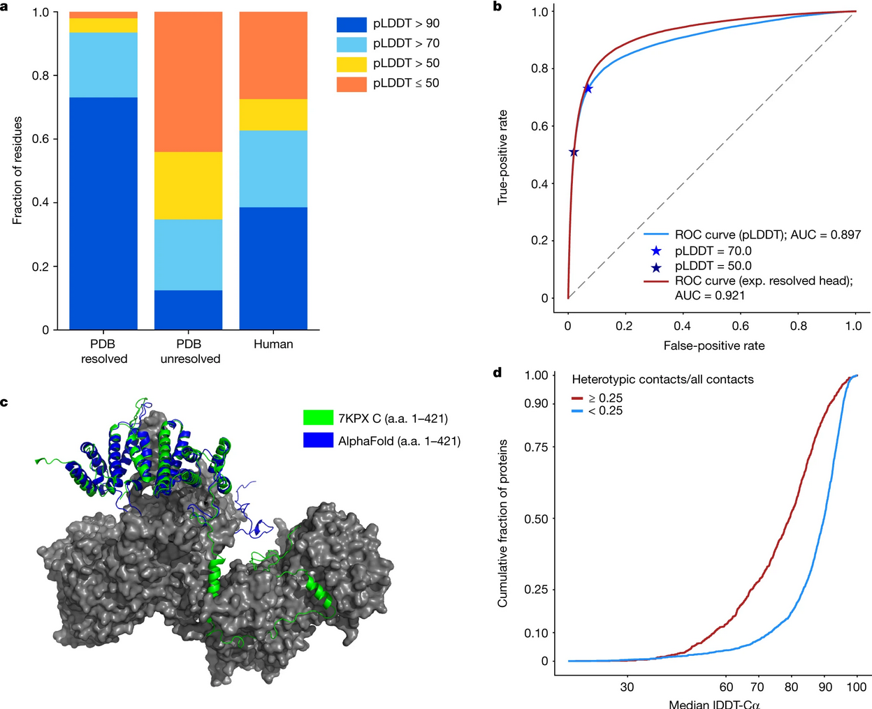

Slide 10
Disorder is common
Fully solved structures have few disordered regions
Intrinsic bias in reports/studies
AF predicts these extremely well
Or
Regions that are ordered in complexes

Slide 11
What is the relevance for MD?

Slide 12
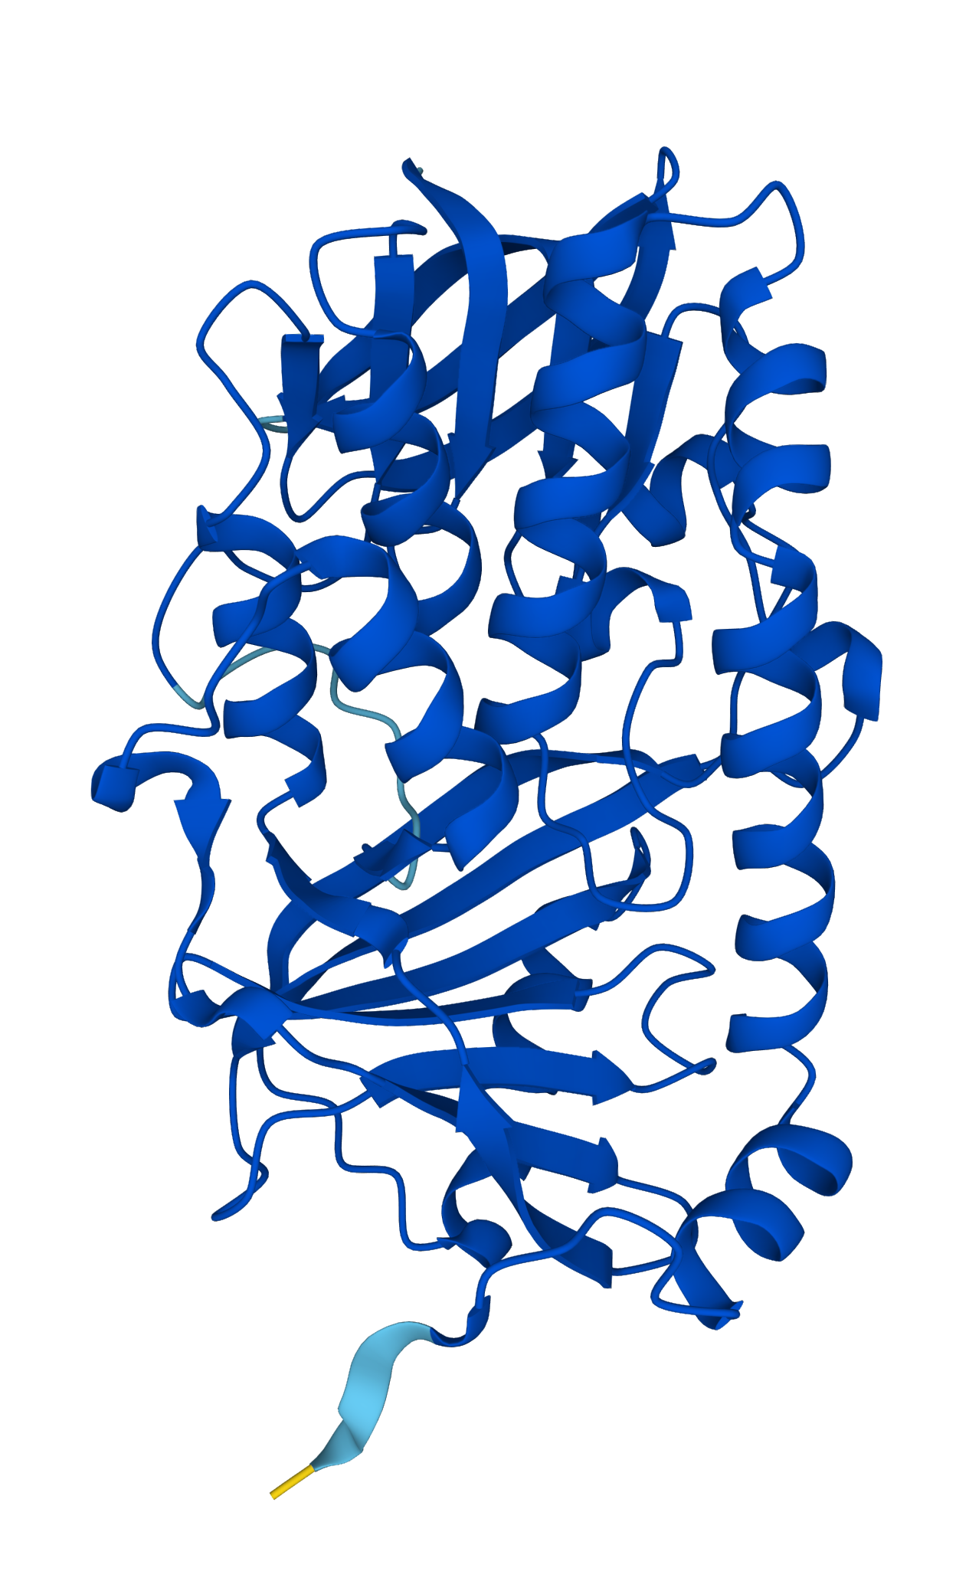
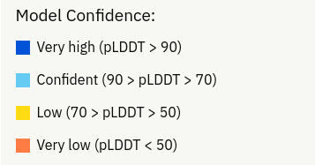
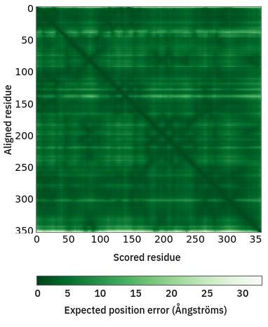
Protein CbrA
How would we transfer this to MD?
What would we see in an all atom simulation?

Slide 13
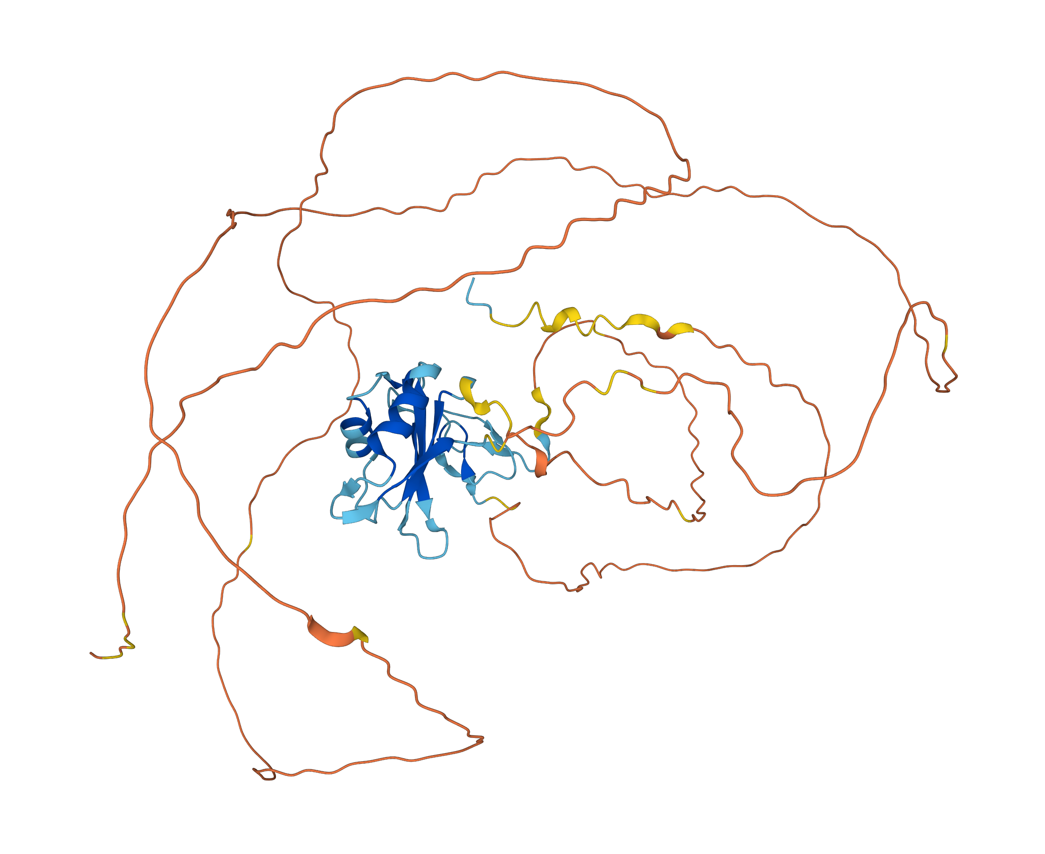
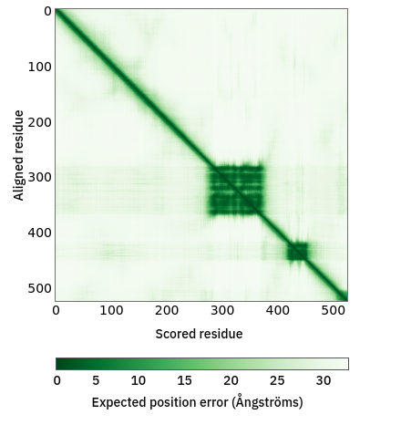
Protein FUS
How would we transfer this to MD?
What would we see in an all atom simulation?

Slide 14
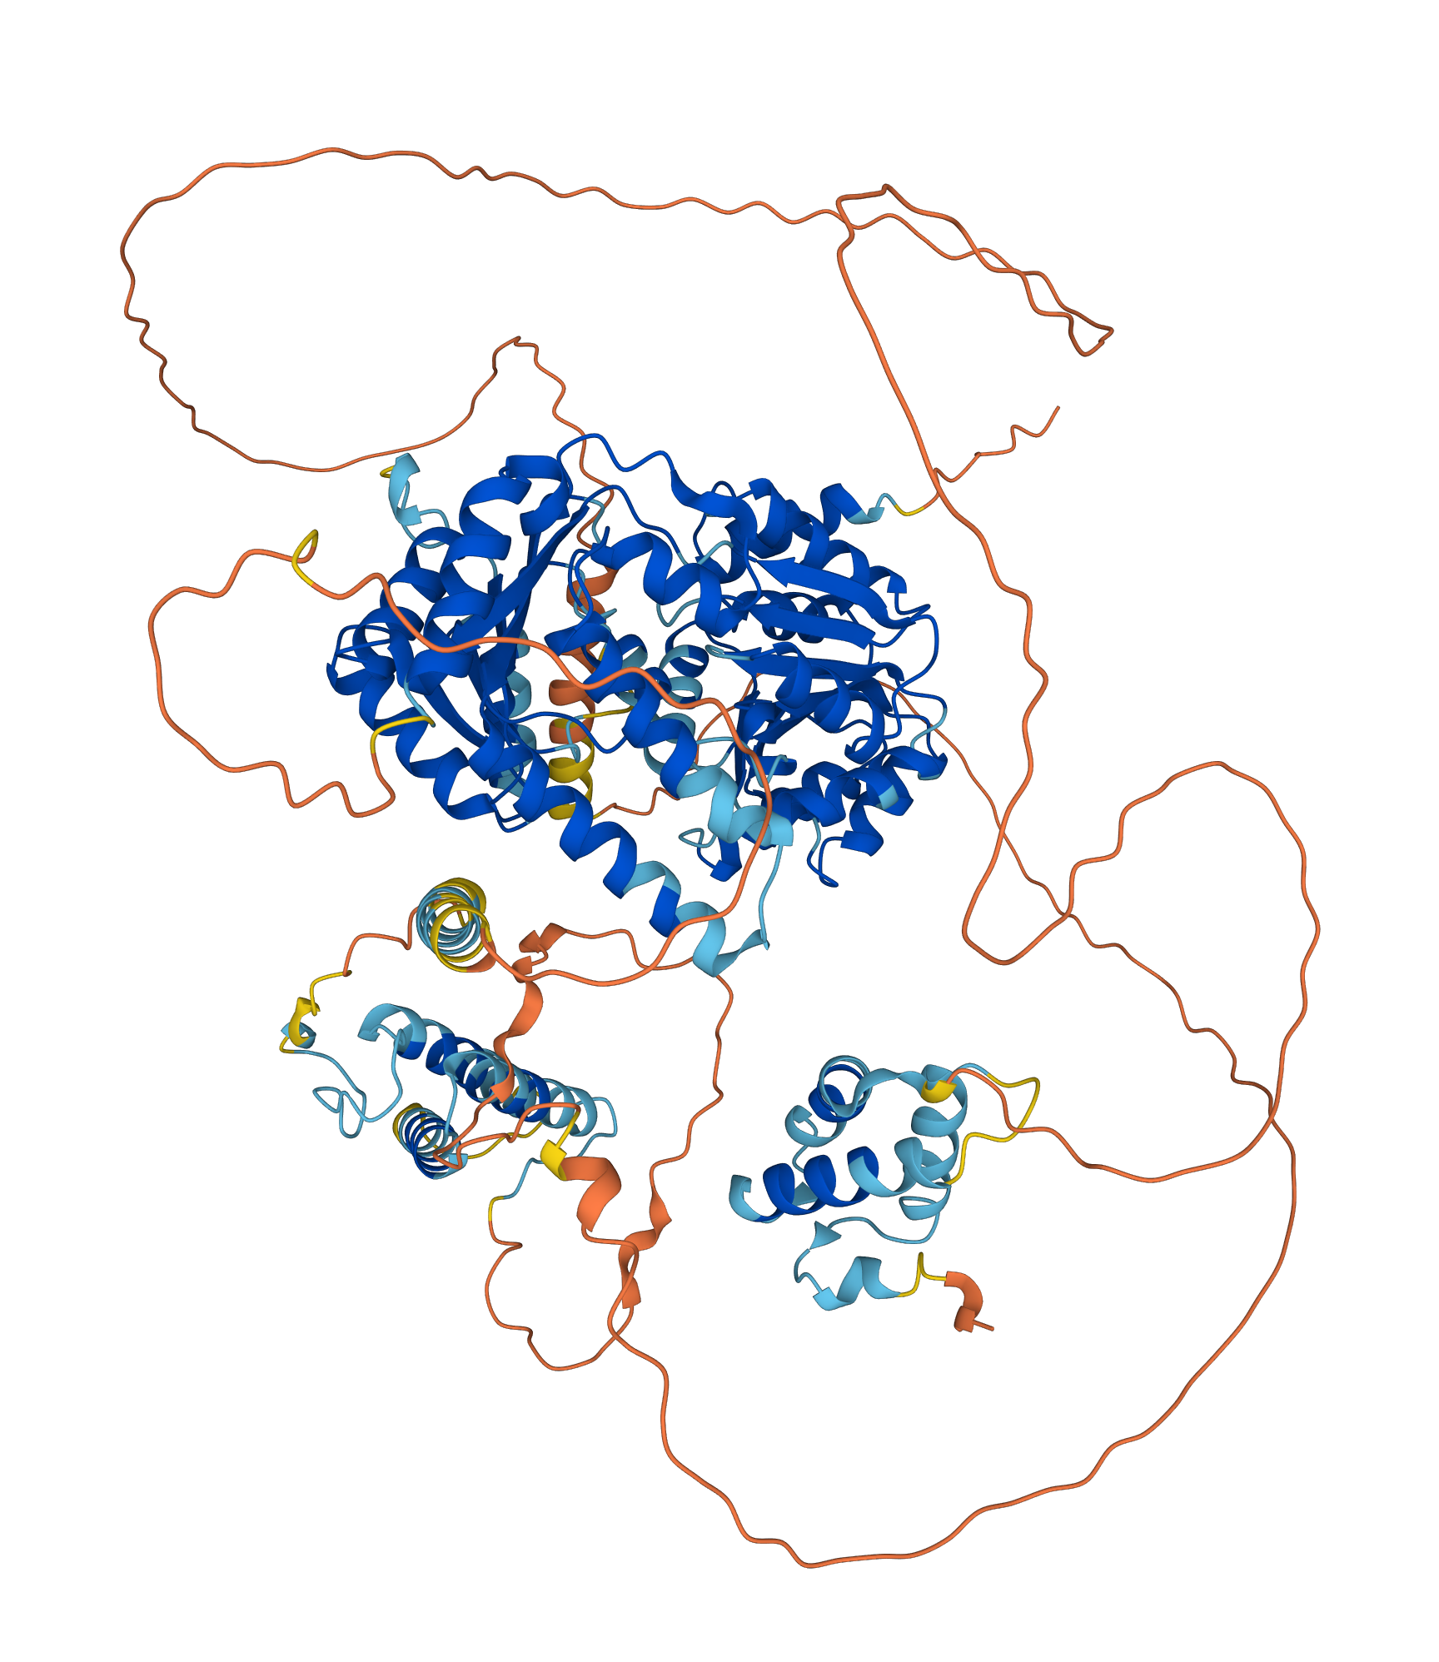
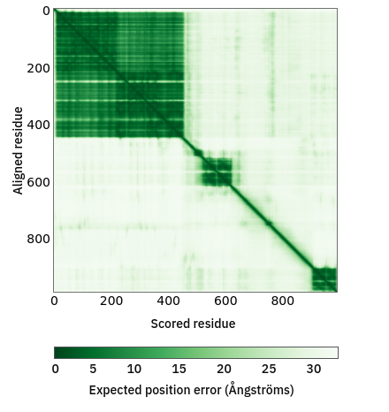
Protein RECQL5
How would we transfer this to MD?
What would we see in an all atom simulation?

Slide 15
Protein RECQL

Slide 16
In today's practical...
Analyze proteins using online databases
Download a protein structure (you decide from where!)
Simulate your multi-domain protein with and without rigid bodies
Compare given datasets from modelling with multiple forcefields

