Slide 1
C9555: A Practical Guide to Simulations
Week 5
Denys Biriukov – Oct. 15th 2026

Slide 2
Get ready for practical session
Open new terminal Ctrl + Alt + T
Course materials at: https://github.com/VachaLab/C9555
Any technical issues/problems/questions? Checklist:
  Access to Wolf.
  Proper infinity and uv environments.

Slide 3


Acknowledgments
This part of the course is inspired and partially based on:
Teaching materials of “Spring School in Computational Chemistry 2023” taken place in Finland and prepared by Dr. Hector Martinez-Seara and Dr. Matti Javanainen.
Teaching course about molecular dynamics simulations at Charles University by prof. Lukasz Cwiklik.

Slide 4
More a discussion than monologue
If you have a quick question to catch up, raise your hand and ask – we will try to fix it and bring you back
If quick answer does not help, let’s chat during a break or after
This course is mainly practical – theory will be trying to catch up, not vice versa
Some topics will be repeated – it’s fine, you’ll cover the same material with multiple teachers

Slide 5
Get ready for practical session
git clone --depth 1 https://github.com/VachaLab/C9555.git C9555_git
cd C9555_git/
cd week05/
bash ../infinity/infinity-temp.sh
bash ../uv/uv-activate.sh
bash ../uv/jupyter-start.sh

Slide 6
What is today?
Teaching week | Date | Lecturer | Topic
01 | 17.09 | AT
02 | 24.09 | AT
03 | 01.10 | IK
04 | 08.10 | LS
05 | 15.10 | DB | How to run MD simulations?
06 | 22.10 | DB
07 | 29.10 | IK
08 | 05.11 | IK
09 | 12.11 |  | BREAK
10 | 19.11 | DB
11 | 26.11 | DB
12 | 03.12 | AT/LS
13 | 10.12 | AT/LS
Week 5:
How to run MD simulations?
How and why MD is useful
  Physics behind MD simulations
GROMACS
  Perhaps, the fastest freely-available MD engine
GROMACS in combination with Jupyter notebooks and Matplotlib

Slide 7
Today program
Lecture
Recall of basics of MD: why we need it and what physics is behind.
MD ensembles, relation to thermodynamics.
Practical session
GROMACS – what is it and how to use it?
Basic tools to build a system and run a simulation in GROMACS.

Slide 8
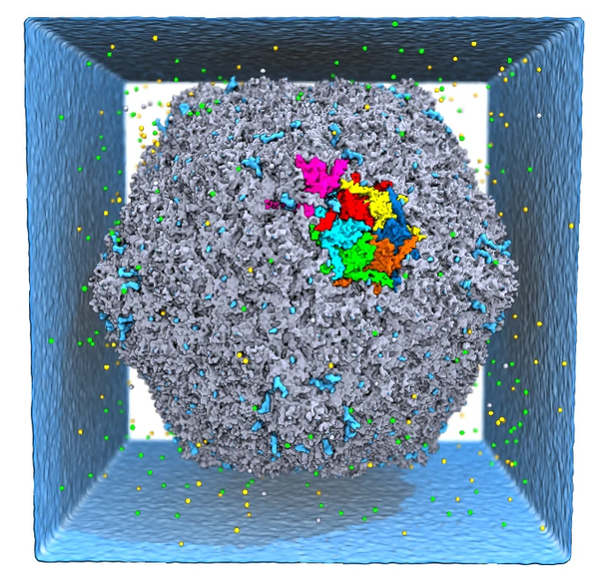
Molecular Simulations: Physics, not Cartoon
Why do we actually use simulations?
  Visualizing experiments? Reproducing? Confirming?
A molecular simulation is a well-controlled in silico experiment itself!
  “Computational microscope”, “computational experiment”.
Good simulation model – predictive power of simulations.
  Simulations can initiate new experimental work.
  Certain computational screenings of novel drugs are more efficient (and much cheaper) than many (if not all) experiments.
Good model = fundamental physics behind it (approximation of fundamental physical laws).
atomistic model of bacteriophage HK97
Coshic et al. Nature, 627, 905–914 (2024)

Slide 9
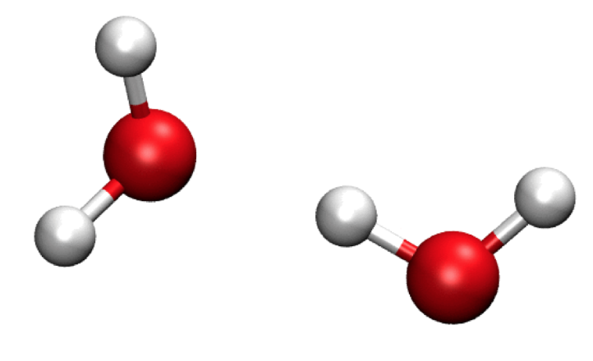
Quantum physics?
Biosimulations usually do not have electrons. Is it legal?
  Atoms are represented as billiard balls.
  Averaged effects of electrons are considered through a set of parameters (force fields).
  Force fields define the potential energy of a system as a function of atomic positions.
This approximation does not work:
  Electron transfer processes.
  Reactive systems.
  Strong quantum effects.
Use instead: ab initio molecular dynamics (AIMD), quantum mechanics/molecular mechanics (QM/MM) methods.

Slide 10
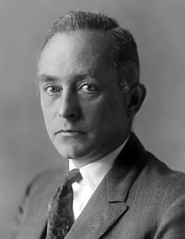

Born-Oppenheimer approximation

Slide 11
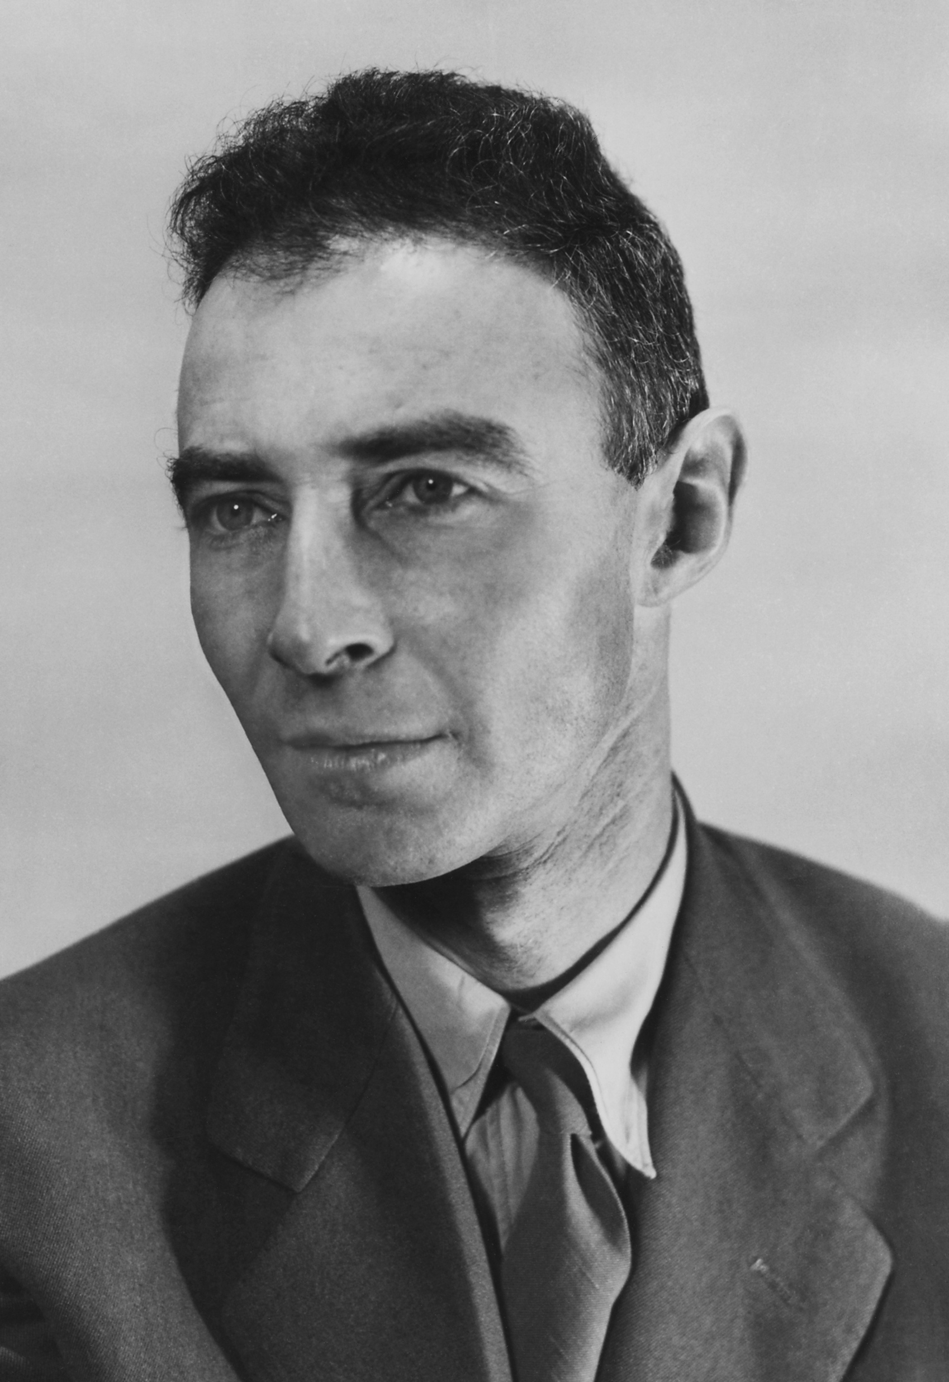
Born-Oppenheimer approximation

Slide 12
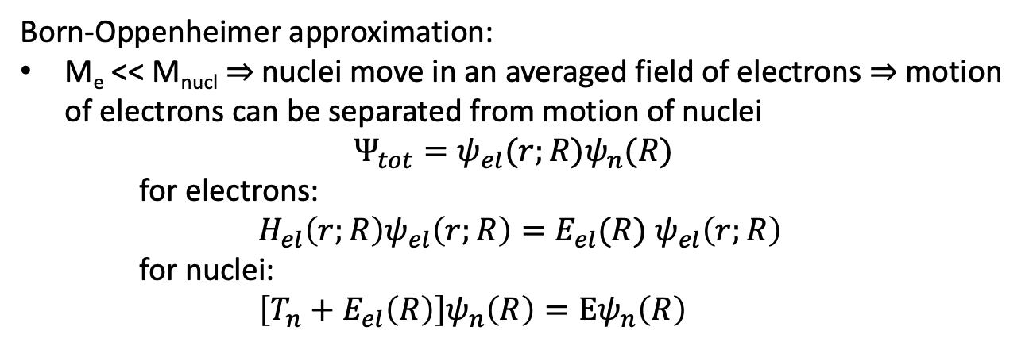

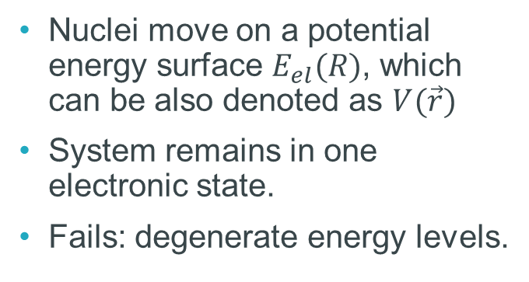


Born-Oppenheimer approximation
Nuclei move on a potential energy surface $E_{el}(R)$, which can be also denoted as $V(\vec{r})$
System remains in one electronic state.
Fails: degenerate energy levels.
$$E_{el}(R)$$
Classical mechanics can be used for nuclei
  The de Broglie wavelength of nuclei is typically much smaller than the distances between atoms, so their quantum wave effects can often be neglected.
Not the case of an electron
$$R$$

Slide 13

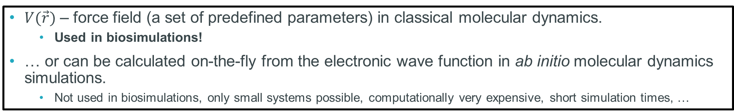
Born-Oppenheimer approximation
Nuclei move on a potential energy surface $E_{el}(R)$, which can be also denoted as $V(\vec{r})$
System remains in one electronic state
Fails: degenerate energy levels.
$V(\vec{r})$ – force field (a set of predefined parameters) in classical molecular dynamics.
  Used in biosimulations!
… or can be calculated on-the-fly from the electronic wave function in ab initio molecular dynamics simulations.
  Not used in biosimulations, only small systems possible, computationally very expensive, short simulation times, …

Slide 14
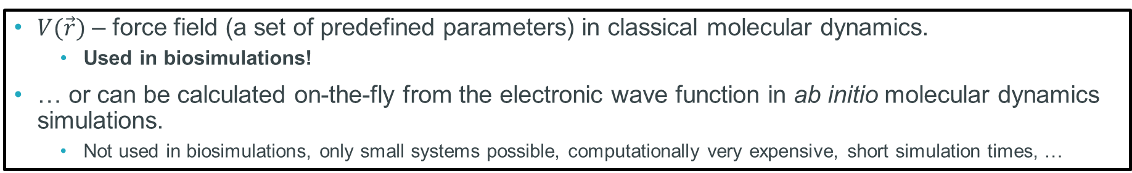
Born-Oppenheimer approximation
Nuclei move on a potential energy surface $E_{el}(R)$, which can be also denoted as $V(\vec{r})$
System remains in one electronic state
Fails: degenerate energy levels.
$V(\vec{r})$ – force field (a set of predefined parameters) in classical molecular dynamics.
  Used in biosimulations!
… or can be calculated on-the-fly from the electronic wave function in ab initio molecular dynamics simulations.
  Not used in biosimulations, only small systems possible, computationally very expensive, short simulation times, …
current trend − machine-learning potentials (force fields) trained on ab initio molecular dynamics
  not trivial, usually slower than conventional force fields, require high-quality training data, can fail on unfamiliar configurations, system-specific, etc.; available in newest GROMACS versions

Slide 15
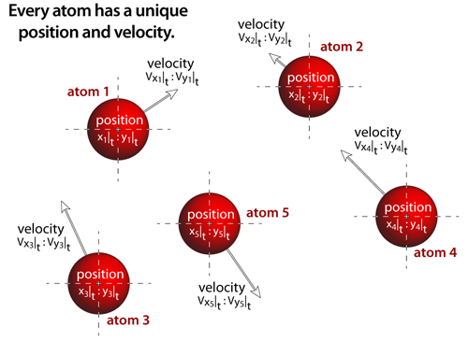
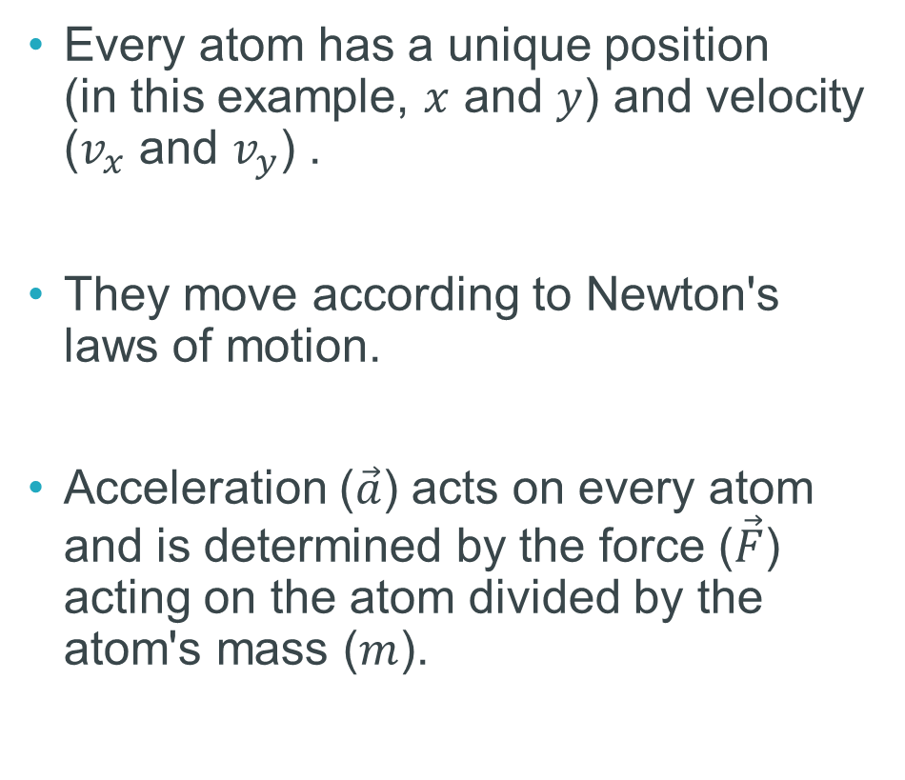
Time evolution
Every atom has a unique position
(in this example, $x$ and $y$) and velocity ($v_{x}$ and $v_{y}$) .
They move according to Newton's laws of motion.
Acceleration ($\vec{a}$) acts on every atom and is determined by the force ($\vec{F}$) acting on the atom divided by the atom's mass ($m$).
http://atomsinmotion.com/book/chapter5/md

Slide 16
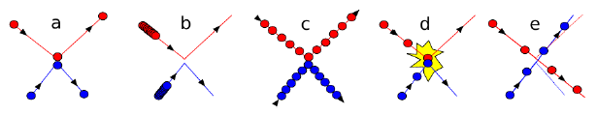
Time step: optimal Δt
Time step: not too big, not too small.
Depends on the force field and its implementation.
Rule of thumb: at least, one order of magnitude shorter than a characteristic time of the fastest motion in the system.
  vibration of bonds, time scale ~10⁻¹⁴ s, i.e., time step ~1–5 fs

Slide 17
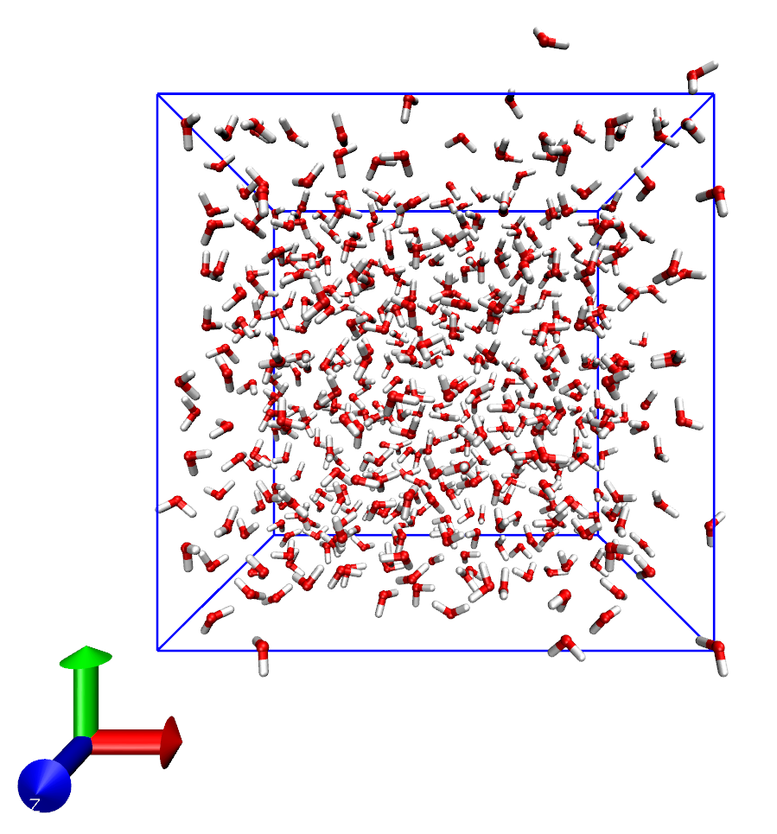
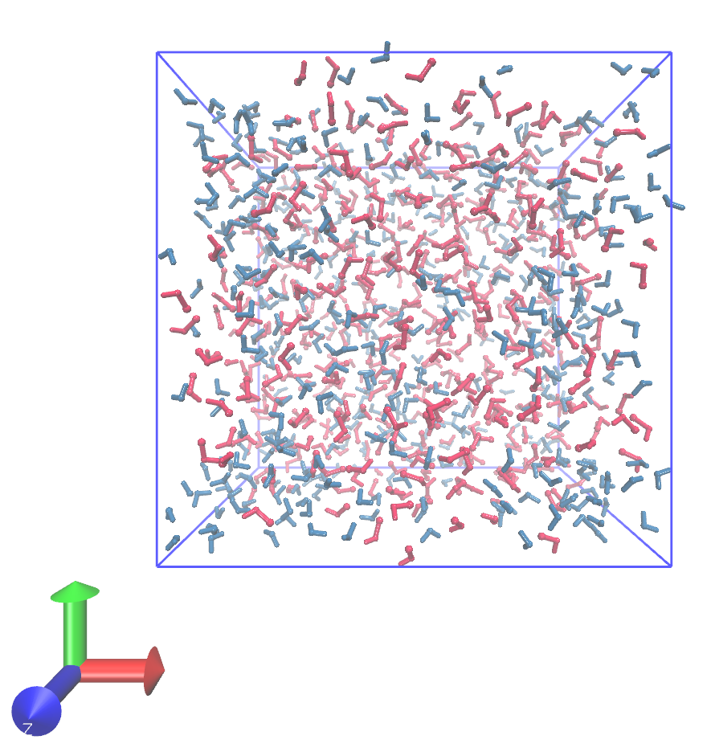
Micro and macro
Newton’s equations of motion govern microscopic evolution (atomic positions, atomic velocities).
They do not explicitly give macroscopic properties (e.g., temperature, pressure, etc.)
Macroscopic properties are obtained from trajectories via statistical mechanics (statistical thermodynamics).

Slide 18
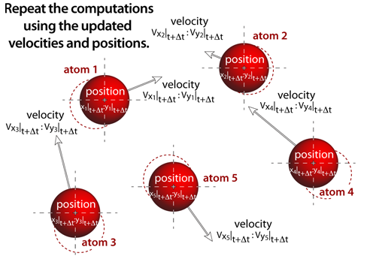
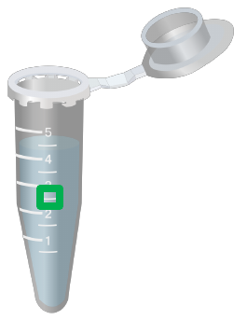
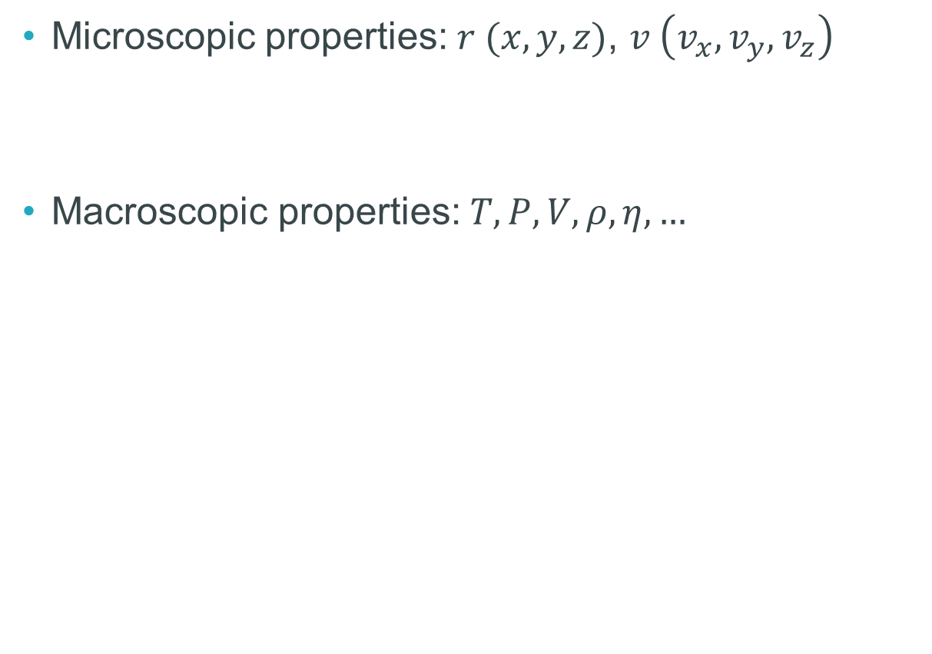
Micro and macro
Microscopic properties: $r (x, y, z)$, $v \left(v_{x},v_{y},v_{z}\right)$
Macroscopic properties: $T, P, V,ρ,η, …$

Slide 19
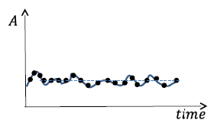

Ensembles and time
Ergodic hypothesis: all accessible microstates are equiprobable over a long period of time.
  Average over ensemble – average over time.
Macroscopic properties are given by probability distribution within an ensemble.
In molecular dynamics simulations, we “move” within the ensemble and reproduce its probability distribution.
  Macroscopic properties can be estimated.
  Applies to equilibrium molecular dynamics.
under equilibrium

Slide 20
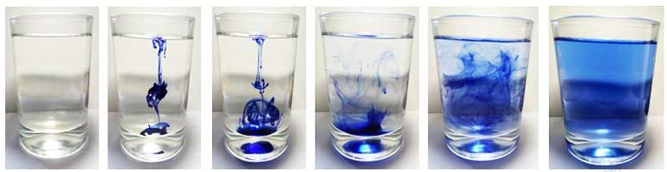
Equilibrium vs. non-equilibrium
from https://www.easybiologyclass.com
a molecular simulation of ink dissolving in water
is a system out of equilibrium
a molecular simulation of this liquid
is a system under equilibrium

Slide 21
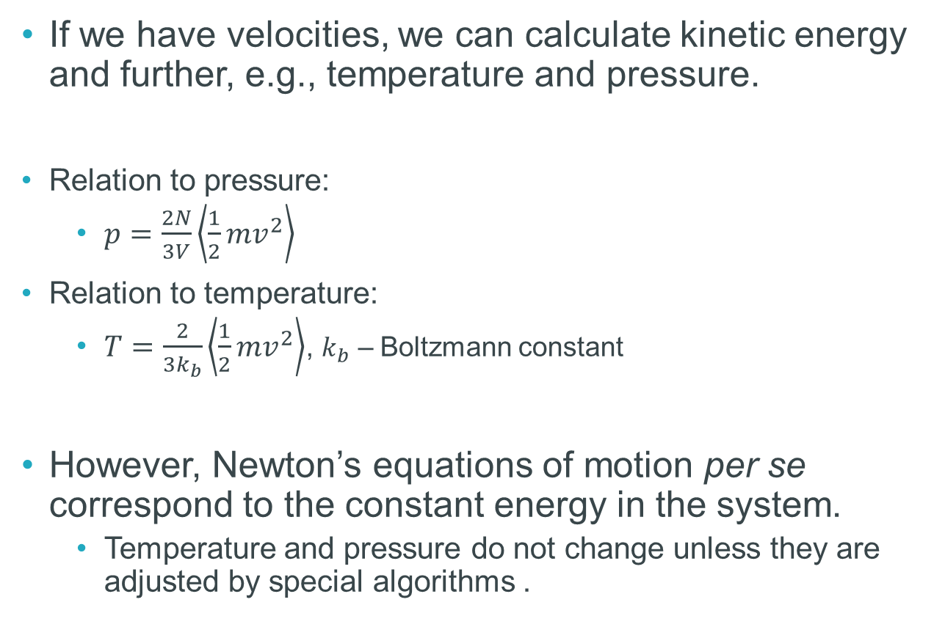
Micro and macro
If we have velocities, we can calculate kinetic energy and further, e.g., temperature and pressure.
Relation to pressure:
  $p=\frac{2N}{3V}\left\langle \frac{1}{2}mv^{2}\right\rangle$
Relation to temperature:
  $T=\frac{2}{3k_{b}}\left\langle \frac{1}{2}mv^{2}\right\rangle$, $k_{b}$ – Boltzmann constant
However, Newton’s equations of motion per se correspond to the constant energy in the system.
  Temperature and pressure do not change unless they are adjusted by special algorithms .
http://atomsinmotion.com/book/chapter5/md

Slide 22
Statistical ensembles in MD
Typically named by three letters.
NVE (microcanonical ensemble):
  N – number of particles (constant in a simulation).
  V – volume (constant in a simulation).
  E – energy (constant in a simulation).
Energy is not added nor removed, fixed volume, particles just move in a locked box.
  Newton’s equations correspond to NVE (no external work, constant total energy, no heat exchange).
Not used in practice: biological simulations are not isolated, big temperature fluctuations, not flexible, convergence and stability issues, etc.

Slide 23
Statistical ensembles in MD
NVT (canonical ensemble, isothermal, Helmholtz canonical):
  N – number of particles (constant in a simulation).
  V – volume (constant in a simulation).
  T – temperature (constant in a simulation).
Temperature is maintained at a desired value through the exchange of energy with the surroundings (conceptually, of course).
Sometimes used in bio: simple, stable, realistic enough, excellent for first equilibration stages.
Disadvantages – volume needs to change in many biosystems, compressibility pressure fluctuations, etc.

Slide 24
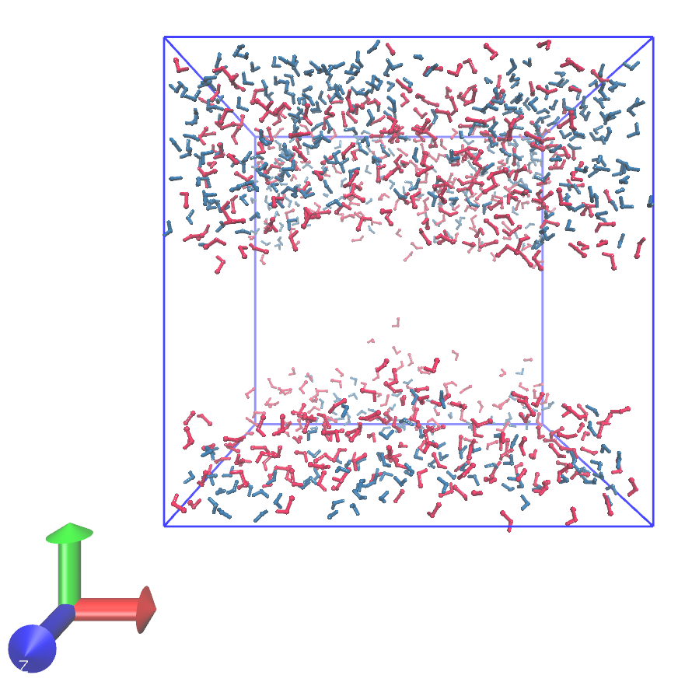
Statistical ensembles in MD
NPT (Gibbs canonical ensemble, isobaric-isothermal):
  N – number of particles (constant in a simulation).
  P – pressure (constant in a simulation).
  T – temperature (constant in a simulation).
Both temperature and pressure are controlled; pressure is controlled through changing box dimensions.
99% use-case in biosimulations, replicates biological conditions, stable, flexible, direct comparison to experimental conditions.
Disadvantages – basically, technical and computational.

Slide 25
Statistical ensembles in MD
Other examples:
  NPH (isoenthalpic-isobaric: number of particles, pressure, enthalpy).
  NPE (isobaric: number of particles, pressure, energy).
  µVT (Grand canonical: chemical potential, volume, temperature).
  µPT (chemical potential, pressure, temperature).
    µVT and µPT are usually used in Monte-Carlo simulations.
  NPγT (number of particles, pressure, surface tension, temperature).
  …
I think you will never use them.

Slide 26
Bonus: energy minimization
Used to relax the initial structure, removing steric clashes and unrealistic geometries
Brings the system to a local energy minimum
Minimizes possible numerical crashes
There is no reason why you should not use it
Today we will test energy minimization, NVT, and NPT

Slide 27
Break!
Get ready for practical session!

