Slide 1

“AI/ML for Predicting Adverse Events and Analyzing Sentiment in Post-Marketing Surveillance data”
By: Vachan Naik
Associate Statistical Data scientist

Slide 2
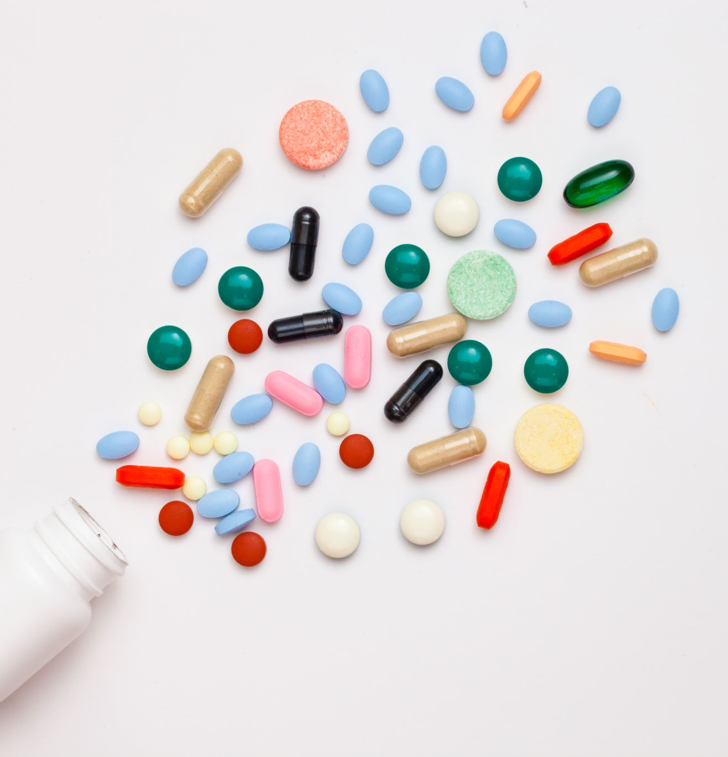
Introduction
Pharmaceuticals play a vital role in modern healthcare, offering treatments and solutions to various medical conditions.
However, ensuring the safety and effectiveness of pharmaceutical products is an ongoing concern.
This presentation delves into a critical aspect of pharmaceutical oversight: post-marketing surveillance.
Post-marketing surveillance is the continuous monitoring of drugs and therapies after they have been approved and are available on the market.
Why is it crucial? It's because real-world data often uncovers new insights and potential risks that may not have been evident during pre-market clinical trials.
In this presentation, we will focus on the application of Artificial Intelligence and Machine Learning (AI/ML) to post-marketing surveillance data.
AI/ML holds the potential to revolutionize how we predict adverse events and understand patient sentiments related to pharmaceutical products.
By harnessing the power of AI/ML, we can improve drug safety, enhance patient experiences, and make more informed decisions in the pharmaceutical industry.

Slide 3
Post-Marketing Surveillance
Post-marketing surveillance, often referred to as pharmacovigilance, is a critical phase in the life cycle of pharmaceutical products.
It involves the continuous and systematic monitoring of drugs, vaccines, and therapies once they have received regulatory approval and are available in the market.
The primary goal of post-marketing surveillance is to ensure the ongoing safety, efficacy, and quality of these products.
Why is post-marketing surveillance important?
1. Uncovering Rare Adverse Events: Clinical trials, while valuable, may not uncover rare or long-term adverse events. Post-marketing surveillance provides an opportunity to detect such events.
2. Real-World Data: It allows the collection of real-world data from a diverse patient population, reflecting how drugs perform in actual clinical practice.
3. Identifying New Uses: Sometimes, drugs initially approved for one purpose find new, beneficial uses. Post-marketing surveillance can reveal these opportunities.

Slide 4
Objectives
1. AI/ML Applications for Predicting Adverse Events:
We will explore how Artificial Intelligence (AI) and Machine Learning (ML) are being harnessed in the pharmaceutical industry for the prediction of adverse events.
By the end of this presentation, you will have a clear understanding of the AI/ML techniques used to enhance drug safety through early detection of potential risks.
2. Role of Sentiment Analysis in Understanding Patient Experiences:
We will delve into the field of sentiment analysis and its crucial role in understanding patient sentiments and experiences related to pharmaceutical products.
We will gain insights into how sentiment analysis can provide valuable information about patient satisfaction, perceptions, and preferences.

Slide 5
Adverse Event Prediction
Adverse event prediction using Artificial Intelligence and Machine Learning (AI/ML) is a transformative approach in pharmaceuticals that aims to identify and anticipate potential risks associated with drugs and therapies.
At its core, the concept involves:
Utilizing AI/ML algorithms to analyze extensive datasets.
Identifying patterns and correlations that may be indicative of adverse events.
Providing early warnings and insights for proactive risk management.
To enable accurate and effective adverse event prediction, various sources of data are leveraged:
1. Real-World Data: This encompasses data collected from everyday clinical practice and patient experiences. It reflects how drugs perform in diverse populations and settings.*
2. Electronic Health Records (EHRs): EHR data contains valuable patient health information, treatment histories, and adverse event reports.*
3. Patient Reported Data: Patients' feedback and reports of their experiences with pharmaceutical products are invaluable for identifying adverse events.*

Slide 6
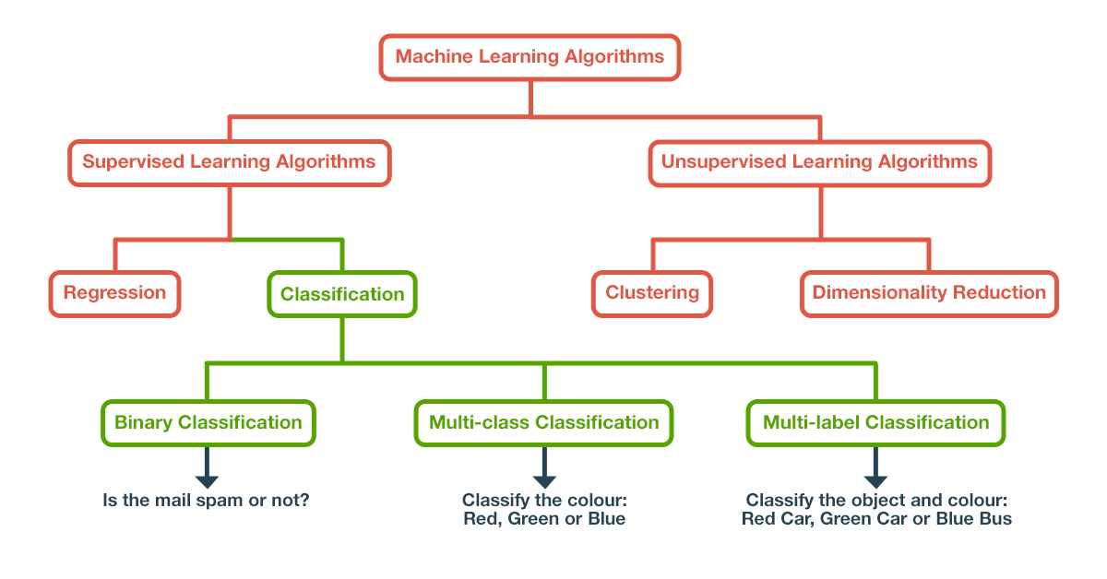
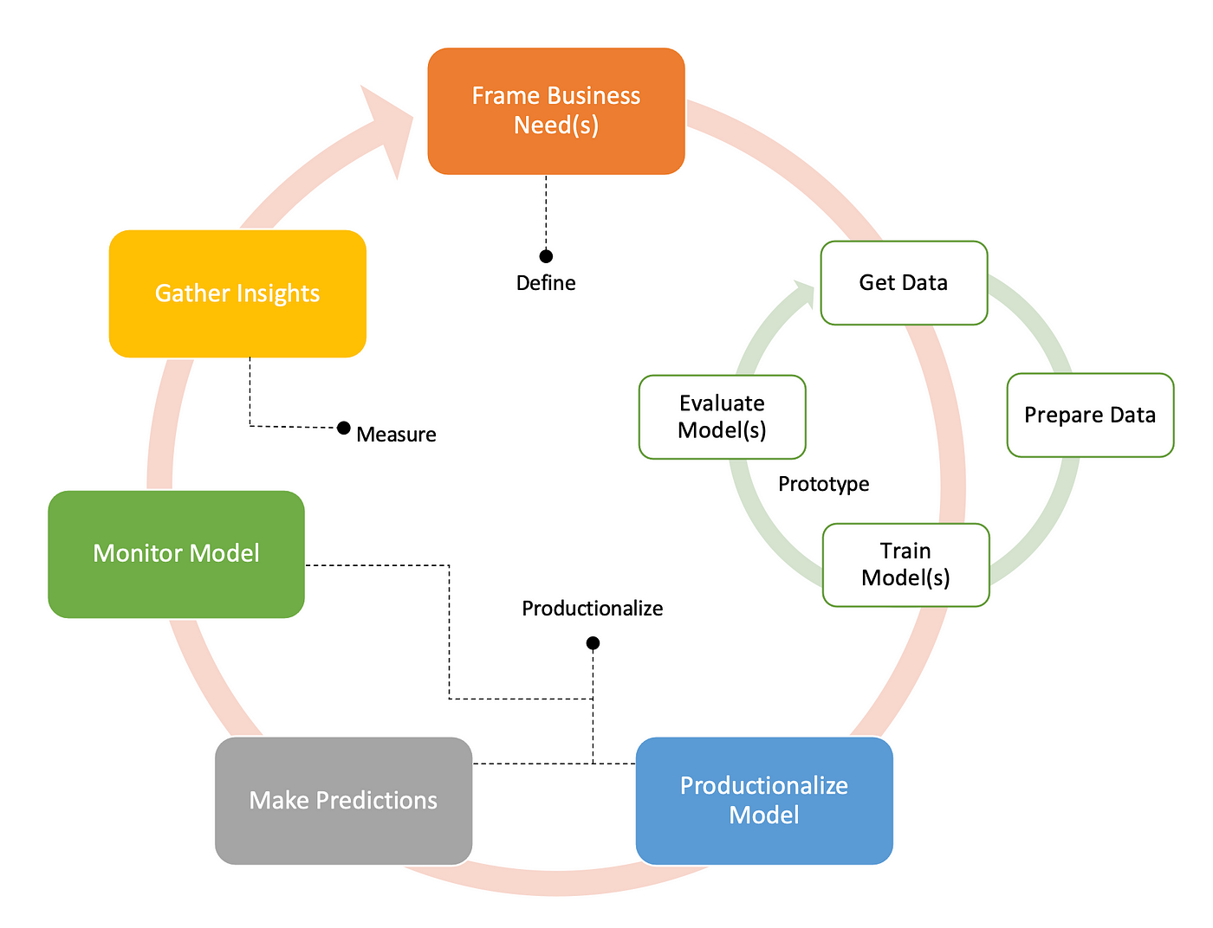
Machine Learning Models
In the domain of adverse event prediction, a wide array of Machine Learning (ML) models and algorithms are employed to analyze complex datasets and make predictions. Let's explore some of the key aspects:
1. Machine Learning Models:
Several ML models are used, including but not limited to:
Logistic Regression
Random Forest
Gradient Boosting
Neural Networks
Support Vector Machines (SVM)
These models are chosen based on factors such as the nature of the data and the specific prediction problem.
2. Multiclassification Models:
In the context of adverse event prediction, multiclassification models are commonly employed.
These models are designed to predict and classify adverse events into various categories, helping to distinguish between different types and severity levels.
3. Model Training and Validation:
The process of training a machine learning model involves:
Feeding the model with historical data, including features related to drug usage, patient characteristics, and other relevant factors.
Teaching the model to recognize patterns and associations between these features and adverse events.
Fine-tuning the model to optimize its predictive accuracy.
Validation is a critical step in the process to ensure model reliability:
Data is divided into training and validation sets.
The model's performance is evaluated on the validation set, assessing its ability to accurately predict adverse events.
Various metrics, such as precision, recall, and F1-score, are used to gauge model performance.

Slide 7
Sentiment Analysis
Sentiment analysis, often referred to as opinion mining, is a process of computationally determining the sentiment or emotional tone expressed in a piece of text, such as patient reviews, social media posts, or textual data from various sources.
In the context of pharmaceuticals, sentiment analysis is highly relevant for several reasons:
1. Understanding Patient Experiences:
Sentiment analysis helps us gain insights into how patients perceive and feel about pharmaceutical products.
It provides valuable information about patient satisfaction, concerns, and preferences.
This understanding is vital for improving patient-centered care and tailoring treatments to individual needs.
2. Identifying Safety Concerns:
By analyzing patient reports and sentiments, pharmaceutical companies can identify potential safety concerns and adverse events.
Early detection of safety issues allows for prompt actions to mitigate risks and ensure patient safety.
3. Monitoring Product Performance:
Sentiment analysis helps in tracking how well pharmaceutical products are performing in the market.
It provides real-time feedback on the effectiveness, tolerability, and side effects of medications.
Textual data sources for sentiment analysis in pharmaceuticals include:
1. Patient Reviews and Surveys:
Reviews and surveys conducted with patients provide direct feedback on their experiences with medications.
These sources offer rich insights into patient sentiments.
2. Social Media Posts:
Social media platforms are often used by individuals to share their experiences and opinions about pharmaceutical products.
Mining social media data can reveal trends and sentiments within the online community.
3. Clinical Notes and Medical Records:
Sentiment analysis can also be applied to clinical notes and medical records to extract insights about patient experiences during treatment.

Slide 8
Tools and Technologies
Content:
The field of AI/ML applications in post-marketing surveillance and sentiment analysis relies on a suite of advanced tools and technologies that empower researchers and practitioners.
1. Machine Learning Frameworks:
A variety of ML frameworks, such as sciket learn, provide the foundation for developing and training predictive models.
These frameworks offer libraries and tools for building, optimizing, and deploying machine learning algorithms.
2. BERT Model for Sentiment Analysis:
For sentiment analysis, advanced deep learning models like BERT (Bidirectional Encoder Representations from Transformers) are commonly employed.
BERT excels in understanding context and nuances within text, making it highly effective for sentiment analysis.
3. Dash App for User Interface:
Creating user-friendly interfaces to interact with AI/ML models is essential.
Dash, a Python web application framework, is often used to build interactive and customizable dashboards for presenting results and insights.
4. Hosting and Deployment:
To make AI/ML applications accessible, they need to be hosted and deployed.
This often involves the use of cloud platforms, such as Render, AWS, Azure, or Google Cloud, to ensure scalability and availability.
5. Python Programming Language:
Python is the language of choice for many AI/ML practitioners due to its rich ecosystem of libraries, extensive community support, and ease of use.
6. Data Processing Tools:
Tools like Pandas and NumPy are essential for data preprocessing and manipulation, enabling researchers to prepare data for analysis.

Slide 9
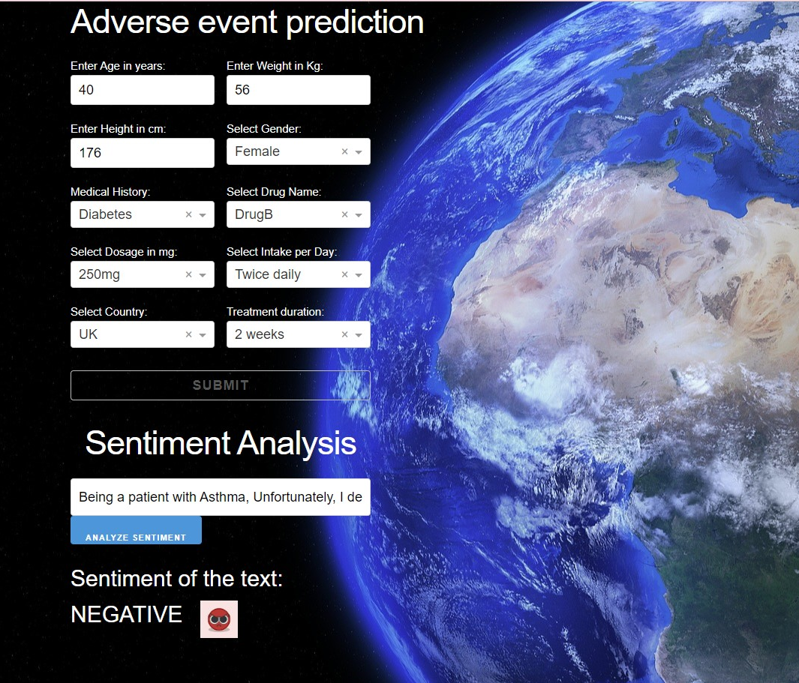
Applications
Timely detection of new and response to adverse events improve patient safety.
Personalized medicine enhances treatment outcomes and minimizes side effects.
Efficient pharmacovigilance leads to cost savings and reduced risks.
Enhanced patient experiences increase patient engagement and loyalty.
Streamlined regulatory compliance expedites product approval and market access.
Overall, AI/ML applications are revolutionizing healthcare by making it safer, more effective, and patient-centric.
Live dashboard link:
https://pms-analyzer12112121.onrender.com
Git hub code and data Predictive adverse event model fig 1(AI application) : https://github.com/VachanNaik/pms-sentiment
Git hub code and data for dashboard app2: https://github.com/VachanNaik/new-analyzer
Fig1

Slide 10

Conclusion
In conclusion, we've explored the dynamic landscape of AI/ML applications in predicting adverse events and sentiment analysis within post-marketing surveillance. Let's recap the key takeaways:
AI/ML empowers us to predict adverse events with greater accuracy, allowing for early intervention and improved patient safety.
Sentiment analysis provides valuable insights into patient experiences, enhancing patient-centered care and product development.
These applications are revolutionizing pharmaceuticals, making them safer, more personalized, and more patient-centric.
As we look to the future, several exciting research directions and advancements are on the horizon:
1. Enhanced Data Integration: Integrating diverse data sources, such as genomics and wearables, will provide a more comprehensive view of patient health and treatment outcomes.
2. Explainable AI: Developing models with enhanced interpretability and transparency will facilitate trust and regulatory compliance.
3. Real-time Surveillance: Advancements in AI/ML will enable real-time monitoring of adverse events, allowing for rapid response and mitigation.
4. Patient Engagement: AI-driven tools will further engage patients in their healthcare decisions and experiences.
5. Regulatory Collaboration: Collaborative efforts between pharmaceutical companies, regulatory agencies, and researchers will shape the future of post-marketing surveillance.
Thank you

