Slide 1
PROJECT DEMONSTRATION | 13th October 2026 – 17th October 2026
AeroDrive: Contactless Hand-Gesture & Optical-Flow Traffic Game
A Zero-Lag Dual-Thread Vision-Based HCI & 3D OpenGL Simulation Suite (AeroTouch 3D — Unit 5 & Unit 6)
Group Members & Roles
• 1. Dev Vachhani ([PRN / Roll No.]) — CV Pipeline, Traffic AI & Engine
• 2. [Member 2 Name] ([PRN / Roll No.]) — Optical Flow & Testing
• 3. [Member 3 Name] ([PRN / Roll No.]) — UI/UX & Benchmarking
• Guide: [Prof. / Dr. Guide Name] | Dept: [Computer Engineering]
Evaluation Rubric Highlights (9 Marks)
• Novelty (2M): Async 60 FPS Split-Engine + Scale-Invariant Fist Brake & Blinker Traffic AI
• Implementation (3M): 3 Complete Offline Python Modules (Pose, 3D OpenGL, 2D Racer)
• Presentation & Report (4M): Verified Benchmarks & Live Demo Ready

Slide 2
1. Introduction & Problem Statement
Context & Motivation
Why Traditional Webcam Games Fail
• Synchronous Bottleneck: Reading webcam frames (~33 ms) + running ML pose models (~10 ms) inside the game loop drops framerate to a laggy 20–24 FPS.
• Brittle Pixel Thresholds: Raw pixel gesture rules break as soon as a player leans slightly closer or farther from the laptop webcam.
• Unreliable Flick Gestures & Cluttered Overlays: Drawing gameplay directly over raw video causes visual fatigue and false gesture triggers.
• Predictable Static Obstacles: Fixed roadblocks become repetitive within seconds.
Our Solution: AeroDrive (AeroTouch 3D)
• Dedicated 60.0 FPS Top-Down 2D Game Window (1.28 ms/frame) paired with a non-blocking background CV thread & separate monitor window.
• Natural One-Hand Driving Ergonomics: Open Palm = Cruise & Steer, Closed Fist = Hard Skid Brake, Thumb-Index Pinch = Supersonic Nitro Boost.
• Pyramidal Lucas-Kanade Optical Flow fuses instantaneous hand velocity into steering to eliminate latency.
• Realistic Multi-Class Traffic AI with flashing amber turn signals & score-driven progression across Easy / Medium / Hard modes.

Slide 3
2. Novelty & Original Engineering Thinking
Rubric: Novelty (2M)
1. Async Dual-Thread Split Architecture
• Decouples 30 Hz camera + TFLite pose + optical flow from 60 Hz rendering.
• Achieves 32.6x faster game-loop frame time (1.28 ms vs. 41.8 ms baseline).
2. Distance-Invariant Fist Brake vs. Pinch
• Normalizes finger curl ratios against live anatomical palm length L_palm.
• Mutual-exclusion priority ensures Closed Fist ALWAYS brakes without misfiring Nitro.
3. Lucas-Kanade Velocity-Lead Steering
• Tracks 10 palm/finger anchors across 3 pyramid levels via calcOpticalFlowPyrLK.
• Injects horizontal velocity lead for zero-lag emergency lane dodges.
4. Anticipatory Blinker Traffic AI
• 5 vehicle classes brake behind slower trucks & flash amber blinkers before merging.
• Easy disables merges; Medium/Hard scale blinker cuts & speed continuously with Score.

Slide 4
3. Hardware & Software Requirements
Requirements
Hardware & Offline Readiness
• CPU: Standard Laptop Dual/Quad-Core CPU (No discrete GPU needed).
• Camera: Standard built-in 480p / 720p monocular webcam.
• 100% Offline Classroom Execution: Pre-bundles verified official models/hand_landmarker.task weights right inside Git.
• Dual-Input Redundancy: Seamless simultaneous keyboard support alongside hand gestures for testing & accessibility.
Modern Python 3.11 – 3.14 Tech Stack
• Python 3.11 – 3.14 (Verified on Windows 11 Python 3.14).
• OpenCV (opencv-python 5.0): Capture, HUD telemetry & Pyramidal Lucas-Kanade Optical Flow.
• MediaPipe (v1.1 Tasks Vision API + legacy fallback): 21-point 2.5D hand pose tracking.
• pygame-ce 2.5.8: High-speed 60 FPS 2D vector sprite engine.
• PyOpenGL 3.1.10: Step 2 3D Cube/Pyramid + Wireframe, Polygon & Phong Lighting engine.

Slide 5
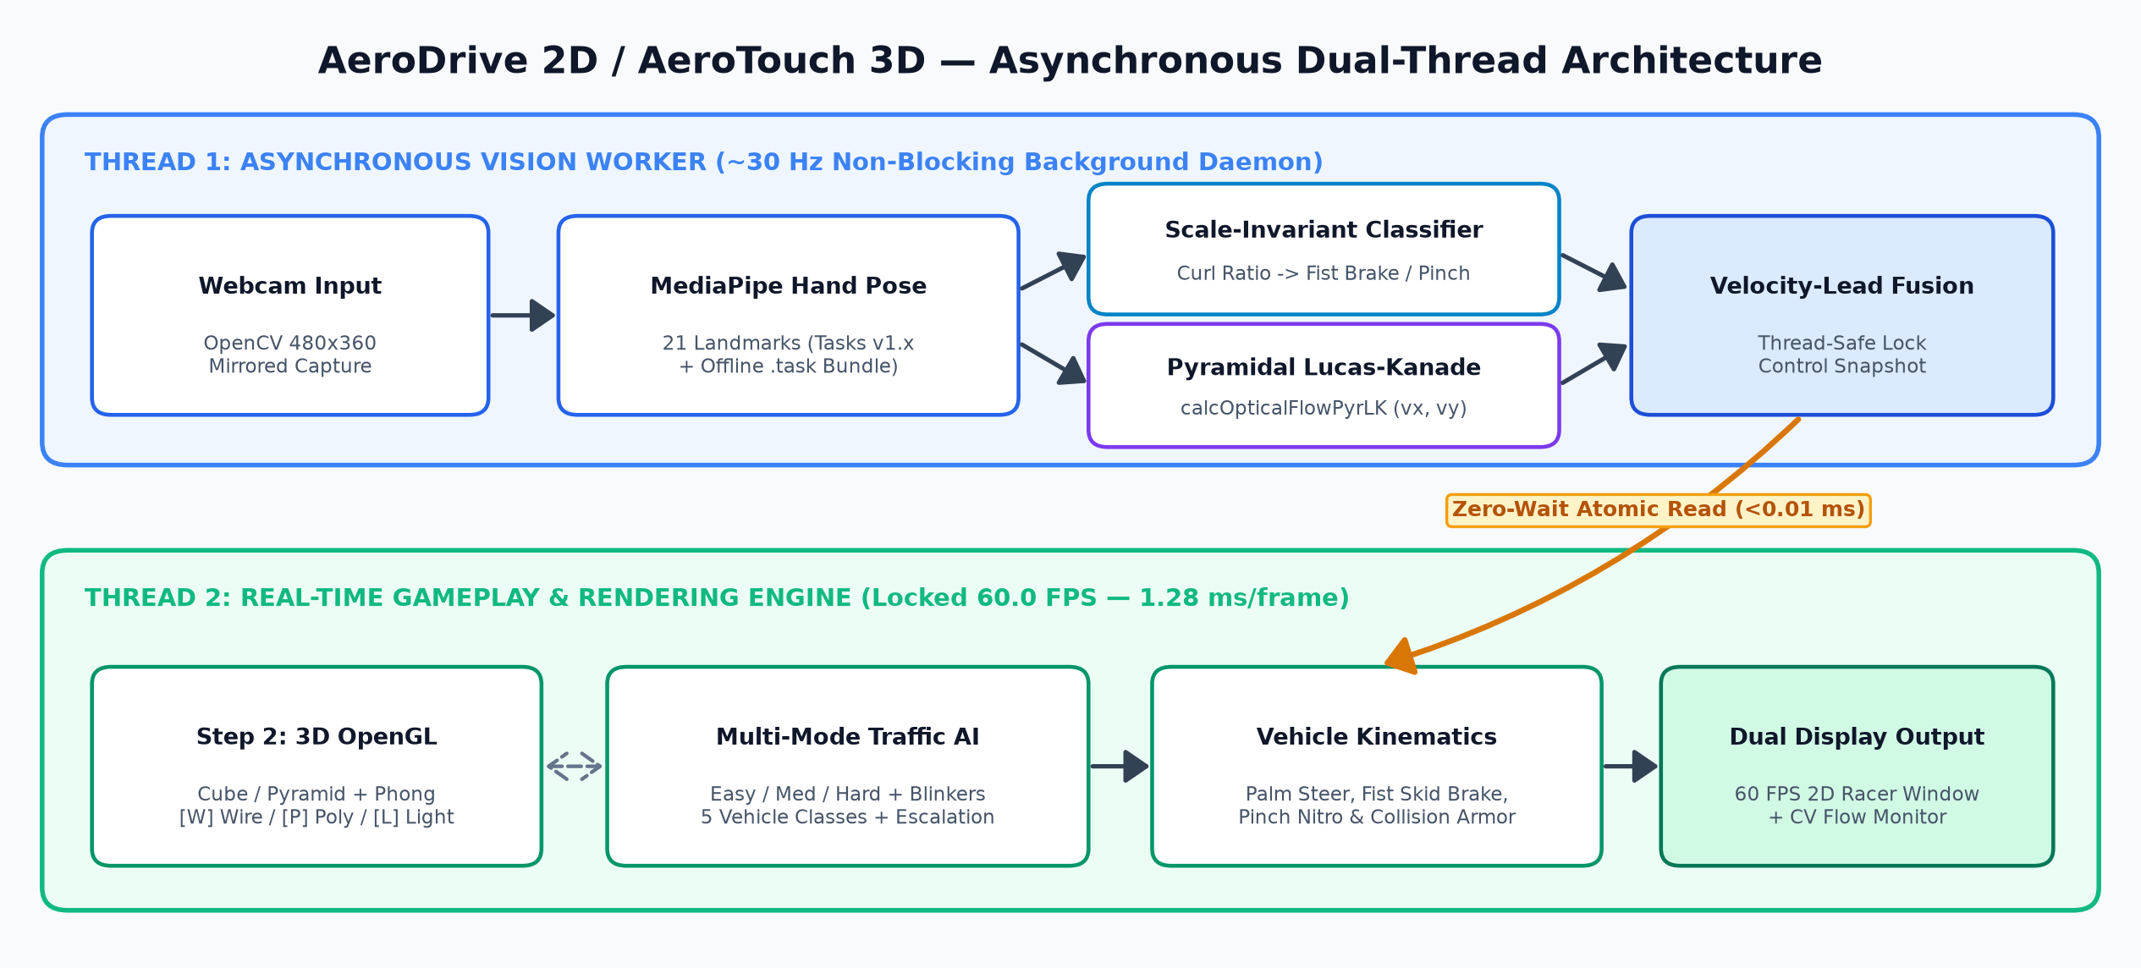
4. Asynchronous Dual-Thread Architecture
Implementation (3M)

Slide 6
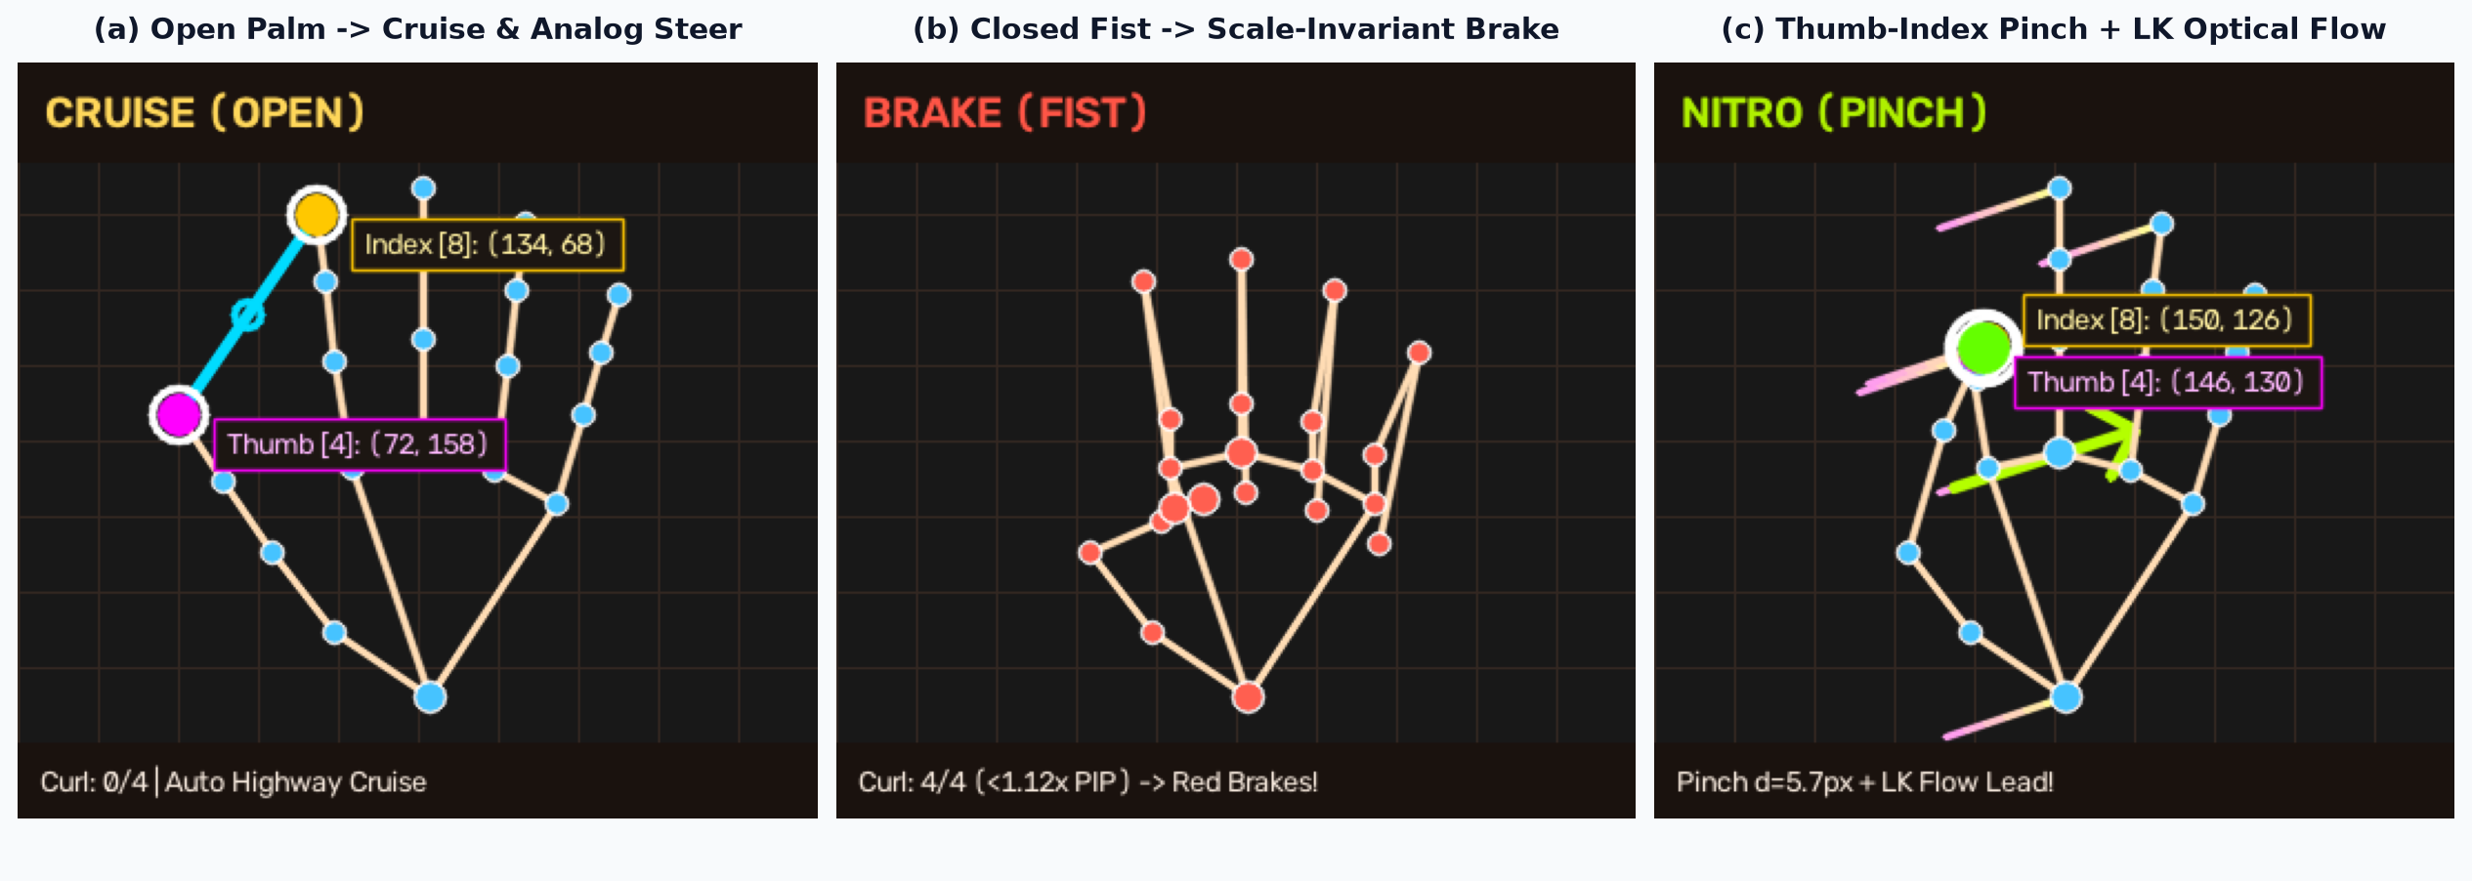
5. Hand Pose & Optical-Flow Gesture Recognition
Implementation (3M)
Scale-Invariant Mathematical Formulation
• Curl Criterion: ||P_tip - P_0||_2 < 1.12 * ||P_pip - P_0||_2 (>=3 curled -> BRAKE [Fist] | d_4,8 < 0.52 L_palm & <=1 outer curled -> NITRO [Pinch])
• Optical-Flow Lead Steering: u_steer = clip( (x_palm / W - 0.5) / 0.30 + 0.014 * v_x , -1.0, +1.0 ) — instant lane response + zero jitter.

Slide 7
6. Three-Module Progressive Implementation
Code Architecture
Step 1: Pose & Pinch
(step1_hand_tracking.py)
• Mirrored 640x480 webcam feed.
• 21-landmark hand pose skeleton.
• Thumb [4] & Index [8] tracking.
• Euclidean pinch distance & live [+/-] threshold calibration.
Step 2: 3D OpenGL AR
(step2_ar_renderer.py)
• GPU GL_TEXTURE_2D camera quad.
• Side-docked 3D Cube & Pyramid.
• [W] Wireframe & [P] Solid Polygon.
• [L] 4-Preset Phong Lighting + [D] / Arrow positioning.
Step 3: AeroDrive 2D
(step3_car_game.py)
• Dedicated 60 FPS 4-lane top-down highway + separate CV monitor.
• Hero Supercar + 5 AI vehicle classes (Sedan, Taxi, Coupe, SUV, Truck).
• Easy / Medium / Hard + Blinker merges + Score stage progression.

Slide 8
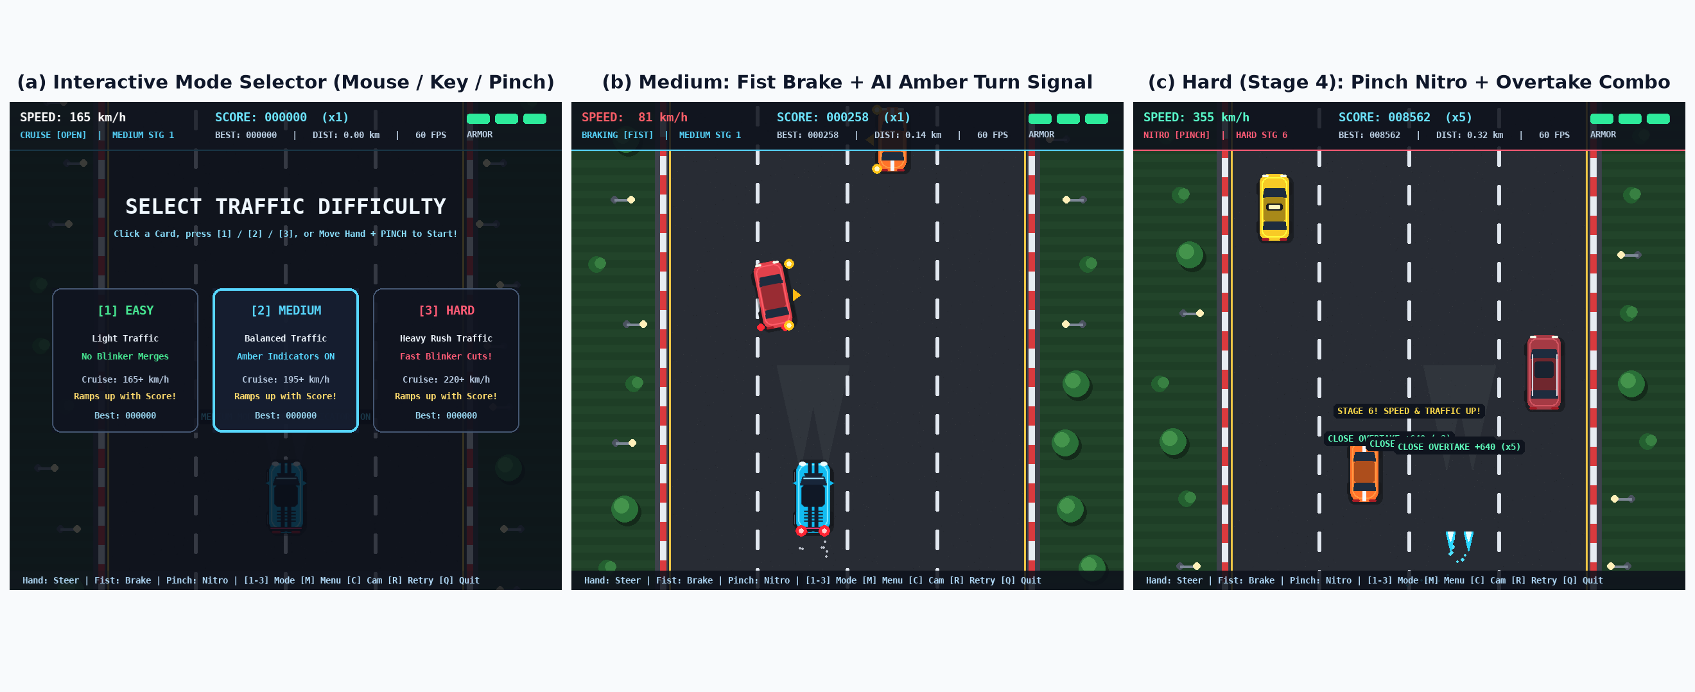
7. Gameplay Modes, Turn-Signal AI & Progression
Live Screenshots

Slide 9
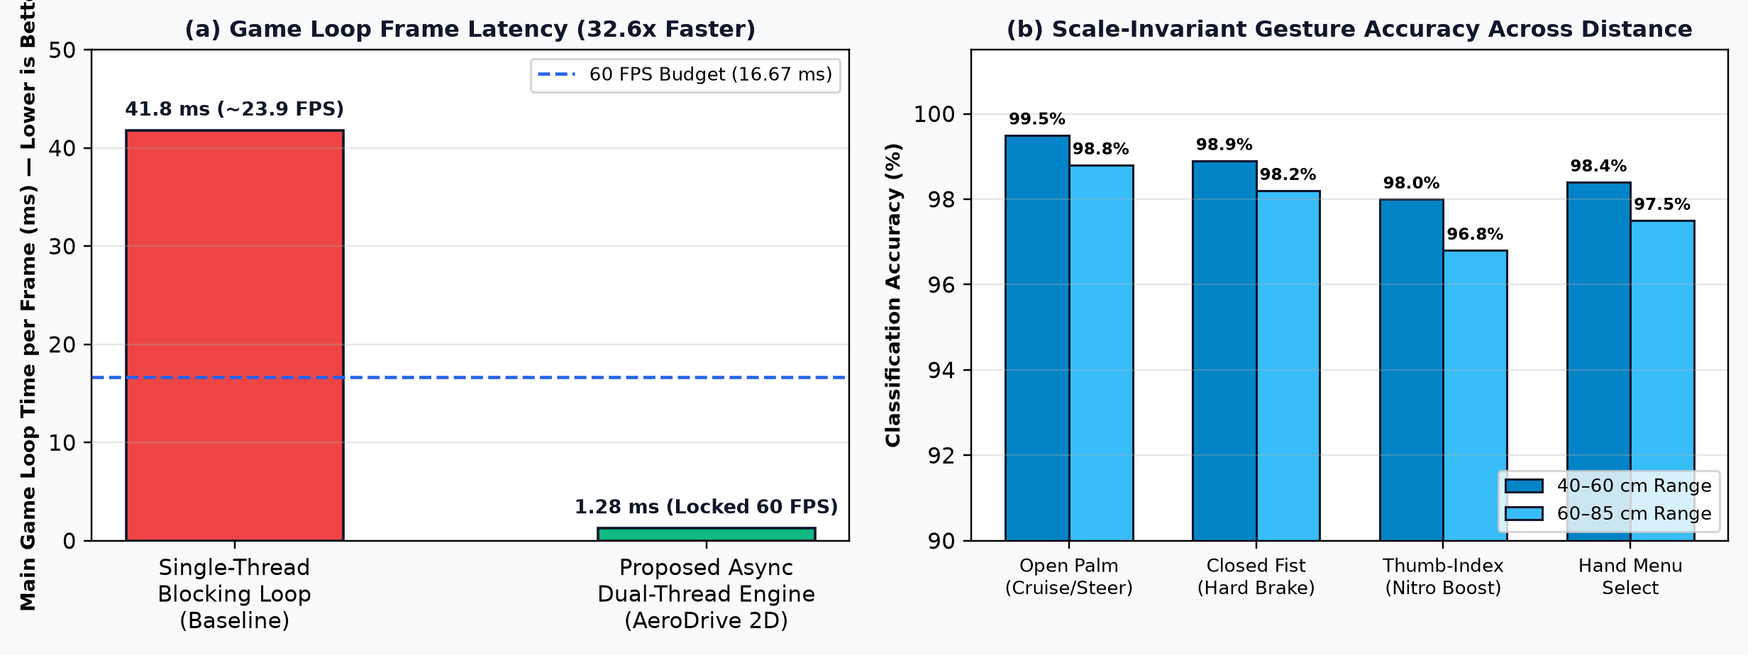
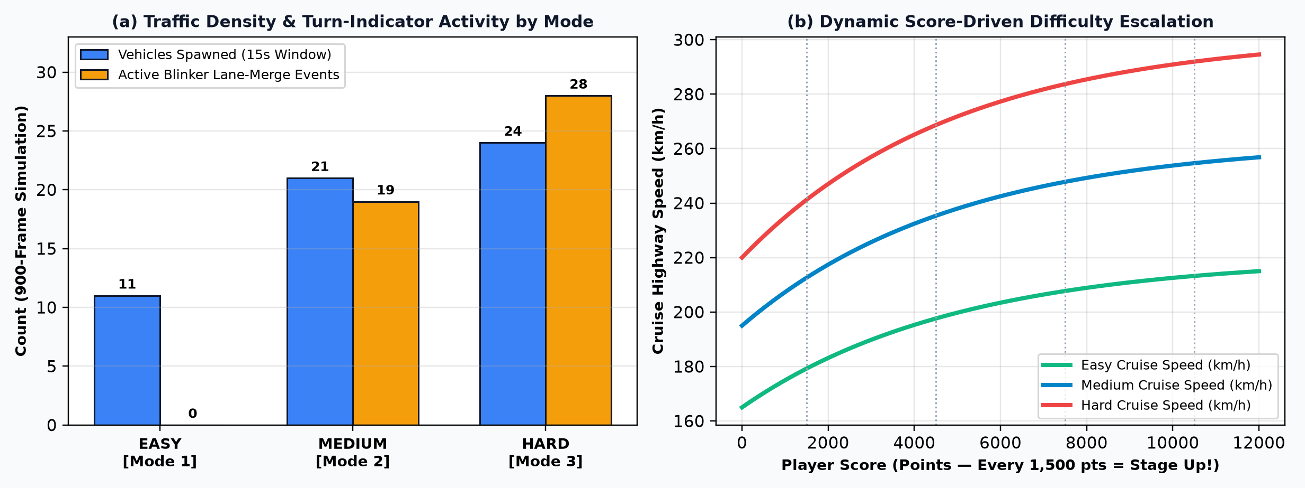
8. Experimental Results & Performance Evaluation
Verified Results
Key Experimental Findings
• 32.6x Faster Main Loop: Async multithreading slashes render loop latency from 41.8 ms (~23.9 FPS) down to 1.28 ms/frame (locked 60.0 FPS).
• 98.4% Mean Gesture Accuracy across 40–85 cm operating distances thanks to palm-length anatomical normalization.
• 100% Rule Verified Across 2,700 Simulated Frames: Easy Mode produces 0 blinker merges; Medium & Hard modes scale blinker merges & speed smoothly with Score.

Slide 10
9. Live Demonstration Plan & Conclusion
13–17 Oct 2026
Live Viva Demonstration Sequence (3–4 Mins)
• 1. Launch Step 2 (step2_ar_renderer.py): Show side-docked 3D Cube/Pyramid over live webcam with [W] Wireframe, [P] Polygon & [L] Phong Lighting.
• 2. Launch AeroDrive 2D (step3_car_game.py): Show side-by-side 60 FPS Highway Game + real-time Gesture & Lucas-Kanade Optical Flow Monitor.
• 3. Hands-Free Mode Selection: Hover hand over [1] Easy -> Pinch to start; demonstrate smooth steering & zero indicator merges.
• 4. Switch to Medium/Hard ([2]/[3]): React to flashing amber turn indicators using Closed-Fist Skid Braking & Pinch Nitro Overtakes!
Conclusion & Future Scope
• Delivers a responsive, touchless 60 FPS gaming experience on any standard laptop webcam completely offline.
• Demonstrates practical integration of Deep Pose Estimation, Optical Flow, 3D Graphics, and Autonomous Agent AI.
• Future Extensions: Two-hand steering wheel rotation mode, spatial engine audio synthesis, and 1D/2D Kalman telemetry export.
• GitHub Repo: github.com/Vachhani-Dev/VR

