Slide 1
Churn Case
Kapacity Telco
Kapacity, August 2021

Slide 2
Content
1. | Introduction
2. | Data
3. | Basic Plan
4. | Plus Plan
5. | Premium Plan
6. | Summary
7. | Annex - Process

Slide 3
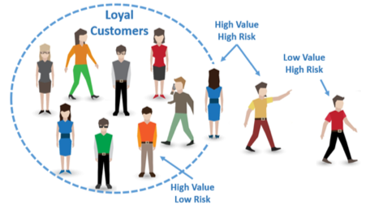
Introduction
Case description
Churn challenge
Offer discount → Fees
Who ?
How much ?

Slide 4
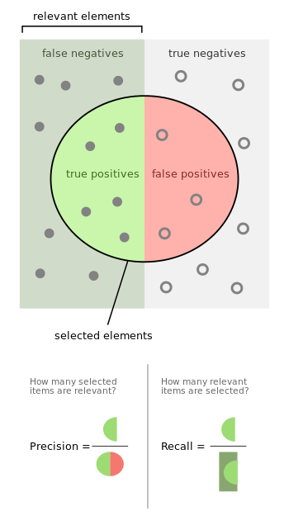
Introduction
Definitions
We will select customers to send discount to:
Precision: For those receiving discount, percentage of churners
Ex: Precision of 90% means that 10% of those who received discount were not about to churn
Recall: Percentage of churners reached
Ex: Recall of 80% means that 80% of all eventual churners received the discount
Balance between sending to all churners (100% recall), but only to churners (100% precision)

Slide 5
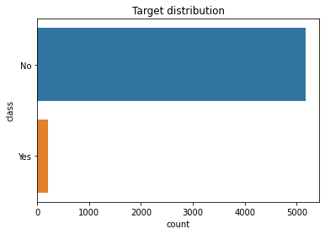
Data
Basics
Strongly imbalanced towards churn:
No Churn Ratio: 0.96
Yes Churn Ratio: 0.04
Good: people stay ☺
Bad: churners are harder to identify ☹
Created new feature:
Number of services

Slide 6
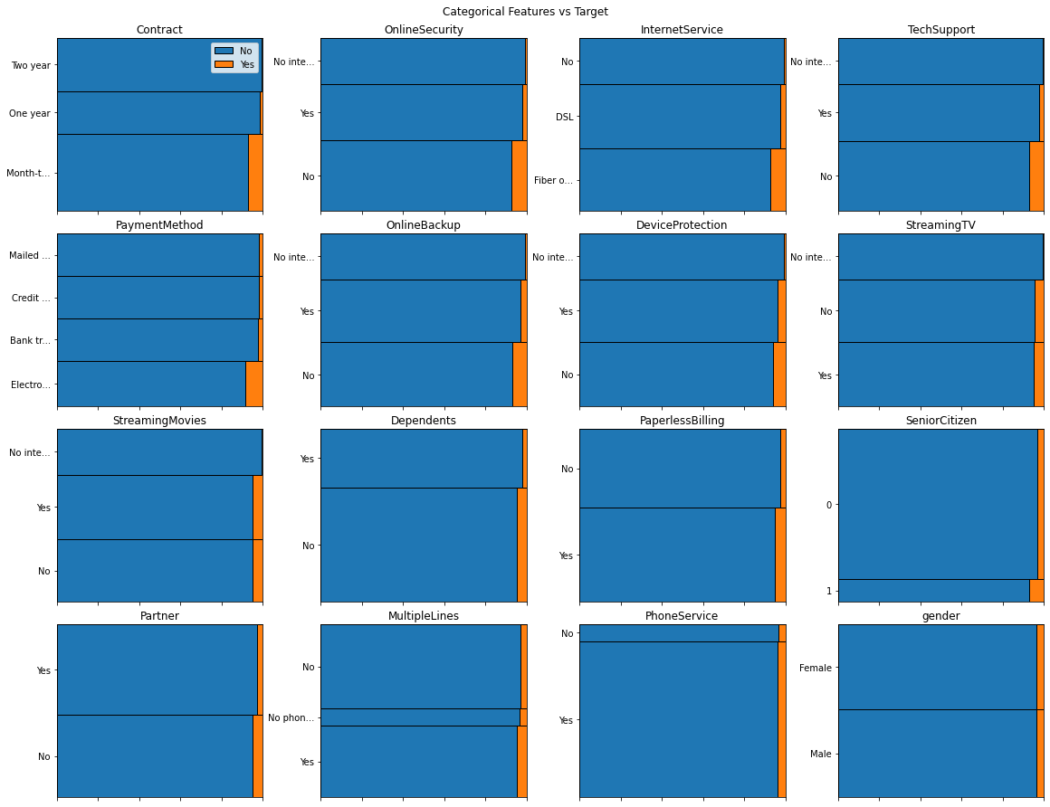
Data
Visuals – Categorical
Looking for strong imbalance in churners (“Yes” - orange) between categories.
Ex: Customers using Electronic Payment Method have bigger ratio of churners.
Ex: Gender doesn’t seem to be a distinguishing feature in regards of churn

Slide 7
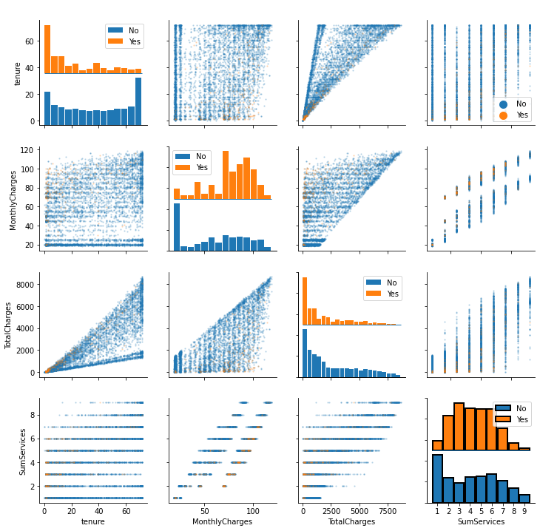
Data
Visuals – Continuous
Looking for strong imbalance in churn for different values.
Ex: Customers with Monthly Charges between 75 and 120 are churning more
Ex: Having 1 (maybe 8 or 9) service has less churn

Slide 8
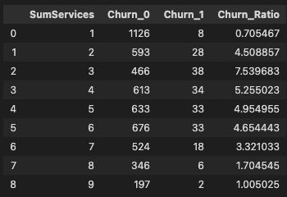
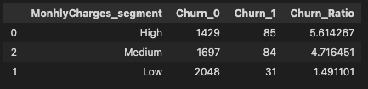
Data
Statistics
Do you really want to reduce the number of services to 1?
Gains are minimal
Ex: 6 to 7 = 1.3 and gain 7 to 8 = 1.6
Do you really want to reduce monthly charges?
* These two features are linked (correlated). Better use other, independent information

Slide 9
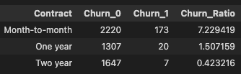

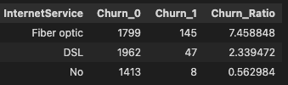
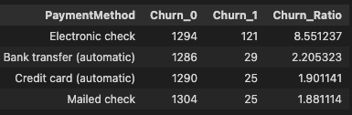
Data
Statistics
Contract: Giving discounts to move from month-to-month one or better, two years contract would help. Moreover, it’s permanent
Senior citizen: They tend to churn more, a campaign for them might be nice
Internet service: Fiber optic has more churn, but probably more revenues, hence not interesting
Payment method: Electronic check having the highest churn ratio, giving discount to go to automatic payment seems great. Moreover, it’s permanent.

Slide 10
Basic Plan
Segment based on statistics – Contract type
Give discount to move from month-to-month to one year or better, two years contract.
Reached 87% of churners
☹ 93% of people you give discount are not thinking about churning (more than 2000 discounts for nothing)
Precision | 7%
Recall | 87%

Slide 11
Basic Plan
Segment based on statistics – Payment method
Give discount to go to automatic payment.
☹ Reached 60% of churners
☹ 91% of people you give discount are not thinking about churning (more than 1000 discounts for nothing)
Precision | 9%
Recall | 60%

Slide 12
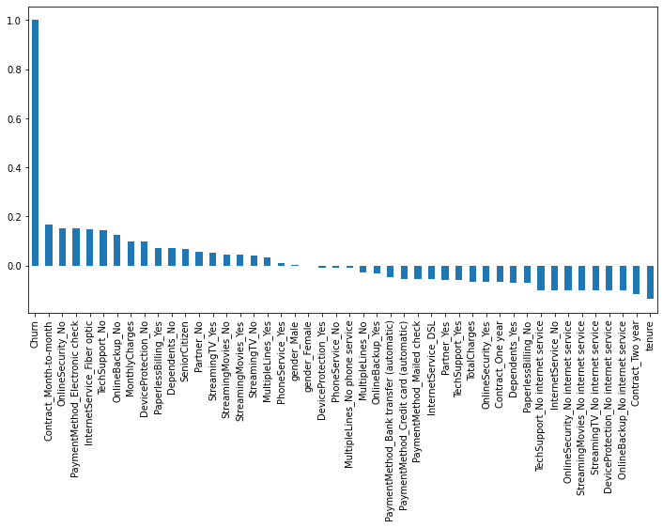
Plus Plan
Model based
Unfortunately, no single factor has a correlation with churn of more than 0.2
→ Build a model to combine factors and predict churn

Slide 13
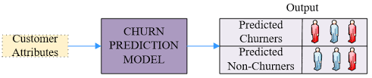
Plus Plan
Model based
Build model that combines feature and predict risk of churn for all customers.
☺ Reached 79% of churners
31% of people you give discount to are not thinking about churning (more than 1600 discounts for nothing)
Once customer identified, campaign can be targeted based on other factors (Ex: senior, payment method,…)
Precision | 69%
Recall | 79%

Slide 14
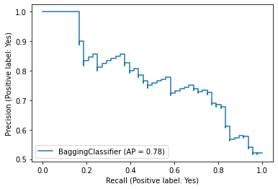
Premium Plan
Model based + segment by risk
Risk to churn
Same model, vary the probability threshold to identify churn. Basic model uses 50%.
High probability threshold:
focused on high risk customers
high precision (no discount to non-churners)
low recall (missing churners)
→ High discount
Low probability threshold:
focused on “all” customers at risk
☹ low precision (discounts to non-churners)
☺ high recall (reached more churners)
→ Smaller discount
Example of precision-recall graph

Slide 15
Premium Plan
Model based + segment by risk
Risk of churn | High | Medium | Low
Threshold | 82 – 100 | 50 – 82 | 30 – 50
Precision | 100% | 64% | 25%
Recall | 17% | 62% (total 79%) | 10% (total 89%)
Type of discount | Big discount | Average discount | Small discount
Plus Plan
Obviously, should combine this with features
- Ex: Offer big discounts to high risk customers using electronic payment if they move to automatic payment
…especially if customer is highly profitable!

Slide 16
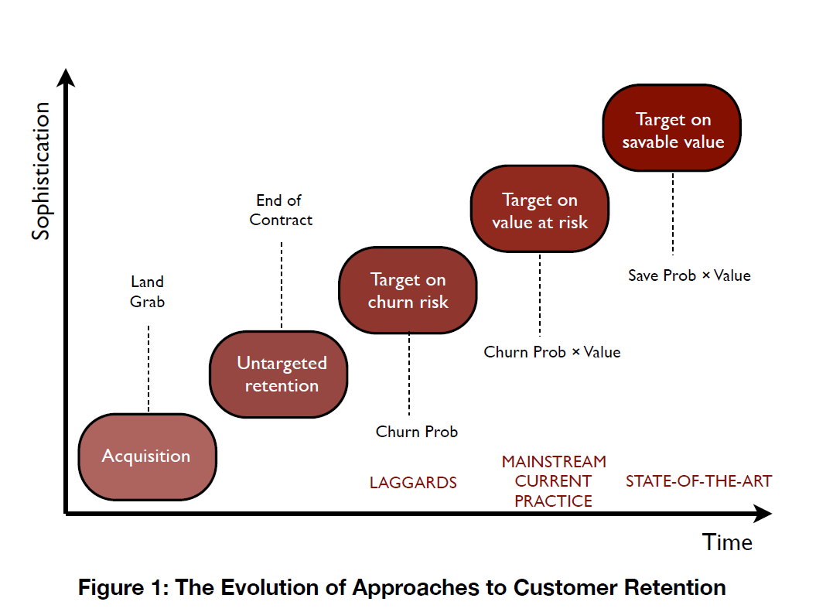
Premium Plan
Customers value
The value of customers should be considered
Focus on customers most profitable Kapacity Telco
Unfortunately, we don’t have this information in the data now.

Slide 17
Premium Plan
Savable customers
Focus on customers that are likely to react positively to discounts
Some customers are note savable. Communicating with some will be the trigger to leave
If you have data about customers and their reaction to offers/emails, we could build a recommendation engine to target the right offer to the right customers

Slide 18
Summary
 | Basic | Plus | Premium *
Risk of churn | Unknown | Medium | High | Medium | Low
Threshold | - | 50 – 100 | 82 – 100 | 50 – 82 | 30 – 50
Precision | By feature | 69% | 100% | 64% | 25%
Recall | By feature | 79% | 17% | 62% (total 79%) | 10% (total 89%)
Type of discount | By feature | Avrg. discount | Big discount | Avrg. discount | Small discount
* Premium Plan could also include customer value targeting and offer recommendation by customer.

Slide 19
Annex – Process
Exploratory Data Analysis
Internet:
Theory of churn and unbalanced data
Models and packages
Business cases on churn
Basic modeling
Tuning
Feature engineering
Undersampling ☺
Presentation Getting results needed
NEXT STEPS:
Cross Validation for mean and standard deviation about model performance
Hyper parameters search

