Slide 1
Data Structure queue, quick overview
First the ArrayList

Slide 2
list.add( );
“A”
0 | 1 | 2 | 3 | 4 | 5
Notes:
When we call the add method, the added element will be placed at the first available position.

Slide 3
0 | 1 | 2 | 3 | 4 | 5
“A”

Slide 4
list.add( );
“B”
0 | 1 | 2 | 3 | 4 | 5
“A”

Slide 5
0 | 1 | 2 | 3 | 4 | 5
“A”
“B”

Slide 6
0 | 1 | 2 | 3 | 4 | 5
“A”
“B”
“C”
“D”
“B”
“E”

Slide 7
list.get(1);
0 | 1 | 2 | 3 | 4 | 5
“A”
“B”
“C”
“D”
“B”
“E”

Slide 8
list.get(1);
“B”
0 | 1 | 2 | 3 | 4 | 5
“A”
“B”
“C”
“D”
“E”
Notes:
You can get from any position in the ArrayList. It returns a reference, i.e. the array is not modified. If you want to modify an ArrayList, you call add or remove method.

Slide 9
ArrayList
We can add at any position
We can remove from any position
We can get from any position

Slide 10

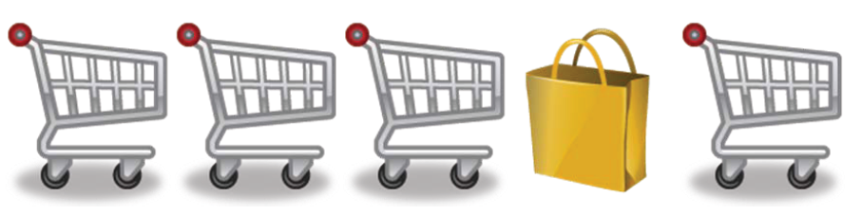
What is a Queue?
Like a queue in the supermarket
Enter and exit only at opposite ends of the line
You add (enqueue) new elements at one end
You take (dequeue) elements from the other end
This is a First In First Out (FIFO)
<<interface>>
QueueADT
+ enqueue(element : T) : void
+ dequeue() : T
+ first() : T
+ indexOf(element : T) : int
+ isEmpty() : boolean
+ size() : int
+ contains(element T) : boolean

Slide 11
What is a Queue?
Like a queue in the supermarket
Enter and exit only at opposite ends of the line
You add (enqueue) new elements at one end
You take (dequeue) elements from the other end
This is a First In First Out (FIFO)
<<interface>>
QueueADT
+ enqueue(element : T) : void
+ dequeue() : T
+ first() : T
+ indexOf(element : T) : int
+ isEmpty() : boolean
+ size() : int
+ contains(element T) : boolean

Slide 12
What is a Queue?
<<interface>>
QueueADT
Add element to the back of the queue
+ enqueue(element : T) : void
+ dequeue() : T
+ first() : T
+ indexOf(element : T) : int
+ isEmpty() : boolean
+ size() : int
+ contains(element T) : boolean

Slide 13
What is a Queue?
<<interface>>
QueueADT
Take front element out of the queue
+ enqueue(element : T) : void
+ dequeue() : T
+ first() : T
+ indexOf(element : T) : int
+ isEmpty() : boolean
+ size() : int
+ contains(element T) : boolean

Slide 14
What is a Queue?
<<interface>>
QueueADT
Return front element from the queue, without modifying the queue
+ enqueue(element : T) : void
+ dequeue() : T
+ first() : T
+ indexOf(element : T) : int
+ isEmpty() : boolean
+ size() : int
+ contains(element T) : boolean

Slide 15
What is a Queue?
<<interface>>
QueueADT
Returns the position of the first occurance of ‘element’
+ enqueue(element : T) : void
+ dequeue() : T
+ first() : T
+ indexOf(element : T) : int
+ isEmpty() : boolean
+ size() : int
+ contains(element T) : boolean

Slide 16
What is a Queue?
<<interface>>
QueueADT
+ enqueue(element : T) : void
+ dequeue() : T
+ first() : T
+ indexOf(element : T) : int
+ isEmpty() : boolean
+ size() : int
+ contains(element T) : boolean
Is the queue empty?

Slide 17
What is a Queue?
<<interface>>
QueueADT
+ enqueue(element : T) : void
+ dequeue() : T
+ first() : T
+ indexOf(element : T) : int
+ isEmpty() : boolean
+ size() : int
+ contains(element T) : boolean
How many elements are in the queue

Slide 18
What is a Queue?
<<interface>>
QueueADT
+ enqueue(element : T) : void
+ dequeue() : T
+ first() : T
+ indexOf(element : T) : int
+ isEmpty() : boolean
+ size() : int
+ contains(element T) : boolean
Does ‘element’ exist in the queue?

