Slide 1
Software Development with UML and Java 2
Design Pattern: Singleton
Part 1

Slide 2
Agenda
Lazy instantiation
Design Pattern: Singleton
Thread safety

Slide 3
Lazy instantiation
Lazy instantiation means to instantiate an object, when you need it. Not before.
Often used for resource heavy objects:
Long creation time
Large memory consumption
Often you check:
If the object I need is null, then I instantiate it

Slide 4
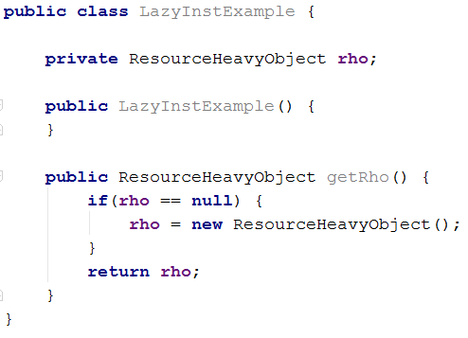
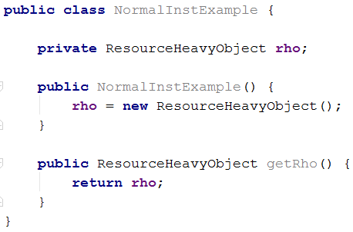
Example

Slide 5
Example

Slide 6
Concept

Slide 7

DB Connection
StoreData
RetrieveData
These could also be Data Access Objects
DeleteData
Managing multiple connections can be tedious, and cause duplicate code
StoreData
MemberData
RetrieveData
DeleteData
DBConnection
InstructorData
DBConnection
EventData

Slide 8
DB Connection
StoreData
RetrieveData
DeleteData
Managing multiple connections can be tedious, and cause duplicate code
StoreData
RetrieveData
DeleteData
DBConnection
MemberData
InstructorData
EventData
DBConnection

Slide 9

Logging
Multiple classes write to a log. We want to make sure they use the same file.
Large System
ClassB
ClassA
ClassC
Logger

Slide 10
Logging
Multiple classes write to a log. We want to make sure they use the same file.
Large System
ClassB
ClassA
ClassC
Logger

Slide 11
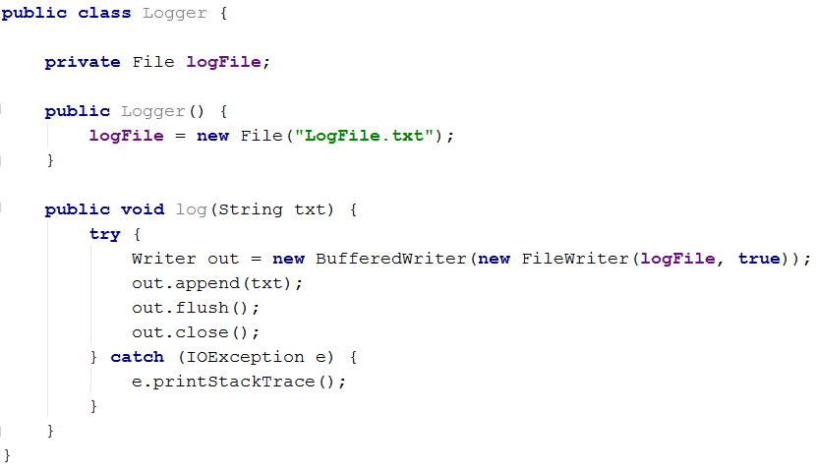
Logger class code

Slide 12
We have a centralized object, which are used by many others.
Logging class, Database Accessor

Slide 13
Software Development with UML and Java 2
Design Pattern: Singleton
Part 2

Slide 14
Design Pattern: Singleton
Intent
Ensure that there is only one instance of a class, and provide a global method to access it
Example
Your system has a logging functionality to output errors and such.
All logging output should go to the same file, the system should always use the same logging class.
Your system uses a database, several classes want access. Make sure they use the same connection.
You printer has a queue, and you want all computers to access the same queue. There can be only one queue.
You GUI can display UI text in different languages. You want to set the language only once, and have all text-instances access this variable.
Problem
How to create a single logging class so that every part of the system has access to this “global” logger?
Notes:
Other example: some kind of network class that handles connections. You want to use the same connection always, instead of creating a new connection between a client and server, every time something new from the server is needed.

Slide 15
Singleton
The same instance of a class is used by many classes.
Many to one relationship.
You want to ensure that there can ever only exists one instance of this class
E.g. we don’t want to log system information into multiple files

Slide 16
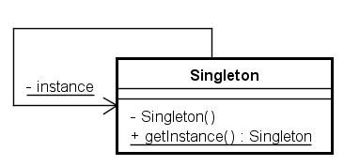
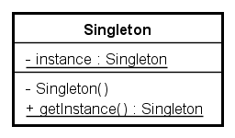
Design Pattern: Singleton. Two common diagrams

Slide 17
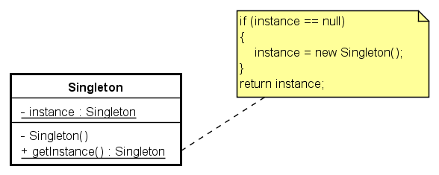
Design Pattern: Singleton
What’s this?
Lazy Instantiation

Slide 18
Design Pattern: Singleton
Why is the constructor private?
Why is method getInstance() static?
Singleton sngl = Singleton.getInstance();

Slide 19
Software Development with UML and Java 2
Design Pattern: Singleton
Part 3

Slide 20




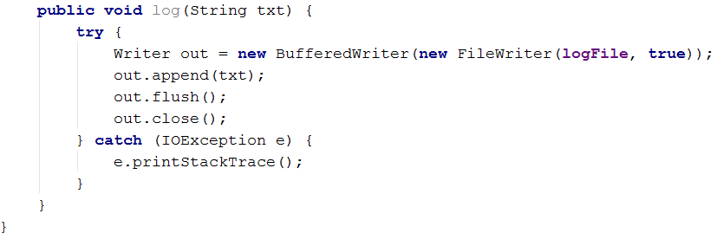
Logger class singleton

Slide 21

Logger class singleton

Slide 22

Logger class singleton

Slide 23
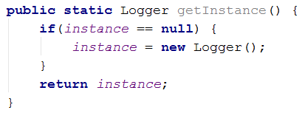
Logger class singleton

Slide 24
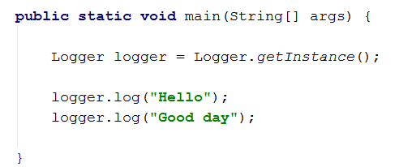
Static method

Slide 25
Singleton use
public class SingletonTest
{
@Test
public void testSingletonOneInstance()
{
Singleton reference1 = Singleton.getInstance();
Singleton reference2 = Singleton.getInstance();
System.out.println("reference1=" + reference1);
System.out.println("reference2=" + reference2);
assertEquals(reference1.toString(), reference2.toString());
}
}
/* OUTPUT:
reference1=Singleton@19821f
reference2=Singleton@19821f
*/

Slide 26
For the Singleton Pattern You Must Remember 3 Things
Private static variable
Private constructor
Static getInstance method → lazy initialization.

Slide 27
Software Development with UML and Java 2
Design Pattern: Singleton
Part 4

Slide 28
Thread safety
Large System
ThreadA
ThreadB
ThreadC
Logger

Slide 29
A
B

Slide 30
B
A

Slide 31
A
B

Slide 32
B
A

Slide 33
A
B

Slide 34
B
A

Slide 35
B

Slide 36
The instance variable was overwritten.
Thread A and Thread B have different instances

Slide 37
Solution?
Synchronize the getInstance method
Double checked locking

Slide 38

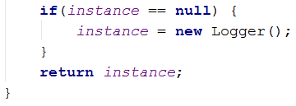
Synchronizationc

Slide 39
Synchronization
May be inconvenient.
We’re blocking access

Slide 40

Double checked locking
Lock object
Lock the ‘critical’ part
Double check

Slide 41
Double checked locking
Lock object
Lock the ‘critical’ part
Double check

Slide 42
Double checked locking
Lock object
Lock the ‘critical’ part
Double check

Slide 43
Double checked locking
Lock object
Lock the ‘critical’ part
Double check
Only the critical section is synchronized, and after initialization, threads don’t block for each other

Slide 44
That was all

Slide 45
