Slide 1
Art Gallery
Year:2023-24

Slide 2

SHRI SHAMBHUBHAI V.PATEL COLLEGE OF COMPUTER SCIENCE & BUSSINESS MANAGEMENT
Guided by: Chandani patel
submitted by: Vadadoriya krishna prafulbhai

Slide 3
Introduction
The Art Gallery Management System has been designed to override the problem of the existing manual system.
This web application is supported to eliminate and in some cases reduce the hardship faced by manual systems.
The application is reduced as much as possible to avoid errors while entering the data.
It also provides a message while entering invalid data.
No formal knowledge is required for the user to operate this system.
Overall we said that the Art Gallery Management System project in PHP is user-friendly.

Slide 4
Project Profile
Project Title | Art Gallery
Project Type | Website
Frontend | HTML,CSS,JS,jQuery,Bootstrap4
Backend | PHP,MYSQL
Web Browser | Mozilla, Google Chrome, IE8, OPERA
Software | XAMPP / Wamp / Mamp/ Lamp (anyone)

Slide 5
Objective
To Create a Seamless User Experience: Stress the importance of delivering a user-friendly experience by ensuring easy navigation, efficient search functionality, and responsive design.
To Facilitate Art Sales: If applicable, state the objective of providing artists with a platform to sell their work and for art collectors to discover and acquire pieces they admire.
Remember to tailor these objectives to the specific goals and mission of your art gallery project, ensuring they align with the content of your presentation. Additionally, make sure your objectives are SMART (Specific, Measurable, Achievable, Relevant, and Time-bound) to provide a clear roadmap for the project's success.

Slide 6
Flow chart
User
Registration
No
Login
yes
Visite site
Purchase art
Manage art

Slide 7
DFD diagram context level dfd
Customer Management
Art Management
Online Art Gallery
Stock Management
Order Management
System User Management
Login Management

Slide 8
First level DFD
Art Management
Generate Art Report
Stock Management
Generate Stock Report
Online Art Gallery
Customer Management
Generate Customer Report
Order Management
Generate Order Report
Login Management
Check User Login Details
System User Management
Generate System User Report

Slide 9
Second level DFD
Login to sysytem
Check Roles of Access
Manage Art Detail
Admin
Manage Order Detail
Forgot Password
Manage Order Update Detail
Check Credential
Manges Modules
Manage Stock Detail
Send Email to User
Manage Customer Detail
Manage Payment Detail
Manage Report
Manage System Admin
Mange Roles Of User
Mange User Permission

Slide 10
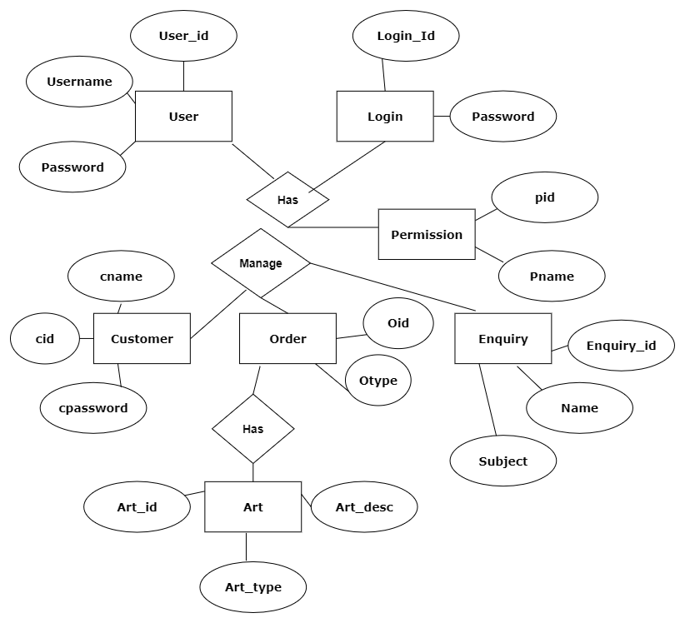
ER Diagram

Slide 11
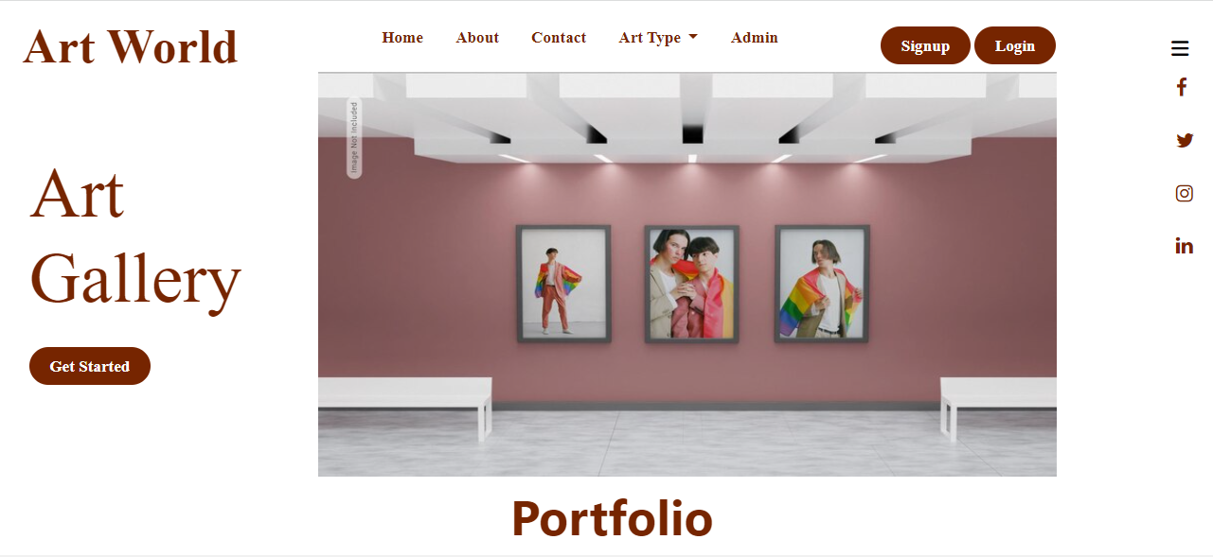
Home page

Slide 12
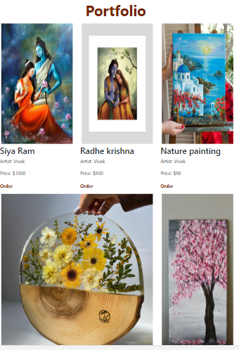

Slide 13
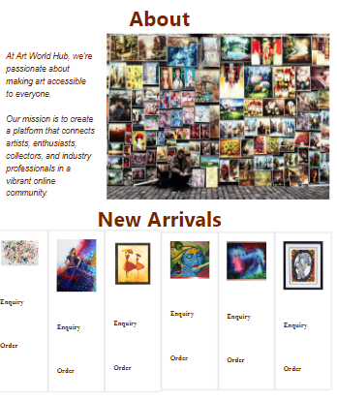

Slide 14
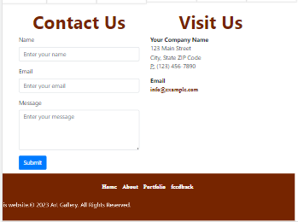

Slide 15
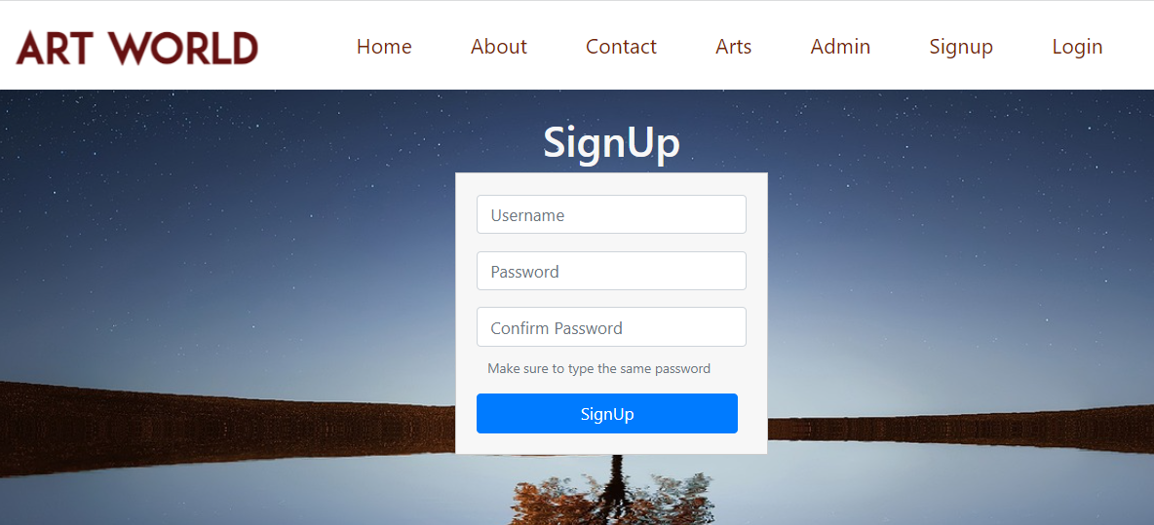
Signup page

Slide 16
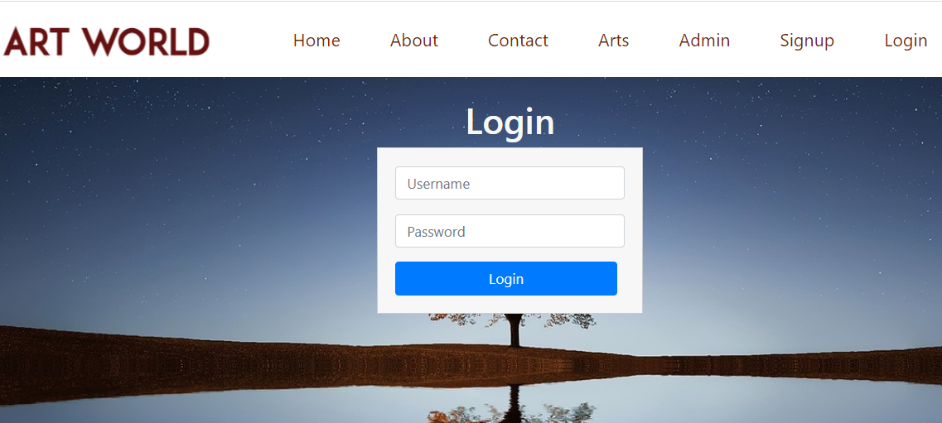
Login Page

Slide 17
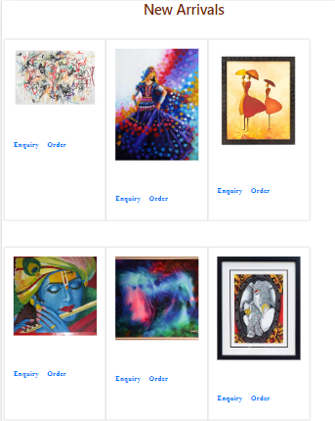
Art Page

Slide 18
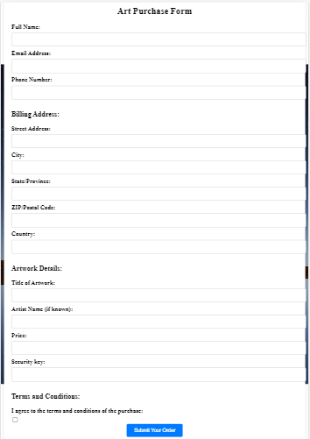
Art Purchase form

Slide 19
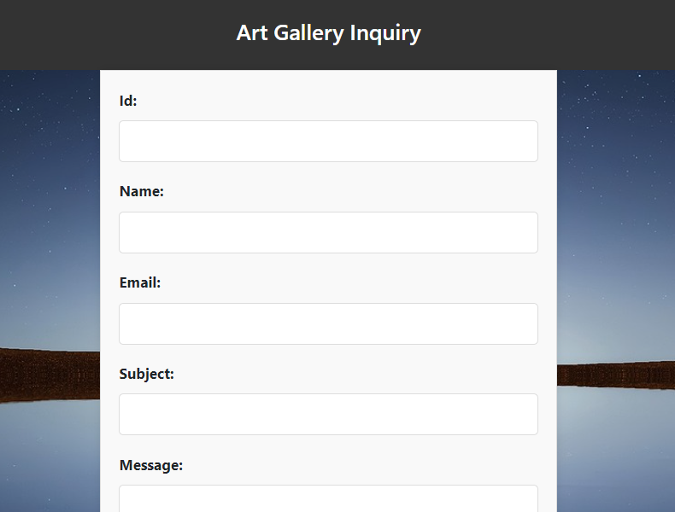
Enquiry Form

Slide 20
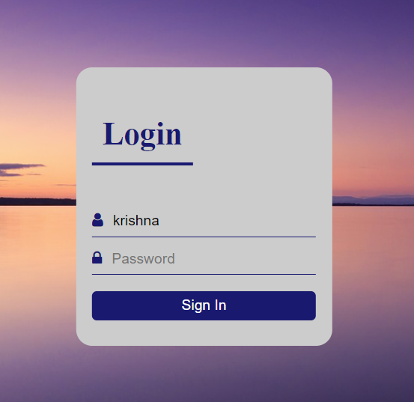
Admin Login

Slide 21
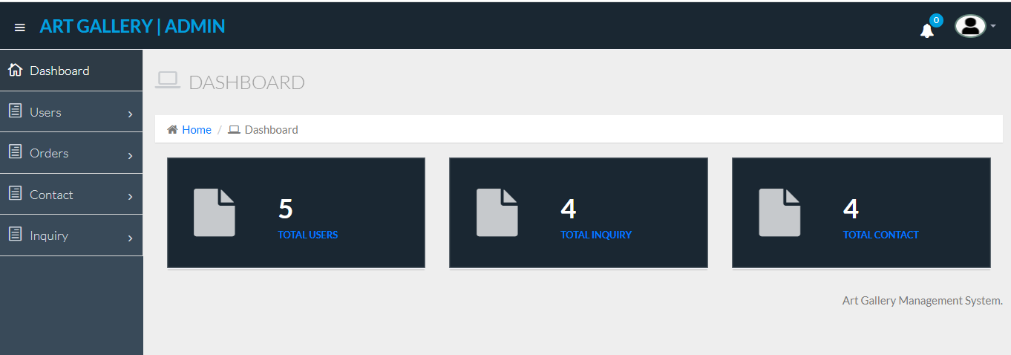
Admin Dashboard

Slide 22
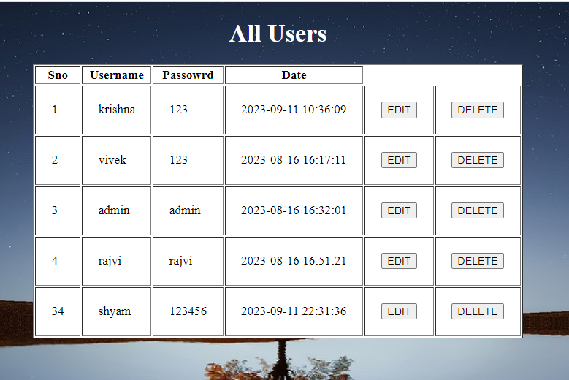
Show all users

Slide 23
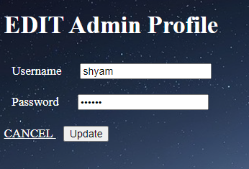
Edit User Profile

Slide 24
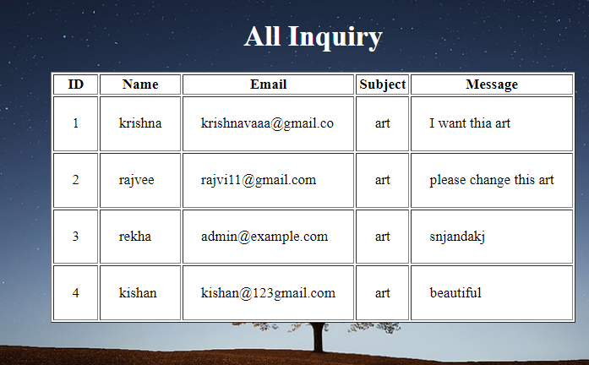
Show inquiry in admin

Slide 25
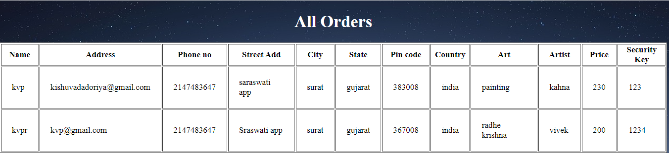
Show Orders in admin

Slide 26
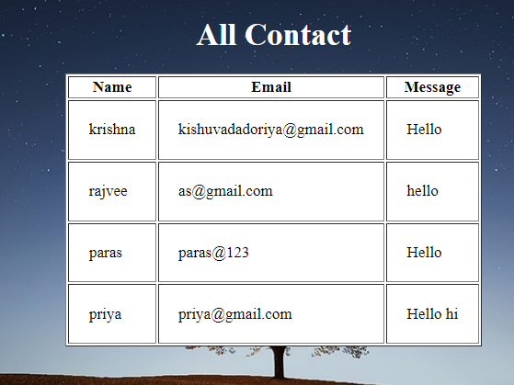
Show Contacts in admin
Thank you

