Slide 1
Nifty100 Financial Intelligence Platform
BlueStock Fintech Internship

Slide 2
Project Overview
Financial analytics platform for Nifty100 companies

Slide 3
Problem Statement
Need centralized investor intelligence and analytics

Slide 4
Objectives
ETL, Data Warehouse, APIs, Dashboards, Cloud

Slide 5
Technology Stack
React, Django, PostgreSQL, Power BI, Python

Slide 6
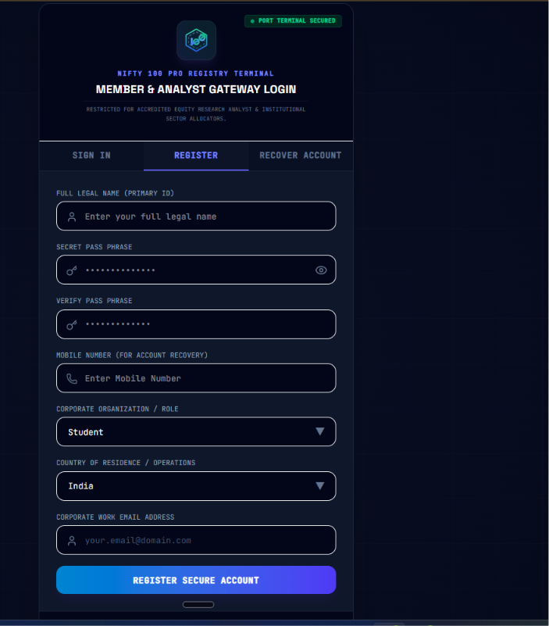
Login & Registration

Slide 7
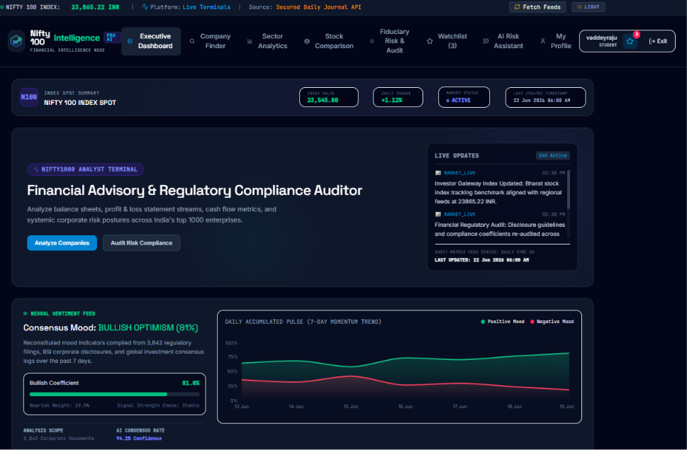
Executive Dashboard

Slide 8
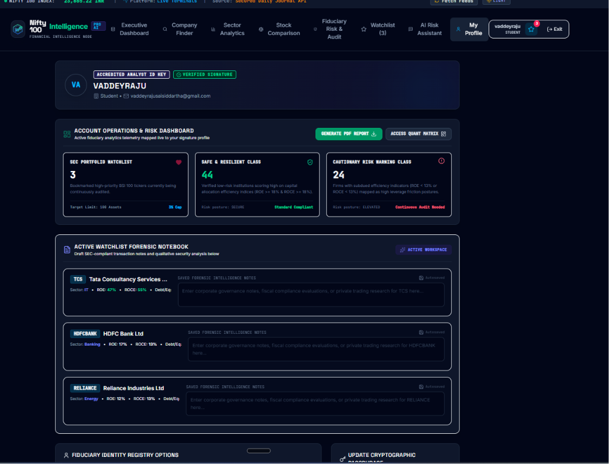
User Risk Dashboard

Slide 9
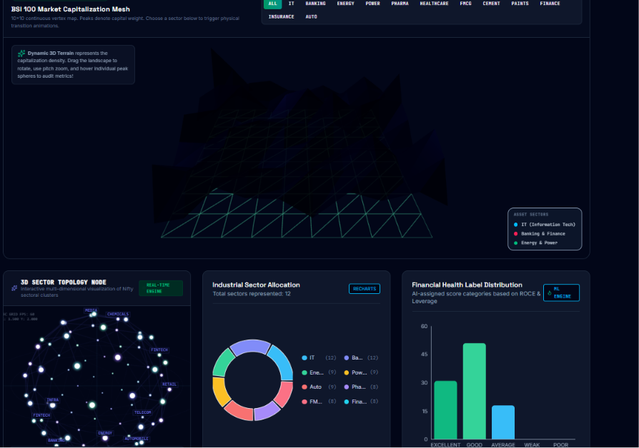
Advanced Analytics Dashboard

Slide 10
Results & Conclusion
Successful deployment and investor analytics

