Slide 1
Mutual Fund Analytics
& Risk Intelligence Dashboard
An End-to-End Data Analytics Project
Python · SQLite · SQL · Power BI
Vaddeyraju Sai Siddartha
· Data Analytics Intern
Bluestock | Data Analytics Project

Slide 2
THE
PROJECT GOAL
CHALLENGE
Build a centralized
analytics platform
!
Funds are hard to compare objectively
that transforms raw mutual fund data
into actionable investment insights.
!
Risk-adjusted returns are poorly understood
40M+
44T+
100+
!
Industry trends go untracked
Folios Tracked
AUM (INR)
Fund Categories
!
Investment decisions lack data backing
Industry AUM Growth (₹ Trillion)

Slide 3
PROJECT OBJECTIVES
⚙
ETL Pipeline
🗄
SQLite Database
🔍
Exploratory Analysis
Ingest, clean & transform raw mutual fund datasets end-to-end
Structured relational schema optimised for analytical queries
Uncover trends in AUM, SIPs, folios & fund categories
📊
Risk & Performance
📈
Power BI Dashboard
💡
Investment Insights
Compute Sharpe, Sortino, Alpha, Beta, VaR & Max Drawdown
Interactive, drill-through visuals for business intelligence
Data-driven recommendations for fund selection & allocation

Slide 4
TECHNOLOGY STACK
Every layer purpose-built for financial analytics
Data Processing
Database
Visualization
Version Control
Python 3.11
SQLite
Matplotlib
Git
Pandas
Queries
Seaborn
GitHub
NumPy
Relational Schema
Power BI
CI/CD Ready
Unified pipeline: Data → Insights → Decisions

Slide 5
PROJECT ARCHITECTURE
1
2
3
4
5
6
Raw Datasets
Data Cleaning
SQLite DB
Analytics & Metrics
Power BI Dashboard
Business Insights
CSV & API data ingestion
Null handling, normalisation
Structured schema design
Sharpe, Beta, VaR, Drawdown
Interactive reports & KPIs
Recommendations & strategy
Project Progress →

Slide 6
EXPLORATORY DATA ANALYSIS
✔ AUM grew 124% over 5 years
✔ SIP inflows nearly 2.5× since FY19
✔ Retail investor base expanded sharply

Slide 7
PERFORMANCE ANALYTICS
1.42
Sharpe Ratio
Large Cap
+2.8%
Alpha
vs Benchmark
0.87
Beta
Low volatility
-18.4%
Max Drawdown
💡 Risk-adjusted performance varied significantly across fund categories — Large Cap led on Sharpe; Small Cap showed highest drawdown risk.
Small Cap

Slide 8
RISK ANALYTICS
Small-cap funds: highest downside risk
CVaR consistently exceeds VaR across all categories
Risk characteristics evolved notably over 2022–2024

Slide 9
DASHBOARD — INDUSTRY OVERVIEW
₹53.4T
₹189B
167M
1,429
Total AUM
SIP Inflows
Folio Count
Scheme Count
+31.9% YoY
+32.2% YoY
+18.4% YoY
Active Schemes

Slide 10
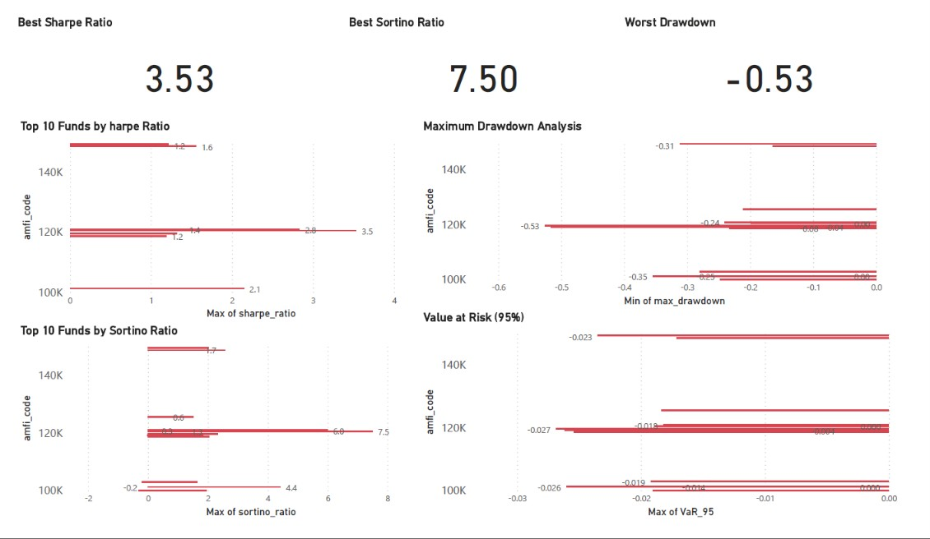
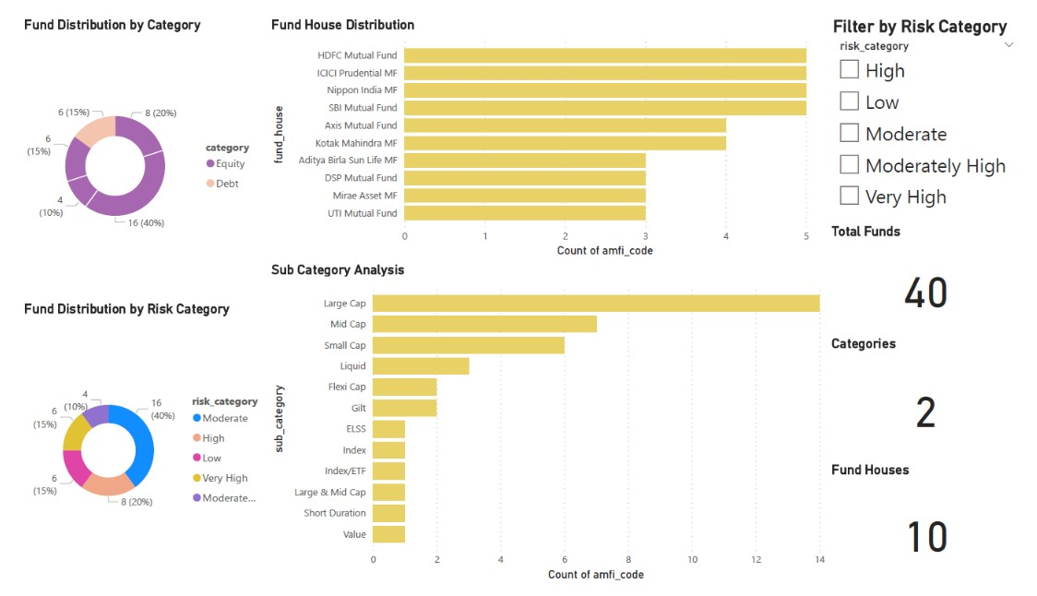
DASHBOARD — ANALYTICS PAGES
🛡 Risk Analytics
📊 Fund Analysis
👥 Investor Analytics
VaR, CVaR, Beta, Drawdown by category & time period
Returns comparison, peer ranking & alpha generation
State-wise folio distribution & SIP penetration
✔ Interactive Filters
✔ Drill-Through Nav
✔ Dynamic Slicers
✔ Mobile-Friendly

Slide 11
KEY FINDINGS & RECOMMENDATIONS
KEY FINDINGS
RECOMMENDATIONS
1
SIP inflows on a consistent upward trend
→
Prioritise risk-adjusted metrics (Sharpe, Sortino) over raw returns
2
Equity funds dominate with 56% AUM share
→
Maintain diversification across equity, debt & hybrid categories
3
Risk-adjusted returns differ widely by scheme type
→
Continue SIP investments for long-term compounding wealth
4
Investor activity concentrated in 5 major states

Slide 12
CONCLUSION
A Complete Mutual Fund
Analytics Platform
⚙
📈
🛡
💡
Data Engineering
Financial Analytics
Risk Management
Business Intelligence
Thank You
Questions & Discussion
github.com/VaddeyrajuSaisiddartha/mutual-fund-analytics
Presented By:
Vaddeyraju Sai Siddartha

