Slide 1
Bandwidth &
Power consumption
10MBps
5G
Wi-Fi
4G
3G
1MBps
Wi-Fi
HaLow
Satellite
BLE
ZigBee
2G
1KBps
LTE-M
NB-IoT
100Bps
LPWAN
LoRaWAN
Sigfox
RFID
NFC
1m
10m
100m
1km
10km

Slide 2


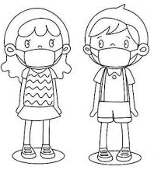
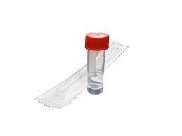




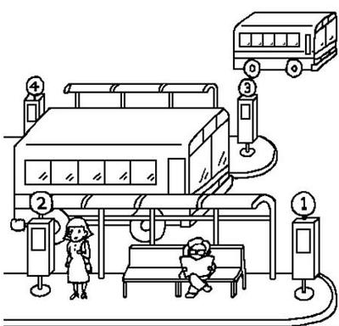
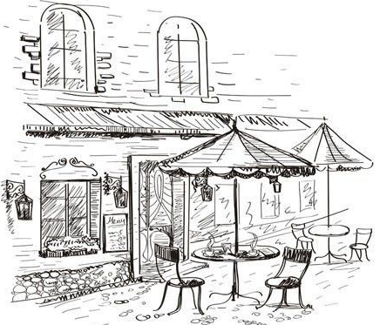
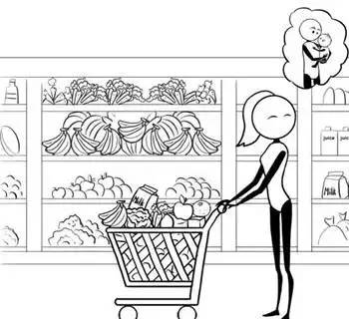

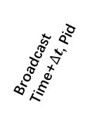
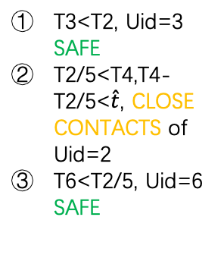
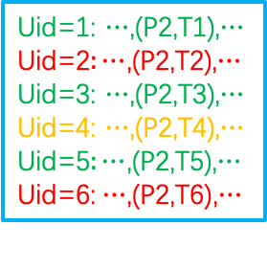
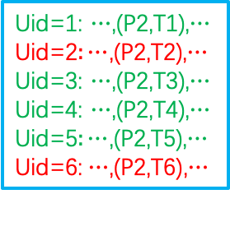
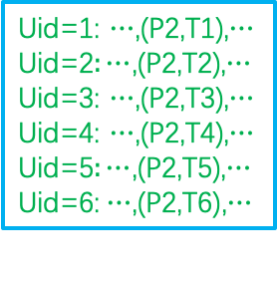
USERS
SERVER
DATA CENTER
HOSPITAL
Uid=1: $⋯$,(P2,T1),$⋯$
Uid=2$\text{:}⋯$,(P2,T2),$⋯$
Uid=3: $⋯$,(P2,T3),$⋯$
Uid=4: $⋯$,(P2,T4),$⋯$
Uid=5$:⋯$,(P2,T5),$⋯$
Uid=6:$⋯$,(P2,T6),$⋯$
NB-IoT
！！！
ASAP
5
2
1
2
3
4
5
6
+
Uid=1: $⋯$,(P2,T1),$⋯$
Uid=2$\text{:}⋯$,(P2,T2),$⋯$
Uid=3: $⋯$,(P2,T3),$⋯$
Uid=4: $⋯$,(P2,T4),$⋯$
Uid=5$:⋯$,(P2,T5),$⋯$
Uid=6:$⋯$,(P2,T6),$⋯$
Broadcast
Time, Pid
Broadcast
Time+$∆t$, Pid
Delete redundant values that are continuous in time
Update once
a day
ACK
Time, Uid
ACK
Time, Uid
$$⋯⋯$$
T3<T2, Uid=3 SAFE
T2/5<T4,T4-T2/5<$\hat{t}$, CLOSE CONTACTS of Uid=2
T6<T2/5, Uid=6 SAFE
Uid=1: $⋯$,(P2,T1),$⋯$
Uid=2$\text{:}⋯$,(P2,T2),$⋯$
Uid=3: $⋯$,(P2,T3),$⋯$
Uid=4: $⋯$,(P2,T4),$⋯$
Uid=5$:⋯$,(P2,T5),$⋯$
Uid=6:$⋯$,(P2,T6),$⋯$
Cable&Wireless
Café
Bus Station
Supermarket
PUBLIC PLACES

Slide 3
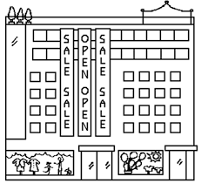


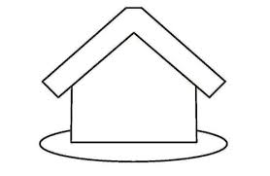





？？
Close
Contacts
Close
Contacts
！
！
！
Normal User
Normal User
Normal User

