Slide 1
Bernstein Vazirani Algortihm
Notes:
In this lecture, we will discuss the Bernstein Vazirani Algorithm

Slide 2

The Bernstein-Vazirani problem
Oracle: an black-box function that “magically” maps an input to an output
For Bernstein-Vazirani problem, we are given an oracle:
In which,
stands for sum modulo 2.
s and x are binary string of length n 00110….01
Notes:
The Bernstein-Vazirani problem is centered around a “oracle”. By definition, the oracle is a black-box function that magically gives outputs everytime we call it with an particular input. We don’t ask how the is output generated according to the input. We just believe this idealized black-box or “oracle” can faithfully answer our call immediately.
For the Bernstein-Vazirani problem, the oracle is a function that maps a binary bitstring to a single bit:0 or 1. To be more specific, it maps the binary bit string x to the inner product of x with another secrete binary string s, and modulo the result by 2. As shown in this expression.
Here we use the circled plus sign to represent modulo 2 after the summation.

Slide 3
The Bernstein-Vazirani problem
Example: s=10101
If x=11111, f(x)=(1*1+1*0+1*1+1*0+1*1) modulo 2 = (3) modulo 2 =1
If x=11100, f(x)=(1*1+1*0+1*1+0*0+0*1) modulo 2= (2) modulo 2 = 0
In other words, f(x) is a modulo-2 dot product of binary string x and a secret binary string s.
Notes:
Here are some examples. Say the secrete binary string s equals 10101.
If x=11111. We can compute the output of the oracle by following the rule of the inner product modulo 2: we add up the first digit of x times the first digit of s, the second digit of x times the second digit of s, all the way to the last digit of x times the last digit of s. And then we modulo the sum by 2. So we can see here the sum is 3, so 3 modulo 2 equals 1 is going the output of our oracle.
Similarly, if x=11100, we see the sum between digits will be 2 because only on the first and third digit do x and s both take the value of 1. Thus the sum modulo by 2 will be 0, which again is the output of the oracle.
To summarize again, the oracle of the Bernstein-Vazirani problem f(x) is a modulo-2 dot product of binary string x and a secret binary string s.

Slide 4
Bernstein-Vazirani problem, Classical solutions
How do we solve the problem classically?
Here is one way to solve it:
We can inquire f(100….)=s1, f(0100…0)=s2, f(0010…0)=s3 …….f(000..1)=sn
to identify each digit of the secret string s.
Example:
S=0101
First, input x=1000. f(1000)=(1*0+0*1+0*0+0*1) modulo 2 = 0 = s1
Then, input x=0100. f(0100)=(0*0+1*1+0*0+0*1) modulo 2 = 1 = s2
Next, input x=0010. f(0010)=(0*0+0*1+1*0+0*1) modulo 2 = 0 = s3
Finally, input x=0001. f(0001)=(0*0+0*1+0*0+1*1) modulo 2 = 1 = s4
So, we have s=s1,s2,s3,s4=0101
Notes:
How can we solve the Bernstein-Vazirani problem, from a pure classical perspective?
Here we give one relatively straightforward example.
Say the secrete binary string s is of length n. We can determine the digits of s one-by-one by feeding in n input binary string, each has only 1 digit equals to one. Because each of these input string only have 1 digit equals one, we can ignore the modulo, and see that each of these input string can selectively identify one digit of the s string for us.
As this example show. We first input x=1000. Then the output only determines on whether the first digit of s—s1 equals 0 or 1. in this case , it equals 0.
Similarly, the input string 0100 reveals the value of the second digit of s. The input string 0010 reveals the third digit of s. The forth input string 0001 reveals the last digit of s.
After these four calls, we know s equals 0101.

Slide 5
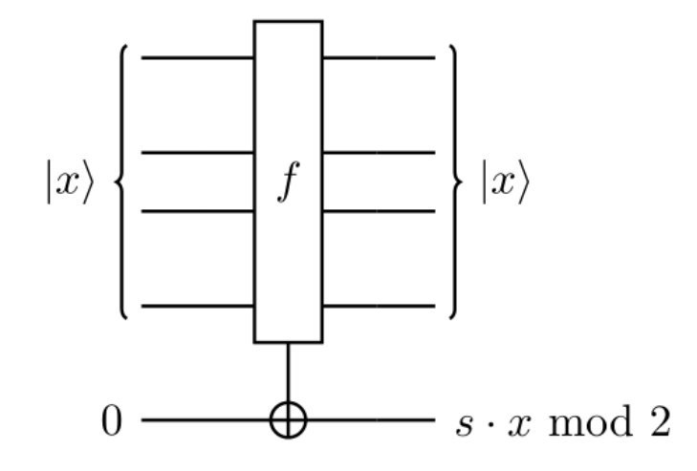
Quantum Solution: Bernstein-Vazirani algorithm
First, we need to use a quantum circuit to represent the oracle
Except the inputs and outputs are written in terms of quantum states using kets. Nothing else is “quantum” .
A classical oracle can exactly be expressed in this form, with input and output being classical signals.
But since quantum states can have superposition, the oracle now need to be capable of simultaneously processing everything in the superposition.
Notes:
Now, if we have a quantum computer, how can we solve the same problem more efficiently?
Then read the slide

Slide 6
Bernstein-Vazirani algorithm: the intuition
One way to look at quantum computing:
It is a parallel computing machine whose power scales exponentially with hardware resources. Because with n qubits, we can process 2^n states simultaneously by creating such superposition.
Example: If we have 3 qubits, we can create a superposition of 2^3=8 different states
|000>+|001>+|010>+|011>+|100>+|101>+|110>+|111> and do computation on all of them simultaneously.
Challenge: After the parallel computation, we will have all the answer in superposition. However, each measurement yields only one random answer.
Solution: Use quantum algorithm to eliminate “bad” answer, via interference, so measurements only give us “good” answer.
Notes:
Now we have the quantum form of the oracle, let’s talk about the intuition behind the Bernstein-Vazirani algorithm. Or it is actually a intuition shared by many quantum algorithms.
Read the slide.
Let’s then see how this intuition is actualized in the Bernstein-Vazirani algorithm.

Slide 7
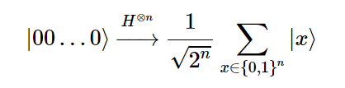
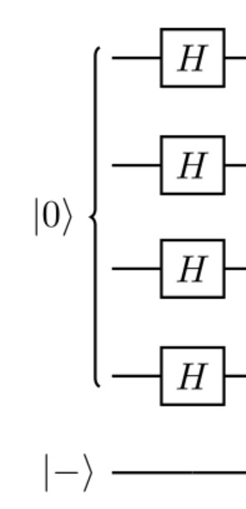
Bernstein-Vazirani algorithm: The implementation
The first step is to create the superposition of all the possible inputs. So we can take advantage of the parallel computing power
Here x stands for all the possible binary strings of length n
Take 2 qubits as example, |00> will be turned into
(|0>+|1>)*(|0>+|1>)=|00>+|01>+|10>+|11>
Normalization constant ignored here
Notes:
The first step is to create the superposition of all the possible inputs. So we can take advantage of the parallel computing power
We use a layer of Hadamard gates for this purpose. The Hadamard gates create a superposition of all the possible bitstring x.
To see this, take 2 qubits as example:………
Note we prepare a superposition of all the 2^N possible inputs. But this is only 1 quantum oracle call by definition.

Slide 8
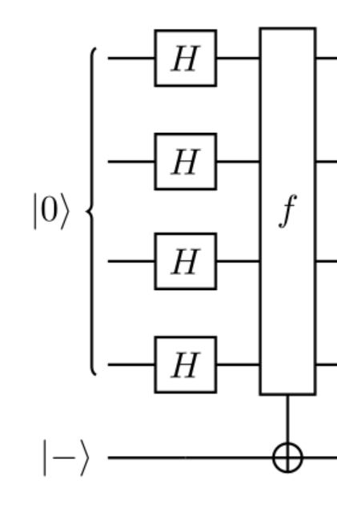

Bernstein-Vazirani algorithm: The implementation
The next step is to parallelly compute all the binary strings in the form of the superposition using the quantum oracle.
But this time, instead of using 0 as the input state of the ancilla, we use |->=|0>-|1> as the input for the ancilla. Again, normalization constant is ignored here.
What does the oracle do to our superposition?
For those X*S=0, the oracle does nothing, but for X*S=1(mod 2), the oracle flip |0> with |1>, thus:
So the superposition become
This is known as the phase kickback
Notes:
Read slide

Slide 9
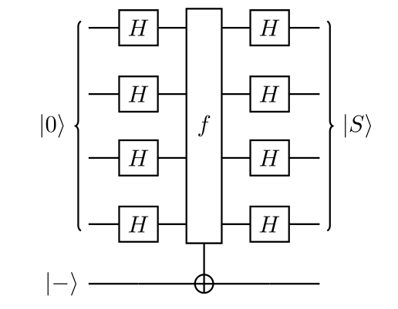



Bernstein-Vazirani algorithm: The implementation
Finally, we finish the algorithm with another round of Hadamard gates of all the input qubits. What does this do to our state?
To answer this, let’s see what a layer of Hadamard gate does to an arbitrary state |P>
Recall from the previous slide, the superposition after the oracle is turned into
Comparing what a layer of Hadamard does to |S>, and note Hadamard gate is self-conjugate, we know the final laser of the Hadamard gates is going to turn the super position into:
Notes:
Read the slide

