Slide 1

The absolute beginners guide to excel
Vadim acosta

Slide 2

outline
Getting Started
The Interface
Making a Spradsheet
Bla

Slide 3
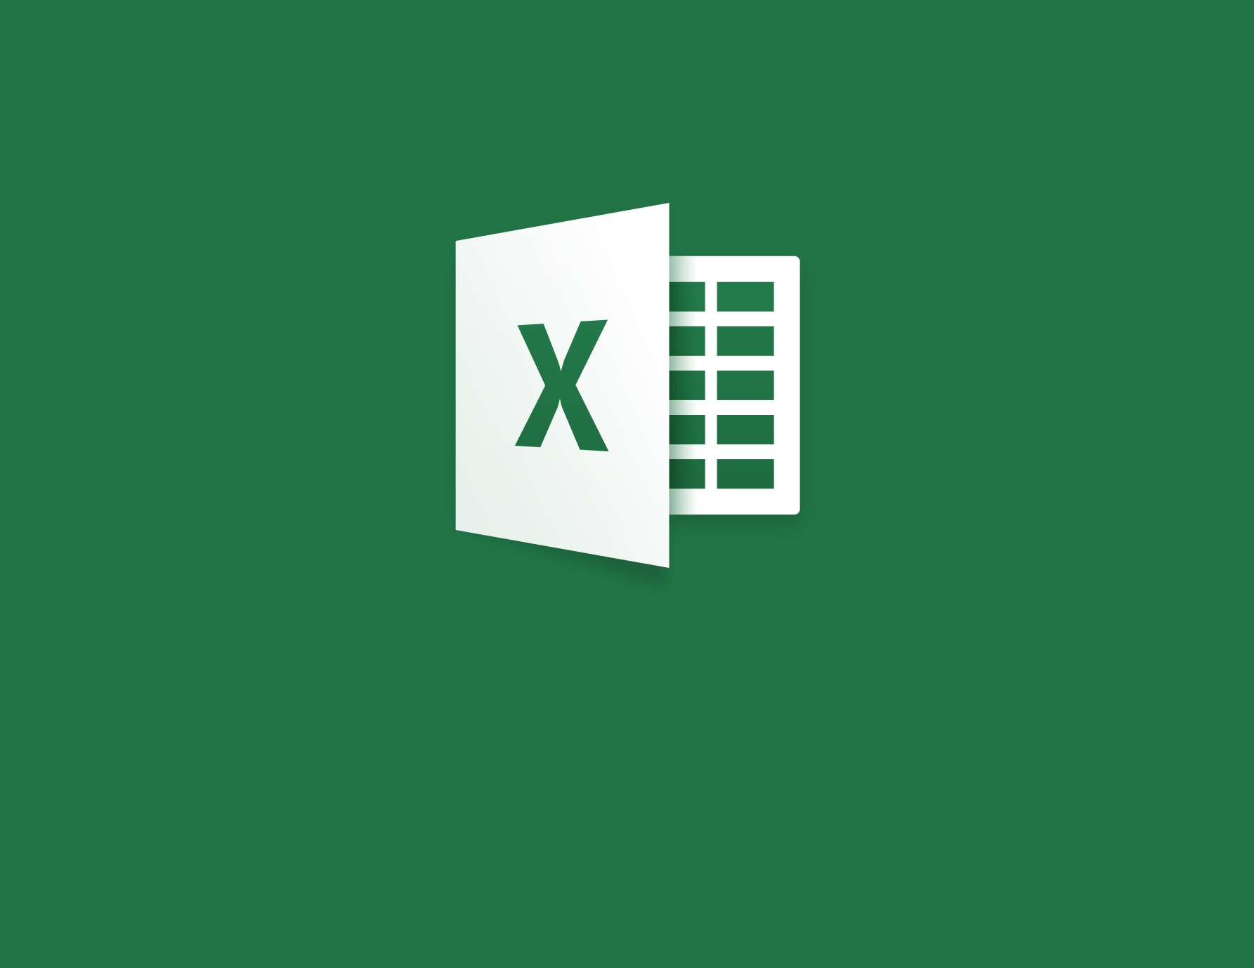
Getting started
Click on the Excel Icon

Slide 4
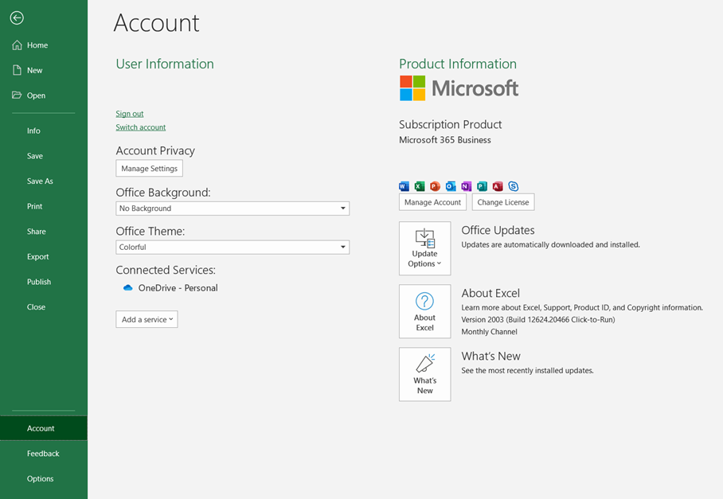
Version control
All examples shown on the Microsoft Excel 365 Business, 2019 update
To check your version go to File -> Account -> About Excel

Slide 5
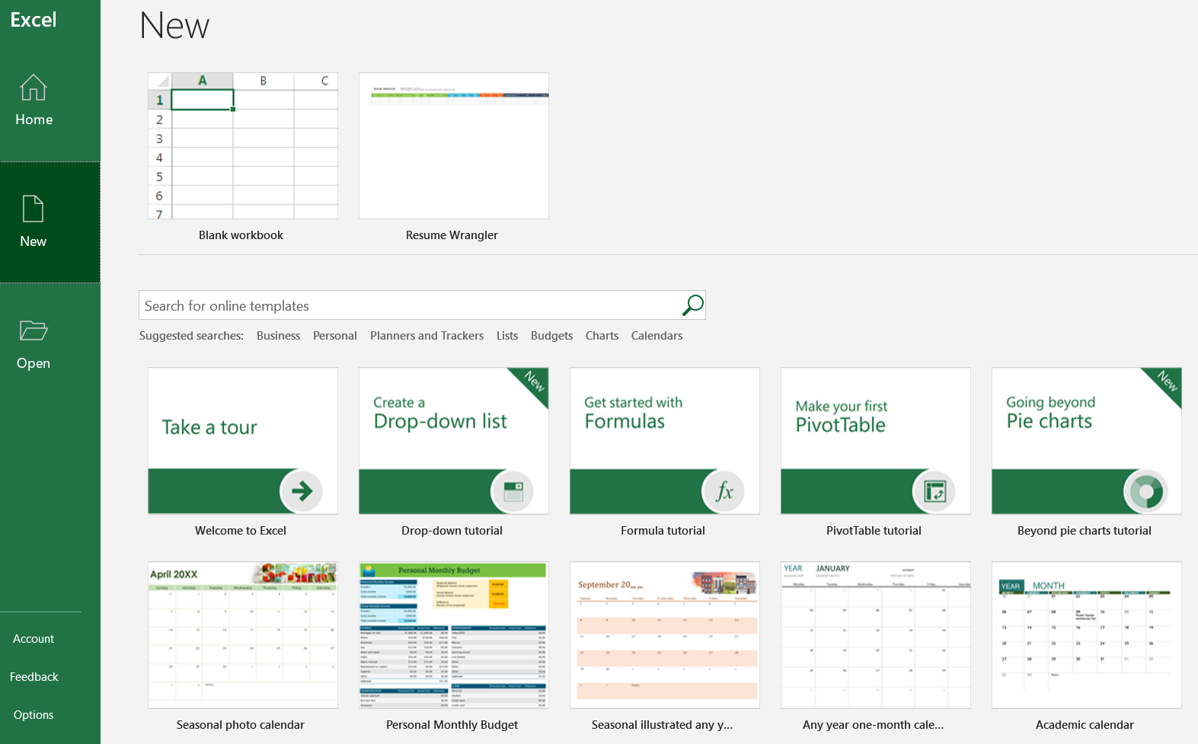
It starts
Click New
Check out tutorials
Check out templates
Start with a Blank Workbook

Slide 6

The interface

Slide 7
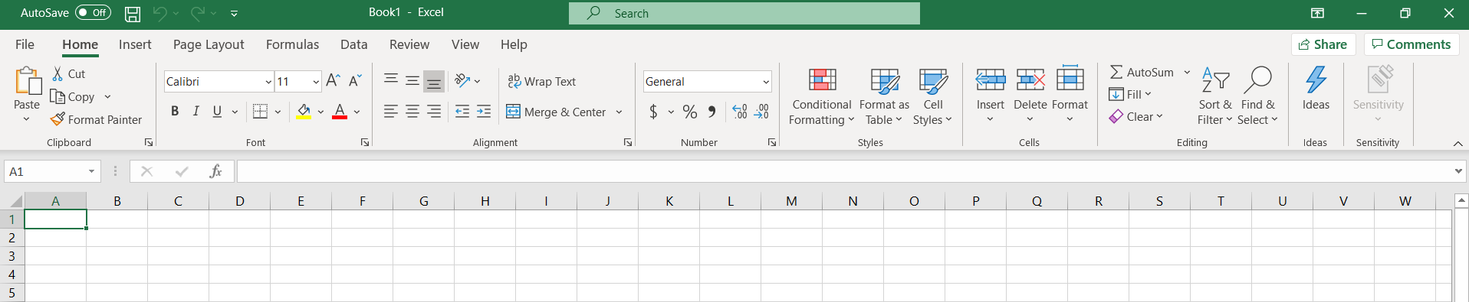
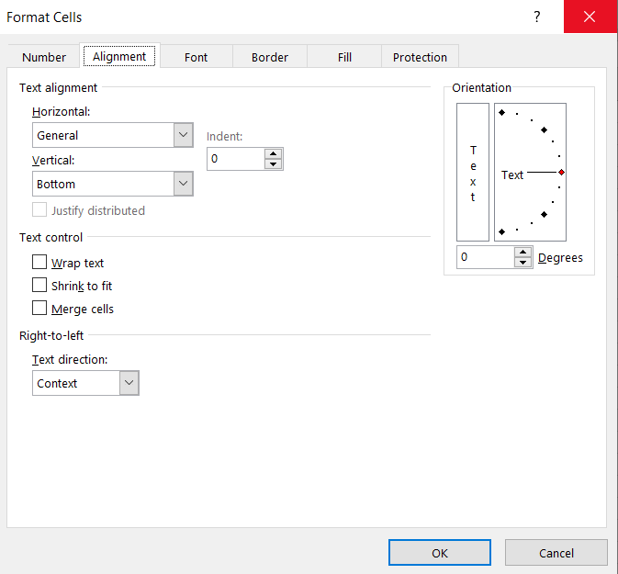
Terminology
TABS
RIBBON
GROUPS
EXPAND

Slide 8
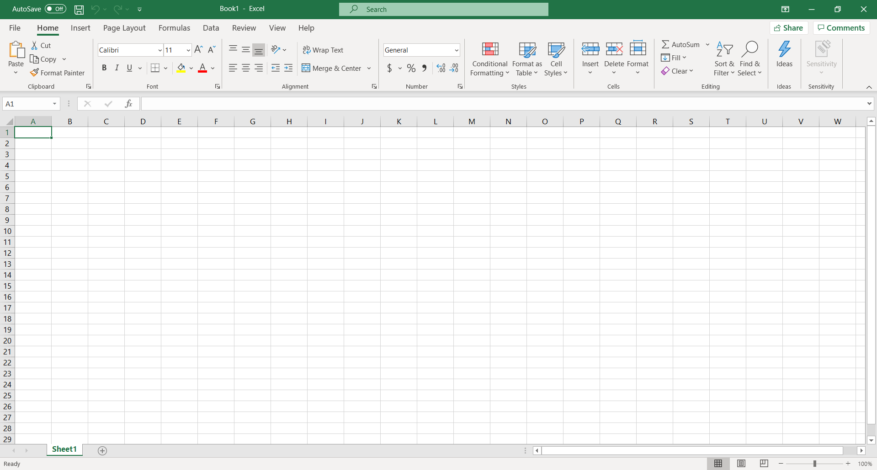
The spreadsheet
Spreadsheet
Spreadsheet tab (double click to rename spreadsheet)
Click on the (+) button to add a spreadsheet to your workbook

Slide 9
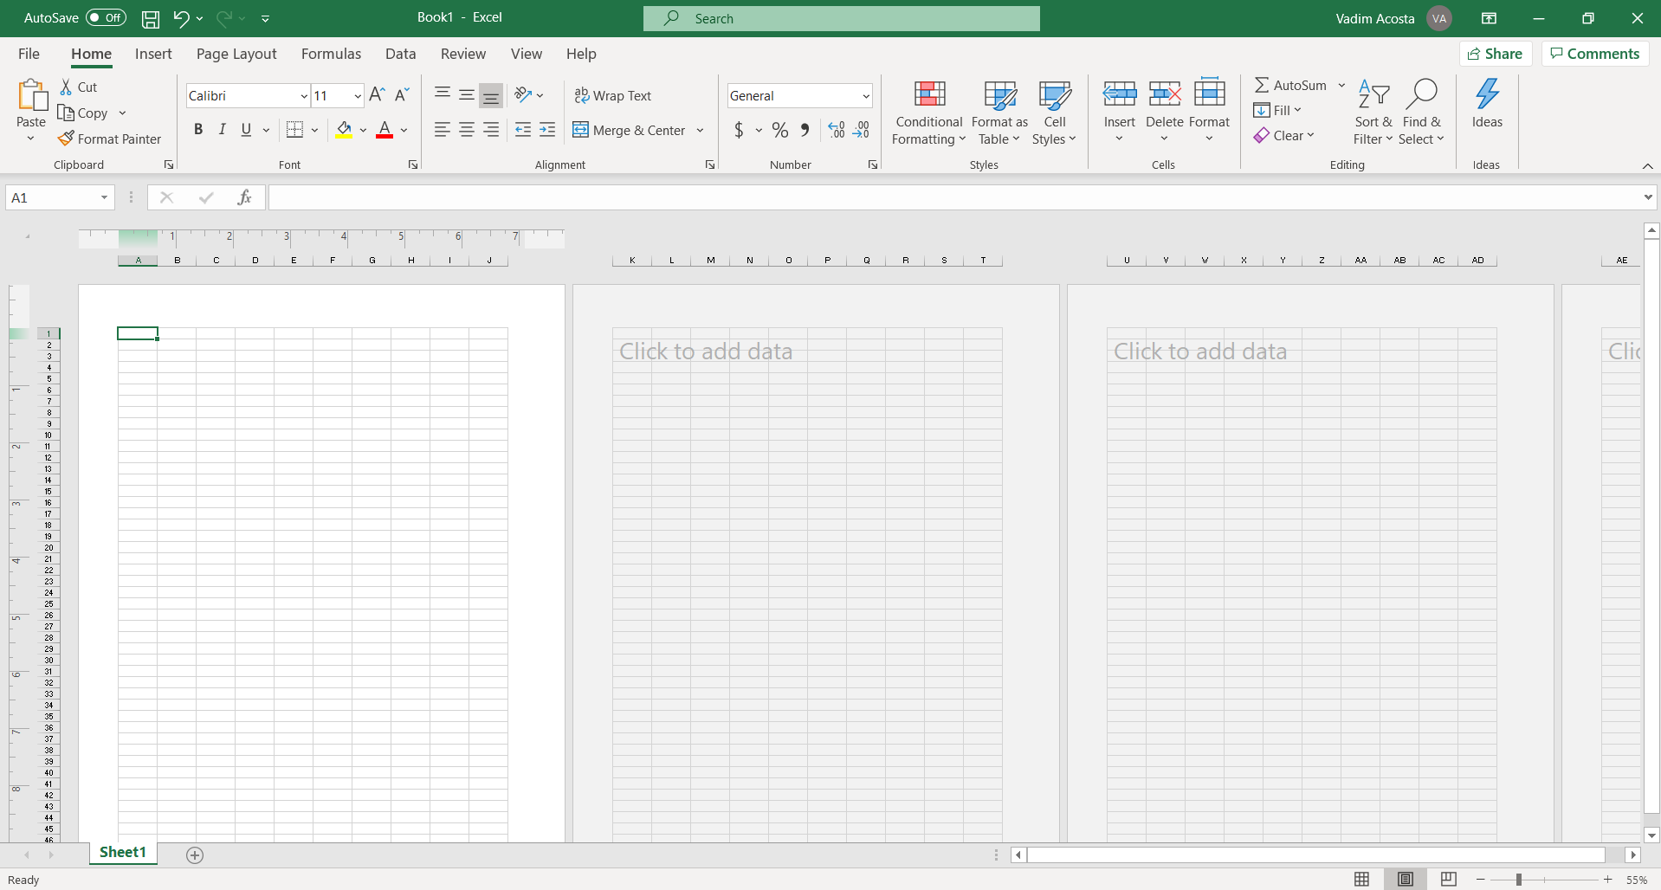
View adjustment
Click here to get a preview of your spreadsheet printed on A4 paper

Slide 10
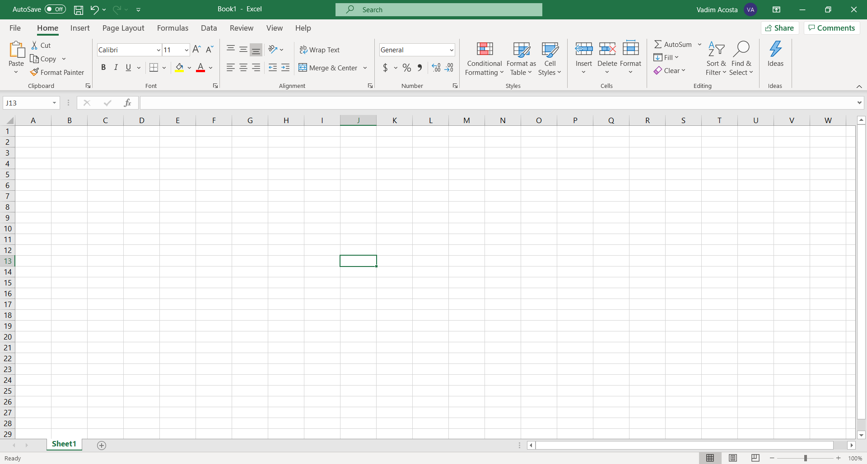
Columns and rows
Columns are vertical and lettered
Rows are horizontal and numbered
PowerPoint conforms with color theory
The coordinates of a cell are given as Column then Row Ex: J13

Slide 11

Fun facts
Each Excel spreadsheet can support up to 1,048,576 rows and 16,384 columns of data that’s a whopping 17,179,869,184 cells!
Each cell in a spreadsheet can contain up to 32,767 characters
If every cell in a spreadsheet was filled to maximum capacity a single excel spreadsheet would contain over 56 trillion characters!
This is still nowhere close to what is needed to manage truly Big Data!

Slide 12

Selecting a cell
Your mouse cursor will turn into a cross as you hover it over the spreadsheet
To select a cell click on it
Now you can write in the cell
hello

Slide 13
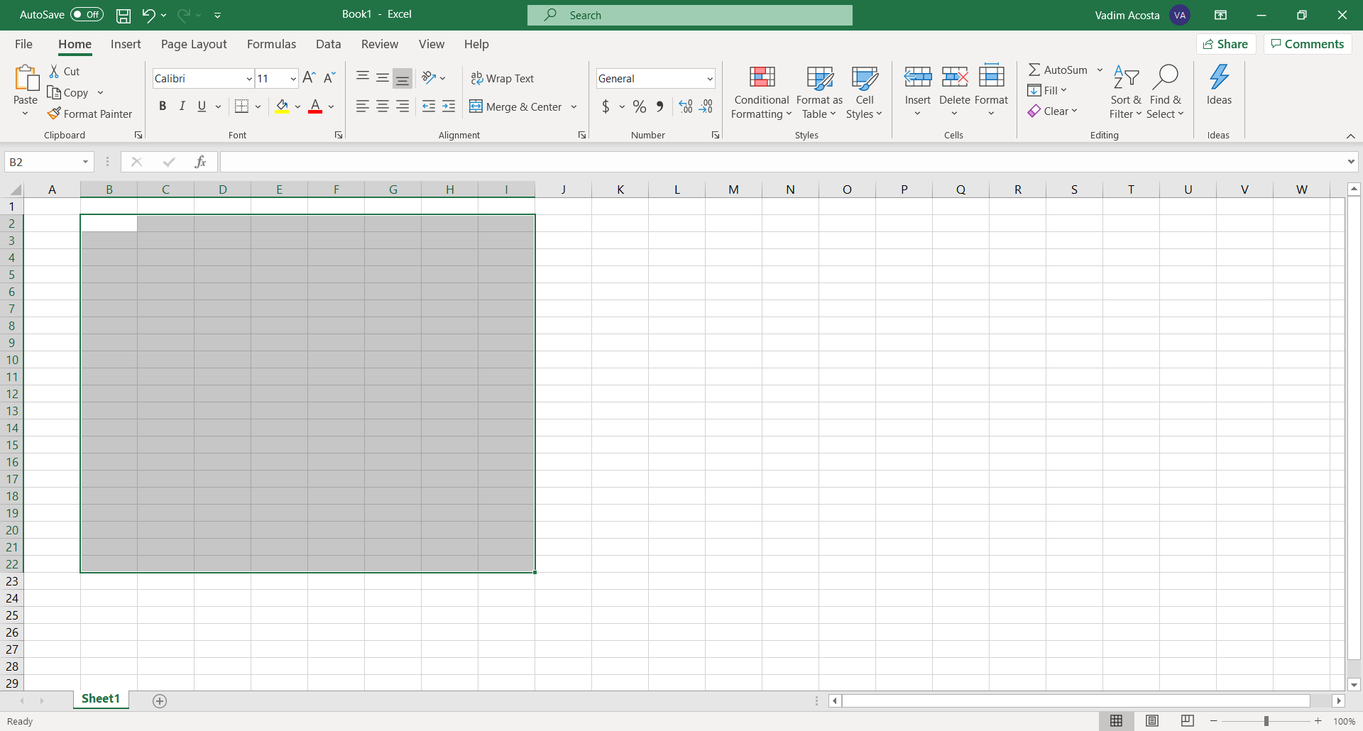
Selecting multiple cells / range
To select multiple cells just click and drag cursor
This is a range of cells

Slide 14
Naming a range
Find the name of the top left cell in the range (B2)
Find the name of the bottom right cell in the range (I22)
The name of the range is ‘B2:I22’
Read out loud as B2 through I22

Slide 15
Make a spreadsheet

Slide 16
GROUPS
LAUNCH
RIBBON
TABS

Slide 17
The spreadsheet

