Slide 1

The absolute beginners guide to excel
Vadim acosta

Slide 2
outline
Introduction to the interface
Bla
Bla
Bla

Slide 3



Slide 4
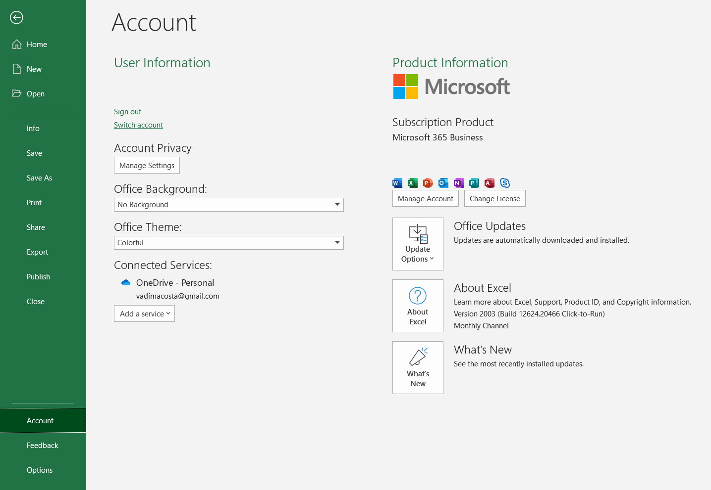
Version control
All examples shown on the Microsoft Excel 365 Business, 2019 update
To check your version go to File -> Account -> About Excel

Slide 5
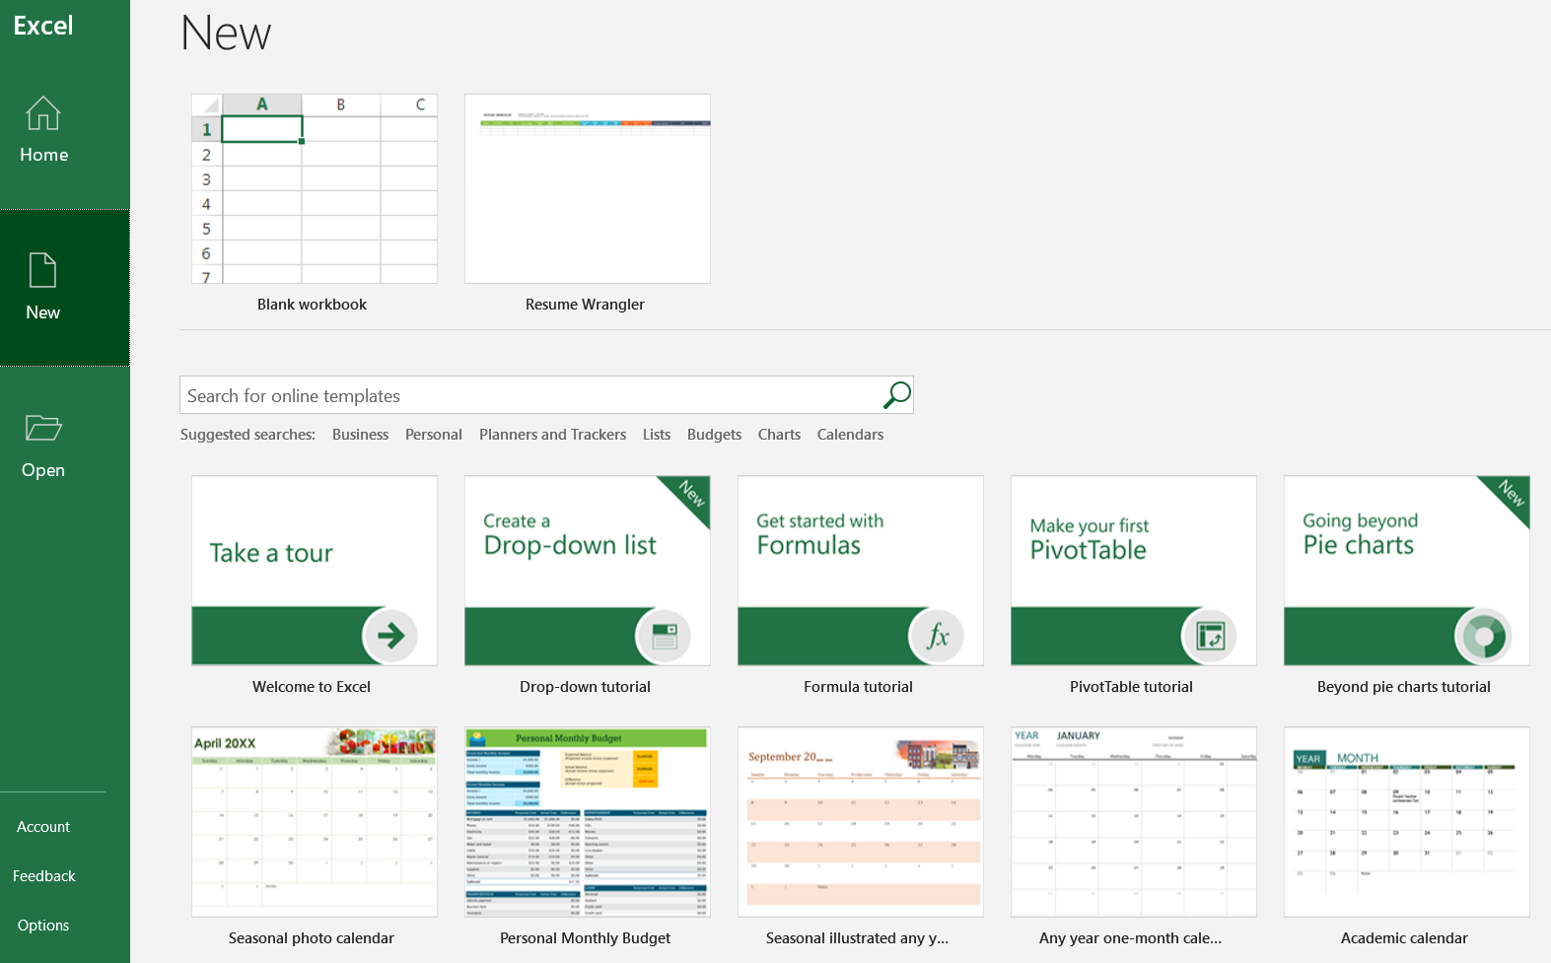
It starts
Click New
Check out tutorials
Check out templates
Start with a Blank Workbook

Slide 6
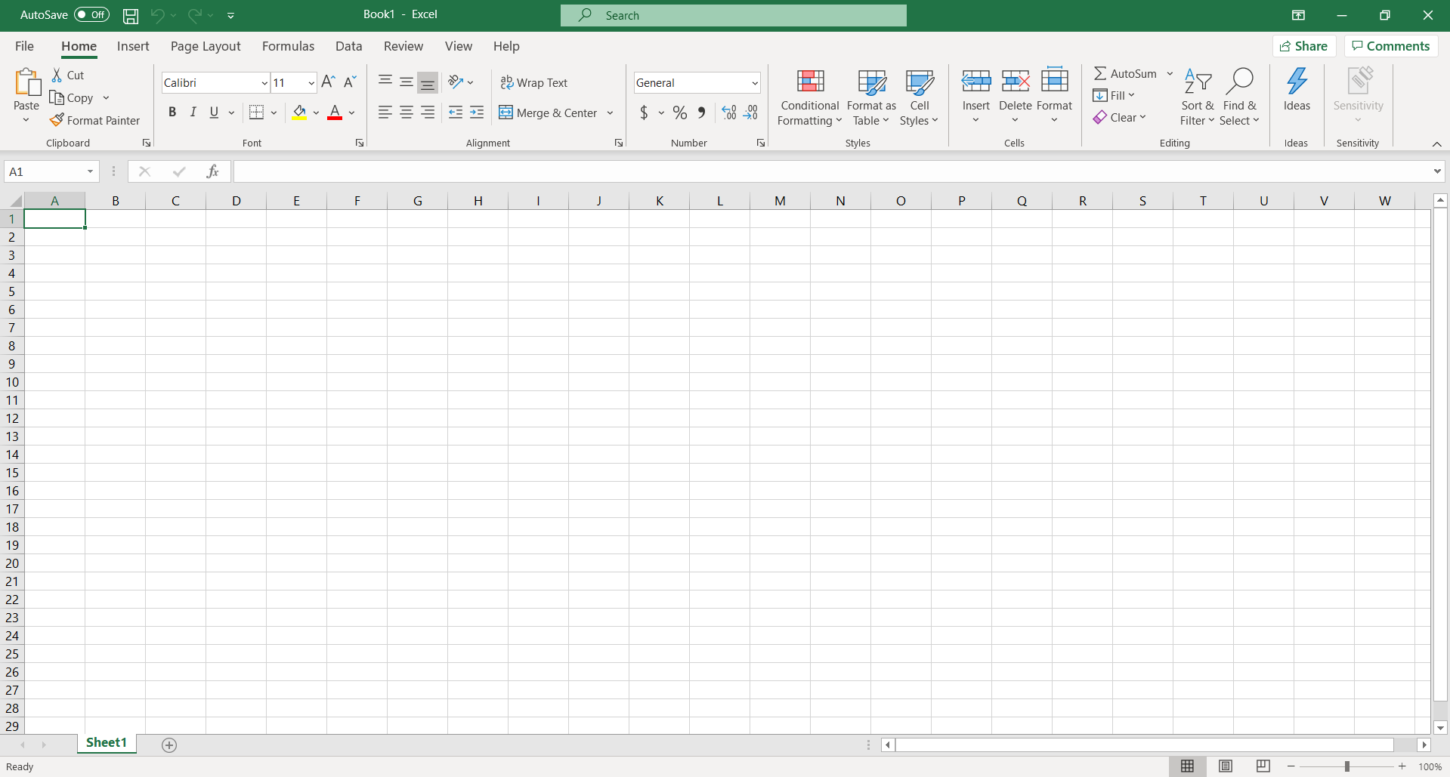
The spreadsheet
Spreadsheet
Spreadsheet tab (double click to name spreadsheet)

Slide 7
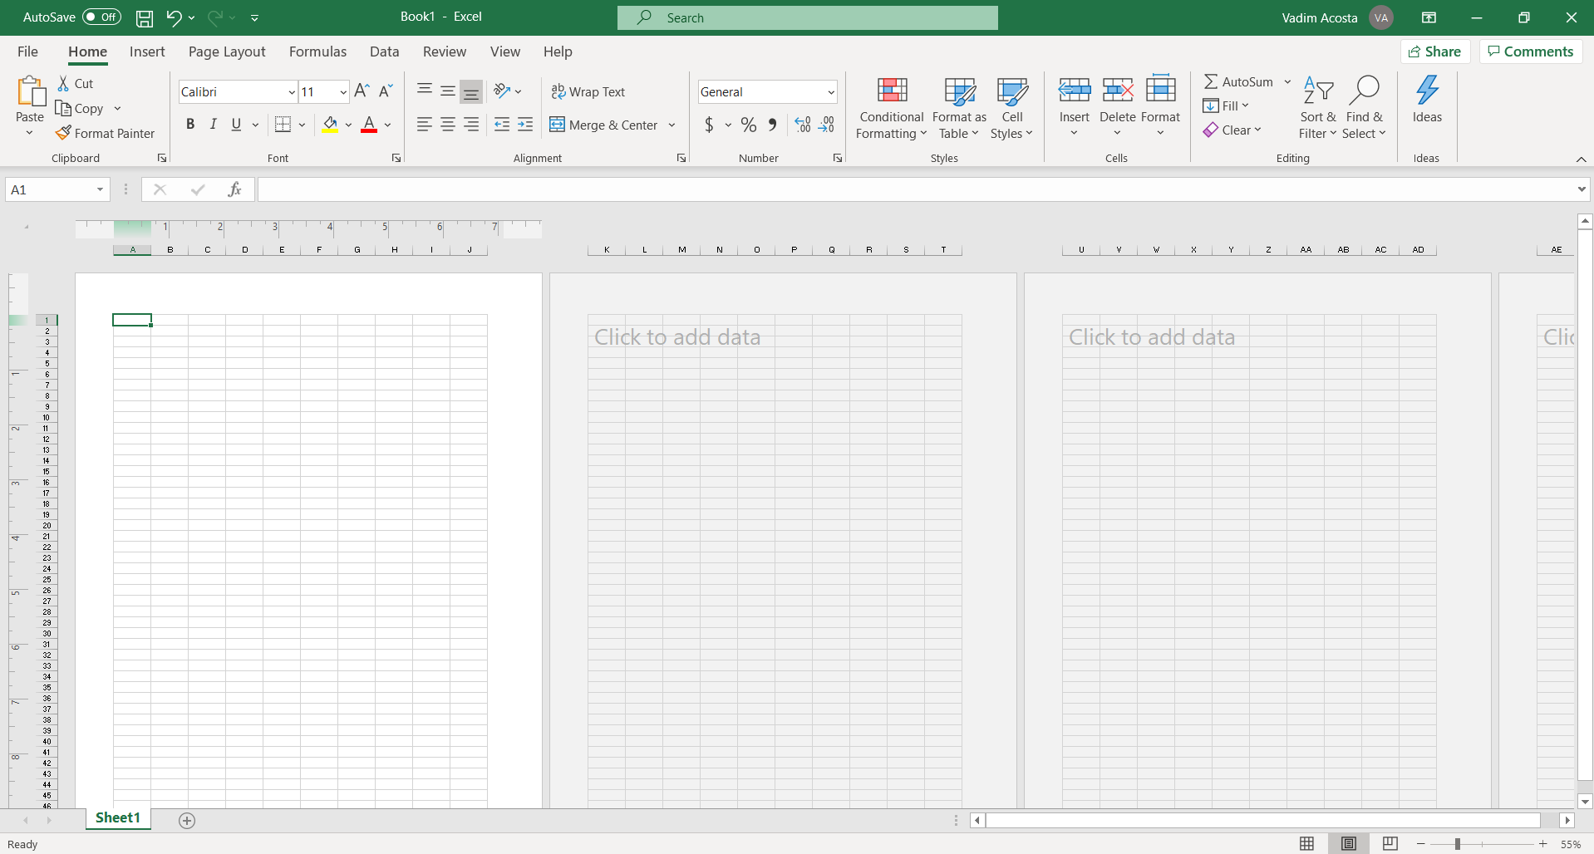
View adjustment
Click here to get a preview of your spreadsheet printed on A4 paper

Slide 8
Columns and rows
Columns are vertical and lettered
Rows are horizontal and numbered
PowerPoint conforms with color theory
Where a Column and Row cross is a Cell
The coordinates of a cell are given as Column then Row Ex: J13

Slide 9
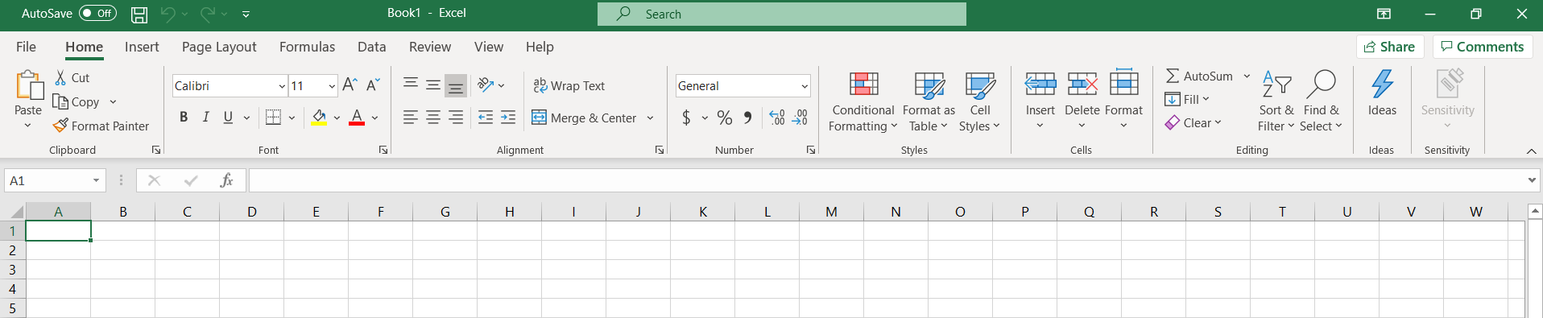
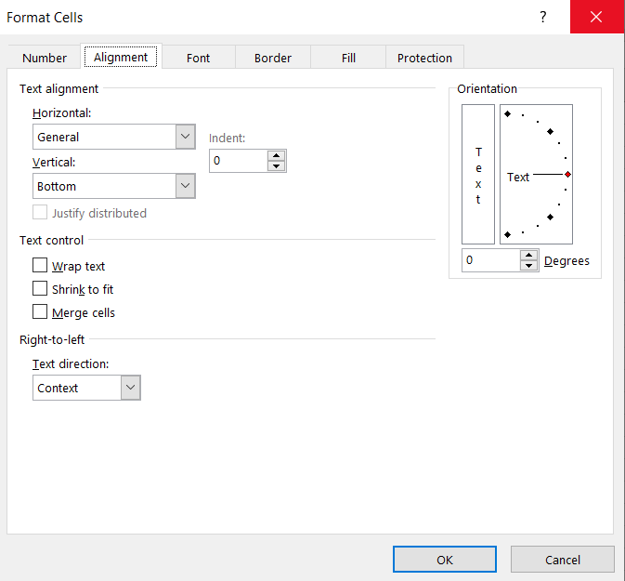
Terminology
TABS
RIBBON
GROUPS
EXPAND

Slide 10
GROUPS
LAUNCH
RIBBON
TABS

Slide 11
The spreadsheet

