Slide 1
PostgreSQL Times and Dates
Vadim Acosta

Slide 2
Information about the data types you can use when creating a table or database can be found below
https://www.postgresql.org/docs/12/datatype-datetime.html

Slide 3
Outline
Time and data types
Timestamps and time zones
Making time (within query)

Slide 4
DATE YYYY-MM-DD IOS
The International Organization for Standardization (ISO) date format is a standard way to express a numeric calendar date that eliminates ambiguity.
ISO 8601 provides a standard cross-national approach that says: A general-to-specific approach, forming a date that is easier to process - thus, the year first, followed by month, then day
With each separated by a hyphen ("-")
Numbers less than 10 preceded by a leading zero

Slide 5
Name | Storage Size | Description | Low Value | High Value | Resolution
timestamp [ (p) ] [ without time zone ] | 8 bytes | both date and time (no time zone) | 4713 BC | 294276 AD | 1 microsecond
timestamp [ (p) ] with time zone | 8 bytes | both date and time, with time zone | 4713 BC | 294276 AD | 1 microsecond
date | 4 bytes | date (no time of day) | 4713 BC | 5874897 AD | 1 day
time [ (p) ] [ without time zone ] | 8 bytes | time of day (no date) | 00:00:00 | 24:00:00 | 1 microsecond
time [ (p) ] with time zone | 12 bytes | time of day (no date), with time zone | 00:00:00+1459 | 24:00:00-1459 | 1 microsecond
interval [ fields ] [ (p) ] | 16 bytes | time interval | -178,000,000 years | 178,000,000 years | 1 microsecond
- the brackets [] denote optional statements that can be used to modify the timestamp
- (p) specifies the number of fractional digits retained in the seconds field.
the allowed range of (p) is from 0 to 6, precision can vary from seconds to microseconds
The presence or absence of time zones in the time doesn’t change storage size

Slide 6
Name | Storage Size | Description | Low Value | High Value | Resolution
interval [ fields ] [ (p) ] | 16 bytes | time interval | -178,000,000 years | 178,000,000 years | 1 microsecond
The interval type has an additional option [ fields ], which is to restrict the set of stored fields by writing one of these phrases:
YEAR
MONTH
DAY
HOUR
MINUTE
SECOND
YEAR TO MONTH
DAY TO HOUR
DAY TO MINUTE
DAY TO SECOND
HOUR TO MINUTE
HOUR TO SECOND
MINUTE TO SECOND
If both [fields] and (p) are specified, the fields must include SECOND, since the precision applies only to the seconds.

Slide 7
Interval is a data type
PostgreSQL implements an interval data type along with the time, date and timestamptz data types. An interval describes a duration, like a month or two weeks, or even a millisecond:

Slide 8
Intervals can be treated like other data types for calculations
SELECT interval '1 month',
interval '2 weeks',
2 * interval '1 week',
78389 * interval '1 ms’;
interval │ interval │ ?column? │ ?column? ══════════╪══════════╪══════════╪══════════════ 1 mon │ 14 days │ 14 days │ 00:01:18.389 (1 row)
Source: https://tapoueh.org/blog/2018/04/postgresql-data-types-date-timestamp-and-time-zones/

Slide 9
Field Value | TIMESTAMP | Interval
CENTURY | The century | The number of centuries
DAY | The day of the month (1-31) | The number of days
DECADE | The decade that is the year divided by 10 | Sames as TIMESTAMP
DOW | The day of week Sunday (0) to Saturday (6) | N/A
DOY | The day of year that ranges from 1 to 366 | N/A
EPOCH | The number of seconds since 1970-01-01 00:00:00 UTC | The total number of seconds in the interval
HOUR | The hour (0-23) | The number of hours
ISODOW | Day of week based on ISO 8601 Monday (1) to Sunday (7) | N/A
ISOYEAR* | ISO 8601 week number of year | N/A
MICROSECONDS | The seconds field, including fractional parts, multiplied by 1000000 | Sames as TIMESTAMP
MILLENNIUM | The millennium | The number of millennium
MILLISECONDS | The seconds field, including fractional parts, multiplied by 1000 | Sames as TIMESTAMP
MINUTE | The minute (0-59) | The number of minutes
MONTH | Month, 1-12 | The number of months, modulo (0-11)
QUARTER | Quarter of the year | The number of quarters
SECOND | The second | The number of seconds in given minute
TIMEZONE | The timezone offset from UTC, measured in seconds | N/A
TIMEZONE_HOUR | The hour component of the time zone offset | N/A
TIMEZONE_MINUTE | The minute component of the time zone offset | N/A
WEEK | The number of the ISO 8601 week-numbering week of the year | N/A
YEAR | The year | Same as TIMESTAMP
ISOYEAR* -> An ISO week-numbering year (also called ISO year informally) has 52 or 53 full weeks.
That is 364 or 371 days instead of the usual 365 or 366 days.
The extra week is sometimes referred to as a leap week, although ISO 8601 does not use this term

Slide 10
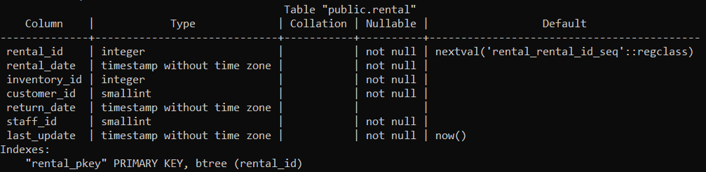
Data Types in SQL BASH
\c database_name -> connects to database
\dt -> provides list of tables in database
\d table_name -> describes columns, data types, and indexes
\d+ table_name -> describes columns, datatypes, indexes, storage type, stats target and description for a table

Slide 11
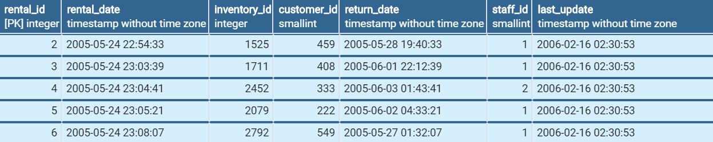
Data Types pgAdmin
SELECT * FROM rental LIMIT 5;

Slide 12

What’s in a timestamp?
DATE
TIME
YEAR
MONTH
DAY
HOUR
MINUTE
SECOND
MICROSECOND
TIME ZONE

Slide 13
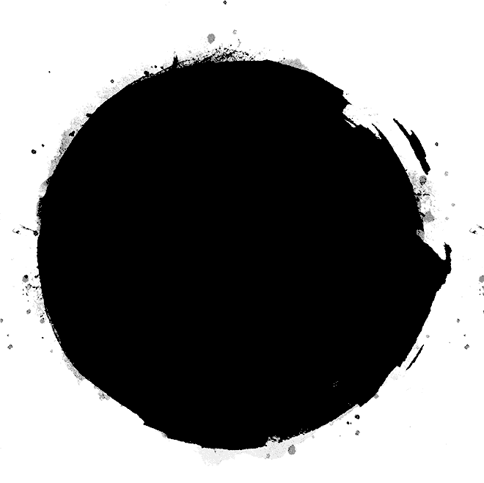

Why was this important?
If it’s not recorded it can’t be selected, use timestamp with tz in most cases!

Slide 14
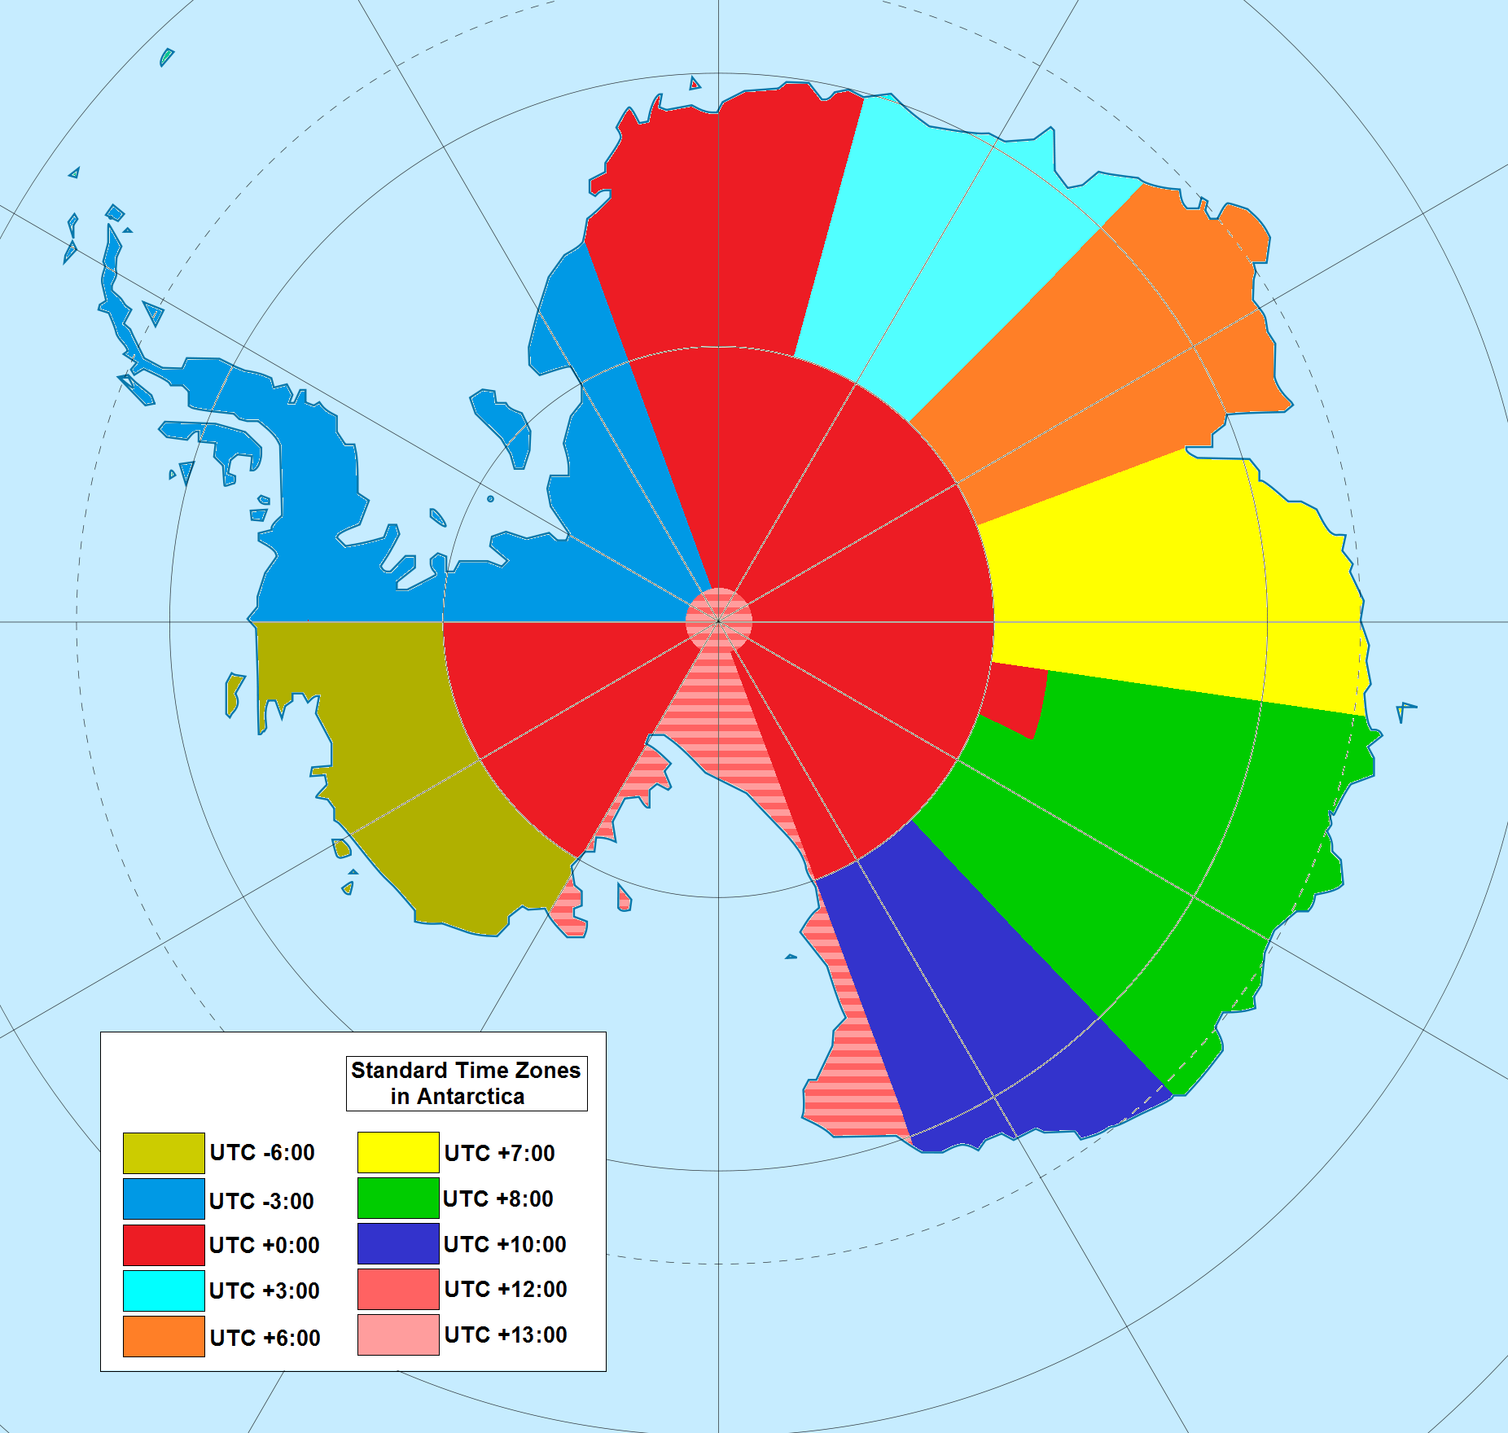
Time zones are weird

Slide 15
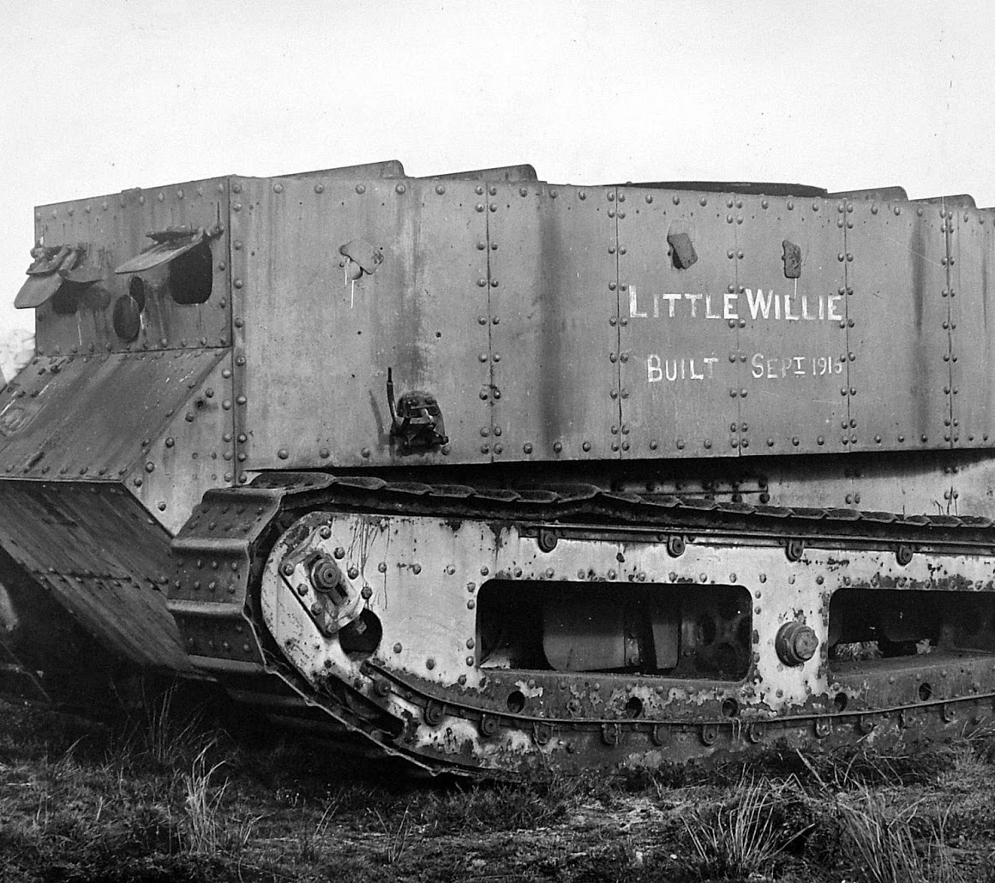
Time zones are modern
In 1883, America’s railroads began using a standard time system involving four time zones. Within each zone, clocks were synchronized. The time-zone system didn’t become official across the United States until 1918.
The first modern tank was patented in 1912 by the inventor Lance De La Mole. Little Willie Landship IFV, first British tank (1915)

Slide 16
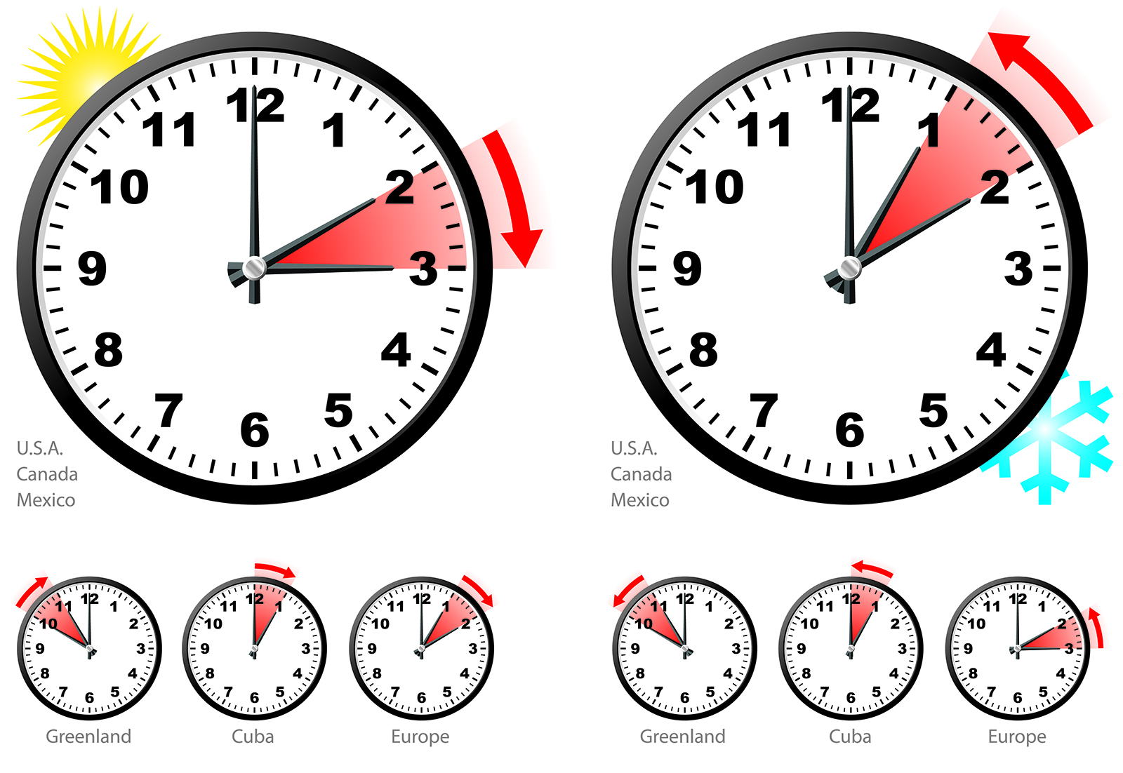
Time Zones are affected by DLS
Today 70 out of 195 countries utilize Daylight Savings Time in at least a portion of the country.
Japan, India, and China are the only major industrialized countries that do not observe some form of daylight saving

Slide 17
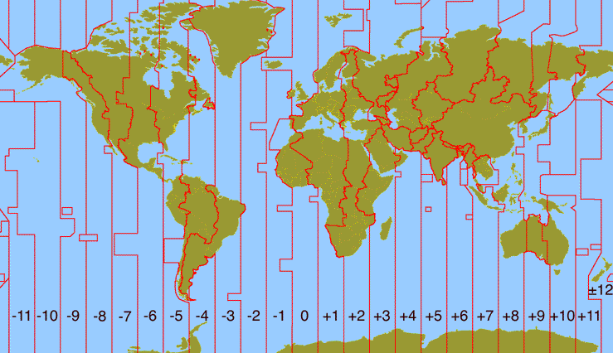
Time zones are political
Russia has 11 time zones, while China, has just a single zone. When the Communist Party came to power in 1949 the government required the entire country to operate on Beijing Standard Time for the sake of national unity

Slide 18
What’s in a timestamp again?
BEFORE 1918 WITH
EXTRA ADJUSTMENTS
CURRENT TIMESTAMP
35 YEARS AGO
WITH DLS
BEFORE 1918 WITH
EXTRA ADJUSTMENTS
AND BC TAG

Slide 19
Make it so (within query)
make_date(year int, month int, day int)
make_time(hour int, min int, sec double precision)
make_interval(years int DEFAULT 0, months int DEFAULT 0, weeks int DEFAULT 0, days int DEFAULT 0, hours int DEFAULT 0, mins int DEFAULT 0, secs double precision DEFAULT 0.0)
make_timestamptz(year int, month int, day int, hour int, min int, sec double precision, [ timezone text ])

Slide 20


make_date(year int, month int, day int)
SELECT make_date(1984, 08, 31);
make_time(hour int, min int, sec double precision)
SELECT make_date(03, 50, 15.5555555);

Slide 21


make_interval(years int DEFAULT 0, months int DEFAULT 0, weeks int DEFAULT 0, days int DEFAULT 0, hours int DEFAULT 0, mins int DEFAULT 0, secs double precision DEFAULT 0.0)
SELECT make_interval (35, 07, 3, 0, 16, 50, 15.5555555 )
make_timestamptz(year int, month int, day int, hour int, min int, sec double precision, [ timezone text ])
SELECT make_timestamptz(1984, 08, 31, 16, 50, 15.5555555,
‘Europe/Zurich’)

Slide 22
Huge caveat [ timezone text ]
We would have to change the timezone client setting for PostgreSQL to output timestamps as expected, in the selected time zone
If you manage an application with users in different time zones and you want to display time in their own local preferred time zone, then you can set timezone in your application code before doing any timestamp related processing

Slide 23
Make some dates, times, intervals and timestamps

Slide 24
What time is it? (timestamp)
clock_timestamp()
now()
current_timestamp
statement_timestamp()

Slide 25
A timestamp by any other name
NOW() = CURRENT_TIMESTAMP =
= TRANSCACTION_TIMESTAMP() = STATEMENT_TIMESTAMP()
The above clauses return a full timestamp at the start of the query; date, time and time zone
They are functionally the same but allow for context specific naming conventions to improve readability

Slide 26

NOW() returns a full timestamp at the start of the query; date, time and time zone. NOW() is STABLE
CLOCK_TIMESTAMP() returns a full timestamp at the point that the clause is processed; date, time and time zone.
CLOCK_TIMESTAMP() is VOLATILE. The difference is significant.

Slide 27
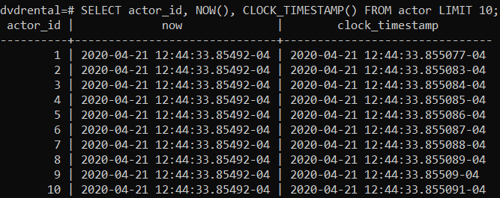
STABLE functions cannot modify the database and is guaranteed to return the same results given the same arguments for all rows within a single statement
VOLATILE functions can do anything, including modifying the database. It can return different results on successive calls with the same arguments

Slide 28
What time is it?
Localtimestamp
current_date
current_time
Localtime
timeofday()

Slide 29
What time is it?
LOCALTIMESTAMP(p) -- timestamp without time zone
CURRENT_TIME(p) -- time with time zone
CURRENT_DATE -- date without time zone
LOCALTIME(p) -- time without time zone
timeofday() Current date and time (like clock_timestamp, but as a text string)

Slide 30
Just select the amount of information you need
SELECT localtimestamp, CURRENT_DATE, CURRENT_TIME, LOCALTIME, timeofday();
Notice timeofday() provides verbal timestamp and timezone and is a VOLATILE function

Slide 31
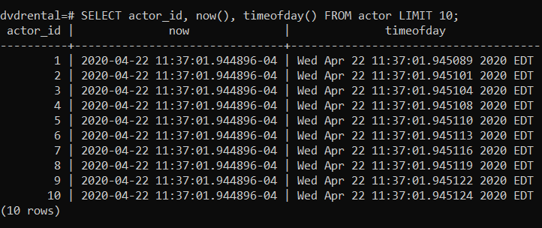
STABLE (What is a stable function?)
VOLATILE (What is a volatile function?)

Slide 32

TIMESTAMP CAST AS (::)
You also can use the double colon :: to cast a timestamp as date or time without time zone
SELECT NOW();
Result - 2020-04-06 13:21:24.225826-04
-- SELECT NOW() :: DATE;
"2020-04-22“
-- SELECT NOW() :: TIME;
"11:49:15.241234"

Slide 33
What’s this date?
Examples with dates and times

Slide 34
Age and interval
age(timestamp)
age(timestamp, timestamp)

Slide 35
age()
The age() function accepts two TIMESTAMP values. It subtracts the second argument from the first one and returns an interval as the result.
age([timestamp value],timestamp value)
If you want to take the current date as the first argument, you can use the following form of the age() function:
age(timestamp)

Slide 36
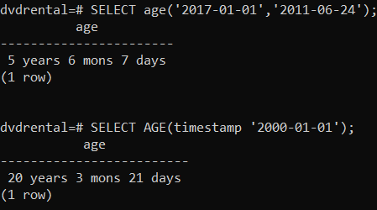
Odd detail
When the age() function takes two arguments they are written in as strings
When the age() function takes one argument the word “timestamp” must be written before the timestamp input
Ex: SELECT AGE(timestamp '2000-01-01');

Slide 37
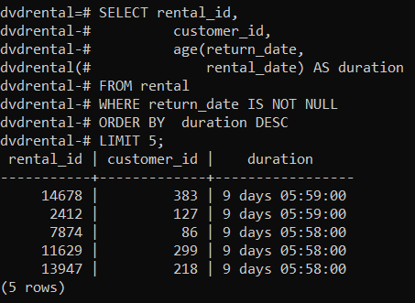
Super Useful
How old are your customers?
How long do your products last?
Suppose, you want to get the top 5 rentals that have the longest durations, you can use the age() function to calculate it as follows:

Slide 38
Edit selection
date_part(text, timestamp)
date_part(text, interval)
date_trunc(text, timestamp)
date_trunc(text, interval)

Slide 39
date_part()
date_part() function extracts a subfield from a date or time value.
date_part(field,source)
The field is an identifier that determines what field to extract from the source, full list on slide 9.
The source is a value of type TIMESTAMP or INTERVAL. If you pass a DATE value, the function will cast it to a TIMESTAMP value

Slide 40
DATE_PART(field,source)
The field is an identifier that determines what field to extract from the source, full list on slide 9.
The source is a value of type TIMESTAMP or INTERVAL. If you pass a DATE value, the function will cast it to a TIMESTAMP value
.

Slide 41
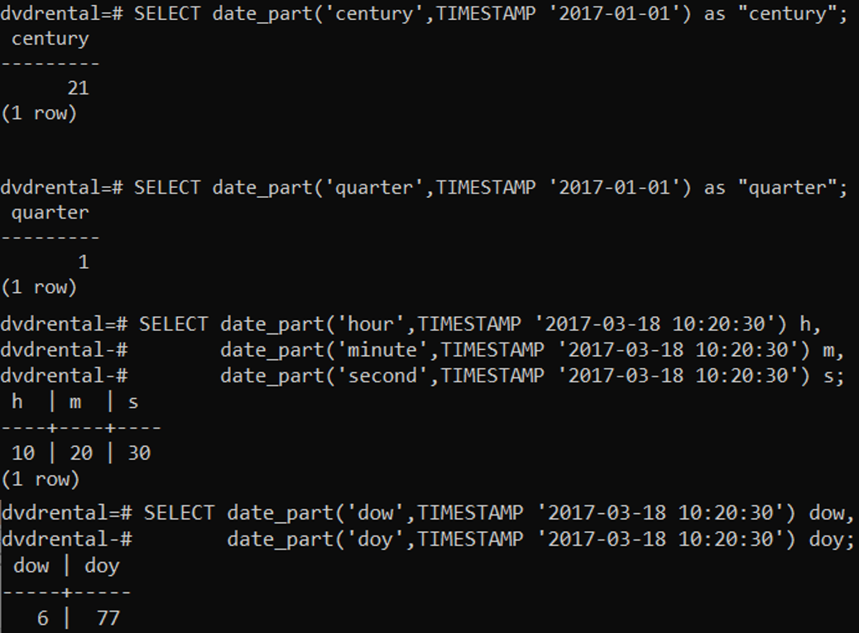
date_part() is full of possibilities
Create many fields out of one
Speed up or simplify calculations of intervals
Allow for better readibility

Slide 42
date_trunc('datepart', field)
Truncates a timestamp or interval to a specified level of precision.
The field is an identifier that determines what field to extract from the source, full list on slide 9.
The datepart argument is the level of precision used to truncate the field, which can be one of the following:
.
millennium
century
decade
year
quarter
month
week
day
hour
minute
second
milliseconds
microseconds

Slide 43
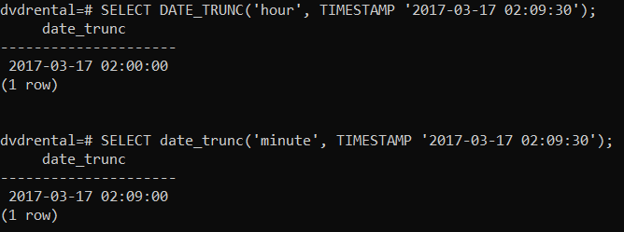
EXAMPLES

Slide 44
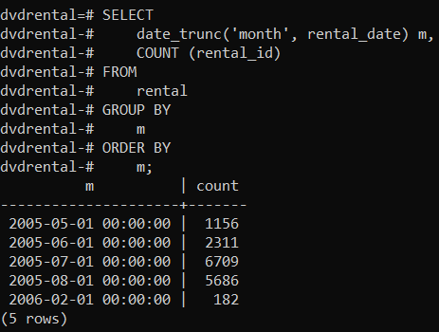
Super Useful
How many rentals were made in given, month, year or hour?
Find out with DATE_TRUNC()!
Great for time- based accounting

Slide 45
Worth Exploring in Depth
select d::date as month,
(d + interval '1 month' - interval '1 day')::date as month_end,
(d + interval '1 month')::date as next_month,
(d + interval '1 month')::date - d::date as days
from generate_series(
date '2017-01-01',
date '2017-12-01',
interval '1 month'
)
as t(d);

Slide 46
What time is it?
clock_timestamp()
current_date
current_time
current_timestamp
Localtime
Localtimestamp
now()
statement_timestamp()
timeofday()
transaction_timestamp()

Slide 47
Age and interval
age(timestamp)
age(timestamp, timestamp)

Slide 48
Edit selection
date_part(text, timestamp)
date_part(text, interval)
date_trunc(text, timestamp)
date_trunc(text, interval)
extract(field from timestamp)
extract(field from interval)
justify_days(interval)
justify_hours(interval)
justify_interval(interval)

Slide 49
Make it so
make_date(year int, month int, day int)
make_interval(years int DEFAULT 0, months int DEFAULT 0, weeks int DEFAULT 0, days int DEFAULT 0, hours int DEFAULT 0, mins int DEFAULT 0, secs double precision DEFAULT 0.0)
make_time(hour int, min int, sec double precision)
make_timestamptz(year int, month int, day int, hour int, min int, sec double precision, [ timezone text ])

