Slide 1
PostgreSQL Times and Dates
Vadim Acosta

Slide 2
Information about the data types you can use when creating a table or database can be found below
https://www.postgresql.org/docs/12/datatype-datetime.html

Slide 3
DATE YYYY-MM-DD IOS
The International Organization for Standardization (ISO) date format is a standard way to express a numeric calendar date that eliminates ambiguity.
ISO 8601 provides a standard cross-national approach that says: A general-to-specific approach, forming a date that is easier to process - thus, the year first, followed by month, then day
With each separated by a hyphen ("-")
Numbers less than 10 preceded by a leading zero

Slide 4

What’s in a timestamp?
DATE
TIME
YEAR
MONTH
DAY
HOUR
MINUTE
SECOND
MICROSECOND
TIME ZONE

Slide 5
Make it so
make_date(year int, month int, day int)
make_interval(years int DEFAULT 0, months int DEFAULT 0, weeks int DEFAULT 0, days int DEFAULT 0, hours int DEFAULT 0, mins int DEFAULT 0, secs double precision DEFAULT 0.0)
make_timestamptz(year int, month int, day int, hour int, min int, sec double precision, [ timezone text ])

Slide 6
-- make_date(year int, month int, day int)
-- select make_date(1984, 08, 31);
-- make_interval(years int DEFAULT 0, months int DEFAULT 0, weeks int DEFAULT 0, days int DEFAULT 0,
-- hours int DEFAULT 0, mins int DEFAULT 0, secs double precision DEFAULT 0.0)
-- SELECT AGE(NOW(), '1984-08-31')
-- SELECT make_interval (35, 07, 3, 0, 16, 50, 15.5555555 )
-- make_timestamptz(year int, month int, day int, hour int, min int, sec double precision, [ timezone text ])
-- SELECT make_timestamptz(1984, 08, 31, 16, 50, 15.5555555)
SELECT make_timestampTz(1984, 08, 31, 16, 50, 15.5555555, 'Europe/Moscow')

Slide 7
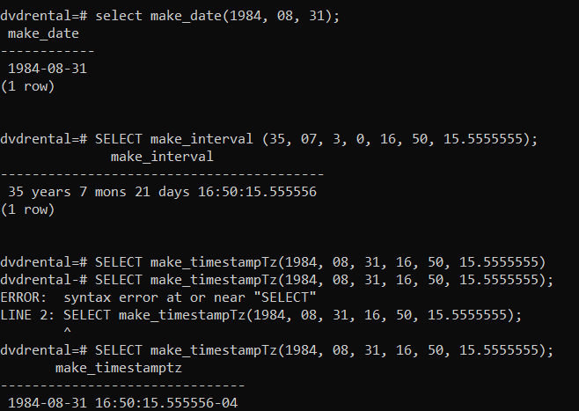

Slide 8

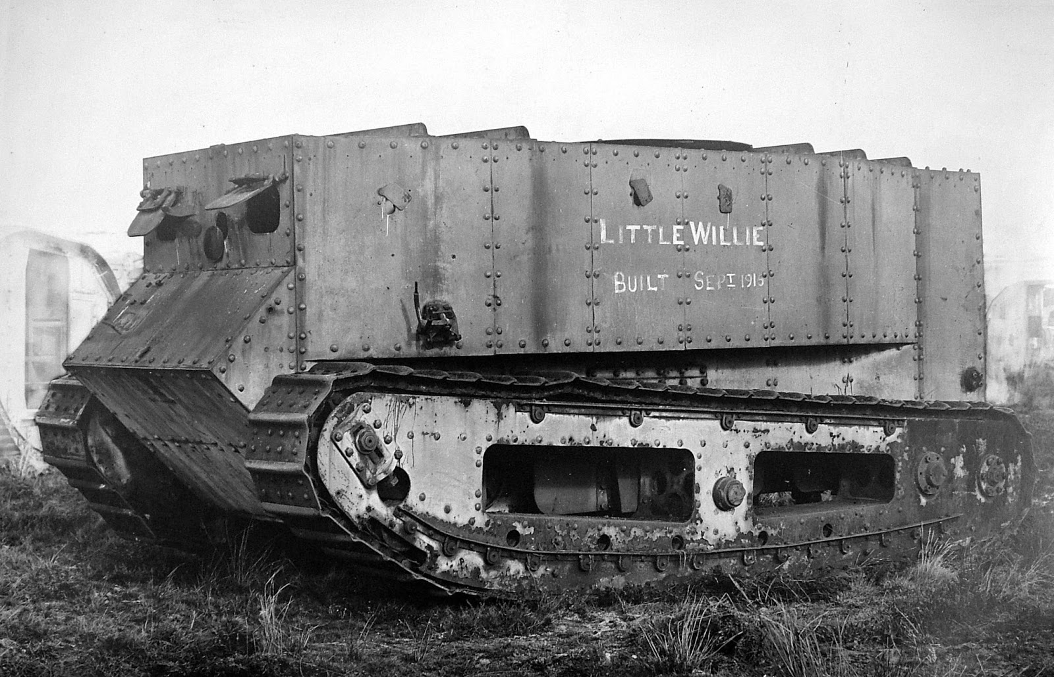
Time zones are modern
On November 18, 1883, America’s railroads began using a standard time system involving four time zones, Eastern, Central, Mountain and Pacific. Within each zone, all clocks were synchronized. The time-zone system didn’t become official across the United States until 1918.
The first modern tank was patented in 1912 by the inventor Lance De La Mole. Little Willie Landship IFV, first British tank (1915)
Synchronizing time before the late 19th century is a quagmire of micro adjustments that we will not be going into.

Slide 9
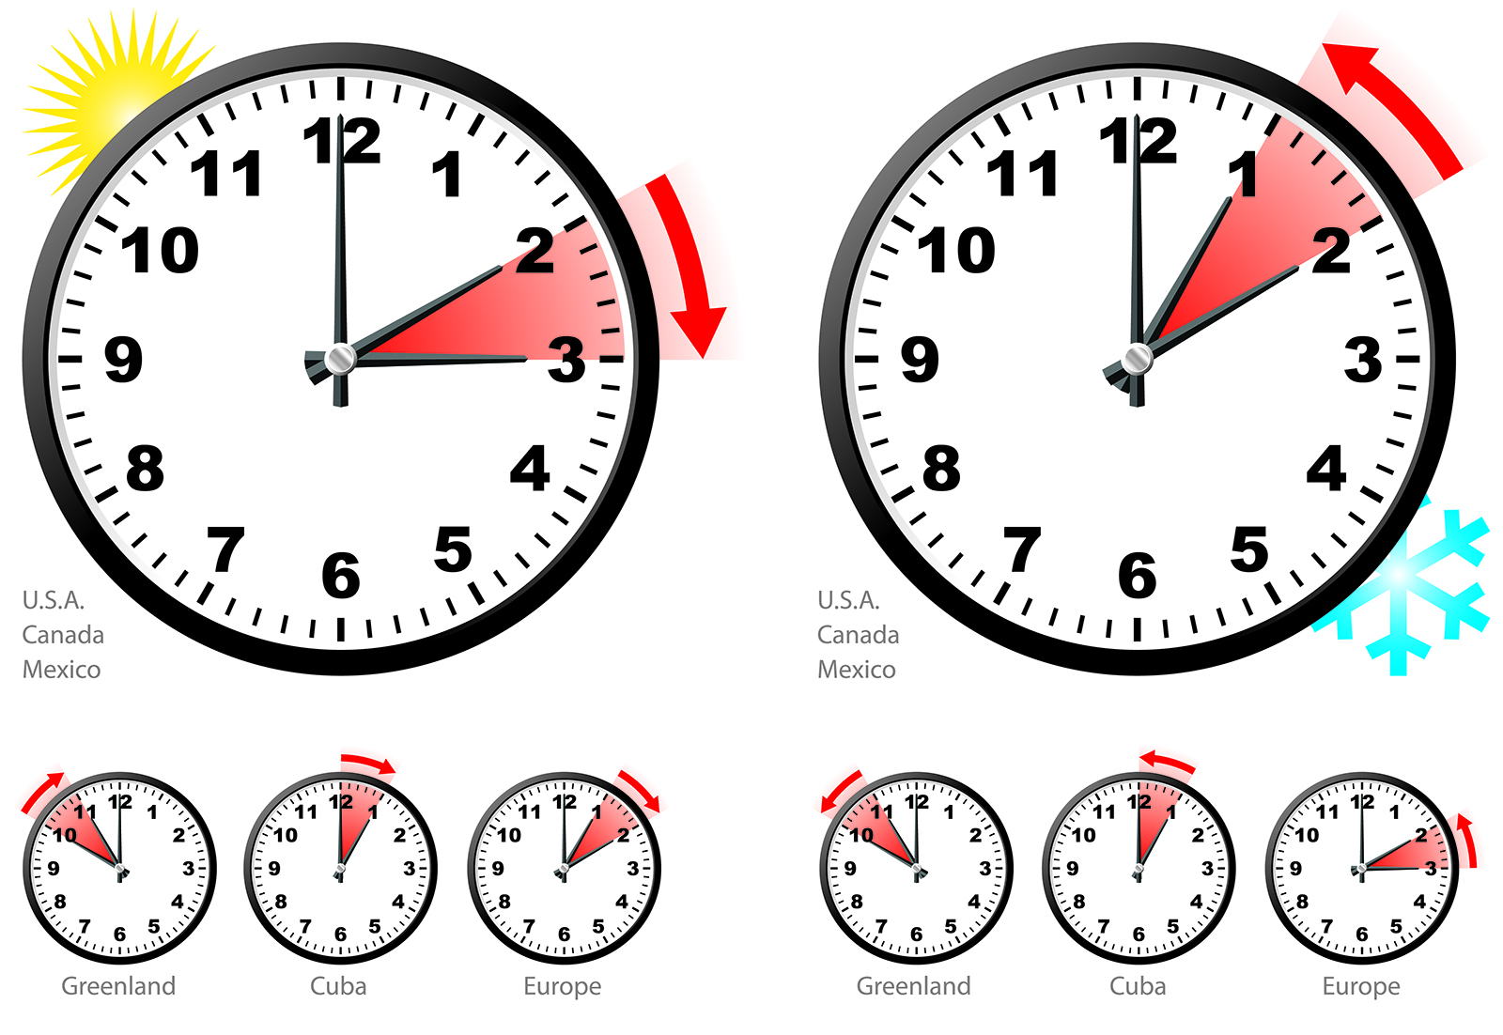
Time Zones are affected by DLS
Today 70 out of 195
countries utilize Daylight Saving Time in at least a portion of the country. Japan, India, and China are the only major industrialized
countries that do not observe some form of daylight saving

Slide 10
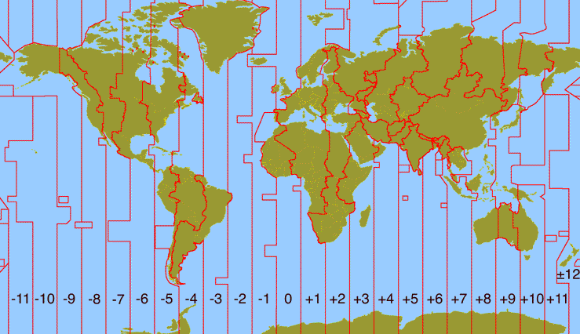
Time zones are political
Russia has 11 time zones, while China, has just a single zone. When the Communist Party came to power in 1949 the government required the entire country to operate on Beijing Standard Time for the sake of national unity

Slide 11
A timestamp by any other name
NOW() = CURRENT_TIMESTAMP =
= TRANSCACTION_TIMESTAMP() = STATEMENT_TIMESTAMP()
The above clauses return a full timestamp at the start of the query; date, time and time zone
They are functionally the same but allow for context specific naming conventions to improve readability

Slide 12

NOW() returns a full timestamp at the start of the query; date, time and time zone. NOW() is STABLE
CLOCK_TIMESTAMP() returns a full timestamp at the point that the clause is processed; date, time and time zone. CLOCK_TIMESTAMP() is VOLATILE. The difference may be significant.

Slide 13
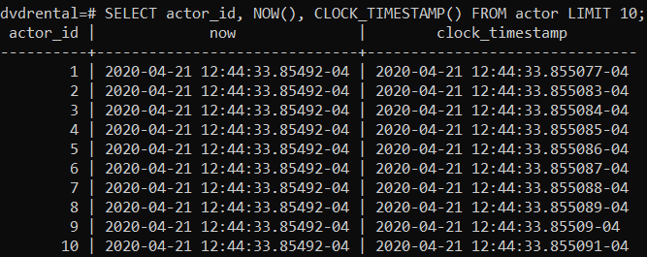
STABLE functions cannot modify the database and is guaranteed to return the same results given the same arguments for all rows within a single statement
VOLATILE functions can do anything, including modifying the database. It can return different results on successive calls with the same arguments

Slide 14
Take it apart

Slide 15
Put it back together

Slide 16
Year | Date & Time | Abbreviation | Time Change | Offset After
1980 | Sun, Apr 27 at 2:00 am | EST → EDT | +1 hour (DST start) | UTC-4h
 | Sun, Oct 26 at 2:00 am | EDT → EST | -1 hour (DST end) | UTC-5h
1981 | Sun, Apr 26 at 2:00 am | EST → EDT | +1 hour (DST start) | UTC-4h
 | Sun, Oct 25 at 2:00 am | EDT → EST | -1 hour (DST end) | UTC-5h
1982 | Sun, Apr 25 at 2:00 am | EST → EDT | +1 hour (DST start) | UTC-4h
 | Sun, Oct 31 at 2:00 am | EDT → EST | -1 hour (DST end) | UTC-5h
1983 | Sun, Apr 24 at 2:00 am | EST → EDT | +1 hour (DST start) | UTC-4h
 | Sun, Oct 30 at 2:00 am | EDT → EST | -1 hour (DST end) | UTC-5h
1984 | Sun, Apr 29 at 2:00 am | EST → EDT | +1 hour (DST start) | UTC-4h
 | Sun, Oct 28 at 2:00 am | EDT → EST | -1 hour (DST end) | UTC-5h
1985 | Sun, Apr 28 at 2:00 am | EST → EDT | +1 hour (DST start) | UTC-4h
 | Sun, Oct 27 at 2:00 am | EDT → EST | -1 hour (DST end) | UTC-5h
1986 | Sun, Apr 27 at 2:00 am | EST → EDT | +1 hour (DST start) | UTC-4h
 | Sun, Oct 26 at 2:00 am | EDT → EST | -1 hour (DST end) | UTC-5h
1987 | Sun, Apr 5 at 2:00 am | EST → EDT | +1 hour (DST start) | UTC-4h
 | Sun, Oct 25 at 2:00 am | EDT → EST | -1 hour (DST end) | UTC-5h
1988 | Sun, Apr 3 at 2:00 am | EST → EDT | +1 hour (DST start) | UTC-4h
 | Sun, Oct 30 at 2:00 am | EDT → EST | -1 hour (DST end) | UTC-5h
1989 | Sun, Apr 2 at 2:00 am | EST → EDT | +1 hour (DST start) | UTC-4h
 | Sun, Oct 29 at 2:00 am | EDT → EST | -1 hour (DST end) | UTC-5h

Slide 17
What’s this date?

Slide 18
Name | Storage Size | Description | Low Value | High Value | Resolution
timestamp [ (p) ] [ without time zone ] | 8 bytes | both date and time (no time zone) | 4713 BC | 294276 AD | 1 microsecond
timestamp [ (p) ] with time zone | 8 bytes | both date and time, with time zone | 4713 BC | 294276 AD | 1 microsecond
date | 4 bytes | date (no time of day) | 4713 BC | 5874897 AD | 1 day
time [ (p) ] [ without time zone ] | 8 bytes | time of day (no date) | 00:00:00 | 24:00:00 | 1 microsecond
time [ (p) ] with time zone | 12 bytes | time of day (no date), with time zone | 00:00:00+1459 | 24:00:00-1459 | 1 microsecond
interval [ fields ] [ (p) ] | 16 bytes | time interval | -178,000,000 years | 178,000,000 years | 1 microsecond
- the brackets [] denote optional statements that can be used to modify the timestamp
- (p) specifies the number of fractional digits retained in the seconds field.
the allowed range of (p) is from 0 to 6, precision can vary from seconds to microseconds
The presence or absence of time zones in the time doesn’t change storage size

Slide 19
Interval is a data type
PostgreSQL implements an interval data type along with the time, date and timestamptz data types. An interval describes a duration, like a month or two weeks, or even a millisecond:

Slide 20
Name | Storage Size | Description | Low Value | High Value | Resolution
interval [ fields ] [ (p) ] | 16 bytes | time interval | -178,000,000 years | 178,000,000 years | 1 microsecond
The interval type has an additional option [ fields ], which is to restrict the set of stored fields by writing one of these phrases:
YEAR
MONTH
DAY
HOUR
MINUTE
SECOND
YEAR TO MONTH
DAY TO HOUR
DAY TO MINUTE
DAY TO SECOND
HOUR TO MINUTE
HOUR TO SECOND
MINUTE TO SECOND
If both [fields] and (p) are specified, the fields must include SECOND, since the precision applies only to the seconds.

Slide 21


Why was this important?
If it’s not recorded it can’t be selected!

Slide 22
What do I need for this application?
Usually a timestamp with tz is enough to derive other values

Slide 23
What time is it?
clock_timestamp()
Localtimestamp
current_date
current_time
Localtime
timeofday()
now()
current_timestamp
statement_timestamp()

Slide 24
What time is it?
clock_timestamp()
current_timestamp
transaction_timestamp()
Statement_timestamp()
Localtimestamp(2)
now()
local
The LOCALTIMESTAMP function returns a TIMESTAMP value without time zone while the CURRENT_TIMESTAMP function returns a TIMESTAMP with time zone.
One of these things is not like the others
CURRENT_TIMESTAMP, transaction_timestamp() and now() do exactly the same thing
CURRENT_TIMESTAMP is a syntactical oddity for a function, having no trailing pair of parentheses

Slide 25
Age and interval
age(timestamp)
age(timestamp, timestamp)

Slide 26
Edit selection
date_part(text, timestamp)
date_part(text, interval)
date_trunc(text, timestamp)
date_trunc(text, interval)

Slide 27
examples

Slide 28
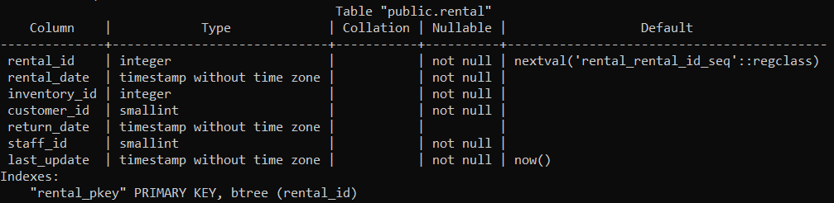
Data Types in SQL BASH
\c database_name -> connects to database
\dt -> provides list of tables in database
\d table_name -> describes columns, data types, and indexes
\d+ table_name -> describes columns, datatypes, indexes, storage type, stats target and description for a table

Slide 29
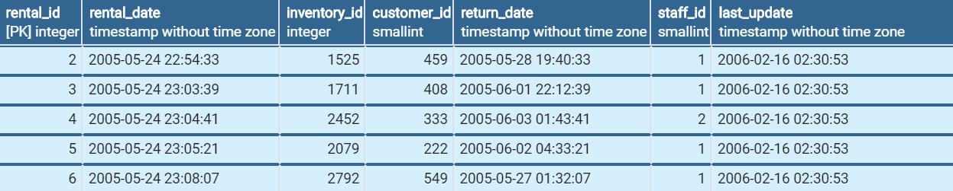
Data Types pgAdmin
SELECT * FROM rental LIMIT 5;

Slide 30
What time is it?
SELECT NOW(); -- timestamp with time zone
CURRENT_TIME; -- time with time zone
transaction_timestamp();
CURRENT_DATE; -- date without timezone
CURRENT_TIMESTAMP; -- timestamp with timezone
LOCALTIME; -- time without timezone
localtimestamp
timeofday() -- Current date and time (like clock_timestamp, but as a text string)
statement_timestamp()

Slide 31
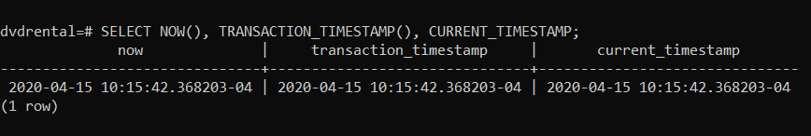
So what’s the difference?
There isn’t any

Slide 32

NOW()
Note the empty parenthesis at the end of the NOW() clause, NOW() is a function and the parenthesis is part of the clause
GIVE IT A TRY!
SELECT NOW();
Result - 2020-04-06 13:21:24.225826-04
-- SELECT NOW() :: DATE;
-- SELECT NOW() :: TIME;
SQL timestamps have the YYYY-MM-DD date format and 24 hour clock and time down to the microsecond
with the time zone at the end. In our case it's -4 (EST timezone)

Slide 33
First, we see that the now() function always returns the same timestamp within a single transaction. If you want to see the clock running while in a transaction, use the clock_timestamp() function instead
Then, we see that when we change the timezone client setting, PostgreSQL outputs timestamps as expected, in the selected timezone. If you manage an application with users in different time zones and you want to display time in their own local preferred time zone, then you can set timezone in your application code before doing any timestamp related processing, and have PostgreSQL do all the hard work for you

Slide 34
Intervals can be treated like other data types for calculations
SELECT interval '1 month',
interval '2 weeks',
2 * interval '1 week',
78389 * interval '1 ms’;
interval │ interval │ ?column? │ ?column? ══════════╪══════════╪══════════╪══════════════ 1 mon │ 14 days │ 14 days │ 00:01:18.389 (1 row)
Source: https://tapoueh.org/blog/2018/04/postgresql-data-types-date-timestamp-and-time-zones/

Slide 35
set intervalstyle to postgres_verbose;
select interval '1 month',
interval '2 weeks',
2 * interval '1 week',
78389 * interval '1 ms’;
interval │ interval │ ?column? │ ?column? ══════════╪═══════════╪═══════════╪═════════════════════ @ 1 mon │ @ 14 days │ @ 14 days │ @ 1 min 18.389 secs (1 row)

Slide 36
Worth Exploring in Depth
select d::date as month,
(d + interval '1 month' - interval '1 day')::date as month_end,
(d + interval '1 month')::date as next_month,
(d + interval '1 month')::date - d::date as days
from generate_series(
date '2017-01-01',
date '2017-12-01',
interval '1 month'
)
as t(d);

Slide 37
2)
SELECT NOW() :: DATE;
SELECT NOW() :: TIME;
- Using the :: (double colon) you can cast (format) the timestamp as a date or time

Slide 38
3)
INTERVAL –
DATE_PART() function extracts a subfield from a date or time value. The following illustrates the DATE_PART() function:
DATE_PART(field,source)

Slide 39
DATE_PART(field,source)
The field is an identifier that determines what field to extract from the source.
The values of the field must be in a list of permitted values mentioned below
The source is a value of type TIMESTAMP or INTERVAL. If you pass a DATE value, the function will cast it to a TIMESTAMP value
.
century
decade
year
month
day
hour
minute
second
microseconds
milliseconds
dow (day of week)
doy (day of year)
epoch
isodow
isoyear
timezone
timezone_hour
timezone_minute

Slide 40
Date Part
DATE_PART() function extracts a subfield from a date or time value. The following illustrates the DATE_PART() function:
DATE_PART(field,source)
EXTRACT(year FROM timestamp) = DATE_PART('year',timestamp)
extract() gets re-written to date_part() - check the execution plan and you will see.
extract() complies with the SQL standard, date_part() is a Postgres specific query. As one gets converted to the other, there is absolutely no performance difference.

Slide 41
Field Value | TIMESTAMP | Interval
CENTURY | The century | The number of centuries
DAY | The day of the month (1-31) | The number of days
DECADE | The decade that is the year divided by 10 | Sames as TIMESTAMP
DOW | The day of week Sunday (0) to Saturday (6) | N/A
DOY | The day of year that ranges from 1 to 366 | N/A
EPOCH | The number of seconds since 1970-01-01 00:00:00 UTC | The total number of seconds in the interval
HOUR | The hour (0-23) | The number of hours
ISODOW | Day of week based on ISO 8601 Monday (1) to Sunday (7) | N/A
ISOYEAR* | ISO 8601 week number of year | N/A
MICROSECONDS | The seconds field, including fractional parts, multiplied by 1000000 | Sames as TIMESTAMP
MILLENNIUM | The millennium | The number of millennium
MILLISECONDS | The seconds field, including fractional parts, multiplied by 1000 | Sames as TIMESTAMP
MINUTE | The minute (0-59) | The number of minutes
MONTH | Month, 1-12 | The number of months, modulo (0-11)
QUARTER | Quarter of the year | The number of quarters
SECOND | The second | The number of seconds in given minute
TIMEZONE | The timezone offset from UTC, measured in seconds | N/A
TIMEZONE_HOUR | The hour component of the time zone offset | N/A
TIMEZONE_MINUTE | The minute component of the time zone offset | N/A
WEEK | The number of the ISO 8601 week-numbering week of the year | N/A
YEAR | The year | Same as TIMESTAMP
ISOYEAR* -> An ISO week-numbering year (also called ISO year informally) has 52 or 53 full weeks.
That is 364 or 371 days instead of the usual 365 or 366 days.
The extra week is sometimes referred to as a leap week, although ISO 8601 does not use this term

Slide 42
What time is it?
clock_timestamp()
current_date
current_time
current_timestamp
Localtime
Localtimestamp
now()
statement_timestamp()
timeofday()
transaction_timestamp()

Slide 43
Age and interval
age(timestamp)
age(timestamp, timestamp)

Slide 44
Edit selection
date_part(text, timestamp)
date_part(text, interval)
date_trunc(text, timestamp)
date_trunc(text, interval)
extract(field from timestamp)
extract(field from interval)
justify_days(interval)
justify_hours(interval)
justify_interval(interval)

Slide 45
Test Bool
isfinite(date)
isfinite(timestamp)
isfinite(interval)

Slide 46
Make it so
make_date(year int, month int, day int)
make_interval(years int DEFAULT 0, months int DEFAULT 0, weeks int DEFAULT 0, days int DEFAULT 0, hours int DEFAULT 0, mins int DEFAULT 0, secs double precision DEFAULT 0.0)
make_time(hour int, min int, sec double precision)
make_timestamptz(year int, month int, day int, hour int, min int, sec double precision, [ timezone text ])

