Slide 1

Rendering atmospheric clouds using neural networks
Author: Mikhail Panin, ITMO
Scientific Supervisor: Anton Kovalev, Assistant Prof., ITMO Scientific Advisor: Sergey Nikolenko, PHD, Head of AI lab, PDMI RAS

Slide 2
Clouds are HARD to render
Light bounces thousands of times
In a non-deterministic manner
And we have to simulate it.
Notes:
When a light ray enters the cloud, it then bounces thousands of times off the tiny droplets of which the cloud consists. It basically does so in a non-deterministic manner. And the simplest solution to rendering the clouds was actually to simulate that using Monte-Carlo style Path Tracing.

Slide 3

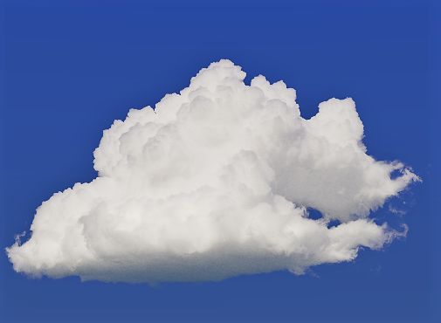
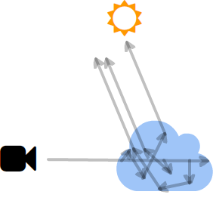
Old Fashioned Solution (path-tracing)
Rendering clouds by simulation of light bounces.
Pros:
Physically correct
Any level of accuracy
Cons:
Takes over 24 hours per image
Notes:
So path tracing process is the following:
We shoot a ray from every pixel of the screen. We simulate it’s propagation through the scene. We do so many times, averaging the results from all the runs.
Pros of that approach: we can get as close as we want to a photorealistic result. *click*
Cons: It takes over 24h to render one fullHD image of a cloud.

Slide 4
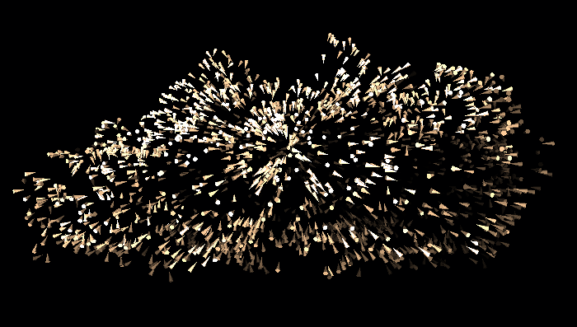
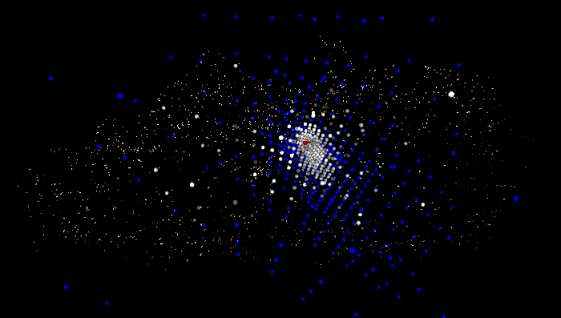
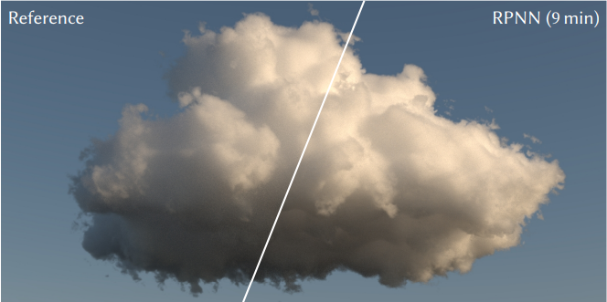
Modern Solution (By Disney Research)
Approximating out coming light using neural network.
Pros:
Takes a few minutes per image
Can be trained for various looks
Cons:
There are corner cases
Still not fast enough
Notes:
In 2017 Disney has released a new solution to this old problem.
What if we shoot the ray only once from every pixel of the camera? And when the ray hits the cloud, we ask a Neural Network to give us the answer: how much light should go from this point in the direction of camera.
The input of the neural network consists of: view direction; sun direction and *click* a cloud’s density descriptor, which somehow represents the density of the cloud around the given point.
The result can be calculated in a matter of minutes. And it is indistinguishable for a human eye from the ground truth. And the neural network can be trained to mimc non-realistic clouds.
Let’s dive into Disney’s solution to find the bottlenecks.

Slide 5
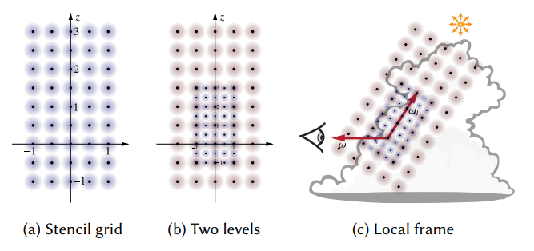
Descriptor
Notes:
The hierarchical density descriptor contains of multiple layers of stencil grids.
Each stencil consists of density values sampled from a 5x5x10 grid build around the hit point. The size of this grid exponentially increases with the layer id.
The grid is pointing with the z axis at the sun and with y axis is perpendicular both to the sun direction and the view direction.
There are 10 layers in the descriptor.

Slide 6
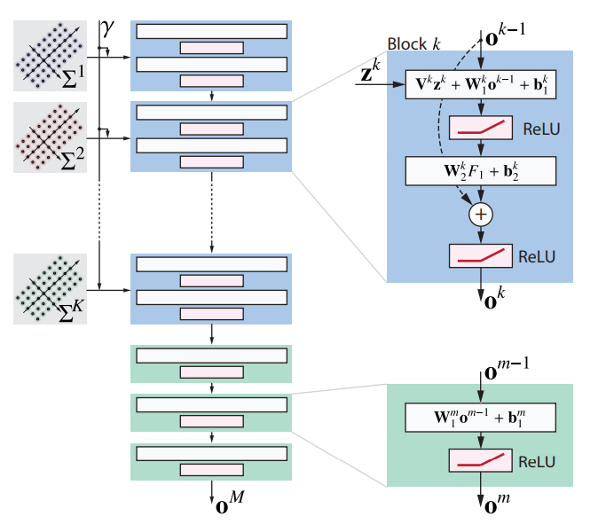
Neural Network
Feed the descriptor layer-by-layer
Three fully connected in the end
Notes:
The neural network consists of 10 descriptor processing blocks. The descriptor’s layers are fed in the network progressively, one per block.
And in the end there are three fully connected layers.

Slide 7
Goal
Beat Disney’s performance
Сome close to a real-time solution.
Notes:
The artists are craving for the iteration speed. Disney’s solution allowed CG clouds in movies to make a huge leap forward solely by improving the iteration speed from 24h to 10 minutes.
Imagine what it would feel like to be able to not only get a still image once in 10 minutes, but to be able to look at the cloud from all directions with virtually zero latency.
Or, better yet, to see the same photorealistic clouds in a real-time computer game.

Slide 8
Objectives
Implement a Monte-Carlo path-tracer (Ground Truth, data source)
Collect a dataset of clouds
Collect a dataset of [LightDirection, SunDirection, Descriptor, Radiance]
Train Disney style Neural Network
Train a faster Neural Network
Implement NN rendering on GPU
Compare images and performance

Slide 9
The new idea (backing of Neural Network)
What if we could pre bake the output of the first K layers?
Problems:
Variable ϒ
Variable view direction
Variable sun direction
Memory footprint
Notes:
So this is what I would like to do:
Precompute the output of the first part of the neural network for each point of the cloud
In runtime only compute the remaining layers.
The problems are:
Variable angle between the sun and the view direction.
Variable view direction and sun direction. Remember: different descriptors should be passed depending on those directions.
And even if the previous problems didn’t exist: the output of the last block consists of 200 floats. Storing that much data for every voxel of the cloud would require hundreds of gigabytes of GPU memory.

Slide 10
The new idea (backing of Neural Network)
Precompute only the first N blocks
Freeze the sun direction
Use the view direction only in the last layers
Different Descriptor for the baked layers
Notes:
Let’s precompute only the first N blocks and for a sparser grid than the original voxel structure of the cloud. The output of those layers represent a low frequency low detail information about light propagation.
And we’ll use the remaining blocks to refine the answer.
We have to freeze the sun direction, which is a common approach in light pre-backing in CG.
This leaves us with the view direction problem. We can only use it in the last layers, which are computed in runtime. So let’s use a slightly different descriptor in the pre-backed layers: instead of using the view direction, for orientation of the grid, we’ll just use an arbitrary direction.

Slide 11
Results
Improved performance
And the same image quality.
Notes:
I am currently in process of implementing the NN renderer with new architecture.
And I expect to see an improved performance with the same image quality.

Slide 12
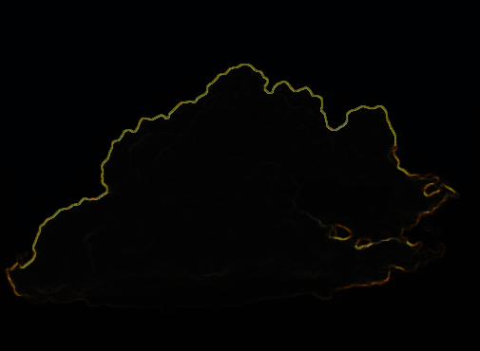
What’s next?
Even faster rendering of dense clouds
By only baking the values on the surface
And using rasterization instead of raytracing
At 10 FPS or more?

Slide 13
Thank you for your attention!
Questions?

