Slide 1
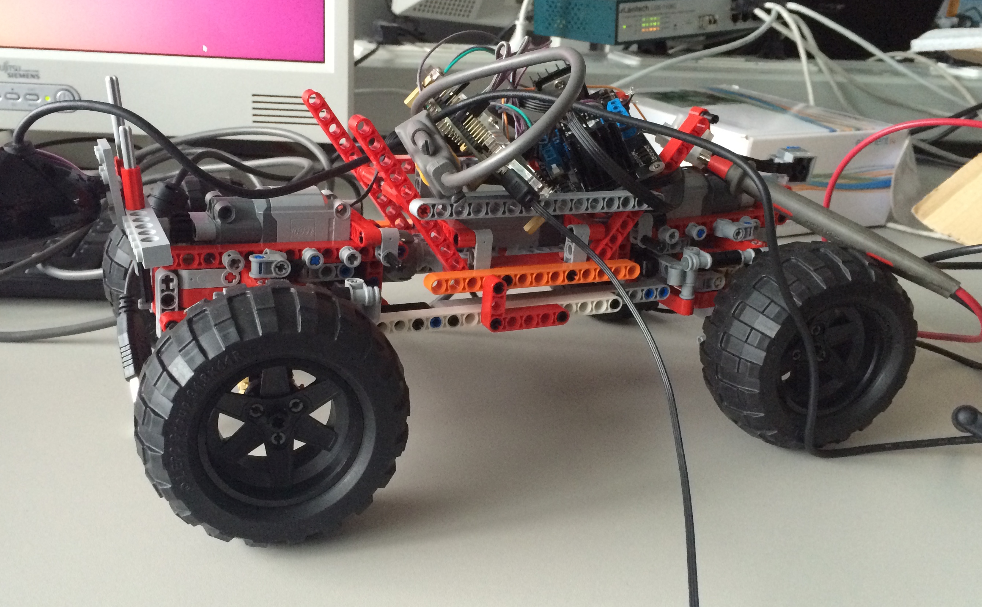
Our *Experiences
with the
Lego Car
*(we mean experiments:P)
Christoph Heidelmann
Nikolai Gruschke
Vadim Lopatkin
Vasif Hasanov
Diana Papyan

Slide 2
Our setup
Motor
Motor
USB
PC
5V
USB
H-Bridge
IMX6
UART
3.3V
NANO
USB
Servo
camera

Slide 3
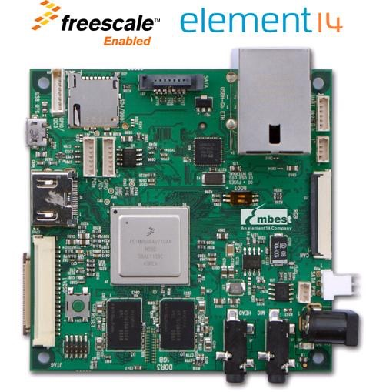
GOALs FOR imx6
Installing a appropriate OS
Getting the camera work
Having an serial connection
Installing openCV
algorithm for path detection

Slide 4
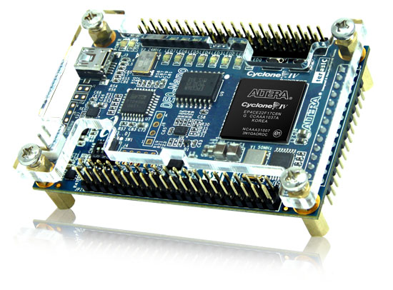
PROBLEMs
Kernel with apt-get and camera support (took unknown hrs.)
Making u-boot load the kernel (also took unknown hrs.)
Altera suite

Slide 5
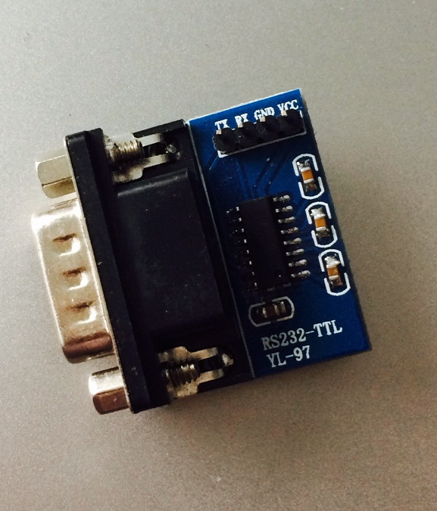
Serial Connection!
IMX6 to Nano
Nano to IMX6

Slide 6

The Path Algorithm
left half
right half

