Slide 1

ngRx
Redux pattern in Angular

Slide 2




What is the state?
Information about the view
User information
Entity data
User selection and input

Slide 3
What is ngRx?
NgRx is a framework for building reactive applications in Angular. NgRx provides libraries for:
Managing global and local state.
Isolation of side effects to promote a cleaner component architecture.
Entity collection management.
Integration with the Angular Router.
Developer tooling that enhances developer experience when building many different types of applications.

Slide 4


What is ngRx?
=
+
ngRx
Redux
Angular

Slide 5

View
User event
Selector
Component
State
Action (dispatch)
Store
State
Reducer
New state

Slide 6
Why use ngRx?
One store instead multiple services
Caching
One single point of truth
Tooling

Slide 7
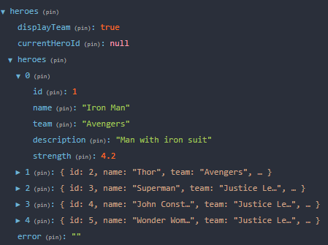
Store
Store (state)
Notes:
Store provides state management for creating maintainable, explicit applications through the use of single state and actions in order to express state changes. Stan związany tylko z komponentem, Formularze, Obiekty nieserializowalne

Slide 8

Action
Actions
Notes:
Actions express unique events that happen throughout your application.

Slide 9
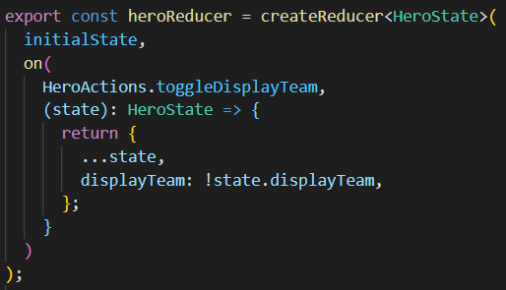
Reducers
Reducer
Notes:
Are responsible for handling transitions from one state to the next state in your application. { search: fromSearch.reducer, detail: fromUserDetail.reducer, detailBase : fromDetailBase.reducer }

Slide 10

View
User event
Selector
Component
State
Service
Action (dispatch)
Store
State
Reducer
Effects
New state
Action (dispatch)

Slide 11
RxJS operators
switchMap – Cancels the current subscription/request and can cause the race condition
Use for get requests or cancelable requests like searches
concatMap – Runs subscription/requests in order and is less performant
Use for get,post and put requests when order is imporatnt
mergeMap – Runs subscriptions/requests in paralel
Use for get, put, post and delete methods when order is not important
exhaustMap – Ignores all subsequent subscriptions/requests until it completes
Use for login when you do not want more requests until the initial one is complete

