Slide 1
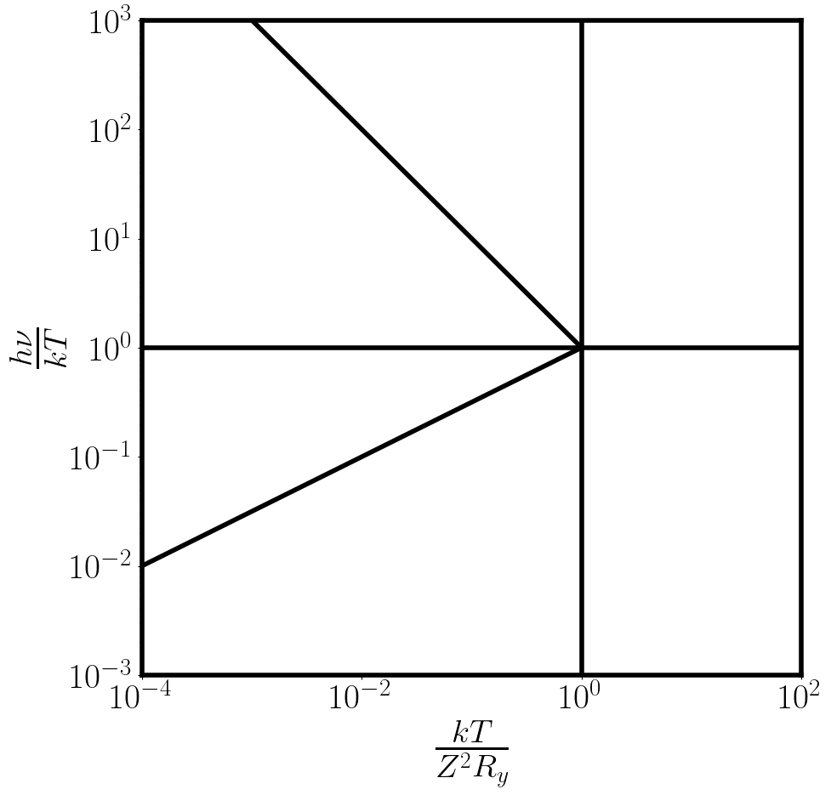



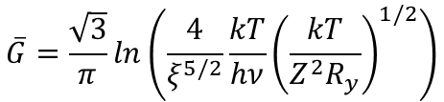


Small-angle, U.P.,
tail region-II
Small-angle, U.P.
Tail region-I
$$\overline{G}={\left(12\frac{Z^{2}R_{y}}{hυ}\right)}^{1/2}$$
$$\overline{G}={\left(\frac{3}{π}\frac{kT}{hν}\right)}^{1/2}$$
Large-angle,
tail region
$$\overline{G}=1$$
Large-angle
region
$$\overline{G}=1$$
Small-angle,
classical region
Small-angle,
U.P. region
$$\overline{G}=\frac{\sqrt{3}}{π}ln\left(\frac{4}{ξ^{5/2}}\frac{kT}{hν}{\left(\frac{kT}{Z^{2}R_{y}}\right)}^{1/2}\right)$$
$$\overline{G}=\frac{\sqrt{3}}{π}ln\left(\frac{4}{ξ}\frac{kT}{hν}\right)$$

