Slide 1
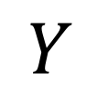
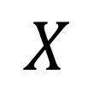
Categorical Variables
Embedding
$$X$$
Rest of the model
$$Y$$
Continuous Variables
Batch Normalization

Slide 2
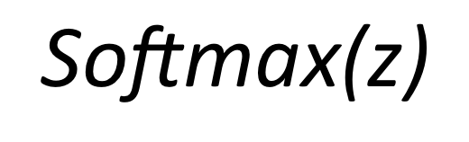
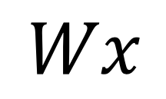
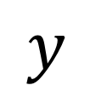


$$x$$
0
0
Linear Transformation
0
$$z$$
$$\text{Softmax}\text{(}\text{z}\text{)}$$
1
$$Wx$$
$$y$$
0
…
0
One-hot encoded
Input

