Slide 1
Why Monte Carlo Fails in High Dimensions
A paper review and presentation by Ryan McKennon-Kelly
Polyak, Boris, and Pavel Shcherbakov. “Why Does Monte Carlo Fail to Work Properly in High-Dimensional Optimization Problems?” ArXiv:1603.00311 [Math], March 1, 2016. http://arxiv.org/abs/1603.00311.

Slide 3
Monte Carlo and Quasi-Monte Carlo
Monte Carlo (MC) paradigm invented by S. Ulam (late 1940s) and has been efficiently used in simulation of various probability distributions, numerical integration, mean estimation, etc.
Has desirable properties when distributions are known or can be simulated
Often challenged in the area of optimization: when looking for “edge” cases or solutions which may not be frequent and therefore are unlikely to be encountered by “brute force” MC
This paper posits that this is particularly true in global optimization paradigms
“Quasi Monte Carlo” (QMC) methods offer performance improvements (fast process / better ‘uniformity’) without substantial difference to traditional MC
MC and QMC are good at capturing “jist” of randomized behavior
Giles, Mike. “Advanced Monte Carlo Methods: Quasi-Monte Carlo”

Slide 4
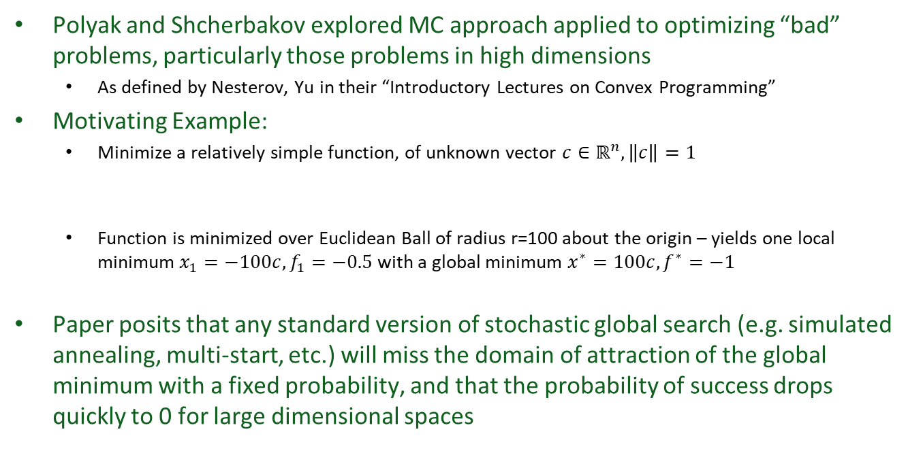
Paper’s Purpose, Methods
“In global optimization, randomness can appear in several ways. The main three are: (i) the evaluations of the objective function are corrupted by random errors; (ii) the points xi are chosen on the base of random rules, and (iii) the assumptions about the objective function are probabilistic.”
Polyak and Shcherbakov explored MC approach applied to optimizing “bad” problems, particularly those problems in high dimensions
As defined by Nesterov, Yu in their “Introductory Lectures on Convex Programming”
Motivating Example:
Minimize a relatively simple function, of unknown vector $c∈ℝ^{n}, \left\|c\right\|=1$
Function is minimized over Euclidean Ball of radius r=100 about the origin – yields one local minimum $x_{1}=−100c, f_{1}=−0.5$ with a global minimum $x^{∗}=100c, f^{∗}=−1$
Paper posits that any standard version of stochastic global search (e.g. simulated annealing, multi-start, etc.) will miss the domain of attraction of the global minimum with a fixed probability, and that the probability of success drops quickly to 0 for large dimensional spaces

Slide 5
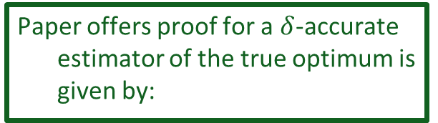
Main Results: Ball-Shaped Sets
As dimensionality grows, the mass of the distribution tends to concentrate closer to the origin
Paper offers proof for a $δ$-accurate estimator of the true optimum is given by:

Slide 6

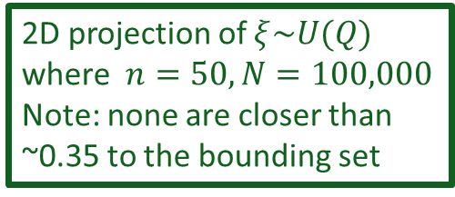
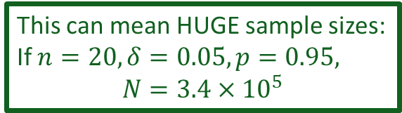
Applying to Multiple Dimensions, multi-Objective Optimization
Paper derives an approach to again estimate the minimum number of samples to capture a $δ$-accurate estimator (i.e. has a high probability of generating a random vector close to the optimal boundary)
This can mean HUGE sample sizes:
If $n=20, δ=0.05,p=0.95,$
$$N={3.4×10}^{5}$$
2D projection of $ξ\sim U(Q)$
where $n=50, N=100,000$
Note: none are closer than ~0.35 to the bounding set
Pareto / Optimal Boundary

Slide 7
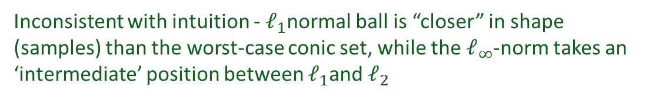
Further Explorations
Box-Shaped Sets (deterministic approach on regular grids)
Inconsistent with intuition - $ℓ_{1}$normal ball is “closer” in shape (samples) than the worst-case conic set, while the $ℓ_{∞}$-norm takes an ‘intermediate’ position between $ℓ_{1}$and $ℓ_{2}$

Slide 8
Further Explorations
Deterministic Grids (Uniform, Sobol [$LP_{t}$])
Note: Maximum = n for the paper’s problem formulation, sample size was fixed
Uniform grid exhibits poor relative performance as dimensionality grows
Sobol and standard MC perform well but still break down in high dimensionality
Conclusion: Paper explores and provides rigorous mathematical explanation of why a direct MC approach is inefficient in high dimensional problems

Slide 9
Questions?

Slide 10
Using Deep Learning for CUBESAT Navigation
A paper review and presentation by Ryan McKennon-Kelly
Shi, Jian-Feng, Steve Ulrich, and Stephane Ruel. “CubeSat Simulation and Detection Using Monocular Camera Images and Convolutional Neural Networks.” In 2018 AIAA Guidance, Navigation, and Control Conference. AIAA SciTech Forum. American Institute of Aeronautics and Astronautics, 2018. https://doi.org/10.2514/6.2018-1604.

Slide 11
Motivation and Method
Innovation and cost reduction in component as well as launch markets has enabled small satellite production to be viable
This opens the market to universities and smaller institutuions to gain access to space
Due to smaller mass (1-10kg) and capability constraints, individual CubeSats are not as capable as their larger counterparts (150+ kg)
Often formations of CubeSats are designed into ‘constellations’ to provide overall functionality across multiple platforms
As such on-orbit navigation and collision avoidance are critical issues
Due to their size, CubeSats cannot accommodate localized sensing such as LIDAR, and so is typically limited to space cameras for Proximity Operations (ProxOps)
With the advent of the Mega Constellations such as those proposed by SpaceX and OneWeb, thousands of vehicles in the sky will quickly overwhelm current operations and so additional decision support is required

Slide 12
Proposed Approach
The team first modeled realistic orbit and attitude dynamics to generate synthetic CubeSat images which in turn train the Convolutional Neural Network (CNN)

Slide 13
Dynamic Regime - Attitude
The simulation for synthetic images leveraged the “CS” or “LVLH” localized frames in training the model. The dynamics of the spacecraft is non-linear (and therefore so is the motion of these separate frames relative to each other)
Orbital Motion
Target Pointing

Slide 14
CNN Image Classifiers
Inception-ResNet-V2 (Szegedy et al.)

Slide 15
The proposed process then feeds the outputs from either the 101-Layer ResNet or Inception-ResNet-V2 with the “Faster-RCNN” Regional Proposal Network to improve performance for classification

Slide 16
Orbit Regime

Slide 17
Virtual Camera Parameters and Synthetic Image Environment
Reasonably small camera (significantly worse than current cell phones) assumed in generation of images
Simple 3D modeling software used to generate synthetic images to train models

Slide 18
Real-World Lab Test Configuration

Slide 19
Simulated “Pose” Of Cubesats

Slide 20
Simulated CubeSat Detections (in presence of other local vehicles)
CNNs were able to detect the CubeSats based on previous training in either the Inception-ResNet-V2 or ResNet-101 based cases

Slide 21
Real-World Application
Operational CubeSat platform detection using faster-RCNN based on various classifier networks. Subfigure (a) is baselined in Inception-ResNet-V2 and Subfigure (b) is baselined in ResNet-101.
Laboratory environment CubeSat platform detection using faster-RCNN based on various classifier networks. Subfigure (a) is baselined in Inception-ResNet-V2 and Subfigure (b) is baselined in ResNet-101.

Slide 22
Conclusions

Slide 23
Questions?

