Slide 1

Simulation of different Modulation schemes and calculating Bit Error Rate by using different channels in Matlab
by
Vadlamudi Girish
(11013327)
Under the guidance of
Prof.Mrs. Pooja Mohnani

Slide 2
Contents
Communication (Digital)
Message signal
Carrier signal
Modulator
Phase Shift Keying
Demodulator
Bit Error Rate
Signal to Noise Ratio
Simulation results
Conclusion
References

Slide 3
Communication (Digital)
Communication is defined as conveying the desired information from a source to a destination.
Digital communication is defined as transmitting this desired information in terms of bits for several advantages including speed and reliability.

Slide 4
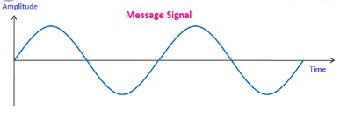
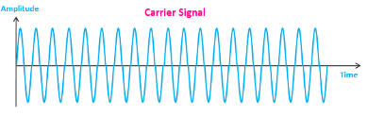
Message Signal
Carrier signal
Message signal contains the desired information from the user which is to be transmitted to the another user at the destination.
It is a low frequency signal which has to undergo the process of modulation, to get transmitted. Hence, it is also called as the modulating signal.
Carrier wave usually has a much higher frequency than the Message signal.
The purpose of the carrier is usually either to transmit the information through space as an electromagnetic wave , or to allow several carriers at different frequencies to share a common physical transmission medium by using frequency division multiplexing.

Slide 5
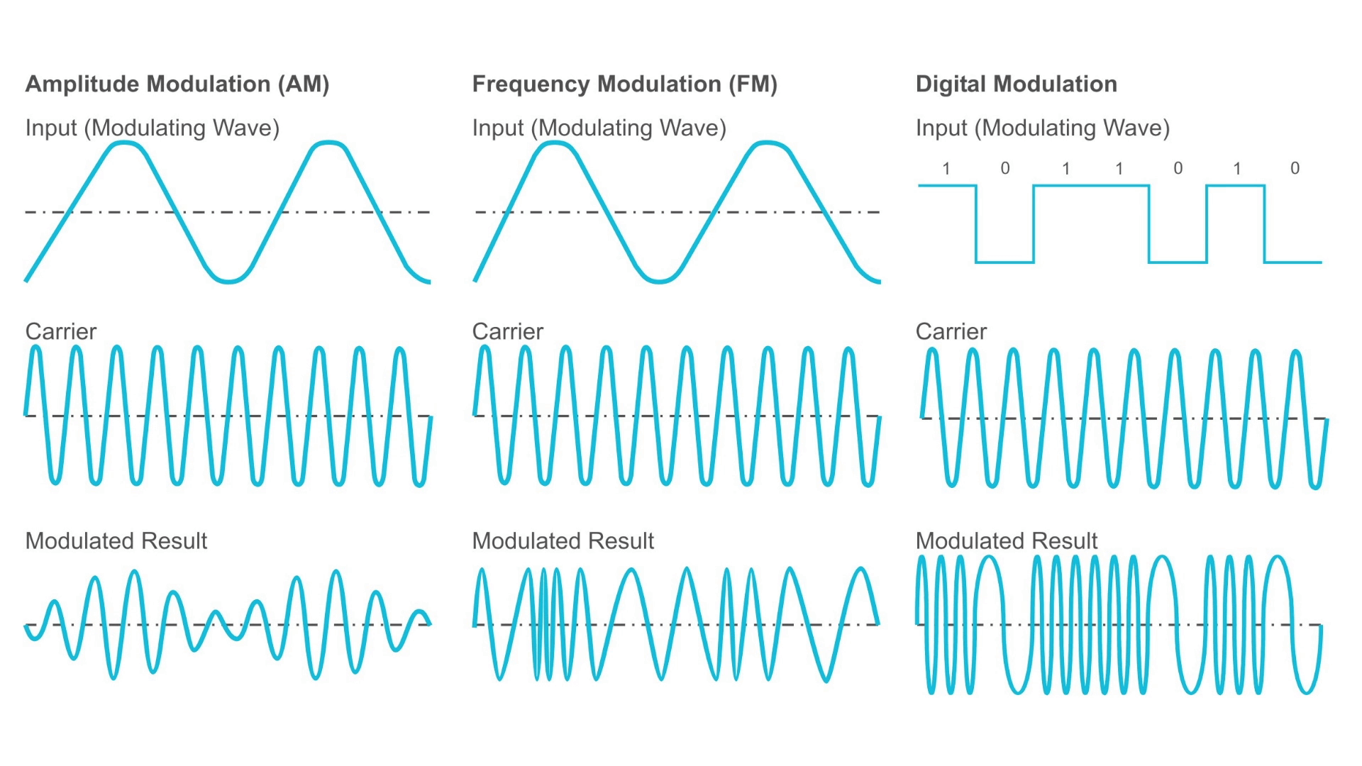
Modulator
In electronics and telecommunications, modulation is the process of varying one or more properties of a periodic waveform, called the carrier signal, with a modulating signal that typically contains information to be transmitted.
Modulator is a device that performs modulation.

Slide 6
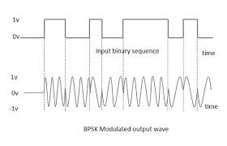
Phase Shift Keying
Phase-shift keying (PSK) is a digital modulation process which conveys data by changing (modulating) the phase of a constant frequency reference signal (the carrier wave). The modulation is accomplished by varying the sine and cosine inputs at a precise time. It is widely used for wireless LANs, RFID and Bluetooth communication.

Slide 7
AWGN Channel
Additive white Gaussian noise (AWGN) is a basic noise model used in Information theory to mimic the effect of many random processes that occur in nature.
Additive, because it is added to any noise that might be intrinsic to the information system.
White, refers to the idea that it has uniform to power across the frequency band for the information system.
Gaussian, because it has a normal distribution in the time domain with an average time domain value of zero.

Slide 8
Rayleigh Channel
Rayleigh fading is a statistical model for the effect of a propagation environment on a radio signal, such as that used by wireless devices.
Rayleigh fading models assume that the magnitude of a signal that has passed through such a transmission medium (also called a communication channel) will vary randomly, or fade, according to a Rayleigh distribution — the radial component of the sum of two uncorrelated Gaussian random variables.
Rayleigh fading is viewed as a reasonable model for tropospheric and ionospheric signal propagation as well as the effect of heavily built-up urban environments on radio signals. Rayleigh fading is most applicable when there is no dominant propagation along a line of sight between the transmitter and receiver.

Slide 9
Rician Channel
Rician fading is a stochastic model for radio propagation anomaly caused by partial cancellation of a radio signal by itself — the signal arrives at the receiver by several different paths (hence exhibiting multipath interference), and at least one of the paths is changing (lengthening or shortening).
Rician fading occurs when one of the paths, typically a line of sight signal or some strong reflection signals, is much stronger than the others. In Rician fading, the amplitude gain is characterized by a Rician distribution.

Slide 10
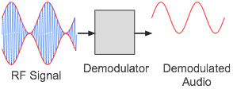
Demodulator
Demodulation is extracting the original information-bearing signal from a carrier wave. A demodulator is an electronic circuit (or computer program in a software-defined radio) that is used to recover the information content from the modulated carrier wave. There are many types of modulation so there are many types of demodulators. The signal output from a demodulator may represent sound, images or binary data (a digital signal). It also converts the obtained message signal into user understandable format.

Slide 11
Bit Error Rate
Signal to Noise Ratio
The bit error rate (BER) is the number of bit errors per unit time. The bit error ratio (also BER) is the number of bit errors divided by the total number of transferred bits during a studied time interval. Bit error ratio is a unit less performance measure, often expressed as a percentage.
Signal-to-noise ratio (abbreviated SNR or S/N) is a measure used in science and engineering that compares the level of a desired signal to the level of background noise. SNR is defined as the ratio of signal power to the noise power, often expressed in decibels. A ratio higher than 1:1 (greater than 0 dB) indicates more signal than noise

Slide 12
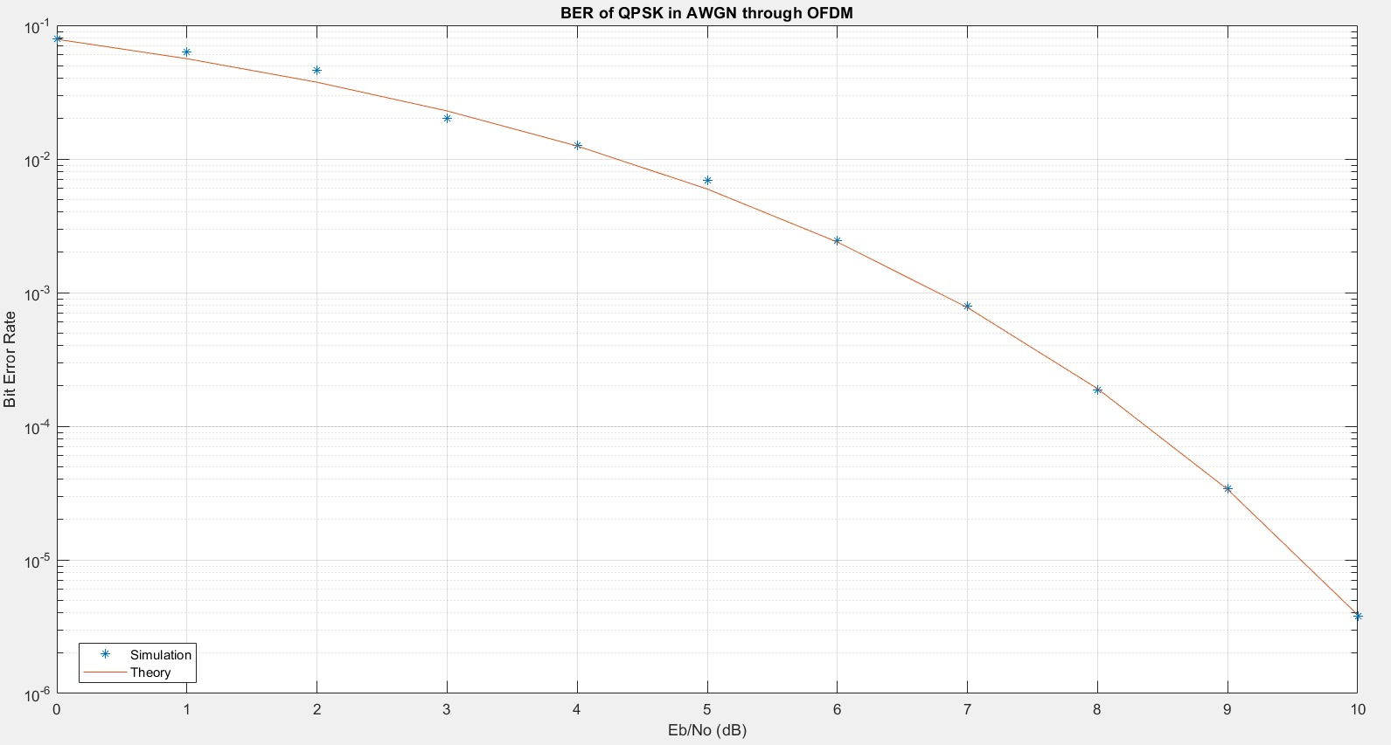
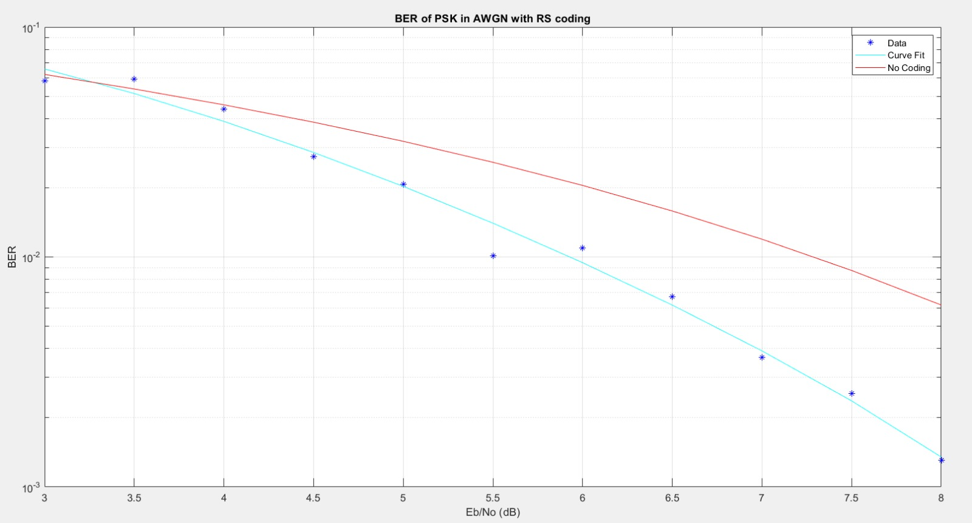
Simulation results

Slide 13
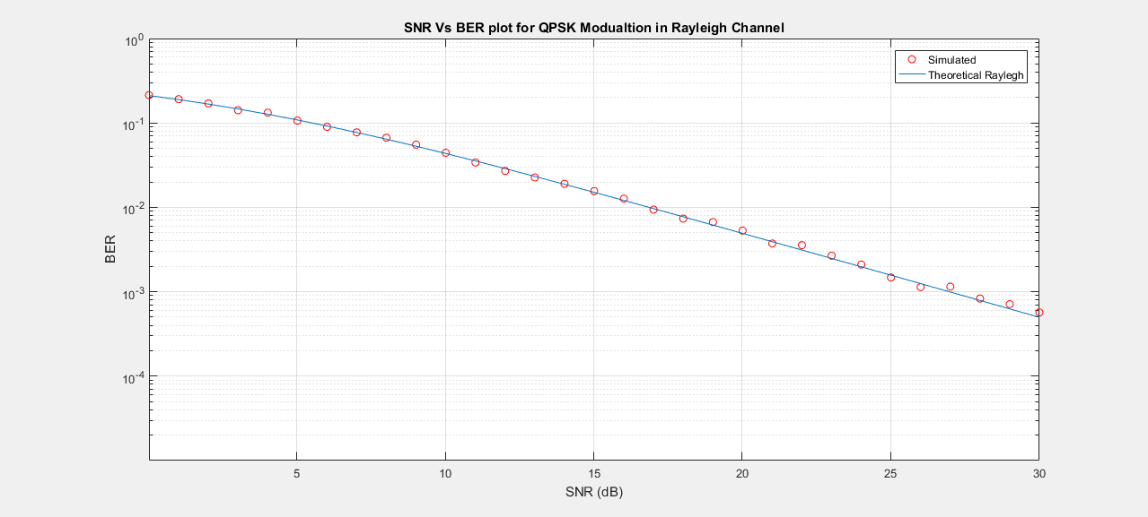
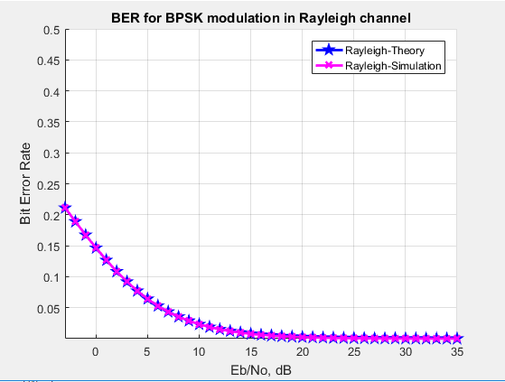
Contd..

Slide 14
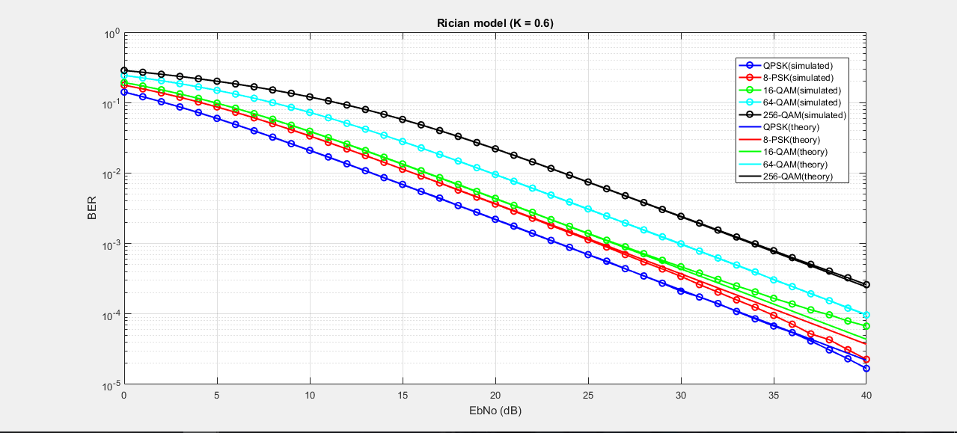
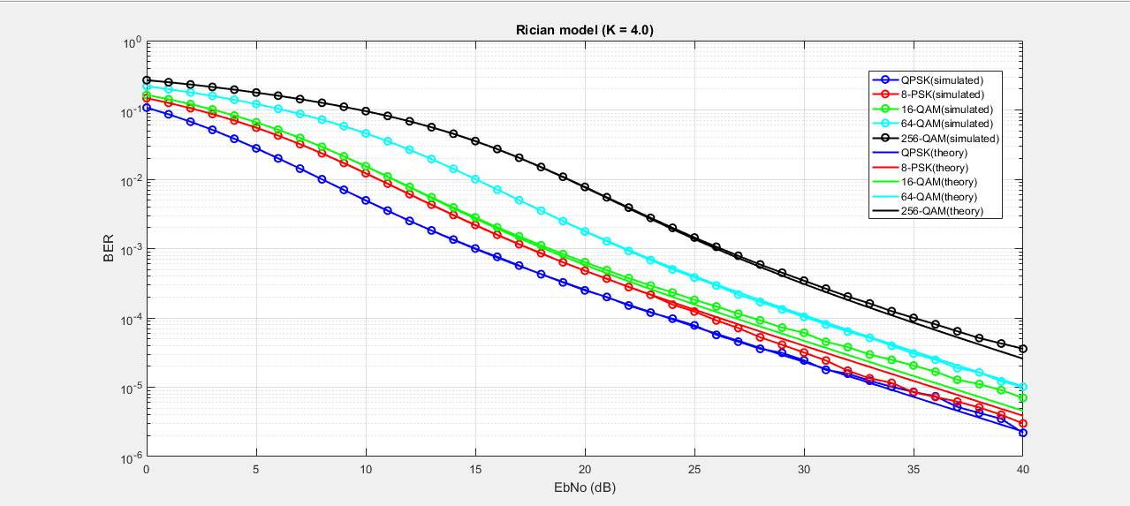
Contd…

Slide 15
Conclusion
We know that everything which is useful to us will have some possible set of advantages and disadvantages. The above mentioned results also show that these techniques have their own set of advantages and disadvantages. We have to precisely select the suitable modulation scheme and multiplexing scheme which will satisfy the needs of application for which we are using this communication.

Slide 16
References
https://matlab.mathworks.com/
https://in.mathworks.com/help/comm/index.html?s_tid=CRUX_lftnav
https://in.mathworks.com/help/comm/examples.html?s_tid=CRUX_gn_example
https://in.mathworks.com/help/comm/gs/qpsk-and-ofdm-with-matlab-system-objects-1.html
https://in.mathworks.com/matlabcentral/fileexchange/
https://en.wikipedia.org/wiki
https://in.mathworks.com/matlabcentral/fileexchange?q=Rician+channel&s_tid=srch_dym_sug

Slide 17
Thank you!

