Slide 1

E-Commerce
Team:
Denuka
Anusha
Bavana
Revanth
Vamshi
Nithyanandh

Slide 2
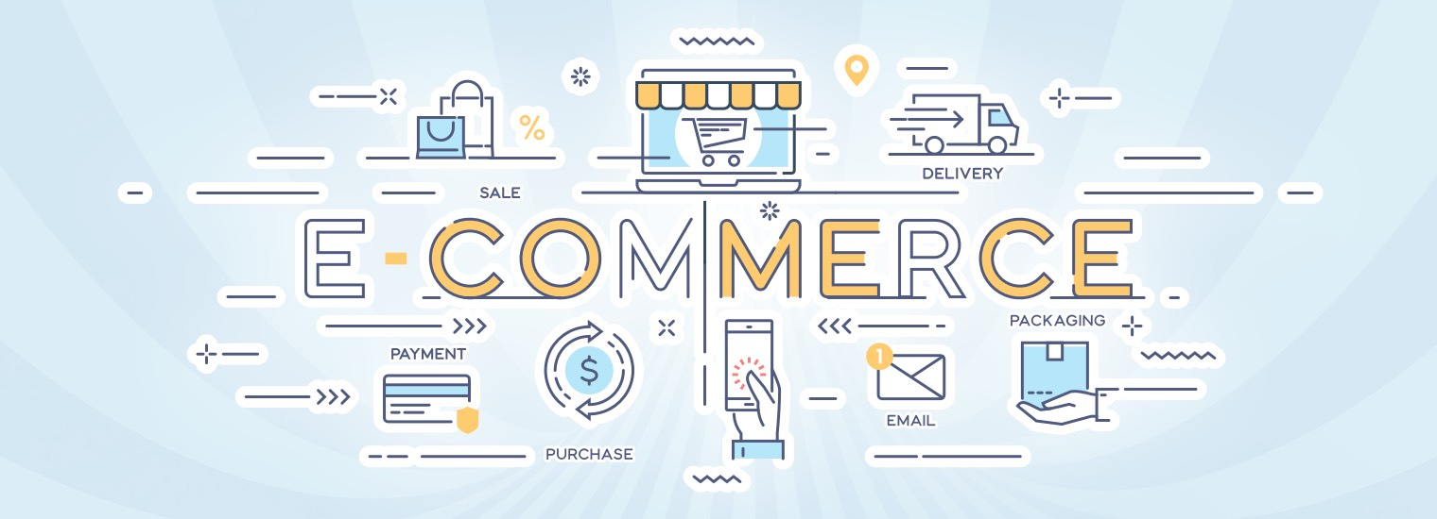
Agenda
1.Login Frame
2.Registration Frame
3.Dashboard Frame
4.Billing Frame
5.Payment Frame

Slide 3
User Registration Form using Swing in Java
In Ecommerce website user registration plays a very crucial role in order to fetch details of the customers.
Registered users normally provide some sort of credentials (such as a username or e-mail address, and a password) to the system in order to prove their identity.
In order to create registration form in java we are using swing package.
The javax.swing package provides classes for java swing API such as JButton, JTextField, JTextArea, JRadioButton, JCheckbox, JMenu, JColorChooser etc.

Slide 4
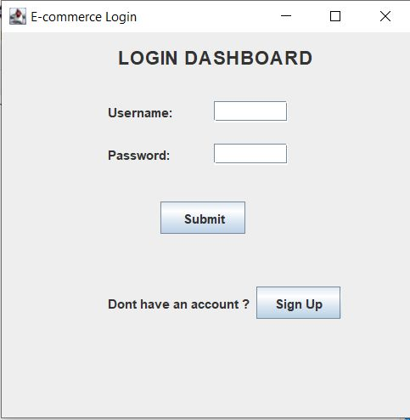
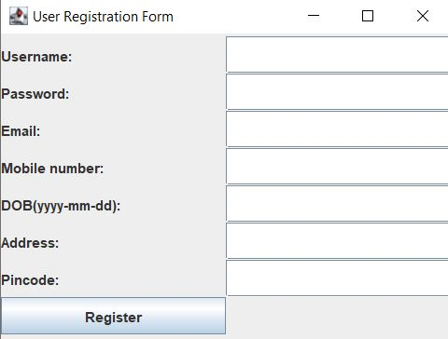
Don’t you have account???
then register
click on sign up

Slide 5






Components in Registration Form
Username Label(JLabel)
Username TextArea(JTextField)
Password Label(JLabel)
Password TextArea(JPasswordField)
Email Label(JLabel)
Email TextArea(JTextField)
Mobile Number(JLabel)
DOB(JLabel)
Address(JLabel)
Pincode(JLabel)
Register Button (JButton)

Slide 6
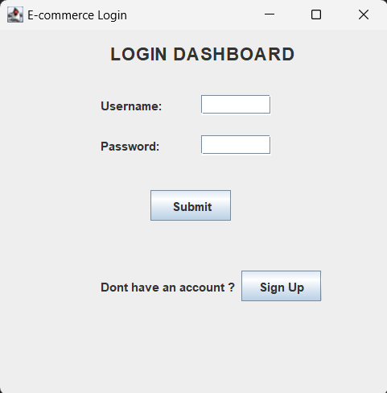
LOGIN FRAME
JLabels
Username
Password
JTextFields
Username field
Password field
JButtons
→Submit
→SignUp

Slide 7
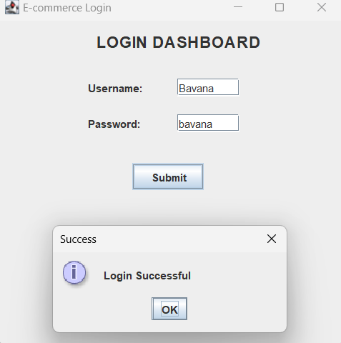
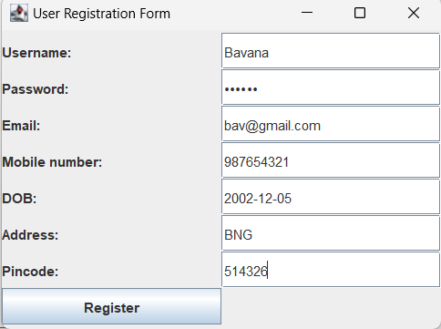
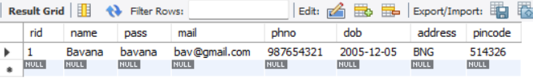

DATABASE connection

Slide 8
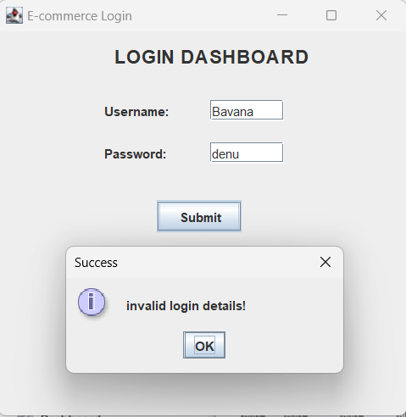
User VALIDATION

Slide 9
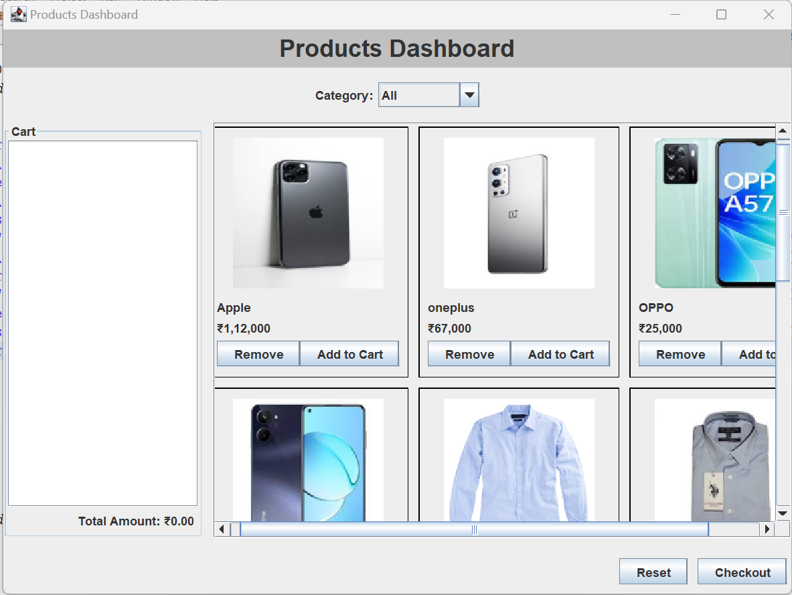
PRODUCTS DASHBOARD
The Products Dashboard serves as the main window of the application, enabling users to find products based on the category , add them to a cart, and proceed to checkout.
Let's take a closer look at how the Products Dashboard enhances the user's shopping experience.

Slide 10

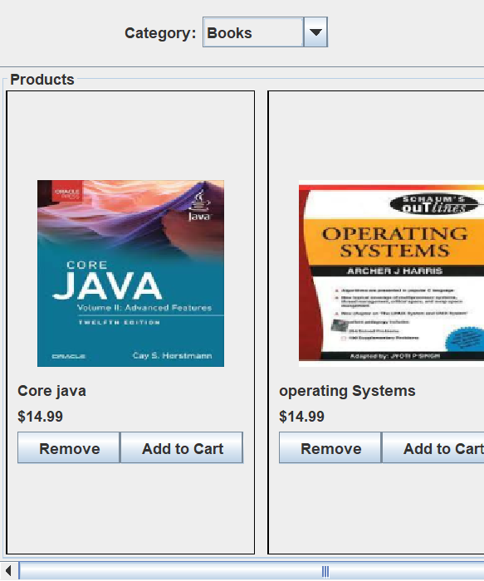
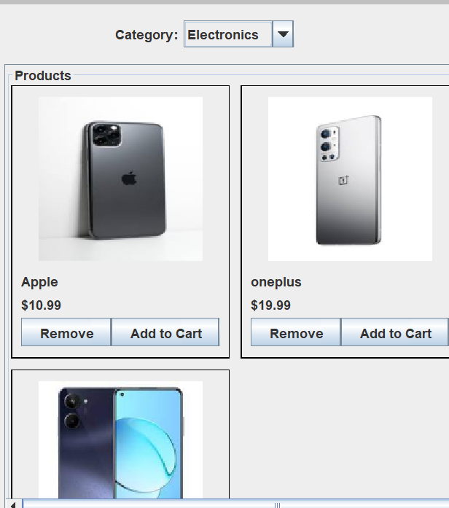
Category menu and Product Panel
The products Dashboard offers users a convenient way to find products by category.
Users can select a category from a dropdown menu, such as "All," "Electronics," "Clothing," "Books," or "Home Decor."
When a category is selected, the Products panel dynamically updates to display only the products belonging to that category.
This feature allows users to easily navigate through the available products and focus on their preferred categories.

Slide 11
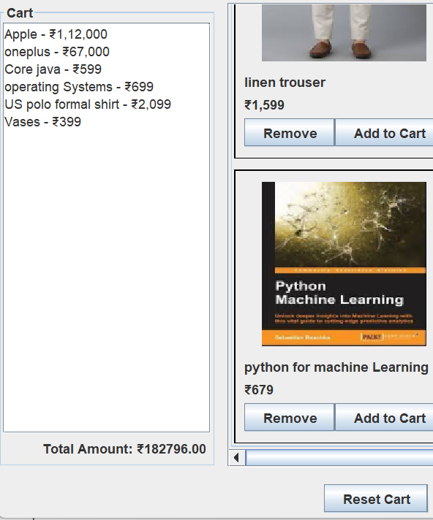
Cart Panel and Reset cart button
The Products Dashboard provides a dedicated cart section, implemented using a JTextArea, to display the selected products in the cart.
The cartTextArea is used to show the name and price of each product added to the cart.
The cartTextArea is set to be non-editable to prevent users from modifying the contents of the cart manually.
As users add products to the cart, the cartTextArea is dynamically updated to reflect the changes.
The User Dashboard includes a "Reset" button that allows users to clear the cart and reset the total amount.
The resetButton is implemented as a JButton component and placed in the bottom panel of the UI.
When the resetButton is clicked, an ActionListener triggers the resetCart() method.
The resetCart() method clears the cartTextArea by setting its text to an empty string, resets the totalAmount to 0.0, and updates the totalLabel to display "Total Amount: ₹0.00".

Slide 12
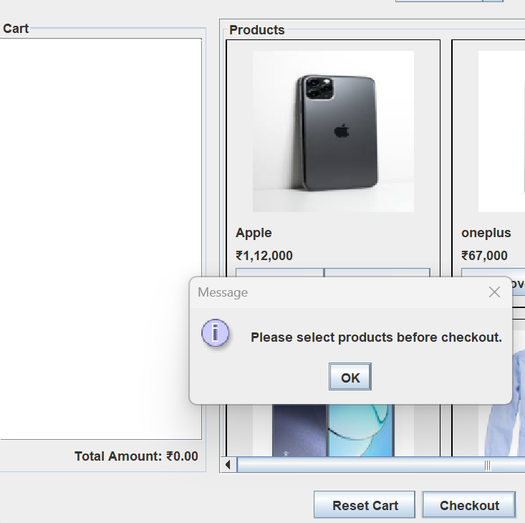
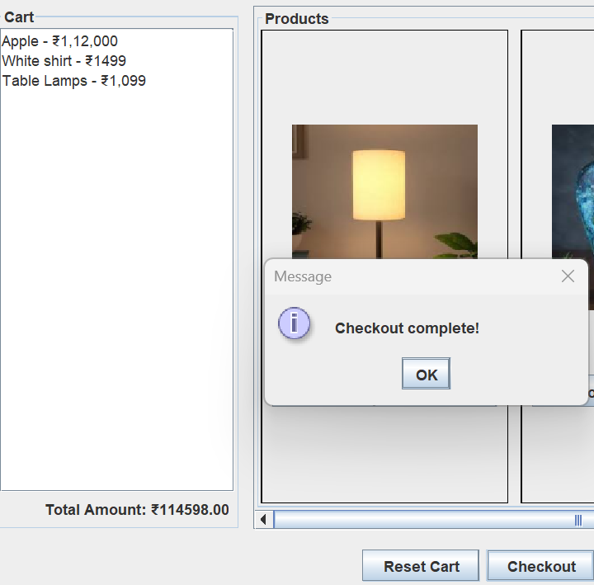
Checkout Button
The Products Dashboard code includes a "Checkout" button that enables users to finalize their purchases and proceed to the billing process.
When the checkoutButton is clicked, the ActionListener checks if the totalAmount is 0.0.
If the totalAmount is 0.0, indicating that no products are selected, a JOptionPane dialog box displays an error message asking the user to select products before proceeding.
If the totalAmount is greater than 0.0, the ActionListener displays a JOptionPane dialog box with a success message, indicating that the checkout is complete.
Additionally, the ActionListener calls the showBillingDashboard() method to navigate to the billing dashboard or perform any further actions related to billing or order processing.

Slide 13
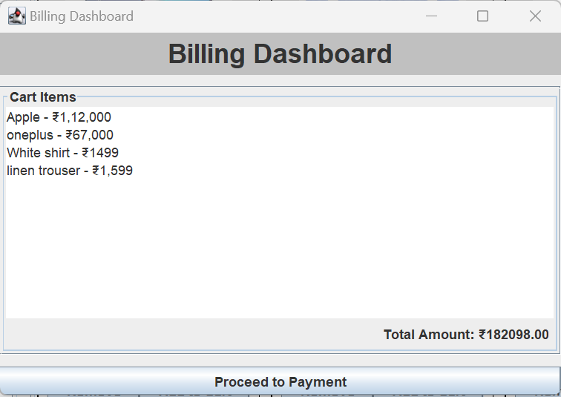
BILLING DASHBOARD
The Billing Dashboard is designed to provide users with an overview of the selected products, the total amount, and a button to proceed to payment.
The Billing Dashboard code is responsible for creating a new JFrame window to display the billing information to the user.
It features a header panel, a cart panel for displaying the selected products, the total amount, and a button to proceed to payment.
The Billing Dashboard provides a user-friendly interface for the final steps of the purchase process.

Slide 14
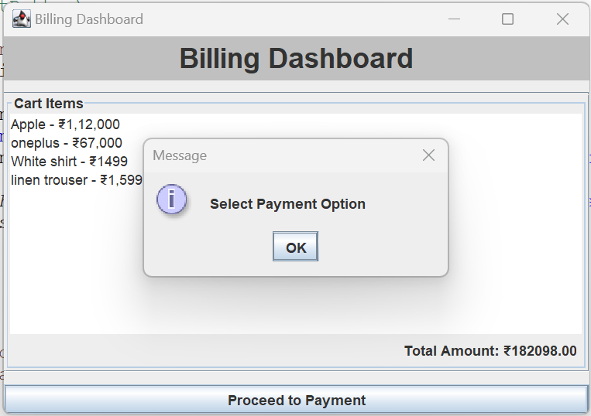
Proceed to Payment Button
The Billing Dashboard includes a button labeled "Proceed to Payment."
When the button is clicked, an ActionListener triggers the payment process.
The ActionListener displays a JOptionPane dialog box, prompting the user to select a payment option.
After displaying the dialog box, the ActionListener opens the PaymentOptionsFrame and passes the product list and total amount.
Finally, the Billing Dashboard frame is closed using the dispose() method

Slide 15
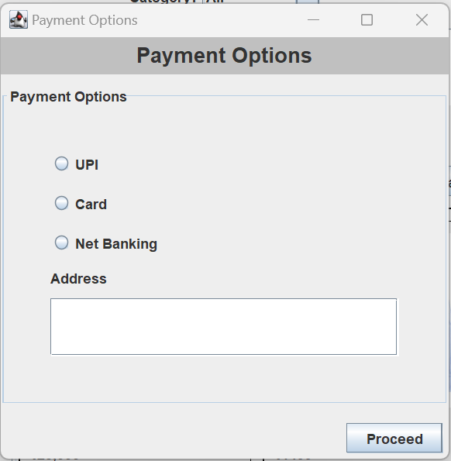
PAYMENT OPTIONS DASHBOARD
The Payment Options Dashboard enhances the user experience by providing various payment options and generating a receipt for the purchase.
The payment options panel contains radio buttons for selecting the payment method.
The address field allows the user to enter their address.
The "Proceed" button initiates the payment process.

Slide 16
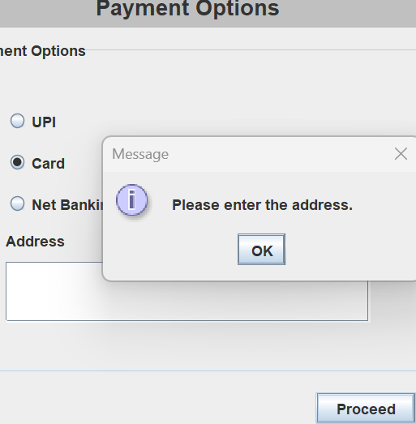
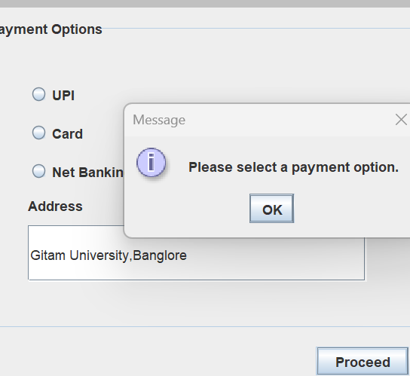
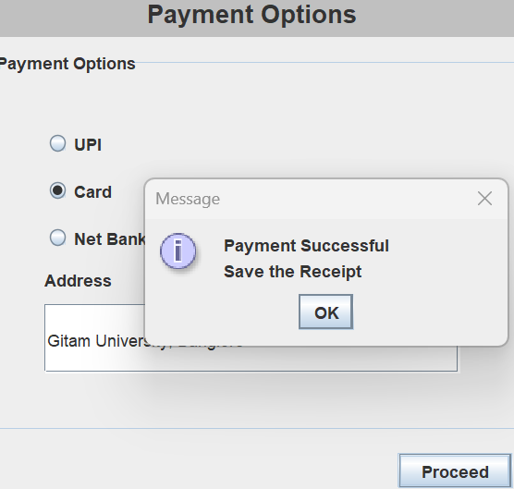
The Proceed Button
The ActionListener for the "Proceed" button handles the payment process.
It first checks if a payment option and an address have been selected.
If not, it displays a JOptionPane dialog box prompting the user to make a selection or enter an address.
If a payment option and address are provided, it proceeds with the payment process.
It displays a success message and calls the "generateReceipt" method to create a receipt for the purchase.

Slide 17
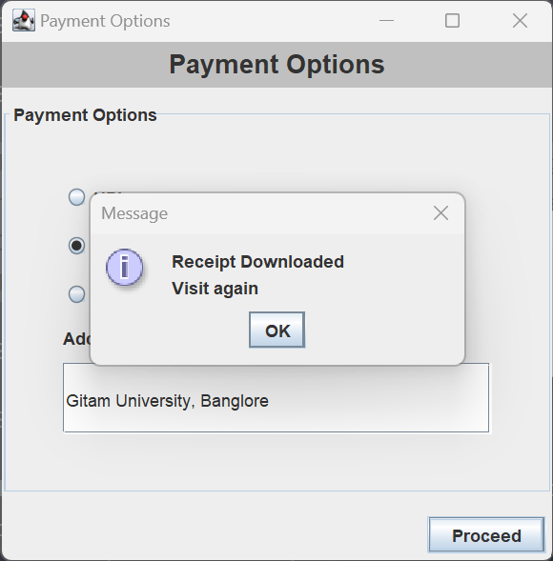
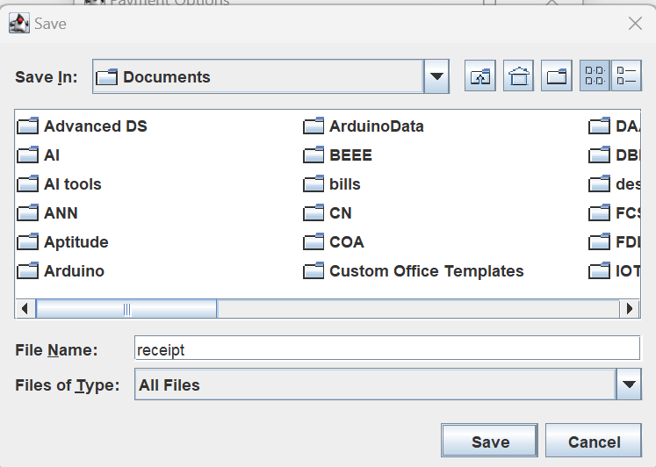
Receipt Generation
The generateReceipt method is responsible for creating a receipt for the purchase.
It prompts the user to choose a location to save the receipt file using a JFileChooser.
Once the user selects a file path and file name, the method writes the receipt details to the file and the receipt get downloaded.

Slide 18

Thank you

