Slide 1
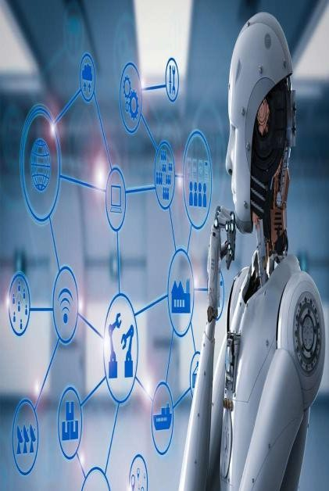
AI FOR M A R K E T I N G
-GENERATE AD- COPY, CAMPAIGN IDEAS, SLO G A NS
Presented by:
V. Ravalika
T. Sai Sushmitha Reddy

Slide 2
ABSTRACT
This project aims to develop an innovative AI-powered marketing platform leveraging LangChain technology to generate high-quality ad copies, campaign ideas, and slogans. The platform will utilize natural language processing (NLP) and machine learning algorithms to analyze market trends, consumer behavior, and brand identities, producing tailored marketing content that resonates with target audiences.
Key Features:-
Ad Copy Generation Campaign Idea Generation
Slogan Generation

Slide 3
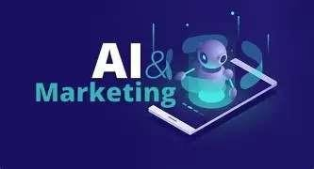
INTRODUCTION
Objective: To automate & build a creative assistant for marketers for generating ad copy, slogans, and campaign ideas using Langchain.
Key Features: Multi-model support (Together, Groq, Ollama),Voice input support, Export as PDF / TXT, Real-time analytics for model responses.
Target Users: Marketing teams, brand strategists, digital advertisers.
Key Value: Save time, ensure brand consistency, and spark creativity using AI.

Slide 4
REQUIREMENTS
Tech Stack & Tools:
Model APIs Integrated:
Technology: Python 3.9
Notes Cloud- hosted, powerful LLaMA 3
Model
Provider
UI used: Streamlit
Mistral 7B
Together AI
Chaining LLM’s: LangChain
Voice input: Speech Recognition
Groq
Fast inference
low latency
Charts: Plotly
Runs without internet
PDF export: ReportLab Cloud-
hosted, powerfulLLaMA 3
LLaMA 2(local)
Ollama (offline)

Slide 5




WORKFLOW
User Input
Voice/Text
Prompt Builder
LangChain Runnables
LLM API (Together / Groq / Ollama)
Output +
Export +
Analytics

Slide 6
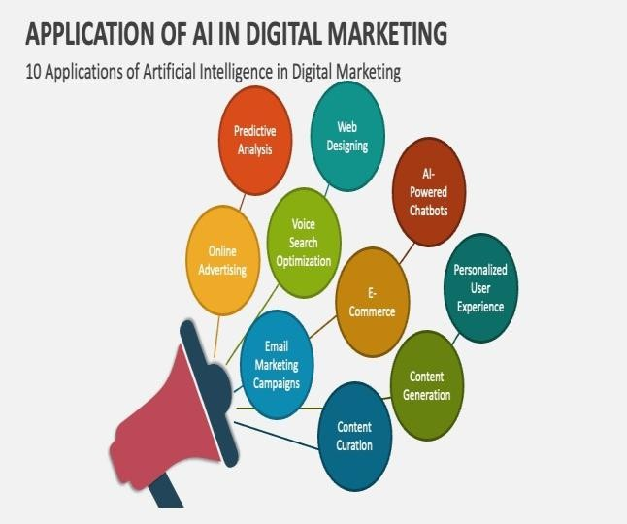






FEATURES
Voice Input via mic
Secure API integration
Prompt Generator
Response Time Comparison Chart
Export as TXT & PDF
Beautiful gradient UI
Theme toggle: Light/Dark
Multiple model integration
Real-time performance tracking

Slide 7
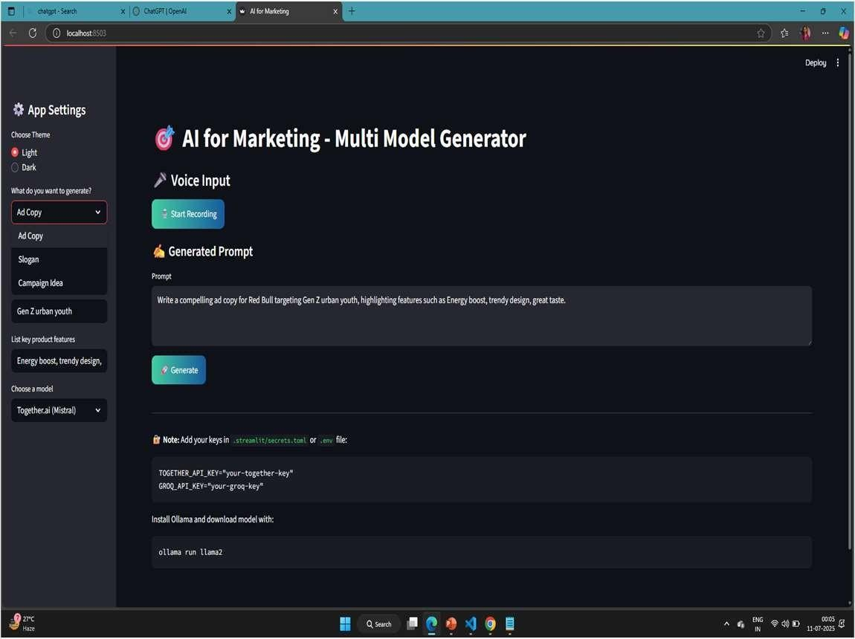
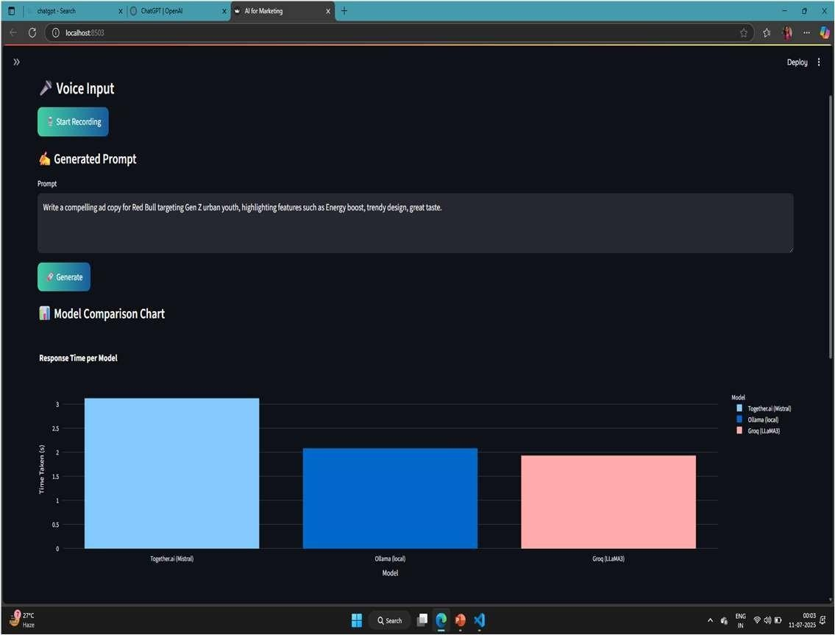
SCREENSHOTS PLACEHOLDERS

Slide 8
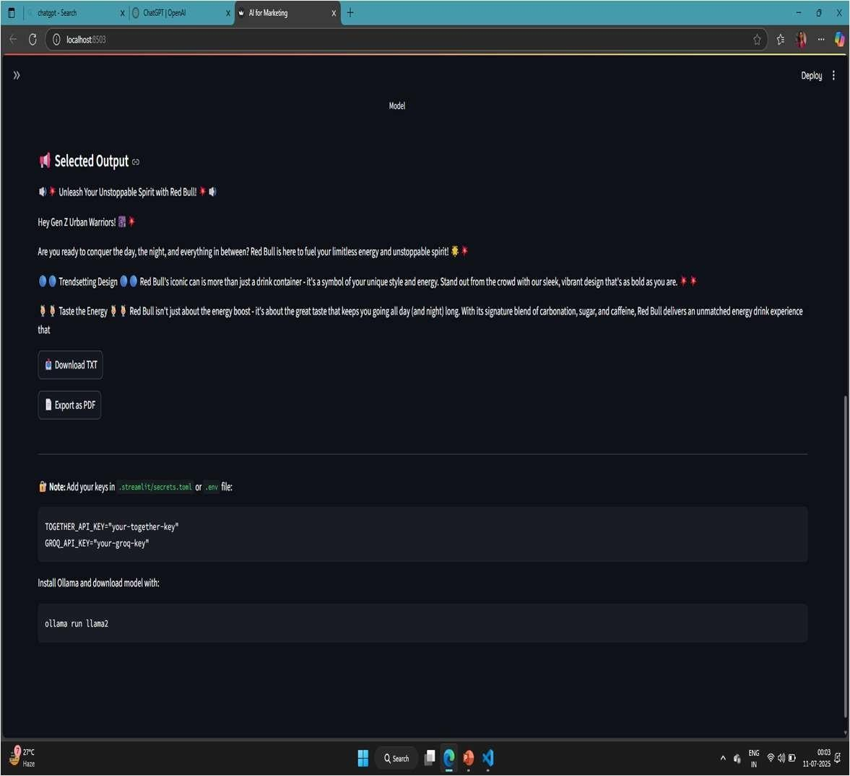
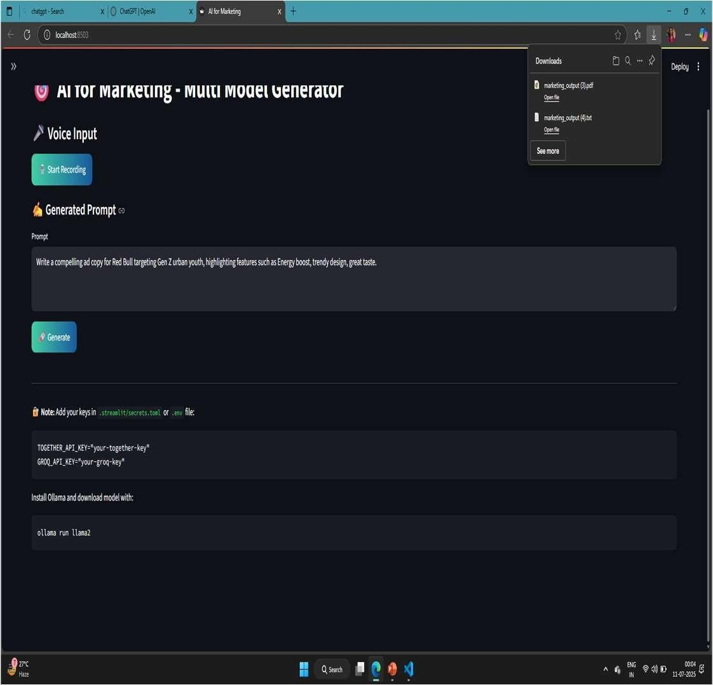

Slide 9
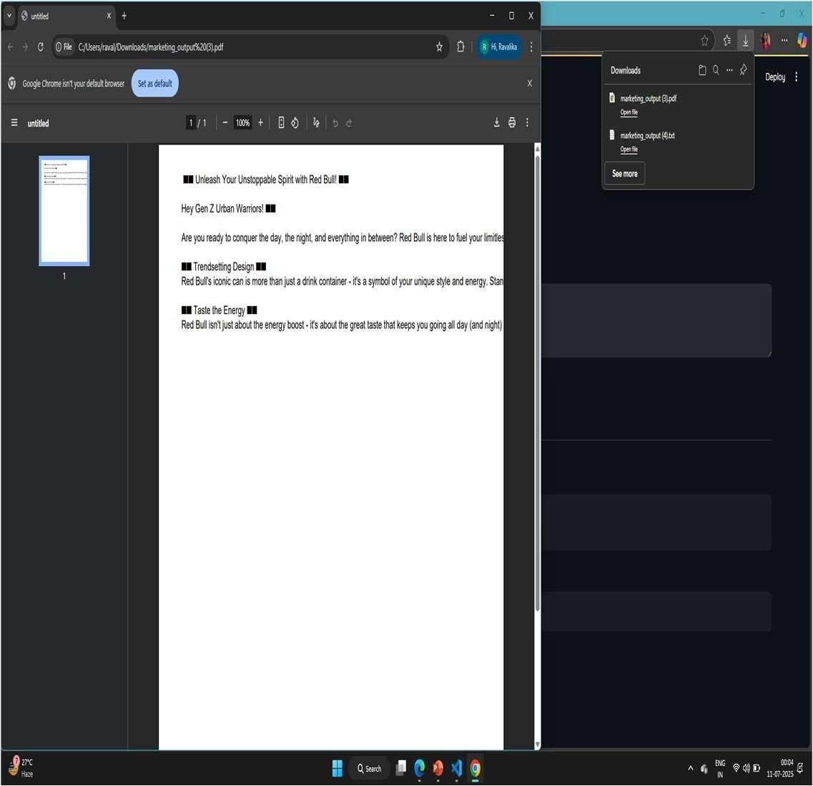
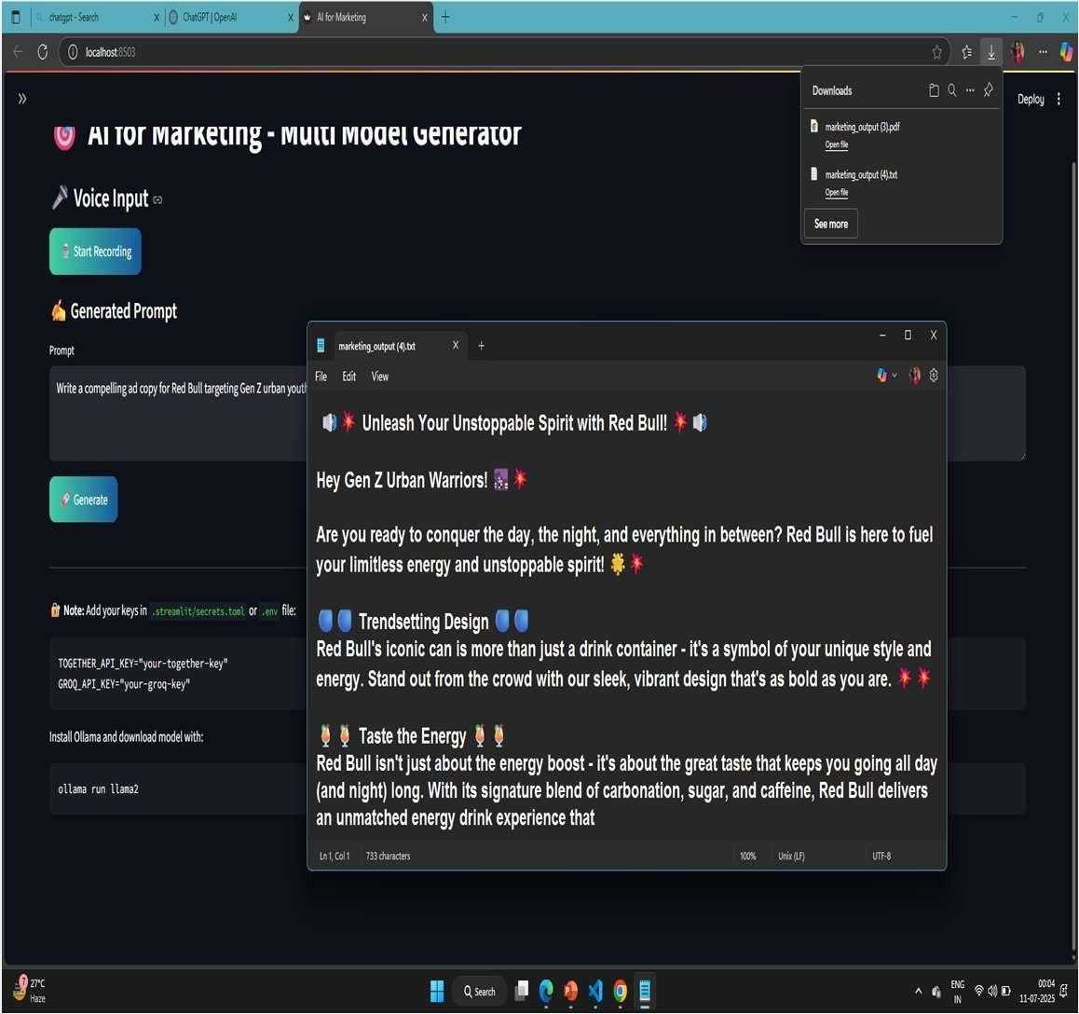

Slide 10
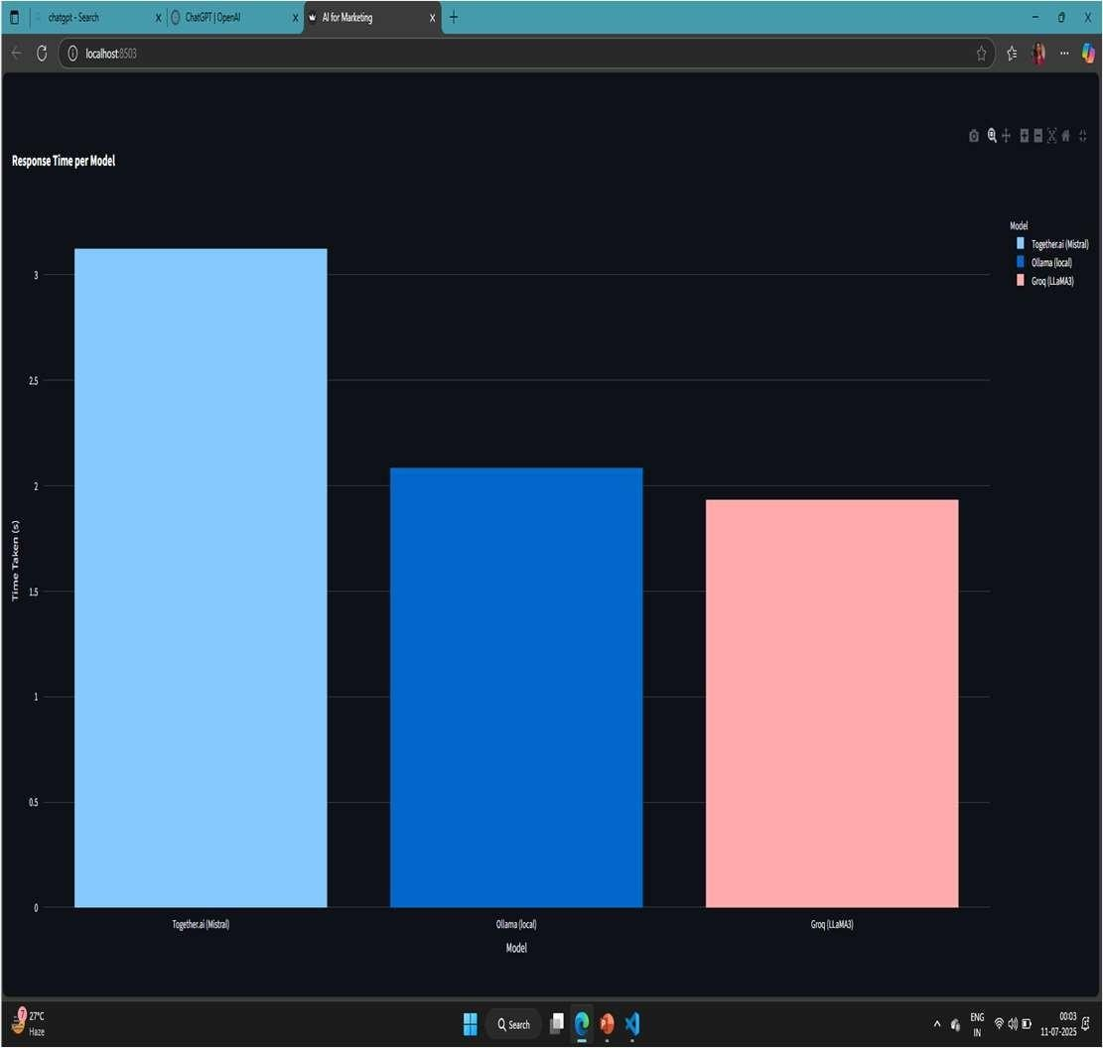
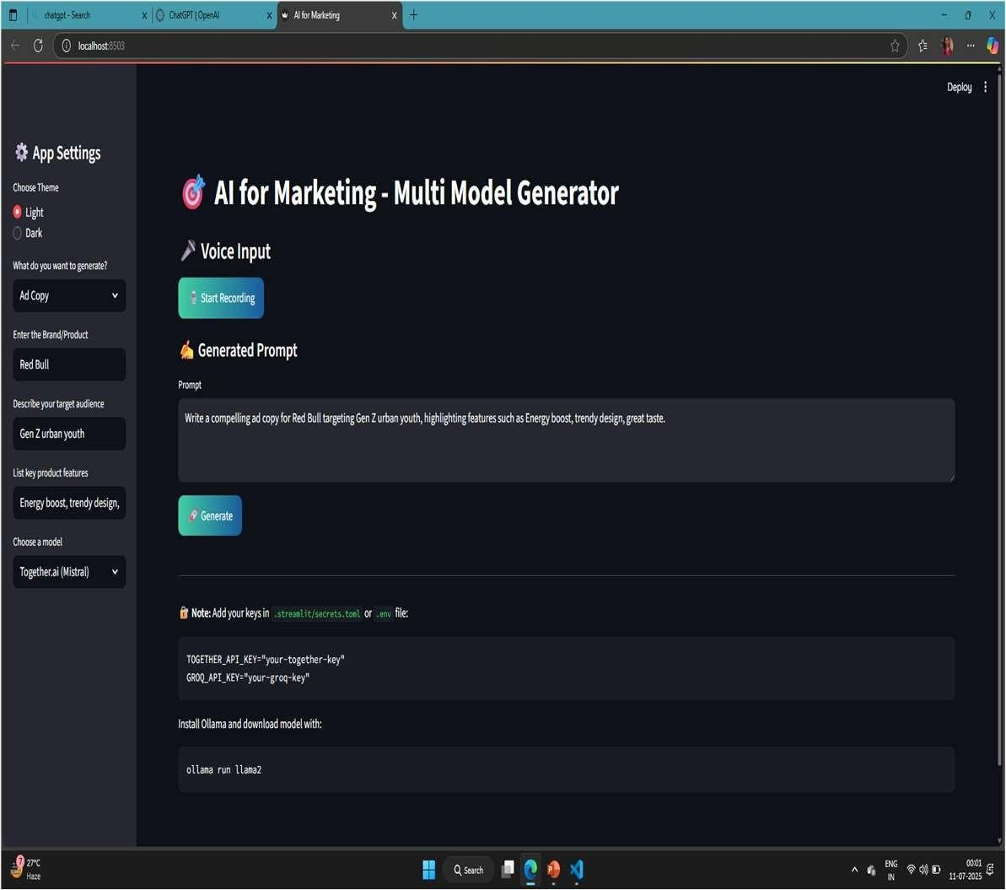

Slide 11
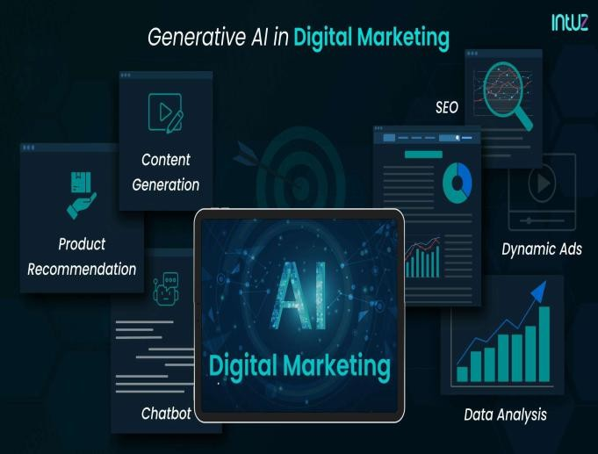
FUTURE ENHANCEMENTS
Google Sheets integration
Chat-style history/logging
Campaign calendar builder
User login & session tracking
AI image generation for ad visuals
Inline copy editing with AI rephrasing

Slide 12
CONCLUSION
The AI for Marketingis a powerful and user-friendly platform that leverages state-of-the-art AI to
streamline the creation of marketing content.
By integrating multimodal inputs,platform-specific customization, it empowers marketers to generate high-quality slogans, ad copy, and campaign ideas effortlessly.
With built-in evaluation metrics and export options, it not only enhances productivity but also
ensures content quality and relevance across diverse audiences and channels.
This tool marks a significant step toward automating and optimizing modern marketing strategies using AI.

Slide 13
THANKYOU

