Slide 1
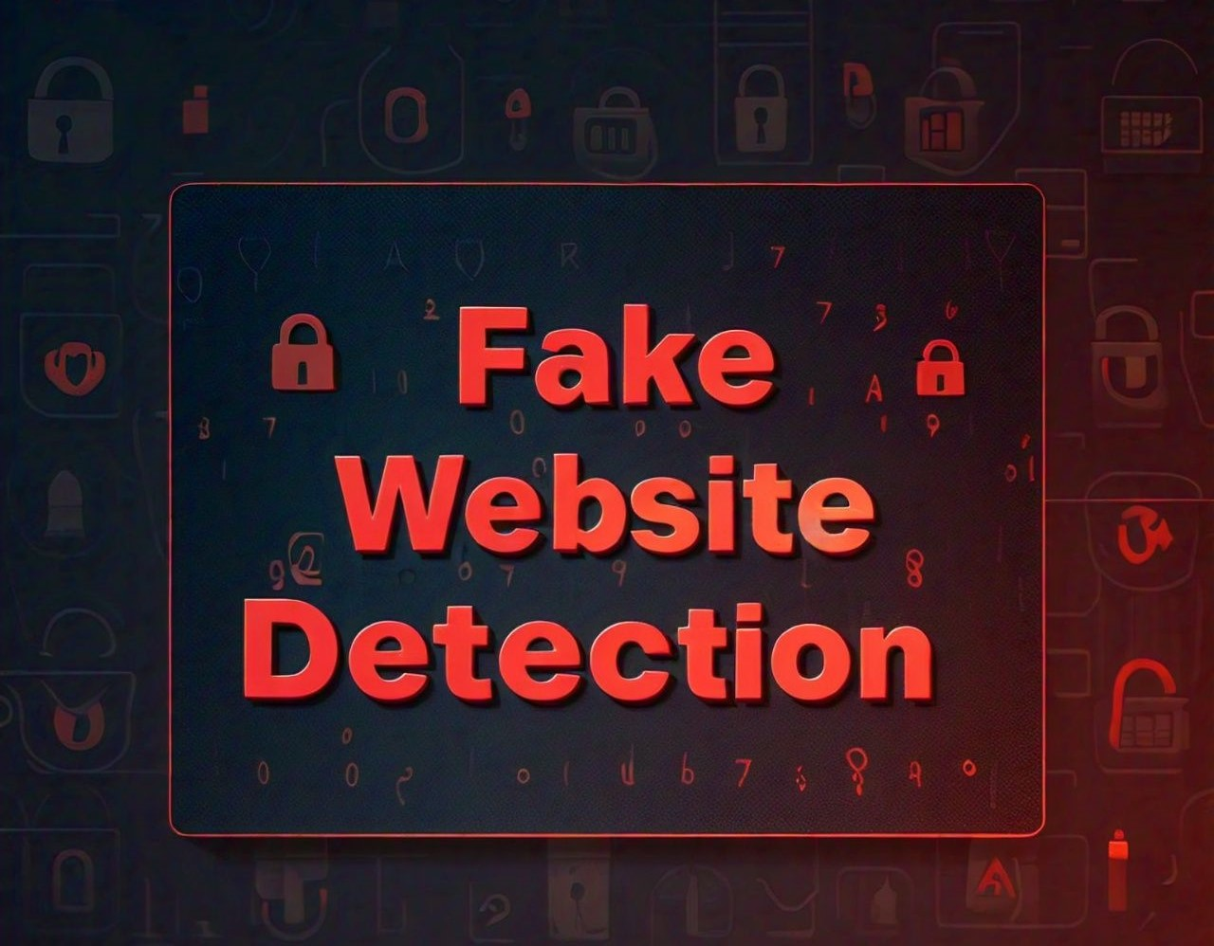

How to identify and avoid online scams

Slide 2
What is Fake Website Detection?
Fake website detection involves recognizing fraudulent websites designed to trick users into providing personal information or making payments. Various methods are used by hackers to attack the vulnerable users such as :
MESSAGING
CALLS
SPOOFED LINK
counterfeit websites

Slide 3

What my project do?
Now a days, we are seeing most of them have lost their money by some fake websites. Even though there are many websites or apps to identify whether it is a fake website or not but most of them are still getting trapped in this fake website.
So, I planned to create a website to identify whether it is fake website or not. So, just copy the link of that website and paste in our website, so you can see the information, regarding that website, it identifies if it is fake or not and also, its gives us information regarding that website.
My website can be prevented by detecting the websites and creating awareness to users to identify the fake websites.

Slide 4
Why and how ?
Since most of the users go online to access the services provided by government and financial institutions, there has been a significant increase in fake attacks for the past few years.
This websites people started this to earn money and they are doing this as a successful business.
It is very easy to create counterfeit websites, which looks like a genuine website in terms of layout and content.
The reason for creating these websites is to get private data from users like account numbers, login id, passwords of debit and credit card, etc..
Moreover, attackers ask security questions to answer to posing as a high level security measure providing to users. When users respond to those questions, they get easily trapped into phishing attacks.
Many researches have been going on to prevent this attacks by different communities around the world.

Slide 5
TECHNOLOGIES USED!!!...
Domain : machine learning
Technology : python
Machine learning algorithms have been one of the best technique in detecting fake websites.
Machine learning is a powerful tool used to strive against these fake attackers.

Slide 6
COMMON FEATURES OF FAKE WEBSITE.
🚫
Misspelled domain names
🚫
Poor design
🚫
Fake contact info
Warnings / Alerts
Suspicious URLs (HTTP instead of HTTPS)
Pop-ups or excessive

Slide 7
CONCLUSION
I conclude that this project helps the users to be aware of fake websites. I have come across with many fake websites. so i decided to implement this project.
This project identifies whether website is fake or not, and it gives warning messages, it gives information regarding the websites like what happens if you open the website.
let us be aware of these fake websites and from fake peoples.

Slide 8

Any Questions? FEEL FREE TO ASK ME ….

