Slide 1
Name : v.sandhya
Branch : computer science and engineering
College : R.M.K engineering college
Counselors : Muthukumar sir
Mentor : Ms.s.Sivagami madam
NUMBER GUESSING GAME

Slide 2
Abstract
My project title is about “NUMBER GUESSING GAME”.
Mostly we are seeing that due to heavy works, most of the people are suffering from stress and they may be disturb. To overcome from it play the games which are interactive with you. So then our stress levels be normal and mind will be fresh.
Given an integer from 1 to 100. The user should suppose to guess the number that computer had chosen. The user should guess the number in 10 attempts only. The game will end after 10 attempts and if the player failed to guess the number, and then he/she will lose the game. If the player guessed the number in 10 attempts he/she will win the game.

Slide 3
Contents
Introduction/Objective
Hardware and Software requirements
Block diagram
Methodology
Output/Screenshot
Conclusion
References

Slide 4
Introduction
Now a day’s most of them are in stress, tension. There is no refreshment for their mind. They are working whole day to get success. So that I had chooses a game for refresh our mind and that was program on number guessing game. The user should find the computer guessed number to win the game.
The main scope of the project is to overcome from stress and relaxation. This will help the user to improve their knowledge skills. The user will be peaceful when playing this game. This project gives the hints to user whether the user guessed number is low or high. We can quickly guess the number what computer taken number randomly. It is very entertaining game and useful for us. If the user guessed a number random the computer say lower number or higher number or you win. But the computer gives 10 attempts only. If the user not guessed in 10 attempts he loses the game. This will help them to improve their peace of learning. It is very simple and very easy.

Slide 5
Objective
The main objective of my project is
=> To overcome from stress => quick grasping
=> great thinking power => refreshing our mind
=> knowledge
These were the objectives/rules that the Guessing Game had to have :
The player playing has to make a guess of a number between 1 and 100.
The player then presses the button to submit the answer.
The computer then tells the player if the number they entered was correct, too high or too low.
The game carries on until the player guesses the correct number.

Slide 6
Hardware and software requirements
Hardware requirements
Operating system : windows
Processor : 2.0 GHZ
Ram : 4GB
Input devices : keyboard
Software requirements
1. Operating System: Windows, macOS, Linux, or Chrome OS
2. Web Browser: Google Chrome, Mozilla Firefox, Safari, or Microsoft Edge.
3. Programming Language: (HTML, CSS, JS)
4. Runtime Environment: Browser-based (no additional installation required)

Slide 7
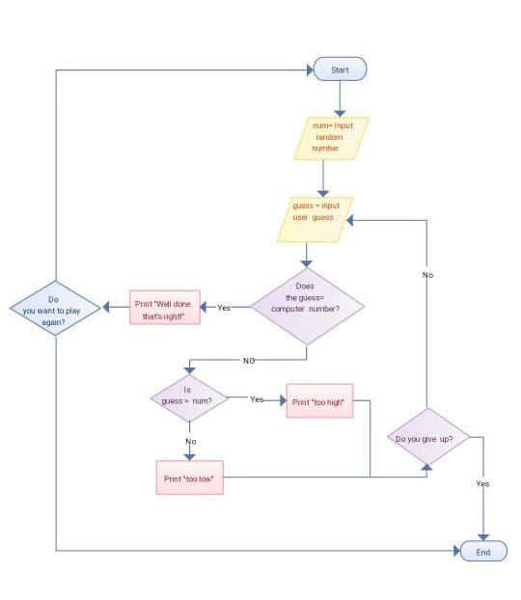
Methodology

Slide 8
This is the game played by a single player. Computer guess is equal to input user guess. Guess the computer number. The user should guess the secret number of computer in 10 attempts. After every guess the algorithm will tell the user if the guess was too high, too low, or was correct. The game is about guessing a number for IQ power.
It is the game played for quick grasping our mind and refreshing our mind. It is interesting to us. It is not only for people who doing job, it is also for children.

Slide 9
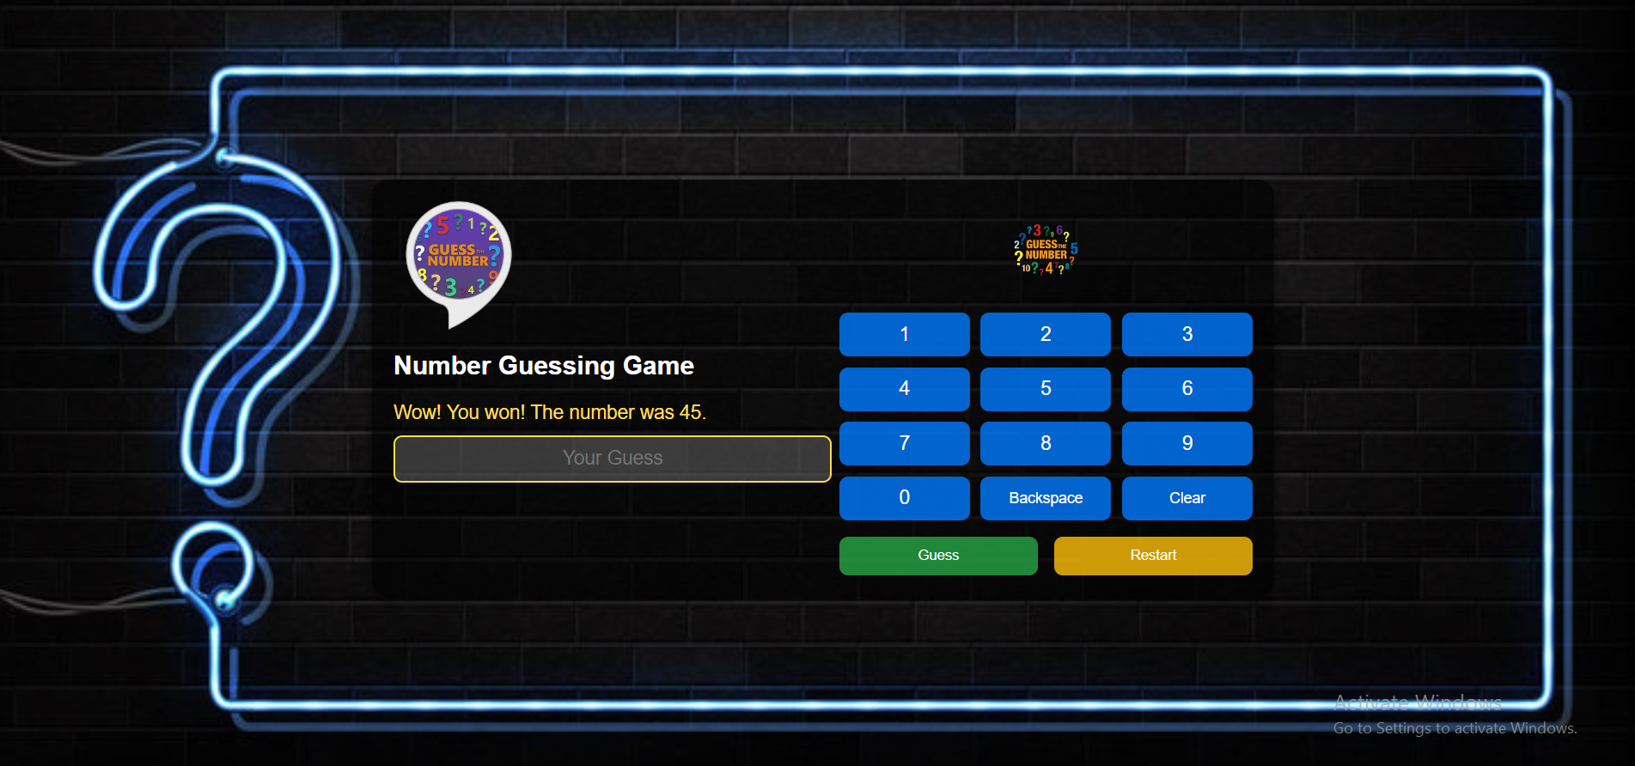
Output screenshot

Slide 10
Use the on-screen numeric keypad to make guesses quickly and easily, with options to correct or reset your input.
Receive hints after each guess, guiding you to choose higher or lower numbers as needed.
Players get 10 attempts to guess the right number, adding excitement and challenge.
Neon-themed design with instant feedback on your guesses, keeping you engaged and informed.
Easily restart the game after winning or using all attempts with a simple button.
I have guessed the number in 7 attempts and won the game.
It is user friendly game, and easy to play.

Slide 11
Conclusion
The number guessing game has been implemented successfully. By doing methodology I got the idea for code execution. My guessing game worked correctly as it followed by most of the objectives. It told you if your guess was too high or too low and if your guess was right it told you that also. It had a limit between 1-100 so that it wasn’t too hard for people to guess. As well as this the final, completed guessing game didn’t come up with error messages as it ran through the flow chart each time a number was entered which shows that it was correct. It was only a basic version and wasn’t expanded but it worked fine.
"Every guess brings you closer to victory."

Slide 12
References
I am an embedded c software engineer and a corporate trainer, currently, I am working as senior software engineer in a largest software consulting company. I have working experience of different microcontrollers, drivers, POS device and payment gateway.
Hunt J.(2019) number guessing game. In: A beginner’s guide to c programming, undergraduate topics in computer science. Springer, Cham is publishers of this book.

Slide 13


